Slide 1
The Landscape of the Future: Open Content, Open Knowledge, Open Educational Resources
Brandon Muramatsu and Jean Runyon
Citation: Muramatsu, B., & Runyon, J. (2012, February). Open content, open knowledge, open educational resources: The landscape of the future. Presentation at eLearning 2012, Long Beach, CA.
Notes:
Citation: Muramatsu, B., & Runyon, J. (2012, February). Open content, open knowledge, open educational resources: The landscape of the future. Presentation at eLearning 2012, Long Beach, CA.
Unless otherwise specified, this work is licensed under a Creative Commons Attribution 3.0 United States License.

Slide 2
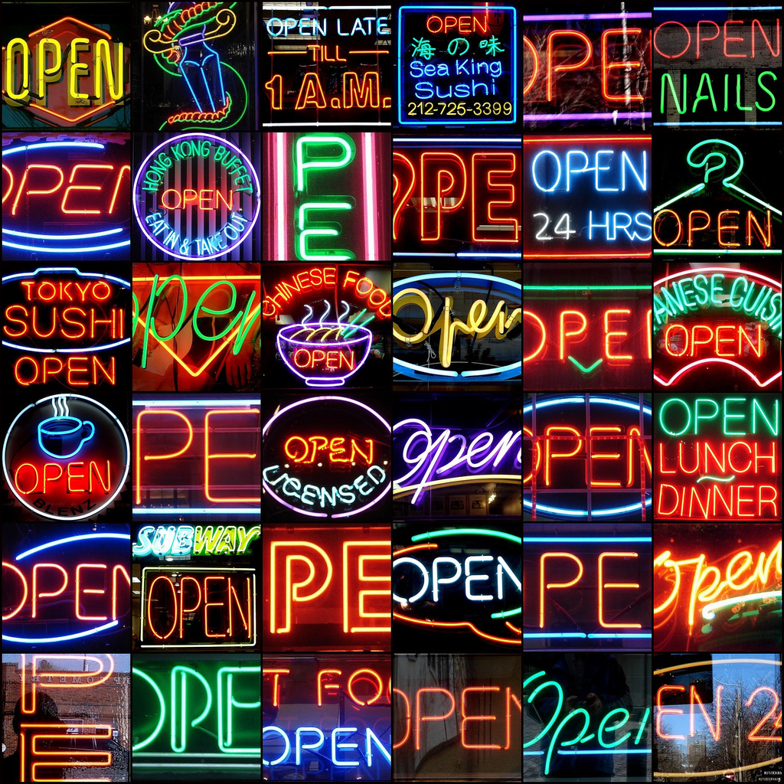
Open
Flickr @mag3737 cc-by-nc-sa

Slide 3
Outline
What is this “Open” thing I keep hearing about?
Thinking about Open differently
What’s the big deal about Open?
Key Mechanic of Open
Choose your own presentation…
Finding or Creating
Wrapup

Slide 4
Outcomes
Understand the scope of the Open landscape, with a focus on Open Content
Understand the implications and importance of Open
(Hopefully) Identify something to take with you… How will you adopt, produce, or encourage the use of Open?

Slide 5
What is this “Open” thing I keep hearing about?

Slide 6
So, what have you heard?
It’s Free!
Open Course Library
iTunesU
General topic, but limited in specific areas
Non-credit
Creative Commons licensing
Issues with accuracy, completeness, quality, aligning
It’s scary, when you commit, you’re on your own, to mediate content, to build support
Good metadata is crucial to find what you want, to find meaningful results

Slide 7
Open…
Education
Source
Content / Educational Resources
CourseWare / Courseware
Textbooks
Courses
Educational Practice
Journals
Knowledge
Policy
We’re going to focus on this part
Cable Green will talk about this in the closing keynote

Slide 8
What are some benefits and challenges of Open Educational Resources (OERs)?
Benefits
Challenges
Free!
Cost savings to students
Ease of updating
Free!
Making sense and using resources
Convincing articulating universities to accept courses that utilize OERs
Technical compatibility
(no publisher support)
Reliability
Need to update
Functionality—bundled systems

Slide 9
Thinking about Open differently
What are OERs?

Slide 10
How do you define “Open Educational Resources”?
More audience participation…

Slide 11
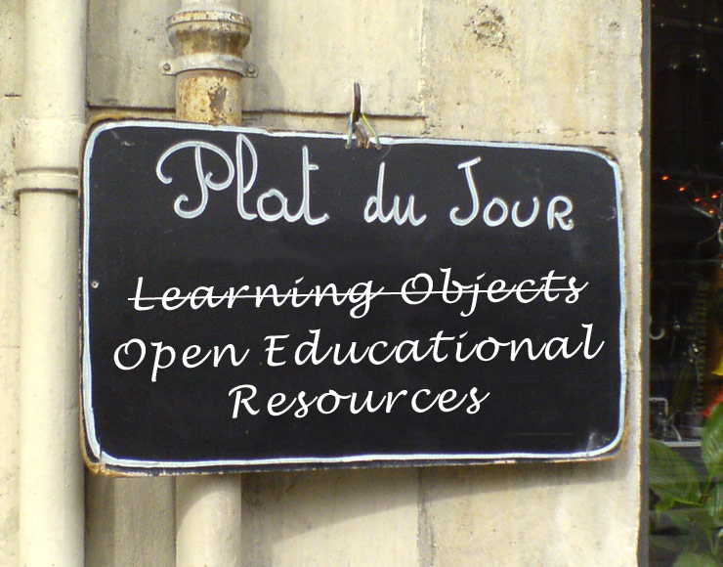
OER: l’innovation du jour?
We’re going to talk about OER writ large.
We’re not going to bore you with definitions! (Well, we’ll try!)
We’re not going to get all religious about OERs!
Photo: Flickr @_boris cc-by-nc-sa
Photo: Flickr @dullhunk, cc-by

Slide 12
Think of OER as a Starting a Conversation
A conversation about teaching, crafting courses, & sharing course materials
A conversation about collaborating with peers and even students
This doesn’t sound like it’s specific to OERs does it? And, you’re probably already using OERs!

Slide 13
Poll: Do you (or your faculty)…
Talk about courses with peers?
Borrow course materials, teaching techniques, sources?
Share materials back with your peers?

Slide 14
OER is all of these things!
At it’s heart, OER is about doing these sorts of things!
And, it’s about encouraging sharing of materials and practices…
And, it’s clearly communicating what others are allowed to do with the materials…

Slide 15
Ok, let’s get a bit more formal
Photo: Flickr @mringlein, cc-by-nc-nd

Slide 16
Recall…OER: A Definition
OER are teaching, learning, and research resources that reside in the public domain or have been released under an intellectual property license that permits their free use or re-purposing by others. Open educational resources include full courses, course materials, modules, textbooks, streaming videos, tests, software, and any other tools, materials, or techniques used to support access to knowledge.
The resource is available for others to use
Atkins, Daniel E., John Seely Brown, Allen L. Hammond. (2007-02). “A Review of Open Educational Resources (OER) Movement: Achievements, Challenges, and New Opportunities.” Menlo Park, CA: The William and Flora Hewlett Foundation. p. 4.

Slide 17
U.S. Department of Education
Open Educational Resources (OER) are an important element of an infrastructure for learning.
Department of Education. (2010). National Education Technology Plan: Transforming American Education: Learning Powered by Technology. http://www.ed.gov/technology/netp-2010/open-educational-resources

Slide 18
OERs are a part of Open Education
OERs focus on resources
They have been getting a lot of attention at the federal and state levels
They are primarily course materials and open textbooks
Open Education is the bigger concept
Sharing, availability and access

Slide 19
Selected Open Education Timeline
“Open Educational
Resources”
Coined By UNESCO
2002
OpenCourseWare
Consortium
FlatWorld Knowledge
2008
“Open Content”
David Wiley
1998
Open University
OpenLearn
2006
Open Course Library
MITx
2011
1999 Connexions
2001
Wikipedia
Creative Commons
MIT OpenCourseWare
2000s
William and Flora Hewlett
Foundation
Support
2007
Community College OER Consortium
Cape Town
Declaration
2009
Open High School of Utah
University of the People
College Open Textbooks
Source: WikiEducator. (2012). OER Timeline. http://wikieducator.org/OER_timeline

Slide 20
What’s the big deal about Open?
Importance of Open

Slide 21
Importance of Open Education
Potential for…
Reclaiming control
From publishers, from static content
Enabling flexibility to mix and match
Changing the nature of the educational experience
Smaller chunks, focused objectives
MOOCs, alternate credentialing
Reigning in costs without sacrificing quality or access
Student and institutional
Open is a means to an end: Improved learning and performance

Slide 22
Key mechanic of Open
Adding a license to your resource…

Slide 23
Poll: When borrowing resources…
Do you look at the license or terms of use?
Do you provide attribution for those resources?

Slide 24
What are you allowed to do? What might you allow others?
Instead of “All Rights Reserved”
Can someone else use the materials?
Can someone build upon or modify the materials?
Can they use those materials commercially?
Do they have to share any materials they develop the same way the materials were originally shared?
Do these sound familiar?

Slide 25
Recall…OER: A Definition
OER are teaching, learning, and research resources that reside in the public domain or have been released under an intellectual property license that permits their free use or re-purposing by others. Open educational resources include full courses, course materials, modules, textbooks, streaming videos, tests, software, and any other tools, materials, or techniques used to support access to knowledge.
The resource is available to others to use
Atkins, Daniel E., John Seely Brown, Allen L. Hammond. (2007-02). “A Review of Open Educational Resources (OER) Movement: Achievements, Challenges, and New Opportunities.” Menlo Park, CA: The William and Flora Hewlett Foundation. p. 4.

Slide 26
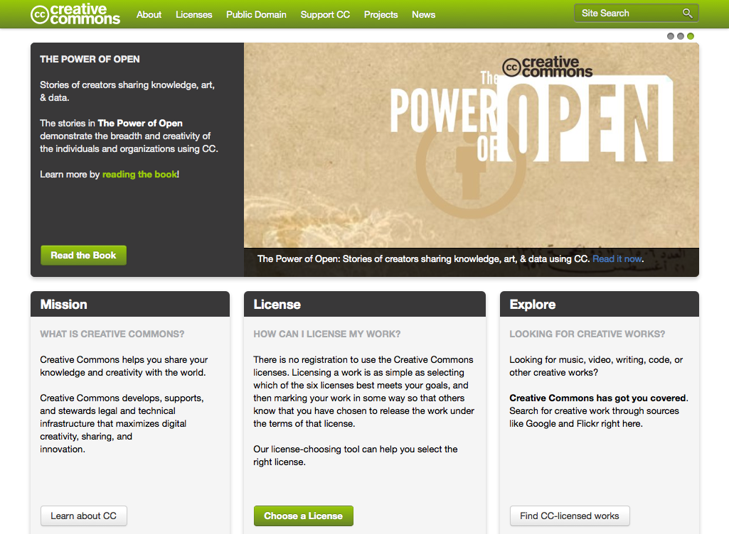
Creative Commons: Enabling OER

Slide 27
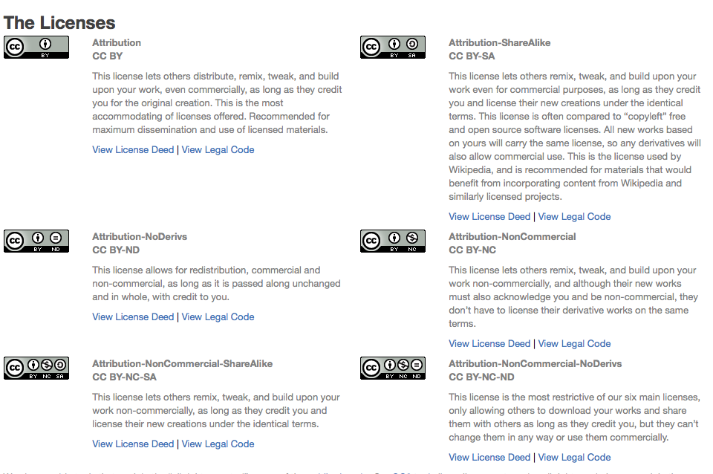
Creative Commons Licenses
creativecommons.org
A “standard” way providing permissions to your work
The easiest way of communicating your resource is “open”

Slide 28
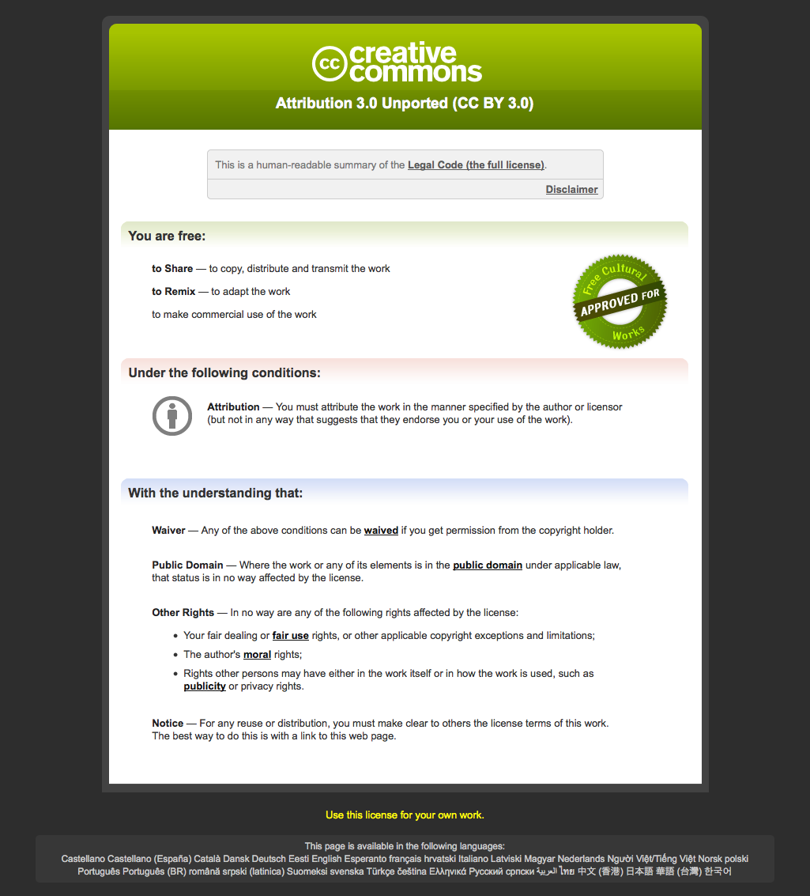
Creative Commons: CC-by License Deed

Slide 29
Choose your own presentation…
Where do we go next?
Finding and identifying OERs
Creating an OER

Slide 30
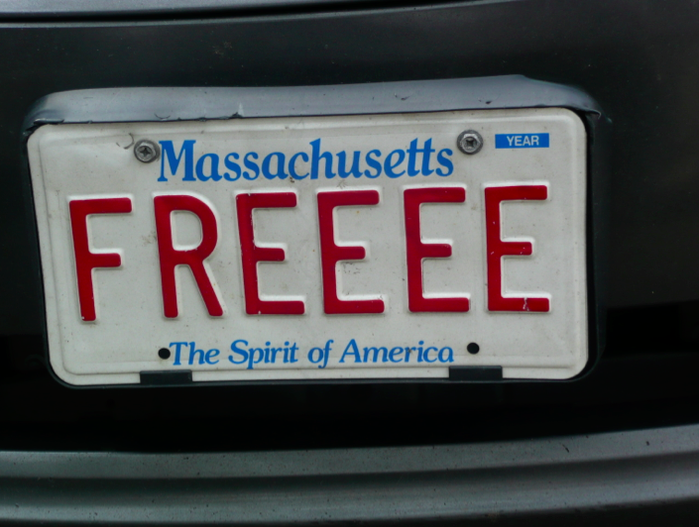
Set them freeee…
Creating an OER
Demonstration
Photo: Patrick McAndrew, cc-by

Slide 31
Let’s make an OER
Apply License, Citation, Metadata
Share

Slide 32
Applying a license to this presentation
Ok, so how do I do it?
Select a license
Add Creative Commons logo to the title slide
Add a license statement to the title slide (and notes field)
Add an attribution statement
Add metadata to Presentation properties

Slide 33
Creative Commons: Pick a License

Slide 34
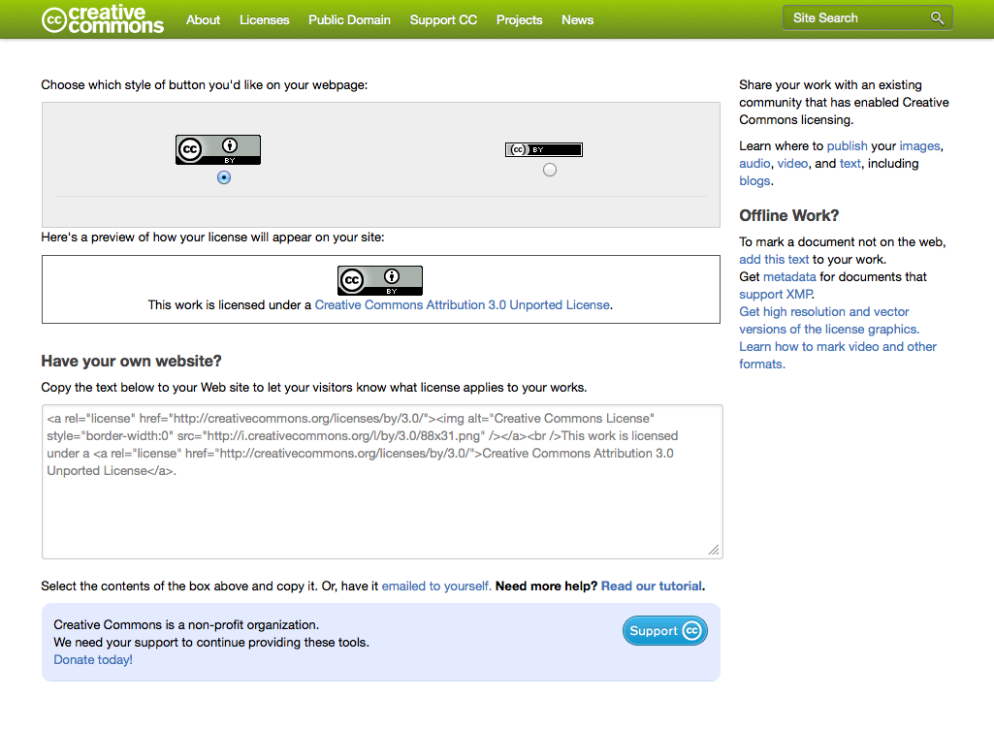
Creative Commons: Attribution

Slide 35
Creative Commons: CC-by License Deed

Slide 36
Slideshare.net

Slide 37
An OER walks into a bar…
Finding and Recognizing OERs
Demonstration

Slide 38
Finding OERs
How do you find out about them?
Talking to peers in your department?
Through ITC? Other professional organizations?
Looking through digital repositories?
Google searches?

Slide 39
Recognizing OERs: Examples
Flickr (www.flickr.com)
MIT OpenCourseWare (ocw.mit.edu)
MERLOT (www.merlot.org)
OER Commons (www.oercommons.org)
Open Course Library (www.opencourselibrary.org)
Wikipedia (www.wikipedia.org)
Crowd choice (what will it be?)
Notes:
Some of the largest collections of OERs (aka Creative Commons licensed resources)

Slide 40
Pattern
Check out the Site
Search for Resources
Look at detailed results
Review the resource itself
Is it an OER?

Slide 41
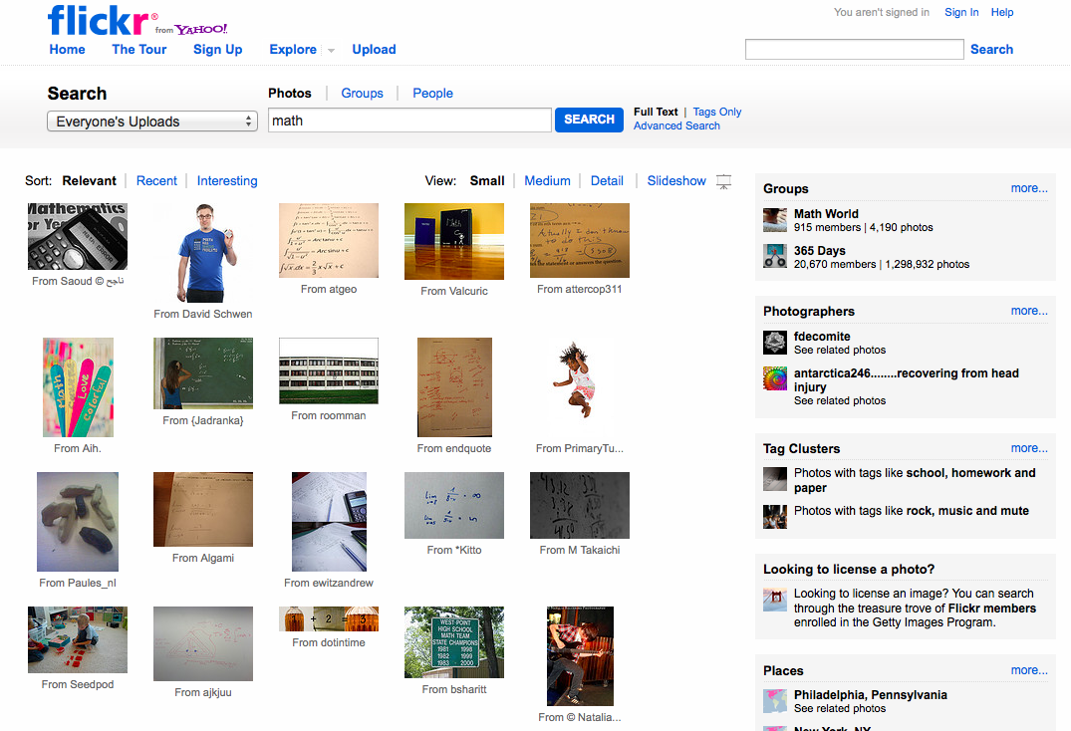
Have you used Flickr?
Did you know that Flickr allows photo sharers to indicate a license?
And that you can search for Creative Commons licensed photos?
Notes:
Did you know that Flickr allows photo sharers to indicate a license?
And that you can search for Creative Commons licensed

Slide 42
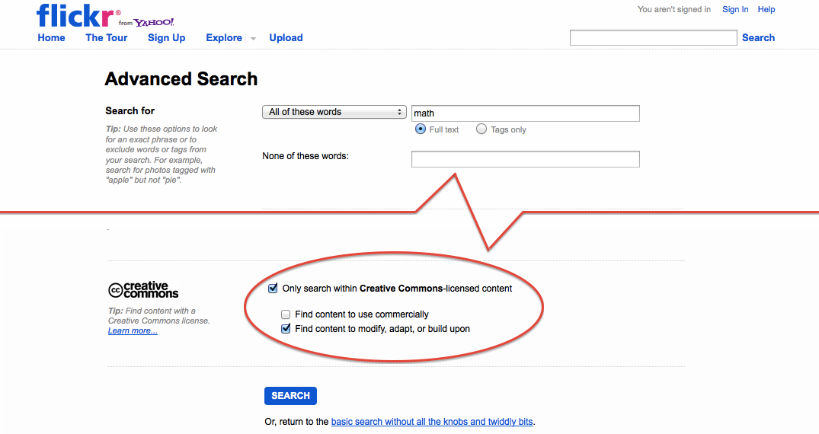
Searching for Openly Licensed Photos at Flickr

Slide 43
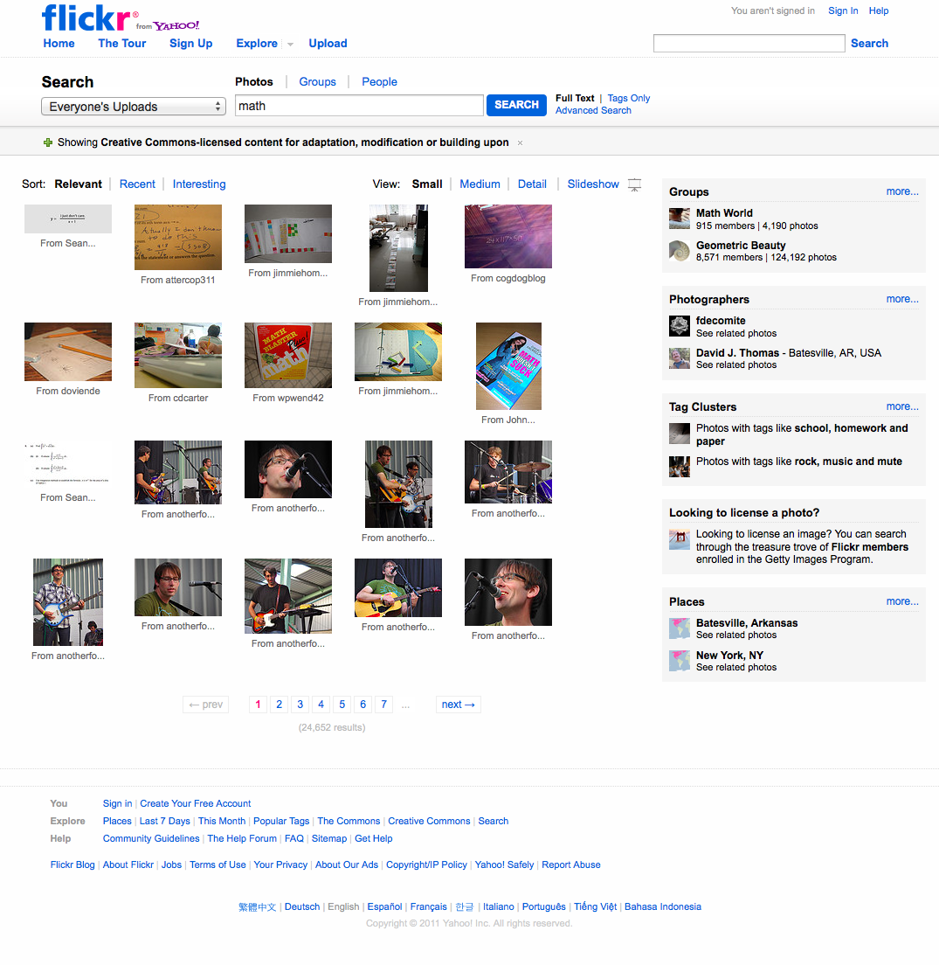
Flickr Search Results

Slide 44
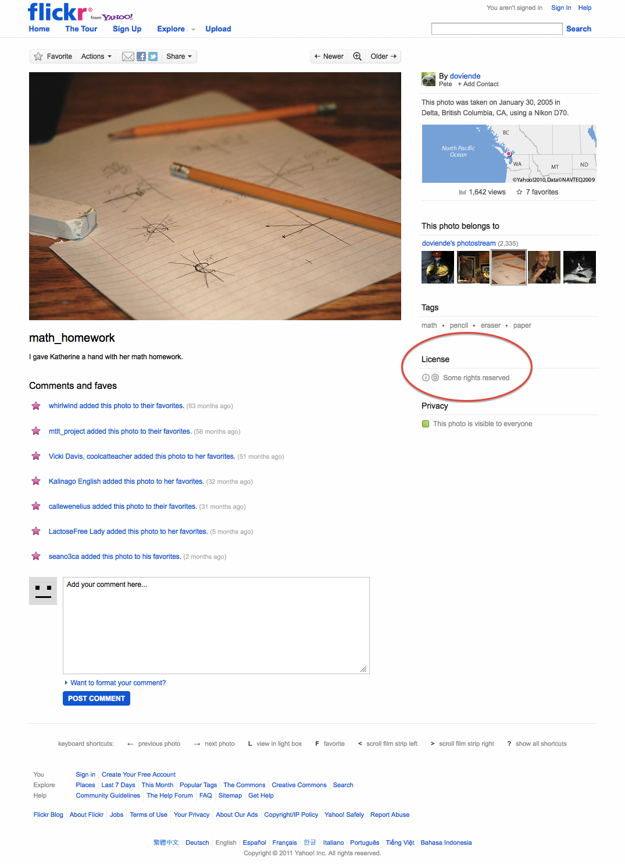
CC-Licensed Math Photo

Slide 45
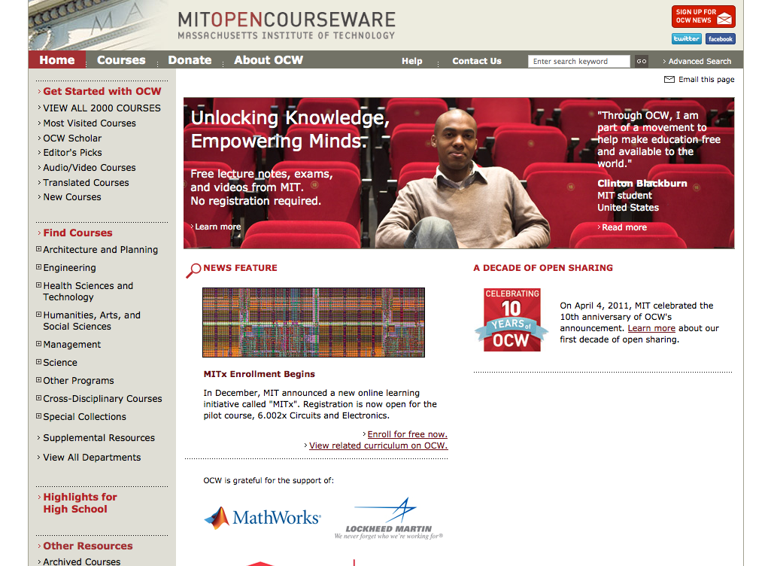
MIT OpenCourseWare
ocw.mit.edu

Slide 46
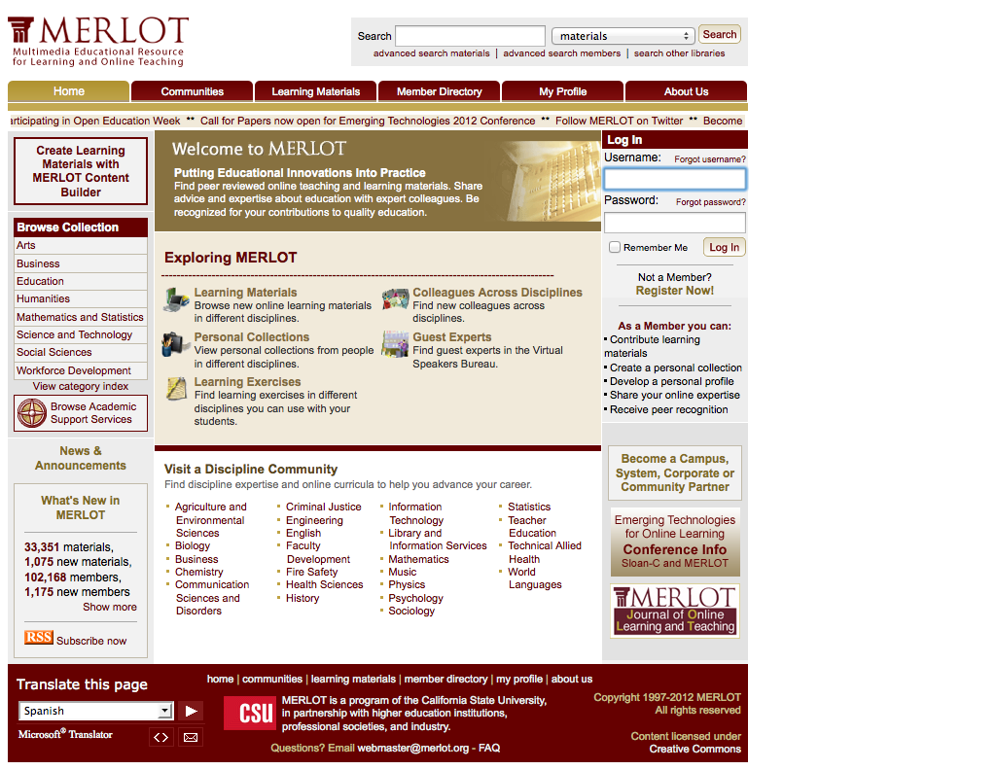
MERLOT
www.merlot.org

Slide 47
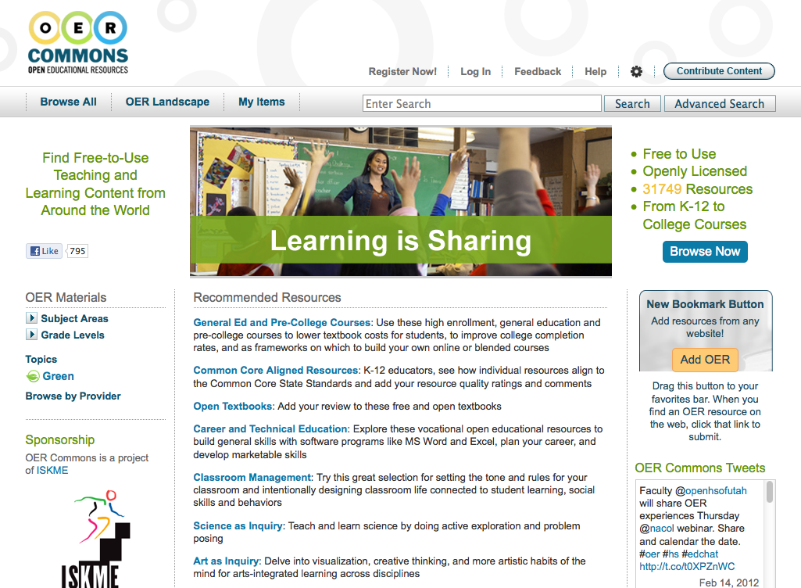
OER Commons
www.oercommons.org

Slide 48
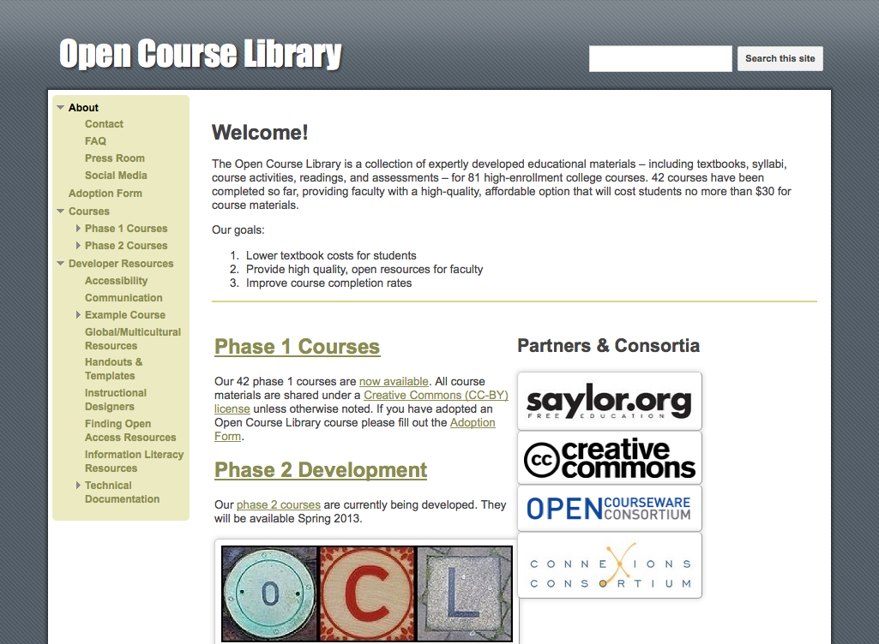
Open Course Library
www.opencourselibrary.org

Slide 49
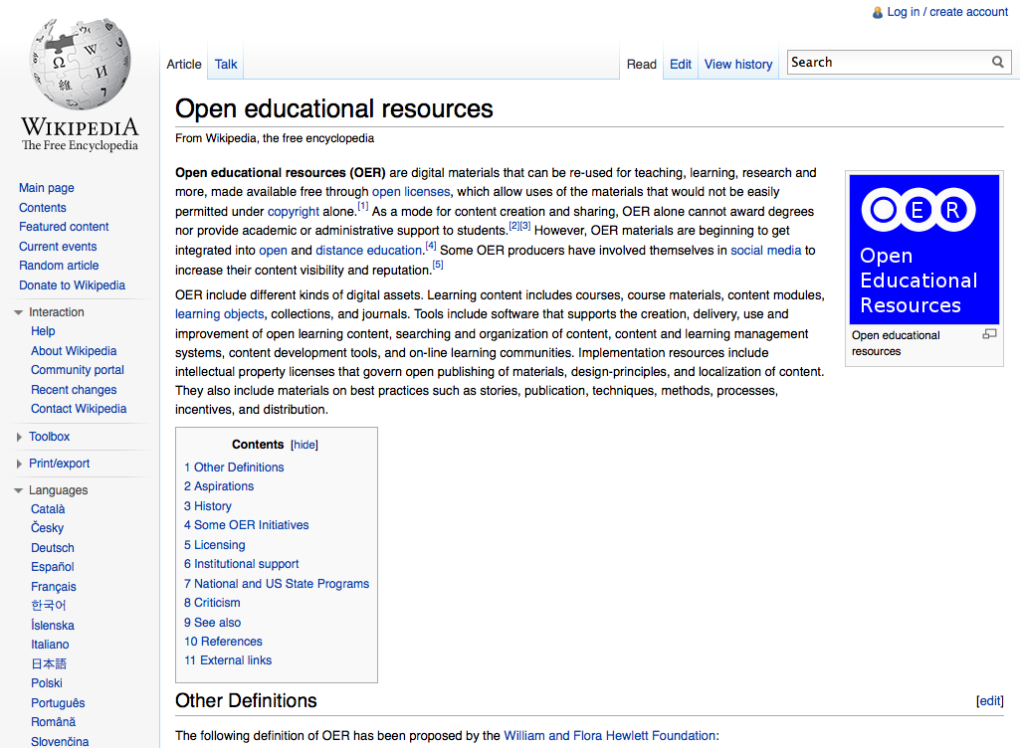
Wikipedia
www.wikipedia.org

Slide 50
Audience Choice?

Slide 51
Examples of OERs
Flickr (www.flickr.com)
Some CC-licensed, find via Advanced Search
MIT Open CourseWare (ocw.mit.edu)
One of the granddaddy’s of OERs, CC-by-nc-sa
MERLOT (www.merlot.org)
Wide range of resources, complex licensing
OER Commons (www.oercommons.org)
Wide range of resources, nearly all CC-licensed
Open Course Library (www.opencourselibrary.org)
Open Textbooks, 42 published, more coming, CC-by
Wikipedia (www.wikipedia.org)
Probably the biggest OER, support for attribution

Slide 52
Discussion Questions
What makes a site an OER?
Did any of the sites surprise you?
What features make some sites better than others?

Slide 53
Selected additional resources
Bridge to Success (shameless plug), b2s.aacc.edu
CK-12, www.ck12.org
College Open Textbooks, www.collegeopentextbooks.org
Community College Consortium for Open Educational Resources, www.oerconsortium.org
Flat World Knowledge, www.flatworldknowledge.com
Kaleidoscope Project, www.project-kaleidoscope.org
Open High School of Utah, ocw.openhighschool.org
Open University OpenLearn, www.open.edu/openlearn
P2PU, www.p2pu.org
Saylor Foundation, www.saylor.org
WikiEducator, wikieducator.org

Slide 54
OER Smörgåsbord
OER as a conversation: Sharing, access, materials, practice
OER as a continuum
Individual
Images
Standalone
Modules
Course Materials
Open Textbooks
Whole Courses
Flickr
Open Course Library
OpenLearn
Saylor
B2S Courses

Slide 55
Wrap-Up
Revisiting Outcomes
Discussion

Slide 56
Revisiting Outcomes
Understand the scope of the Open landscape, with a focus on Open Content
Understand the implications and importance of Open
(Hopefully) Identify something to take with you… How will you adopt, produce, or encourage the use of Open?

Slide 57
Discussion of OERs
Creative Commons licensing
Modularizing, and a chunk or chunks, using OERs may make them more accessible
Tie in with teaching and learning
Start redesigning course, crowd-source, get students to help—discuss, analyze, integrate

Slide 58
Contact Us
Brandon Muramatsu, MIT
Jean Runyon, AACC
mura@mit.edu
@bmuramatsu
jmrunyon@aacc.edu
Slides will be posted to: http://slideshare.net/bmuramatsu
Notes:
Citation: Muramatsu, B., & Runyon, J. (2012, February). Open content, open knowledge, open educational resources: The landscape of the future. Presentation at eLearning 2012, Long Beach, CA.
Unless otherwise specified, this work is licensed under a Creative Commons Attribution 3.0 United States License.

