Slide 1
Online Course Design
Some thoughts as you begin to develop massive online courses
Brandon Muramatsu, mura@mit.edu
Citation: Muramatsu, B. (2013, October). Online course design:. Invited Presentation at Kyoto University, October 2, 2013.
Notes:
Citation: Muramatsu, B. (2013, October). Online course design:. Invited Presentation at Kyoto University, October 2, 2013.
Unless otherwise specified, this work is licensed under a Creative Commons Attribution 3.0 United States License.

Slide 2
Outline
Introduction
Confluence of events
“The world is changed.”
Are you asking the right questions?

Slide 3
Introduction

Slide 4
About Me
B.S. & M.S. in Mechanical Engineering
Taught multimedia design and open education
20 years in digital learning
  Decade or more each in educational digital libraries, engineering education, Open Education
“Been There, Done That”
  Multimedia courseware design and course support, web software design, digital libraries, metadata, learning objects, educational technology standards, open educational resources/OpenCourseWare

Slide 5
Disclaimers
This is very much a work in progress…
Much of this is not new or novel…
  We might be at a point where technology and the environment may make it easier to do these things
  But, your mileage may vary
And, some of this is personal opinion…

Slide 6
Confluence of Events
“The world is changed.”
— Galadriel, Lord of the Rings
Notes:
Galadriel. The Lord of the Rings

Slide 7
Confluence of Events
Global financial crisis…
  Dramatic reduction in education budgets, continuing rise in costs, and rise in student loan debt
Changing perceptions of the value of a degree
Competency-based education/prior learning assessment

Slide 8
Confluence of Events (cont.)
Changing methods of accessing information and knowledge
Recognition of the half-life of learning in many disciplines
  Transition to continual learning in many career paths
Rise of openly accessible information, learning materials and opportunities, at scale
  Wikipedia, Open Educational Resources/OpenCourseWare, Creative Commons licensing
  Khan Academy, Codecademy
And…

Slide 9


Slide 10
What I find unique about MOOCs
It’s not their instructional design/pedagogy…
It’s not their use of video…
It’s not the hype!
It is their scale!
It is their departure from “traditional” online courses
For today’s talk, it is mostly their interleaving of content and (parameterized) formative assessment

Slide 11
Are you asking the right questions?
As you begin to develop online courses…
some thoughts to consider…

Slide 12
Ask yourselves
3 simple questions…

Slide 13
① Are you “designing” your online courses?

Slide 14
Exploring the Guide
Brandon Muramatsu
MIT Office of Educational Innovation and Technology
mura@mit.edu
Cite as: Muramatsu, B. (2013, October). Online course design: Exploring the guide. Invited Presentation at Kyoto University, October 2, 2013.
Notes:
Cite as: Muramatsu, B. (2013, October). Online course design: Exploring the guide. Invited Presentation at Kyoto University, October 2, 2013.
Unless otherwise specified this work is licensed under a Creative Commons Attribution 3.0 License.

Slide 15
Setting the Stage
Have you taken a traditional online course?
A MOOC course?
Have you taught a traditional online course?

Slide 16
Online Course Design
Designing an good online course
is designing a good course!

Slide 17
Online Course Design Guide Organization
Pre-Design
Design and Development
Facilitation
Evaluation

Slide 18
Part 1: Pre-Design

Slide 19
Part 1: Pre-Design
“Gathering all of the necessary information to ensure that the course will meet the needs of the learners and engage them throughout the learning journey.”
What’s different online:
  More difficult to make spontaneous adjustments
  The asynchronous nature means you need to be thoughtful about creating interaction opportunities

Slide 20
Pre-Design Questions (1)
Who are my learners?
What do they currently know?
… you need to make sure you can produce content for their level and the correct voice.
…so you can avoid repetition and focus on growing what they have learned.

Slide 21
Pre-Design Questions (2)
What do they need to know before starting the course?
…so you can provide prerequisite materials to learners and they can plan accordingly before the course begins.

Slide 22
Pre-Design Questions (3)
What other content is available that supports meeting learning outcomes?
Do you have existing material that can be used in the course?
…curating content you already have means not having to start everything from scratch.
…being able to identify other resources that support your key topics adds greater depth to the course.

Slide 23
Pre-Design Questions (4)
What content must be revised for an online format or created from scratch?
… taking inventory of the varying stages of content will inform the design phase and give you a better sense of how much work it will require to prepare the content for online use.

Slide 24
Going Behind The Curtain
Exploring a online course
OEIT recently developed
(not a MOOC)

Slide 25
Best Practices for Teaching and Learning
Course Goals:
How do we design a course?
What are the best methods for promoting critical thinking skills, knowledge retention, and transfer?
…primarily for in-person classes

Slide 26
Background on the Course
Created for as a proof-of-concept for an online teacher education program
Based on a 14 week course that MIT provides for graduate students and Post-Docs who wish to learn how to teach
Course is run by the MIT Teaching and Learning Laboratory (TLL)
  They work with faculty on education research and pedagogically informed teaching practice
  Perform some of the functions of a Center for Teaching and Learning

Slide 27
Background on the Course (cont.)
Instructors have taught the face-to-face version of this course
  Experienced in teaching in Biology
  Experienced in research in Biology, both have Ph.D.s
  Deep interest in biology education, especially preparing students for careers in Biology
Instructors have not taught online before
  Relying on others for that experience ⬅ it takes a team!

Slide 28
Question: Who are my learners?
Faculty interested in learning “best practices”
  Might be in teacher education departments
  With possible focus on Science / Math education
Challenges
  Different from the course upon which it was based
  MIT graduate students ≠ faculty in teacher education programs

Slide 29
Question: What do my learners currently know?
Unknown
  Might, or might not, have experience with “good” teaching practice
  Might not have been formally trained to “teach”
Challenge
  Didn’t have the opportunity to really find out about the participants before designing the course, had to make assumptions

Slide 30
Question: What do my learners need to know before starting the course?
Participants should have:
  Experience in teaching
  Perhaps experience in teaching pre-service teachers
Challenges
  Didn’t have the opportunity to really find out about the participants before designing the course
  Had to make assumptions

Slide 31
Question: Who are the subject matter experts?
Each session comes with pre-session readings from “experts”
Topics presented in each session that represent the work of “experts” are clearly cited
Challenges
  Not overwhelming participants
  But providing a deep enough research basis for those interested in finding out more
  Serendipitous linkage with the Online Course Design Guideline and Digital Learning Toolkit

Slide 32
Question: Do you have existing material that can be used in the course?
Yes!
Challenges
  Material designed for face-to-face interactions
  Materials designed for a 14 week course

Slide 33
Question: What other content is available that supports meeting learning outcomes?
Lots and lots
Challenges
  Pre-supposes learning outcomes!
  Some materials are referenced in pre-session readings
  Some materials are referenced during the session videos (as citations)

Slide 34
Question: What content must be revised or created from scratch?
Lecture videos
  Most of the course is an interactive discussion in class based around the pre-session readings
Slides
Activities
Challenges
  Developing a mostly-asynchronous learning experience for what was a highly synchronous course

Slide 35
Part 2: Design and Development

Slide 36
Part 2: Design and Development
“In this phase, learning strategies are mapped out, learning content and media are developed, organized, and sequenced, and supporting technology is selected.”
What’s different online:
  Online learning is more exploratory in nature, and oftentimes less directed than in-person
  Learners access materials asynchronously: The easier it is for learners to locate and engage with learning activities, the more mental energy they will have to focus on the content.

Slide 37
Objectives and Outcomes
“Learning outcomes are general statements that describe the essential learning (knowledge, skills, and attitudes) that learners will achieve by the end of the course. They should encompass the depth of the knowledge and skills that you will be ultimately assessing. When composing outcomes, be mindful not to combine elements that cannot be assessed by a single method.”

Slide 38
Designing a Blueprint
What’s a blueprint?
  A comprehensive plan that allows “you to design with the big picture in mind to ensure you reach every milestone and build consistency throughout the curriculum.”
Key Elements
  Course information
  Course learning objectives and outcomes
  Lesson topics and format
  Learning resources
  Activities and assessment

Slide 39
Content Patterns: Organizing & Sequencing (1)
“Constructing patterns in your curriculum is one way to infuse consistency throughout the course, which helps the learners manage time and resources. How you approach your content each week should be organized in such a way that the learner understands what is being taught and how to interact and engage with the material and community.”
What’s different online:
  The easier it is for learners to locate and engage with learning activities, the more mental energy they will have to focus on the content.

Slide 40
Content Patterns: Organizing & Sequencing (2)
Write all course content using a consistent voice
Create patterns in activity structure (e.g., description, rationale, deliverables, and resources)
Establish a consistent schedule (e.g., standardize due dates and plan synchronous sessions, virtual meetings, office hours, and other activities at the same time each week)
Align learning objectives to each segment of content
Structure the content into smaller pieces
Notes:
Holly

Slide 41
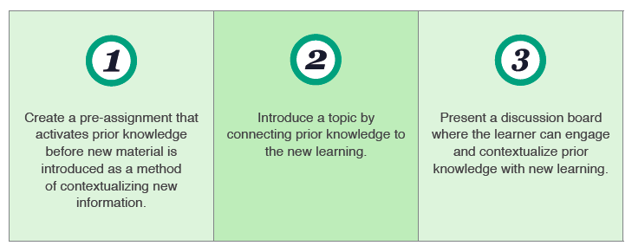
Creating Content Relationships
“Strategically organize and present all course content to leverage the learners’ existing expertise on a topic against the concepts and skills they are going to learn.”

Slide 42
Lesson Development with Media (1)
“Depending on how you choose to introduce, curate, or present the learning topics, creative applications of media can further engage learners in the material.”
What’s different online:
  Just posting your slides does not leverage the opportunities in an online course
  Simply recording a video of an in-person lecture does not leverage the opportunities in an online course

Slide 43
Lesson Development with Media (2)
Media can:
  Introduce and guide main concepts
  Generate interest in a subject
  Reinforce confusing or complex ideas
  Frame overarching themes
  Set the stage for an activity
  Curate a particular approach for how the learner should explore a topic

Slide 44
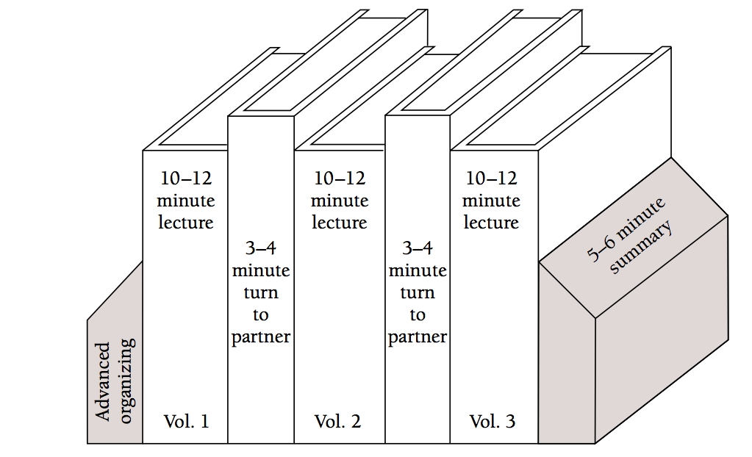
Best Practices Course: Media Example
Tablet drawing versus screenshot
Smith, K. (2000). Going Deeper: Formal Small-Group Learning in Large Classes
Notes:
Static image from the research paper.

Slide 45
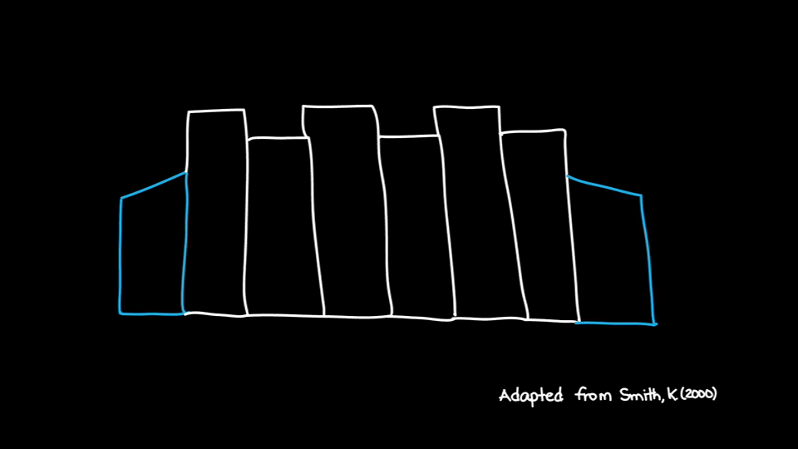
Best Practices Course: Media Example
Notes:
Talk through the idea of dividing a class into 10-15 minute segments with activities as the animation proceeds. Animation will repeat 20 times.

Slide 46
Content Licensing
Keep in mind licensing laws
  What materials developed by others can you use?
  Will you share your materials—license them—in such a way as others can build upon them (e.g., Creative Commons licensed)

Slide 47
Designing Community
“While meaningful learning can happen outside of a community, the overall learning experience usually benefits from community.”
  Build rapport
  Encourage interaction with clear expectations

Slide 48
Designing Assessments
“Align each assessment with specific learning objectives and course outcomes”
“Diversify assessment types to align learning with particular objectives”
“Create both formative and summative assessments to evaluate the progression of learners throughout your course.”
What’s different online:
  Some assessments can be automatically scored, and can be parameterized

Slide 49
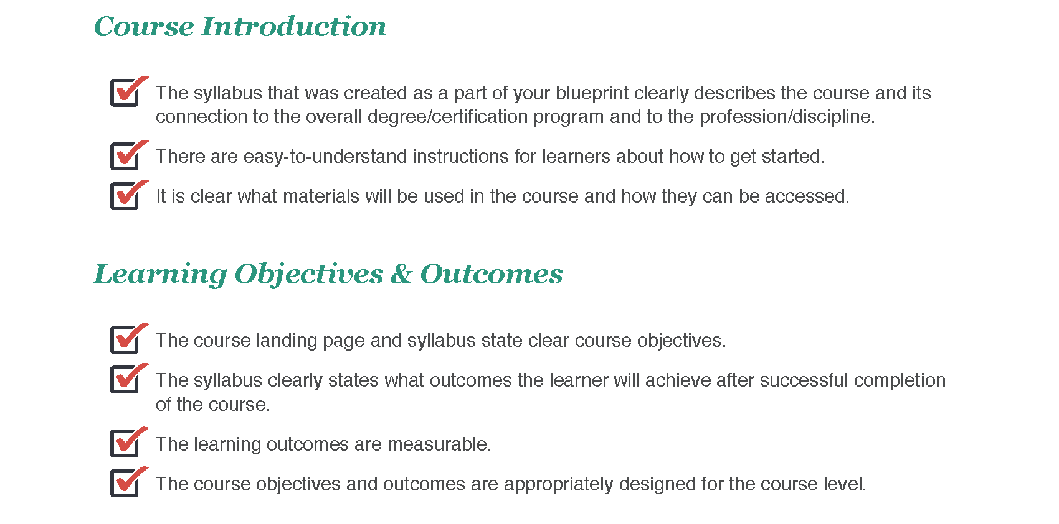
Checklist (1)

Slide 50
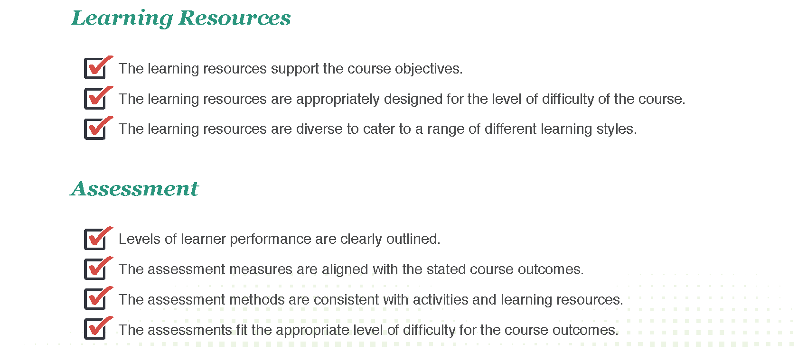
Checklist (2)

Slide 51
Part 3: Facilitation

Slide 52
Part 3: Facilitation
“Learners should be able to absorb the information presented and share their interpretations and knowledge with their peers so that the online environment feels like a collaborative community.”
What’s different online:
  In person, we’re adept and reading eye-contact, body language and human gestures—online we have limited opportunities
  In person, it’s easy to ask spontaneous questions—online this requires intentional design

Slide 53
Instructor Presence
“Online courses do not replace the instructor”, the instructor’s role “shifts to guiding the learning process, encouraging interaction, and prompting reflection.”
  Welcome learners
  Encourage community
  Connect with learners
  Actively participate

Slide 54
Learner Feedback
Leverage Learner Contributions
  Encourage, nurture, and recognize
  Focus the discussion in forums
  Respond to individual learners
  Involve learners as co-facilitators
  Facilitate synchronous events

Slide 55
Time Management
Instructor’s Perspective:
  Can require more time to prepare and teach an online course
  Time shifts from in-class activities (lecturing) to answering emails, participating in chats / discussion forums (facilitating)
  Tip: Set expectations on when you’ll respond
  Tip: Engage students in supporting each other
Student’s Perspective:
  Students will spend time understanding the course organization, and interacting with the online resources
  Tip: Students should formally set aside time to do the course activities

Slide 56
Part 4: Evaluation
“Evaluation is a critical part of the teaching and learning process. It completes the feedback loop, and helps you determine if the learners have understood the material presented to them. During this phase, you should be assessing the knowledge and skills that were defined in the learning outcomes statements.”
What’s different online:
  In person, it’s easy to ask spontaneous questions—online this requires intentional design for reflection
  Technologies allow peers to easily review each others’ work

Slide 57
Digital Learning Toolkit
Coming Soon!
http://dltoolkit.mit.edu/

Slide 58
Exploring the Guide
Brandon Muramatsu, MIT OEIT, mura@mit.edu
October 2, 2013
Notes:
Cite as: Muramatsu, B. (2013, October). Online course design: Exploring the guide. Invited Presentation at Kyoto University, October 2, 2013.
Unless otherwise specified this work is licensed under a Creative Commons Attribution 3.0 License.

Slide 59
② Are you developing and managing content and curricular materials for re-use?

Slide 60
Managing Content for Re-Use
Design and manage for the long-term, platforms will come and go
“Own” your content, separate from the delivery of it
The time to start is, NOW!
Experiences: Berkeley, Open University

Slide 61
③ Are you developing content to be modular and tied to learning objectives/concepts?

Slide 62
Modularity & Learning Objectives
Design learning experiences, and hence content, to be small, modular “chunks”
Identify learning objectives (outcomes, concepts) for individual “chunks”
It’s really just good instructional design…
Experiences: Modularity experiments, concept-based tools

Slide 63
③+ Are you prepared to think different? Are you really thinking about the learning experience?
This is the big opportunity!

Slide 64
Think different!
Learner control versus institutional mandate
Smaller “course” length, 4 weeks instead of semester-length?
Small tools, loosely joined (services-based)

Slide 65
③+ Are you developing formative assessments that are validated and tied to learning objectives/ concepts?

Slide 66
Formative Assessments
Design formative assessments to allow learners to gauge their understanding/mastery, and interleave with content
  Be creative; start simple and layer in complexity (psychometrics, IRT, etc.)
Use the power of computers to create parameterized assessments (problems)
Examples: Embedded assessment tools

Slide 67
There are probably lots more “simple” questions to ask yourselves…

Slide 68
Contact Me
Brandon Muramatsu
mura@mit.edu
@bmuramatsu (Twitter, Slideshare)
www.mura.org
Citation: Muramatsu, B. (2013, October). Online course design:. Invited Presentation at Kyoto University, October 2, 2013.
Notes:
Citation: Muramatsu, B. (2013, October). Online course design. Invited Presentation at Kyoto University, October 2, 2013.
Unless otherwise specified, this work is licensed under a Creative Commons Attribution 3.0 United States License.

