Slide 1
Exploring the Guide
Brandon Muramatsu, MIT OEIT, mura@mit.edu
September 16, 2013
Cite as: Muramatsu, B. (2013, September). Online course design guide workshop: Exploring the guide. Workshop presented to the EDC Pre-STEP Program. Lahore: Pakistan.
Notes:
Cite as: Muramatsu, B. (2013, September). Online course design guide workshop: Exploring the guide. Workshop presented to the EDC Pre-STEP Program. Lahore: Pakistan.
Unless otherwise specified this work is licensed under a Creative Commons Attribution 3.0 License.

Slide 2
Agenda
Introduction
Overview of the Course Design Guidelines and Blueprint
Part 1: Pre-Design
Lunch
Part 2: Design and Development
Part 3: Facilitation
Wrap-Up

Slide 3
Workshop Outcomes
Participants will create a blueprint for an online course
Participants will understand:
The difference between face-to-face and online course
What good online facilitation means
The importance of learning outcomes

Slide 4
About Brandon Muramatsu
B.S. & M.S. in Mechanical Engineering
Taught multimedia design and open education
20 years in EdTech
~10 years in educational digital libraries: Collections, nationwide collaborations, quality and peer review
9+ years in Open Education: Open Educational Resources and OpenCourseWare
“Been There, Done That”
Multimedia courseware design and course support, course design, video production software design, digital libraries, metadata, learning objects, open educational resources/OpenCourseWare, …

Slide 5
About you!
Please introduce yourselves with your Name and Institution
What do you hope to get out of the workshop?

Slide 6
Participants’ Interests
How to design the online B.Ed. Program
Developing online courses to develop reflective practices
Have a toolkit to design an online course
How to improve existing online courses
Software and tools that can be used for online courses

Slide 7
Participants’ Interests
Elements in the design online courses
Practical approaches to launch the courses
Framework
What kind of digital resources are available
What is the “digital toolkit” and how to use it

Slide 8
Setting the Stage
Have you taken an online course?
Have you taught an online course?
What courses are you teaching now?

Slide 9
Setting the Stage
Practical skills and how to do it.
Why do we need an online course, especially if there’s an existing face-to-face course
Areas where we can use the toolkit, and the importance of the toolkit
Hands on practice to use the toolkit

Slide 10
Why develop the Guide?

Slide 11
The Project
Rationale:
Came from observing the transition from existing courses (especially correspondence / distance learning ones) to “contemporary” online courses
My interest in designing contemporary (for the 21st century) courses that take into account everything we know about good design practice
My desire to share the experiences of experts, and their tips and tricks <we’re still working on this one>

Slide 12
The Participants
Brandon Muramatsu
Project Lead, MIT OEIT
Holly Ludgate
Project Lead, New Media Consortium
Samantha Adams Becker
Writer/Editor, New Media Consortium
Tom Caswell
Contributor, Western Governors University
Marion Jensen
Contributor, American Express
Gretchen Ulrich
Contributor, Northeastern University
Emily Wray
Contributor/Editor/Designer, Full Sail University

Slide 13
Developing the Guidelines and Toolkit
1.5 Day Meeting
Discussed the structure of the guidelines, and goals
Draft (write) sections of the guidelines, contribute worksheets and identify resources
Edit, edit, edit

Slide 14
Online Course Design
Designing an good online course is designing a good course!

Slide 15
Part 1: Pre-Design

Slide 16
Part 1: Pre-Design
“Gathering all of the necessary information to ensure that the course will meet the needs of the learners and engage them throughout the learning journey.”
What’s different online:
More difficult to make spontaneous adjustments
The asynchronous nature means you need to be thoughtful about creating interaction opportunities

Slide 17
Pre-Design Questions (1)
Who are my learners?
What do they currently know?
… you need to make sure you can produce content for their level and the correct voice.
…so you can avoid repetition and focus on growing what they have learned.

Slide 18
Pre-Design Questions (2)
What do they need to know before starting the course?
…so you can provide prerequisite materials to learners and they can plan accordingly before the course begins.

Slide 19
Pre-Design Questions (3)
What other content is available that supports meeting learning outcomes?
Do you have existing material that can be used in the course?
…curating content you already have means not having to start everything from scratch.
…being able to identify other resources that support your key topics adds greater depth to the course.

Slide 20
Pre-Design Questions (4)
What content must be revised for an online format or created from scratch?
… taking inventory of the varying stages of content will inform the design phase and give you a better sense of how much work it will require to prepare the content for online use.

Slide 21
Going Behind The Curtain
Exploring a MIT online course

Slide 22
MIT and Education
MIT does not have a School of Education
MIT does have faculty that are deeply interested in education
Eric Klopfer (the same faculty member leading the Games and Simulation Course) runs the Scheller Teacher Education Program to prepare MIT students to teach in K-12 schools
MIT has a number of central units (TLL, OEIT, etc.) that provide support for teaching and learning.

Slide 23
Best Practices for Teaching and Learning
One of the courses MIT developed for the EDC Pre-STEP program
Course Goals: How do we design a course? What are the best methods for promoting critical thinking skills, knowledge retention, and transfer? …primarily for in-person classes

Slide 24
Background on the Course
Based on a 14 week course that MIT provides for graduate students and Post-Docs who wish to learn how to teach
Course is run by the MIT Teaching and Learning Laboratory (TLL)
They work with faculty on education research
They work with faculty on pedagogically informed teaching practice
Perform some of the functions of a Center for Teaching and Learning

Slide 25
Background on the Course
Instructors have taught the face-to-face version of this course
Experienced in teaching in Biology
Experienced in research in Biology, both have Ph.D.s
Deep interest in biology education, especially preparing students for careers in Biology
Instructors have not taught online before
Relying on others for that experience <- it takes a team!

Slide 26
Question: Who are my learners?
Faculty interested in learning “best practices”
Might be in teacher education departments
With possible focus on Science / Math education
Challenge:
Different from the course upon which it was based
MIT graduate students ≠ faculty in teacher education programs

Slide 27
Question: What do my learners currently know?
Unknown
Might, or might not, have experience with “good” teaching practice
Might not have been formally trained to “teach”
Challenge:
Didn’t have the opportunity to really find out about the participants before designing the course, had to make assumptions

Slide 28
Question: What do my learners need to know before starting the course?
Participants should have:
Experience in teaching
Perhaps experience in teaching pre-service teachers
Challenge:
Didn’t have the opportunity to really find out about the participants before designing the course
Had to make assumptions

Slide 29
Question: Do you have existing material that can be used in the course?
Yes!
Challenges:
Material designed for face-to-face interactions
Materials designed for a 14 week course

Slide 30
Question: What other content is available that supports meeting learning outcomes?
Lots and lots
Challenge:
Pre-supposes learning outcomes!
Some materials are referenced in pre-session readings
Some materials are referenced during the session videos (as citations)

Slide 31
Question: What content must be revised or created from scratch?
Lecture videos
Most of the course is an interactive discussion in class based around the pre-session readings
Slides
Activities
Challenges:
Developing a mostly-asynchronous learning experience for what was a highly synchronous course

Slide 32
Pre-Design Activity
Break up into small groups
Select a course you teach or would like to teach
What’s the course title? What’s the course about?
Answer the pre-design questions
Report back

Slide 33
Pre-Design Questions
Who are my learners?
What do my learners currently know?
What do my learners need to know before starting the course?
Do you have existing material that can be used in the course?
What other content is available that supports meeting learning outcomes?
What content must be revised for an online format or created from scratch?

Slide 34
Pre-Design: Group 3
Functional English
Graduate students 14 years of education
Studied English as a subject for 12 years, basic grammar, sufficient vocabulary, comprehension (reading writing, speaking, listening)
Basic technology knowledge (IT literacy)
Existing materials: textbooks
Other materials: British Council online courses, BBC Online Language course, AIOU course
What need to be revised, or created? Teacher guides and textbooks
Questions: What are the assessments? Test, quizzes

Slide 35
Pre-Design: Group 1
Child psychology
Don’t know about philosophy of learning
What will they learn about the course
Existing materials: Textbooks and course guides
Other resources: Other published materials, purchase textbooks online, Wikipedia
What is needed: Will need to design for online courses
What to revise: Change from print to online

Slide 36
Pre-Design: Group 4
ICT in Education
Audience: Students of B.Ed. Hons.
Existing knowledge: Knowledge of basic computers
Required knowledge: how to use the Internet and modern technology to access the course
Existing materials: Course guide, text material, A/V aids
Other materials: Sources from website, e.g., MIT, production center
Revision of materials: Assessment system needs to be changed for the online course, textbooks print -> digital, method of teaching and classroom teaching will be revised with videos and assignments

Slide 37
Pre-Design: Group 2
Classroom Management
Audience: undergraduates, 18-20, Men/Women, rural and urban background
What do they know: Educational psychology, child development, methods of teaching, awareness of school-based visits, <- Question: is there relevancy for some of these
Need to know?: Scheme of studies <- Question is this necessary, Purpose of the course, IT skills
Existing Materials: Printed, websites, videos, course guides
Other materials: more videos, online simulations / games
Revision: study guides, scheme of studies, assessment tasks

Slide 38
Break

Slide 39
Part 2: Design and Development

Slide 40
Part 2: Design and Development
“In this phase, learning strategies are mapped out, learning content and media are developed, organized, and sequenced, and supporting technology is selected.”
What’s different online:
Online learning is more exploratory in nature, and oftentimes less directed than in-person
Learners access materials asynchronously: The easier it is for learners to locate and engage with learning activities, the more mental energy they will have to focus on the content.

Slide 41
Objectives and Outcomes
“Learning outcomes are general statements that describe the essential learning (knowledge, skills, and attitudes) that learners will achieve by the end of the course. They should encompass the depth of the knowledge and skills that you will be ultimately assessing. When composing outcomes, be mindful not to combine elements that cannot be assessed by a single method.”

Slide 42
Designing a Blueprint
What’s a blueprint?
A comprehensive plan that allows “you to design with the big picture in mind to ensure you reach every milestone and build consistency throughout the curriculum.”
Key Elements
Course information
Course learning objectives and outcomes
Lesson topics and format
Learning resources
Activities and assessment

Slide 43
Content Patterns: Organizing & Sequencing (1)
“Constructing patterns in your curriculum is one way to infuse consistency throughout the course, which helps the learners manage time and resources. How you approach your content each week should be organized in such a way that the learner understands what is being taught and how to interact and engage with the material and community.”
What’s different online:
The easier it is for learners to locate and engage with learning activities, the more mental energy they will have to focus on the content.

Slide 44
Content Patterns: Organizing & Sequencing (2)
Write all course content using a consistent voice
Create patterns in activity structure (e.g., description, rationale, deliverables, and resources)
Establish a consistent schedule (e.g., standardize due dates and plan synchronous sessions, virtual meetings, office hours, and other activities at the same time each week)
Align learning objectives to each segment of content
Structure the content into smaller pieces

Slide 45
Best Practices Course: Organizing and Sequencing Example
Demo Organizing and Sequencing in Session 1

Slide 46
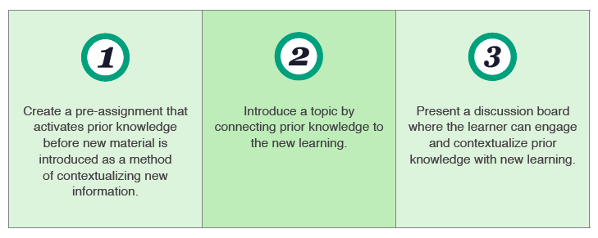
Creating Content Relationships
“Strategically organize and present all course content to leverage the learners’ existing expertise on a topic against the concepts and skills they are going to learn.”

Slide 47
Best Practices Course: Content Relationship Example
Demo Content Relationships in Session 1

Slide 48
Lesson Development with Media (1)
“Depending on how you choose to introduce, curate, or present the learning topics, creative applications of media can further engage learners in the material.”
What’s different online:
Just posting your slides does not leverage the opportunities in an online course
Simply recording a video of an in-person lecture does not leverage the opportunities in an online course

Slide 49
Lesson Development with Media (2)
Media can:
Introduce and guide main concepts
Generate interest in a subject
Reinforce confusing or complex ideas
Frame overarching themes
Set the stage for an activity
Curate a particular approach for how the learner should explore a topic

Slide 50
Best Practices Course: Media Example (1)
Demo Whodunnit Video from Session 1
Notes:
Watch the lead in from Lourdes, show the Whodunnit video on YouTube

Slide 51
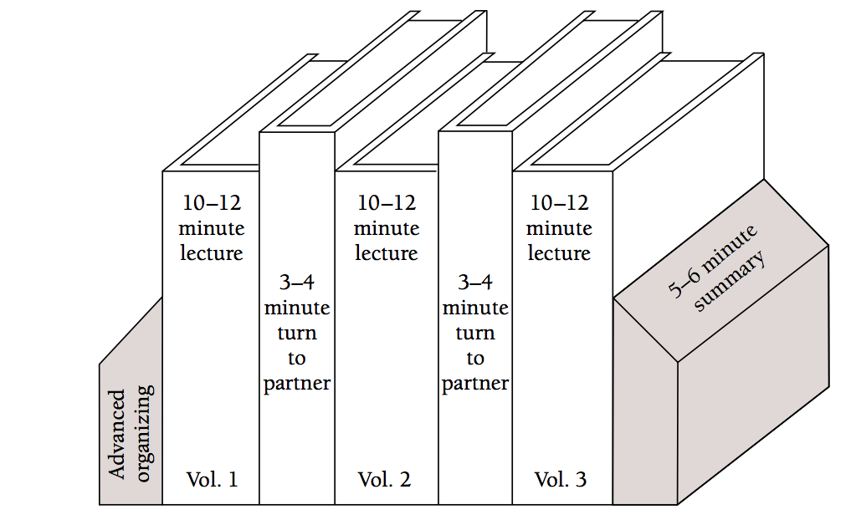
Best Practices Course: Media Example (2)
Tablet drawing versus screenshot
Smith, K. (2000). Going Deeper: Formal Small-Group Learning in Large Classes
Notes:
Static image from the research paper.

Slide 52
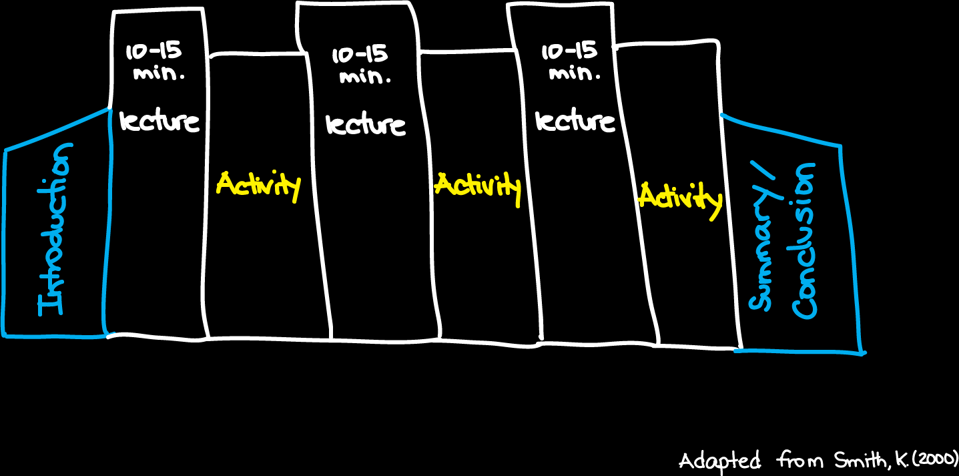
Best Practices Course: Media Example (2)
Notes:
Recreated in Session 4 Video

Slide 53
Content Licensing
Keep in mind licensing laws
What materials developed by others can you use?
Will you share your materials—license them—in such a way as others can build upon them (e.g., Creative Commons licensed)

Slide 54
Designing Community
“While meaningful learning can happen outside of a community, the overall learning experience usually benefits from community.”
Build rapport
Encourage interaction with clear expectations

Slide 55
Designing Assessments
“Align each assessment with specific learning objectives and course outcomes”
“Diversify assessment types to align learning with particular objectives”
“Create both formative and summative assessments to evaluate the progression of learners throughout your course.”
What’s different online:
Some assessments can be automatically scored, and can be parameterized

Slide 56
Checklist (1)

Slide 57
Checklist (2)

Slide 58
Part 3: Facilitation

Slide 59
Part 3: Facilitation
“Learners should be able to absorb the information presented and share their interpretations and knowledge with their peers so that the online environment feels like a collaborative community.”
What’s different online:
In person, we’re adept and reading eye-contact, body language and human gestures—online we have limited opportunities
In person, it’s easy to ask spontaneous questions—online this requires intentional design

Slide 60
Instructor Presence
“Online courses do not replace the instructor”, the instructor’s role “shifts to guiding the learning process, encouraging interaction, and prompting reflection.”
Welcome learners
Encourage community
Connect with learners
Actively participate

Slide 61
Learner Feedback
Leverage Learner Contributions
Encourage, nurture, and recognize
Focus the discussion in forums
Respond to individual learners
Involve learners as co-facilitators
Facilitate synchronous events

Slide 62
Time Management
Instructor’s Perspective:
Can require more time to prepare and teach an online course
Time shifts from in-class activities (lecturing) to answering emails, participating in chats / discussion forums (facilitating)
Tip: Set expectations on when you’ll respond
Tip: Engage students in supporting each other
Student’s Perspective:
Students will spend time understanding the course organization, and interacting with the online resources
Tip: Students should formally set aside time to do the course activities

Slide 63
Example: Best Practices Course (1)
Instructor Presence
Introduction Video: Introduces instructors, provides an overview of the course
Asked for students to introduce themselves
Learner Feedback
Synchronous weekly events

Slide 64
Example: Best Practices Course (2)
Time Management
Each session requires extensive pre-session readings
Video divided into segments

Slide 65
Post Mortem on the Best Practices Course

Slide 66
Big Challenges: Best Practice Course (1)
Getting students to login and participate
Many things we could have done better to support students
Not fully understanding the infrastructure challenges
Reliable electricity and access to computers and network
Bandwidth: We did use a “low” resolution/data-rate on videos, probably needed to be even lower

Slide 67
Big Challenges: Best Practice Course (2)
Clearly explaining course structure and activities
Pre-session readings are critical
Participation in discussion forums was a key part of the course, but they need sufficient participants and constant participation
Semi-Synchronous Session Design
Expecting students to watch pre-recorded videos and participate in activities by starting and stopping the videos

Slide 68
Digital Learning Toolkit
Coming Soon!
http://dltoolkit.mit.edu/

Slide 69
Exploring the Guide
Brandon Muramatsu, MIT OEIT, mura@mit.edu
September 16, 2013
Notes:
Cite as: Muramatsu, B. (2013, September). Online course design guide workshop: Exploring the guide. Workshop presented to the EDC Pre-STEP Program. Lahore: Pakistan.
Unless otherwise specified this work is licensed under a Creative Commons Attribution 3.0 License.

