Slide 1
Selecting and Adapting Digital Learning Resources for Science, Mathematics, Engineering and Technology Education
Brandon Muramatsu, mura@smete.org
Originally Published 2001. Republished 2013. This work is licensed under a Creative Commons Attribution-Noncommercial-Share Alike 3.0 United States License (http://creativecommons.org/licenses/by-nc-sa/3.0/us/)

Slide 2
Outline
Background
Mechanisms and Methodologies to Evaluate and Select Digital Learning Resources
Mechanisms to Locate Resources
Educational Digital Libraries
National SMETE Digital Library Program
SMETE Open Federation

Slide 3
Background
Information technologies provide the opportunity to “re-think” how we teach our classes and better understand how students learn
Computers, Web and other learning technologies
Builds upon the work of:
NEEDS, a digital library for engineering education
Premier Award for Excellence in Engineering Education Courseware
Engineering Education Coalitions
SMETE Open Federation

Slide 4
The Audience
Introductions
Department?
Professor or Grad Student?
Have you developed digital learning materials?
What are/were they? Websites, applets, etc.?
Have you adopted or adapted materials developed by others?

Slide 5
Approach we will be discussing...
Provides processes and frameworks
To help you understand what tools you might want to use
To evaluate the quality of learning technologies
Leading to selecting and adapting learning technologies for your courses
Uses learning technologies as tools to improve teaching and learning
Learning technologies provide a number of benefits … but … don’t use technology just because you can.

Slide 6
How do you select learning technologies?

Slide 7
Selecting Learning Technologies...
…begins with an understanding of the environment in which it will be used
Establish Course Goals
Identify Student Learning Outcomes
Design Learning Environment
Design Learning Process
(e.g., individual or collaborative)
Design Learning Activities
(e.g., computer or other non-computer
Assess Student Learning

Slide 8
7 Principles of Good Teaching
Encourages contact between students and faculty
Develops reciprocity and cooperation among students
Encourages active learning
Gives prompt feedback
Emphasizes time on task
Communicates high expectations
Respects divers talents and ways of learning
Chickering, A.W. & Z. F. Gamson. (1991). “Applying the Seven Principles for Good Practice in Undergraduate Education.” New Directions for Teaching and Learning. Vol. 47. San Francisco: Jossey-Bass Inc.

Slide 9
Guidelines for Selecting Learning Technologies
Support Good Practices in Higher Education (Seven Principles)
Support teaching goals and learning outcomes
Consider (technical) support environment
Use quality resources

Slide 10
How do you evaluate learning technologies? What things do you consider?

Slide 11
Evaluating Learning Technologies
Identifying high-quality learning materials based upon criteria developed for Premier Award for Excellence in Engineering Education Courseware
Developed with the help of a number of experts in the field
Evolved over the last four years of competition
Brings diverse viewpoints together -- content area experts, instructional designers, students and publishers

Slide 12
Premier Award Selection Criteria
Instructional Design
Will students learn from the courseware?
Interactivity: Is the learner actively involved and does the interaction enhance learning?
Cognition/Conceptual Change: Is learning significant and long lasting, allowing the construction of useful cognitive models?
Content: Is the content well chosen and structured?
Multimedia Use: Is multimedia used effectively to promote learning objectives and goals?
Instructional Use/Adaptability: Can the software be used in a variety of settings?

Slide 13
Premier Award Selection Criteria, cont.
Software Design
Is the software well designed and useable?
Engagement: Does the software hold the interest of a diversity of learners?
Learner interface and navigation: Is the software easy to use?
Technical reliability: Is the software free from technical problems?

Slide 14
Premier Award Selection Criteria, cont.
Engineering Content
Is the content appropriate and error-free?
Accuracy of content: Is the content error-free?
Organization of content: Is the content presented consistent with typical engineering instruction.
Consistency with learning objectives: Does the content match the stated learning objectives?

Slide 15
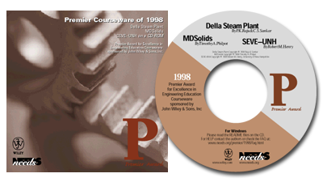
Premier Courseware of 1997 & 1998
Virtual Disk Drive
Design Studio
Drill Dissection and
Bicycle Dissection
Mars Navigator
Della Steam Plant
MDSolids
Structural Engineering Visual Encyclopedia - UNH
3,800 CD-ROMs Distributed
1,950 CD-ROMs Distributed
For more info or to receive copies go to http://www.needs.org/engineering/premier/

Slide 16
Premier Courseware of 1999 & 2000
Engineering Graphics
Cracking Dams
Project Links
West Point Bridge Designer
2,000 CD-ROMs Distributed
1,600 CD-ROMs Distributed
For more info or to receive copies go to http://www.needs.org/engineering/premier/

Slide 17
Locating Learning Technologies
How do you locate learning technologies?
Through word of mouth?
Through educational digital libraries?

Slide 18
Educational Digital Libraries
What do you think I mean?
Who’s the user?
What services are available?

Slide 19
“Working” Description of Educational Digital Libraries
…or…what makes them different from research digital libraries…
Directly supports teaching and learning Activities
Supports communities of users
In K-12 through higher-education to life-long learning
Across a wide range of disciplines

Slide 20
Background and History of the National Science Foundation’s National SMETE Digital Library Program

Slide 21
The SMETE Open Federation A Brief Introduction

Slide 22
Brief Background
To build a successful National SMETE Digital Library for deployment in Fall 2002…
That focuses on science, mathematics, engineering and technology at all levels
And more importantly, it focuses on education
…we needed to develop a team…
To overcome the challenges we face in developing a National SMETE Digital Library
To cover target audiences and disciplines
To share in the development efforts

Slide 23
Vision
The SMETE Open Federation is committed to providing a service
to support learning
across disciplines in science, mathematics, engineering and technology
providing access to high-quality resources
in support of education reform and cross-disciplinary learning
from K-12 to higher education to professional development

Slide 24
SMETE Open Federation |  |  | Industry
Access Excellence & National Assoc. Biology Teachers (Biology Education Online) (www.accessexcellence.org and www.nabt.org) American Association for the Advancement of Science (www.aaas.org) BioQUEST Curriculum Consortium (www.bioquest.org) Coalition for Networked Information (www.cni.org) CITIDEL (www.citidel.org) Digital Library for Earth Systems Education (www.dlese.org) Eisenhower National Clearinghouse for Mathematics and Science Education (www.enc.org) | iLumina (www.ilumina-project.org) Mathematics Association of America (www.maa.org) MathDL (www.mathdl.org) Math Forum (www.mathforum.com) MERIT Network/Michigan State University (Michigan Teacher Network and TeacherLIB) (www.merit.edu) MERLOT (www.merlot.org) National Action Council for Minorities in Engineering (www.nacme.org) NEEDS—National Engineering Education Delivery System* (www.needs.org) | Northern Arizona University* (www.nau.edu) Project Kaleidoscope (www.pkal.org) University of California Teaching and Learning with Technology Center (www.ucop.edu/acadinit/tltc) University of Maryland Baltimore County (www.umbc.edu/engineering/me/wood.html) University of Missouri Columbia (cecssrv1.cecs.missouri.edu/NSDLProject) Utah State University (ia.usu.edu) Virginia Tech* (www.vt.edu & fox.cs.vt.edu) | Autodesk* (www.autodesk.com) Cisco Systems (www.cisco.com) John Wiley & Sons* (www.wiley.com) Eduprise (www.eduprise.com) Mathworks* (www.mathworks.com) Microsoft Research* (research.microsoft.com) Sun Microsystems (www.sun.com) WebCT (www.webct.com) *Involved with NEEDS

Slide 25
Development Philosophy
The difference is learning, not just bibliographic information retrieval
Teaching and learning require something more
Guided by user needs and philosophy of education that is constructivist
Link content to community and services
Build integrative tools and incorporate “best of breed” tools from partners

Slide 26
Strengths of Partners
Partners with existing collections each have a decade of experience providing digital SMETE resources to their target audiences and disciplines
ENC, NEEDS, Math Forum, BioQUEST
Most partners each have more than ten years of experience as organizations promoting SMETE reform
AAAS, Project Kaleidoscope, NACME, Mathematical Association of America, SRI International

Slide 27
Strengths of Partners (cont.)
Collections and service providers range from well established collections to incipient collections
Organizations serve full spectrum of audiences
K–12, pre-College, community colleges, liberal arts colleges and universities, public and private research universities, and professional societies
Extended affiliations include professional development organizations

Slide 28
Services
Interoperability of collections on a number of different levels
Federated search
Shared user profiles to enable personalization services
Support for community building
Recommender systems
Outreach and education efforts

Slide 29
Making it All Work
What do we mean by interoperability?
We want to provide “seamless access to collections and services”
Existing and new collections
Existing and new services
We recognize there are different types of agreements necessary to provide “seamless access”
Social
Technical

Slide 30
Social Aspects of Interoperability
Agree to interoperate
Shared principles
Shared understanding of the issues
Build an identity
Meet to develop common language and technical protocols

Slide 31
Technical Aspects of Interoperability
Agree to common methods of representing information
Common metadata to help organize and describe collections
Common thesauri/controlled vocabularies to describe resources in consistent manner across collections
Agree to common methods for transmitting information
Protocols/specifications/API’s for shared access to contents of collections and services

Slide 32
Technical Aspects of Interoperability
Agree to common methods of representing information
Common metadata to help organize and describe collections
Common thesauri/controlled vocabularies to describe resources in consistent manner across collections
Agree to common methods for transmitting information
Protocols/specifications/API’s for shared access to contents of collections and services

Slide 33
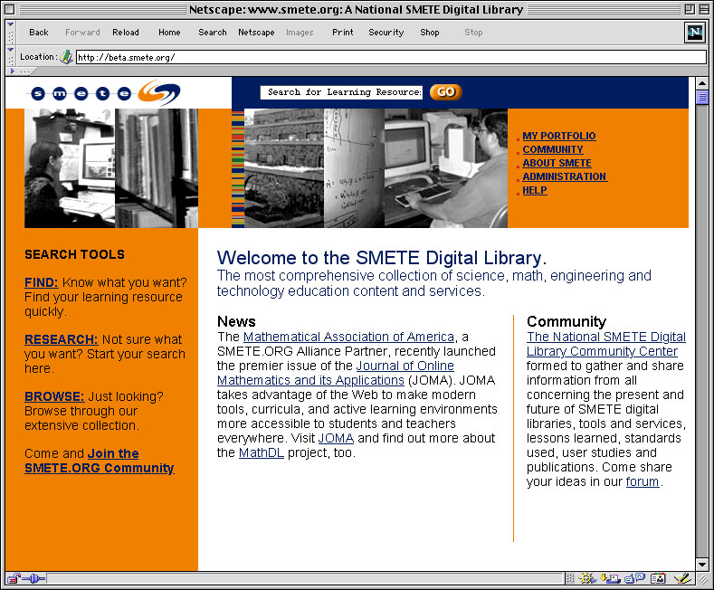
Portal at www.smete.org

Slide 34
Contact Info
Brandon Muramatsu, Project Director
mura@smete.org
University of California, Berkeley
3115 Etcheverry Hall
Berkeley, CA 94720-1750 USA
(510) 643-1817

