Slide 1
Towards a National SMETE Digital Library at www.smete.org Building Upon NEEDS
Brandon Muramatsu
NEEDS Project Director
UC Berkeley
Originally Published 2000. Republished 2013. This work is licensed under a Creative Commons Attribution-Noncommercial-Share Alike 3.0 United States License (http://creativecommons.org/licenses/by-nc-sa/3.0/us/)

Slide 2
Outline
What is an NSDL?
NEEDS—The National Engineering Education Delivery System
Towards a National SMETE Digital Library
Prototype: www.smete.org
Copies of this presentation will be available at:
http://www.needs.org/engineering/info/presentations/

Slide 3
What is a National Science, Mathematics, Engineering and Technology Education (SMETE) Digital Library?

Slide 4
Vision...
“… a network of learning environments and resources for Science, Mathematics, Engineering and Technology education, will ultimately meet the needs of students and teachers at all levels—K-12, undergraduate, graduate, and lifelong learning—in both individual and collaborative settings.”
NSF

Slide 5
Towards A National SMETE Digital Library...
Should NSF Establish and Fund a National Science, Mathematics, Engineering and Technology Education Digital Library?
April 1996 - NSF Committee Meeting (LIBUSE)
“Towards a National Library for Undergraduate Science Education Resources in Science, Mathematics, Engineering and Technology”
August 1997 National Research Council
Digital National Library for SME&T Education Workshop
July 1998 National Science Foundation
SMETE-Lib Workshop
January 1999 National Science Foundation
Digital Libraries and Education Workshop
Funding through
Digital Libraries
Initiative – Phase 2
And NSDL Programs
Notes:
Digital National Library
One program currently under development at NSF is the development of a digital library to support Science, Mathematics, Engineering, and Technology Education.

Slide 6
NEEDS—The National Engineering Education Delivery System www.needs.org

Slide 7
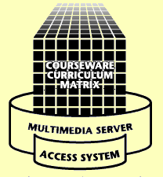
www.needs.org
Delivery
Classrooms
Instructional Labs
Small Study Groups
Residences
Libraries
Anywhere
Development
Courseware Studios
Instructional Labs
Faculty Offices & Residences
Libraries
Anywhere
Database
NEEDS is the foundation for the National SMETE Digital Library at www.smete.org.

Slide 8
What Is NEEDS?
Digital Library of Multimedia Engineering Courseware
Bibliographic records with downloadable courseware
Multimedia elements - downloadable movies, images, and text
Multilevel Courseware Evaluation System
Peer Review of Courseware
Premier Award for Excellence in Engineering Education Courseware
Expanding Services and Features

Slide 9
How does NEEDS help users “re-use” learning materials?
Provides mechanisms to help user locate materials
Uses standardized descriptions (metadata) to describe resources
Provides mechanisms to help users evaluate the “quality of materials”
Developed upon an extendable platform to:
Support multiple uses
Integrate new services and features
Integrate research

Slide 10
Quality Review of Courseware on the NEEDS Database
Establish credibility of NEEDS as a source of Quality educational material
Enhance recognition of scholarly and creative effort of courseware developers
Peer/Expert Review of Courseware
Premier Award for Excellence in Engineering Education Courseware

Slide 11
The Premier Award for Excellence in Engineering Education Courseware
A national competition to identify and reward the authors of high-quality, non-commercial courseware designed to enhance engineering education.
The Premier Award is about the entire experience of using the courseware by learners, not just the courseware itself
A dissemination system to distribute the Premier Courseware (via CD’s and presentation at engineering education conferences).

Slide 12
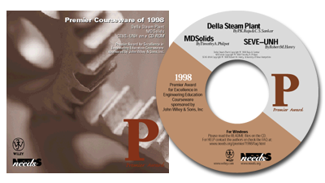
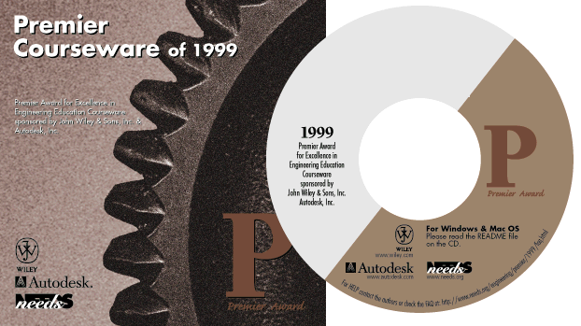
Premier Courseware of 1997-1999
Virtual Disk Drive
Design Studio
Drill Dissection and
Bicycle Dissection
Mars Navigator
Della Steam Plant
MDSolids
Structural Engineering Visual Encyclopedia - UNH
Engineering Graphics
Cracking Dams
6,700 CD-ROMs Distributed
For more info or to receive copies go to http://www.needs.org/engineering/premier/

Slide 13
Towards A National Science, Mathematics, Engineering and Technology Education (SMETE) Digital Library

Slide 14
Needs Assessment with Members of the Math, Science and Engineering Community
Purpose:
To understand the math, science and engineering communities of educators and examine their needs in order to design services and structures to support users from multiple communities.
Research Questions:
What services, features & programs are integral to success?
What do users expect with regards to quality of the holdings?
Who makes up the SMETE digital library community?
American Association of Physics Teachers, American Mathematical Society, American Association for the Advancement of Science, members of the NSF Chemistry Consortia and the NSF Engineering Education Coalitions

Slide 15
Translating Findings into Services & Features
Quality
System to rapidly identify the quality of holding
Place to comment about a learning object or regarding something of interest to the community
Reviewers should include experts in pedagogy and content

Slide 16
Translating Findings into Services & Features
Community
Embedded structures for developing and maintaining communication links
Developing community should be on par with building content
Build on discipline based communities to establish connection to a broader community
Content
Useful content and community interaction ensures user participation as authors, reviewers, adapters/adopters, and consumers

Slide 17
Prototype: www.smete.org
John Wiley
Math Forum
Berkeley
ENC
UMBC
UCOP
Stanford
Northern
Arizona
Virginia Tech
Prototype Goals (1998-2001)
Develop a Prototype National SMETE Digital Library
test interoperability of federated searches/shared services with partners
expand requirements analysis to include K–12
develop criteria and standards to assess the impact of learning objects across disciplines
implement community feedback systems, evaluate services

Slide 18
Building a National SMETE Digital Library at www.smete.org
Searching for learning resources
Cataloging (adding) learning resources
Standards, IEEE and IMS
Evaluating the quality of learning resources
“User” reviews
“Expert” reviews
Forming a community of users in SMETE
PKAL workshops and seminars
Research on adapters

Slide 19
Systems Development
Expanding www.smete.org/NEEDS platform
Continuing to participate in the development of IEEE/IMS Learning Object Metadata Standards
Adopting emerging IEEE standards
Expanding user comments
Implementing discussion systems
Implementing customized
user profiles
Expanding Collections
Expanding into Chemistry,
Physics, and Mathematics
Total Collection
Engineering 58%
Chemistry 21%
Physics 14%
Math 5%
Other 2%

Slide 20
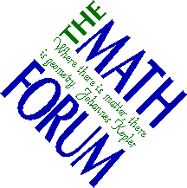
Collaborating with Partners
Working with Eisenhower National Clearinghouse and Math Forum
Identify common metadata
Exchange records for common searching
Working together as part of the American Mathematics Metadata Task Force
www.mathforum.com
www.enc.org

Slide 21
Collaborating with Partners
Working with University of California Office of the President - (10 campuses)
Identifying courseware under development systemwide
Developing TLT@UC Website to showcase teaching and learning with technology at the University of California

Slide 22
Challenges Toward the Future...
Continuing to understand and support changing user needs
Improving ability to encapsulate the instructional intent and use of materials
Metadata standards and cataloging practice
Supporting communities of use and practice
pedagogy
content

Slide 23
Challenges Toward the Future...
Continuing to understand and support changing user needs
Improving ability to encapsulate the instructional intent and use of materials
Metadata standards and cataloging practice
Supporting communities of use and practice
pedagogy
Content
Which allows for a user to find what they’re really looking for as well as personalization of content.

Slide 24
www.smete.org
NACME
WebCT
BioQUEST
John Wiley
Math Forum
Berkeley
ENC
UMBC
UCOP
ILT
Utah State
AAAS
PKAL
Stanford
DLESE
GDL
Northern
Arizona
Virginia Tech
Cisco
Sun
SRI
Eduprise
MAA
TI
NSDL Goals (2000- )
Develop the National SMETE Digital Library
Provide seamless access to services and resources
Create a dynamic learning community that promotes and supports SMET education in the 21st century
Expand Partnerships
Expand Services and Community

Slide 25
Contact Information
Brandon Muramatsu, Project Director
mura@needs.org
3115 Etcheverry Hall
University of California
Berkeley, CA 94720-1750
(510) 643-1817
Copies of this presentation will be available at:
http://www.needs.org/engineering/info/presentations/

