Slide 1
The Development of a National Science, Mathematics, Engineering and Technology Education Digital Library: Lessons Learned from NEEDS
Brandon Muramatsu
UC Berkeley
Originally Published 2000. Republished 2013. This work is licensed under a Creative Commons Attribution-Noncommercial-Share Alike 3.0 United States License (http://creativecommons.org/licenses/by-nc-sa/3.0/us/)

Slide 2
Outline
What is a National SMETE Digital Library?
NEEDS—The National Engineering Education Delivery System
Prototype: www.smete.org
Lessons Learned
Partnerships
Standards and protocols
Community development

Slide 3
Vision...
“… a network of learning environments and resources for Science, Mathematics, Engineering and Technology education, will ultimately meet the needs of students and teachers at all levels—K-12, undergraduate, graduate, and lifelong learning—in both individual and collaborative settings.”
National Science Foundation

Slide 4
Our Goals
Establish a national digital library for SMETE that is a dynamic learning community
To promote and support SMET education in the 21st century
To provide educators and learners with seamless access to partner collections and shared services to improve learning
To support educators and learners in K-12, higher education and life-long learning

Slide 5
Towards A National SMETE Digital Library...
NSF should establish and fund a National Science, Mathematics, Engineering and Technology Education Digital Library
April 1996 - NSF Committee Meeting (LIBUSE)
“Towards a National Library for Undergraduate Science Education Resources in Science, Mathematics, Engineering and Technology”
August 1997 National Research Council
Digital National Library for SME&T Education Workshop
July 1998 National Science Foundation
SMETE-Lib Workshop
January 1999 National Science Foundation
Digital Libraries and Education Workshop
Notes:
Digital National Library
One program currently under development at NSF is the development of a digital library to support Science, Mathematics, Engineering, and Technology Education.

Slide 6
National SMETE Digital Library Program
Test-bed funding under the Digital Libraries Initiative—Phase 2, 1998-2001
Demonstration and full scale development, 2000-2006?
Four focus areas
Core Integration System
Collections
Services
Targeted Research

Slide 7
NEEDS—The National Engineering Education Delivery System www.needs.org

Slide 8
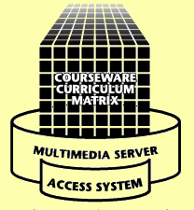
www.needs.org
Delivery
Classrooms
Instructional Labs
Small Study Groups
Residences
Libraries
Anywhere
Development
Courseware Studios
Instructional Labs
Faculty Offices & Residences
Libraries
Anywhere
Database
NEEDS is the foundation for the National SMETE Digital Library at www.smete.org.

Slide 9
What Is NEEDS?
Digital Library of Multimedia Engineering Courseware
Bibliographic records with downloadable courseware
Multimedia elements—downloadable movies, images, and text
Multilevel Courseware Evaluation System
Peer and user review mechanisms
Premier Award for Excellence in Engineering Education Courseware
User Services and Features

Slide 10
Systems Development
Expand www.needs.org/www.smete.org
Continue participation in the development of IEEE/IMS Learning Object Metadata Standards
Adopt emerging IEEE standards
Implement discussion systems
Expand user comments
Implement customized
user profiles
Expand Collections
Chemistry, Physics, Math
Total Collection
Engineering 54%
Chemistry 21%
Physics 17%
Math 5%
Other 3%

Slide 11
The Premier Award for Excellence in Engineering Education Courseware
A national competition to identify and reward the authors of high-quality, non-commercial courseware designed to enhance engineering education.
The Premier Award is about the entire experience of using the courseware by learners, not just the courseware itself
A dissemination system to distribute the Premier Courseware (via CD’s and promotional materials at engineering education conferences).

Slide 12
Prototype at www.smete.org

Slide 13
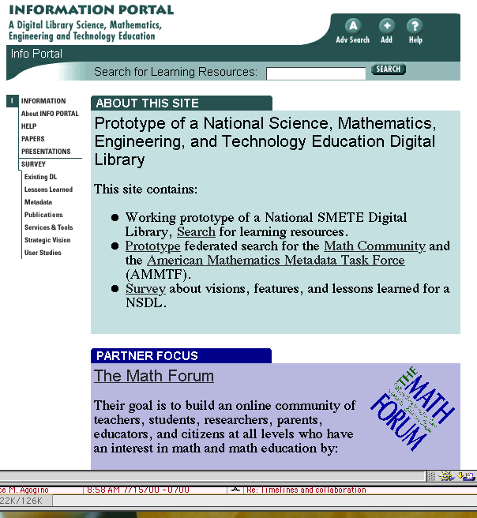
What is www.smete.org?
Learning and teaching resources for science, math and engineering
“Re-use” of learning materials:
Evaluate quality
Locate resources
User comments
Online discussion

Slide 14
Demonstration: www.smete.org
NACME
WebCT
BioQUEST
John Wiley
Math Forum
Berkeley
ENC
UMBC
UCOP
ILT
Utah State
AAAS
PKAL
Stanford
DLESE
GDL
Northern
Arizona
Virginia Tech
Cisco
Sun
SRI
Eduprise
MAA
TI

Slide 15
www.smete.org Goals
Develop a NSDL Core Integration System
Provide seamless access to services and resources
Create a dynamic learning community that promotes and supports SMET education in the 21st century
Demonstrate effectiveness of collaboration to provide
Expanded services
Resources
Community

Slide 16
Multidisciplinary Partnerships
We appreciate the value of multi-disciplinary partnerships
Common with engineering educators
Use of multi-disciplinary/cross-disciplinary teams
www.smete.org has over 20 partners
Industry
Academic
Professional societies

Slide 17
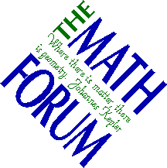
Collaborating with Partners
Working with Eisenhower National Clearinghouse and Math Forum
Identify common metadata
Exchange records for common searching
Working together as part of the American Mathematics Metadata Task Force
www.mathforum.com
www.enc.org

Slide 18
Collaborating with Partners
Working with University of California Office of the President - (10 campuses)
Identifying courseware under development systemwide
Developing TLT@UC Website to showcase teaching and learning with technology at the University of California

Slide 19
How does NEEDS help users find and “re-use” learning materials?
Provides mechanisms to help user locate materials
Uses standardized descriptions (metadata) to describe resources
Provides mechanisms to help users evaluate the “quality of materials”
Developed upon an extendable platform to:
Support multiple uses
Integrate new services and features
Integrate research

Slide 20
Standards and Protocols for Resource Description and Interoperability
Standards for resource description
US-MARC and Library cataloging standards (early-1990’s)
IEEE Learning Object Metadata standard and IMS Metadata specifications (today)
Protocols for interoperability
From the Digital Library community: SDLIP, Dienst
From the Library community: Z39.50

Slide 21
Challenges toward the future...
Improving ability to encapsulate the instructional intent and use of materials
Metadata standards and cataloging practice
Developing subject thesauri to describe science, math and engineering education
Implementing specifications and protocols for interoperability for education

Slide 22
Community Development
Development of a community of use is as important as developing the technical infrastructure
Focus groups with science, math, and engineering educators
Challenge: Form a community of users in SMETE
PKAL workshops and seminars
Work with disciplinary partners
Support both pedagogy and content
Research on adapters

Slide 23
Contact Information
Brandon Muramatsu, Project Director
mura@needs.org
3115 Etcheverry Hall
University of California
Berkeley, CA 94720-1750
(510) 643-1817
Copies of this presentation will be available at:
http://www.needs.org/engineering/info/presentations/

