Slide 1
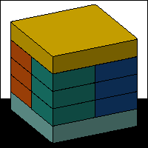
Brandon Muramatsu NEEDS Project Director
NEEDS — The National Engineering Education Delivery System
Today and in the Future
Originally Published 1998. Republished 2013. This work is licensed under a Creative Commons Attribution-Noncommercial-Share Alike 3.0 United States License (http://creativecommons.org/licenses/by-nc-sa/3.0/us/)

Slide 2
Agenda
Vision
Action Agenda and Digital Libraries Initiative - Phase 2
Premier Award
Cataloging
Intercoalitions Workshop Idea

Slide 3
Vision
Develop a global digital library and community of learners in Science, Mathematics, Engineering and Technology Education (SMETE).
To do this we build upon our experience with NEEDS — the National Engineering Education Delivery System — as the foundation for the SMETE Digital Library coupled with on-going research.

Slide 4
Achieving our Vision
SMETE
Digital Library
Digital Library Research
Science and
Math Content
Engineering Content
And New Services
NEEDS
Develop a global digital library and community of learners in Science, Mathematics, Engineering and Technology Education (SMETE).

Slide 5
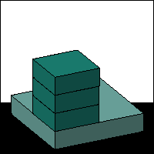
NEEDS
Berkeley
UMBC
Stanford
Virginia
Tech
Northern
Arizona
Oklahoma
Goals
Provide a service to the
engineering education community
Grow and evolve NEEDS as the foundation
for an on-line engineering education community
Expand courseware review and evaluation efforts
Serve as a bridge to the development of a
SMET Digital National Library
Engineering

Slide 6
Expanding NEEDS Services to develop the Foundation for an On-line Community
User and Author Services
User reviews of courseware
User-provided links to related information
On-line discussion
Adoption/Adaptation Usage statistics for the author
NEEDS Services
Extended Usage Tracking
User Registration and Profiles
Engineering

Slide 7
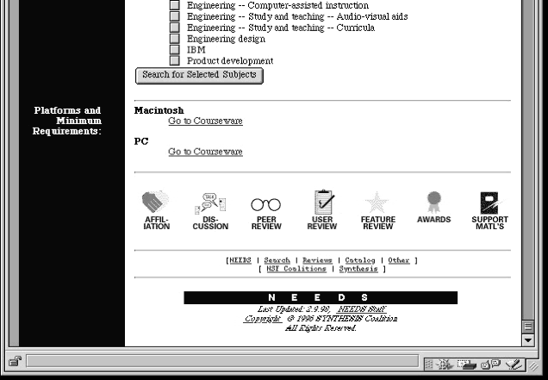
New Services Available from Catalog Records
Affiliations
Discussion
Peer Review
User Review
Feature Review
Awards
Support Materials
Engineering

Slide 8
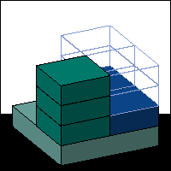
Using NEEDS as the Foundation for a Test-bed SMETE Digital Library
Develop a test-bed SMETE Digital Library using NEEDS as a foundation
Partnership with the University of California System
Begin development of a SMETE on-line user community
Evaluate the test-bed SMETe Digital Library
SMETE

Slide 9
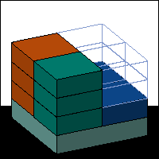
Digital Library Research
Develop a controlled vocabulary for SMET education
Apply this Controlled Vocabulary as metadata for organizing, indexing and retrieving educational materials stored in NEEDS (as a test-bed SMET Digital Library)
Use courseware in NEEDS and the Controlled Vocabulary to structure discussion among our community of learners
Research

Slide 10
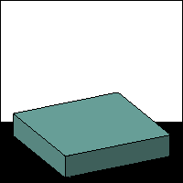
Premier Award Criteria
Engineering Content
Is the content error free?
Software Design
Is it well designed and usable?
Instructional Design
Will students learn from the courseware?
We recognize that all the categories are interwoven.
NEEDS

Slide 11
Premier Courseware of 1998 - Preview
Della Steam Plant
By P. K. Raju and Chetan Sankar at Auburn University
MDSolids
By Timothy Philpot at Murray State University
SEVE-UNH
Robert M. Henry at the University of New Hampshire
Distribution
2000 CD-ROMs
To be announced at an
Awards Luncheon sponsored by
John Wiley & Sons
NEEDS

Slide 12
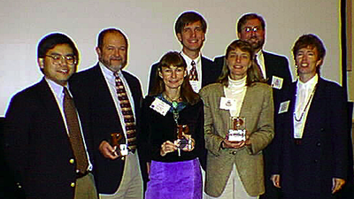
Premier Courseware of 1997
Virtual Disk Drive
Design Studio
Drill Dissection and Bicycle Dissection
Mars Navigator
See
http://www.needs.org/premier/1997/
for more info
Distribution - 3000 CD-ROMs
100 Copies to Authors
650 Copies to FIE `97 Participants
300 Copies to Engineering Deans
400 Copies to ASEE `98 Participants
200 Copies to ICEE `98 Participants
200 Copies to FIE `98 Participants
NEEDS

Slide 13
Cataloging Courseware
Cataloging Update
94 items added under Action Agenda
51 items in process
Coalitions Information
Best contact person
Use of logo
Engineering

Slide 14
Intercoalitions Workshop Idea
"Effective uses of Educational Technology to Improve Student Learning in Engineering Education”
Spring 2000?
Engineering

