Slide 1
A Retrospective View of the
Premier Award for
Excellence in Engineering Education -
What Works and the Challenges Ahead
Wayne Anderson, Pamela A. Eibeck,
Flora McMartin, Brandon Muramatsu, and
Joseph Tront
Originally Published 2001. Republished 2013. This work is licensed under a Creative Commons Attribution-Noncommercial-Share Alike 3.0 United States License (http://creativecommons.org/licenses/by-nc-sa/3.0/us/)

Slide 2
Outline
Introduction to NEEDS
History and Overview of the Premier Award for Excellence in Engineering Education Courseware
Lessons Learned
Next Steps

Slide 3
NEEDS
National digital library emerging from Synthesis Coalition (1990)
Integrated database of multimedia courseware (modules - case studies - full courses)
Multilevel courseware evaluation system (peer review, Premier Award for Excellence in Engineering Education Courseware)
Community of Engineering Educators

Slide 4
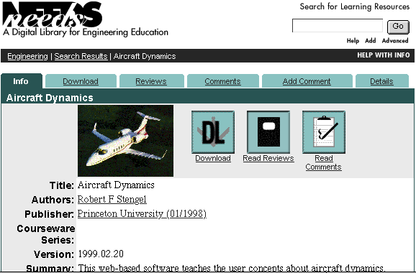
www.needs.org

Slide 5
Premier Award Goals
Enhance Recognition of Scholarly and Creative Effort of Courseware Developers
“Raise the Bar” for Excellence in Engineering Education Courseware

Slide 6
Premier Award Criteria
Instructional Design
Will students learn from the courseware?
Software Design
Is it well designed and usable?
Engineering Content
Is the content well organized?

Slide 7
Premier Courseware of 1997 and 1998
Virtual Disk Drive
Design Studio
Drill Dissection and
Bicycle Dissection
Mars Navigator
Della Steam Plant
MDSolids
Structural Engineering Visual Encyclopedia - UNH

Slide 8
Premier Courseware of 1999 and 2000
Engineering Graphics
Cracking Dams
Project Links
West Point Bridge Designer
For info or to receive copies go to http://www.needs.org/premier/

Slide 9
Recognition for Courseware Developers
Over 9,000 Premier Award CD’s distributed
39 applicants since 1997
10 Awardees
Premier Award courseware consistently in the top 20 most frequently downloaded courseware in NEEDS
Applications for 2001 DUE: July 13

Slide 10
Recognition - continued
Study of PA awardees and non-awardees
Interviews of awardees:
“… it’s amazing, having won the award, how people in my department, all of a sudden, they’re thinking, ‘Maybe, just maybe, he’s doing something that’s of value.’ So the best benefit I’ve received is that I now can say someone else thinks this of value…So that is a tremendous value.”
(Premier Awardee)

Slide 11
Recognition - continued
“It meant a lot to me to get the award and… I kind of have been laboring on my own, and to actually get to go to the conference last year and get a little bit of recognition…you know, it was really nice… my trophy is sitting right on my desk; I look at it all the time. And I’m very pleased with it, and it was very encouraging to continue what I’m doing….”
(Premier Awardee)

Slide 12
Recognition - continued
Survey of non-awardees
70% would apply again
60% believe PA would have positive affect on career
60% thought PA effective way to educate campus administration about the need to reward faculty developing courseware
“We applied for the recognition that such an award brings. There is no direct reward from my university for taking the time to be innovative in course development” (Premier Award Applicant)

Slide 13
“Raise the Bar” for Excellence in Engineering Educational Materials
In 1999 revised scoring method to
Improve reliability
Focus scoring on Instructional Design and student learning through 2 tier scoring process
courseware must meet minimum requirements to be considered in the top tier
Courseware must earn points from 2nd tier to be considered exceptional.

Slide 14
Scoring criteria: Interactivity
The learner is actively involved in the learning process - the interaction enhances learning
Software responds to learner actions
Communication is 2-way
Learners control their own pace
Choices are meaningful
Interactivity is enhanced if:
Learners solve relevant problems
System adapts based on learner actions

Slide 15
Demonstrating Excellence
Award winning courseware addresses:
Higher level cognitive skills
Critical thinking
Problem solving
Design
Real life engineering situations, case studies
Simulations and experimentation

Slide 16
Demonstrating Excellence, continued
Adaptable to multiple learning levels, institutional goals, learning situations (classrooms, self learning)
Addresses different learning styles
Visualization, animation
Numerical, descriptive
Practice problems, interactive games
Includes information to support adaptation
Student reviews
Instructor’s guides

Slide 17
In sum….
Premier Award has a positive impact on awardee careers.
Premier Award software is highly regarded by engineering faculty and popular.
The quality of Premier Award applications appear to be rising.

Slide 18
Next Steps
In partnership with SMETE.ORG, NEEDS is:
Expanding the use of the Premier Award criteria to other SMET disciplines, e.g.,
JOMA - Journal of Online Mathematics and its Applications
Build on Premier Award criteria by partnering with MERLOT to establish and conduct a joint peer review program

