Slide 1
The Best of Both Worlds: Transforming OpenCourseWare in the age of Interactivity
Peter Pinch, pdpinch@mit.edu
Brandon Muramatsu, mura@mit.edu
Cite as: Pinch. P. & Muramatsu, B. (2014, November). The Best of Both Worlds: Transforming OpenCourseWare in the Age of Interactivity. Open Education Conference 2014. Crystal City, VA.
Notes:
Cite as: Pinch. P. & Muramatsu, B. (2014, November). The Best of Both Worlds: Transforming OpenCourseWare in the Age of Interactivity. Open Education Conference 2014. Crystal City, VA.

Slide 2
Background

Slide 3
Content and Assessment are Separate
OER Content
Videos
Lectures
Textbooks
Webpages
Assessments
OER Assessments
“Easy to Share”
Static / Isolated
Separate Quiz
and Test Systems
The Challenge

Slide 4
The Potential?
Do for assessments and items, what’s been done for content (whole courses, lectures, videos)
Embed anywhere
Share
Don’t reinvent the wheel for every course
Evaluate, record and track Responses
Scale –> More use of items/assessments for validity
May lead to evidence of impact?

Slide 5
Focus: Formative Assessment
Putting mechanisms for students to check their understanding / mastery of concepts directly in course materials
Primarily for formative (self-check, understanding) not summative (exams or formal assignments)

Slide 6
What’s done today in OER with formative assessment?

Slide 7
Saylor.org Precalculus II
www.saylor.org
www.saylor.org
Course Assessments
http://www.saylor.org/courses/ma003/?ismissing=0&resourcetype=4
Credit: Saylor Foundation, CC BY
Credit: Saylor Foundation, CC BY

Slide 8
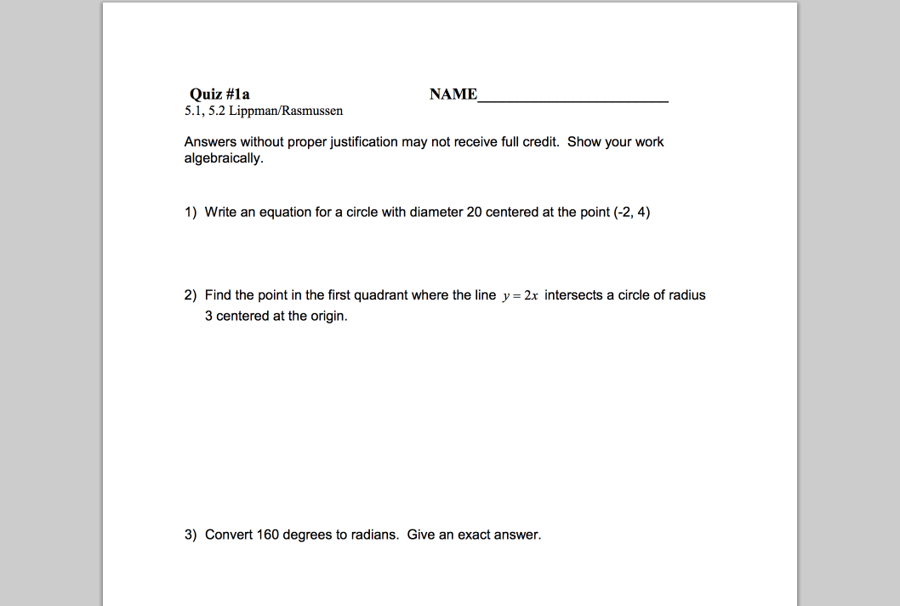
Saylor.org – “Assessment”
http://www.saylor.org/site/wp-content/uploads/2011/11/MA003-1.2.5-PART2.pdf
Credit: Washington SBCTC, CC BY

Slide 9
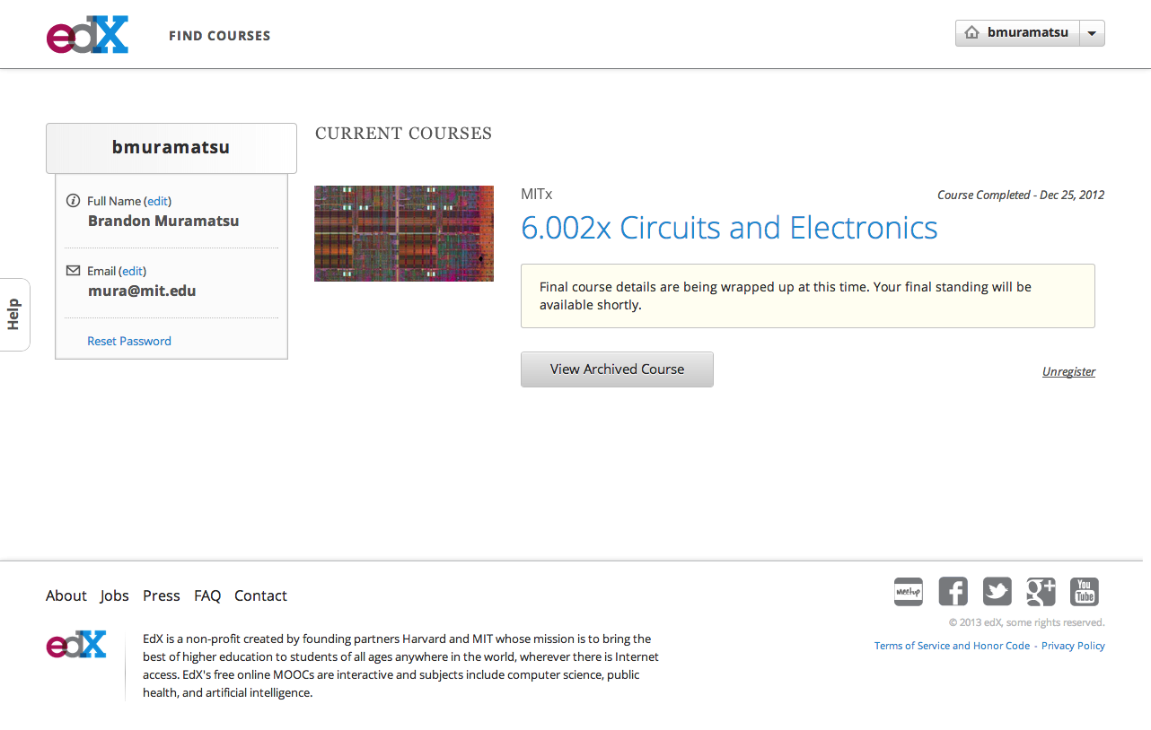
Unless otherwise specified this work is licensed under a Creative Commons Attribution 3.0 License.

Slide 10
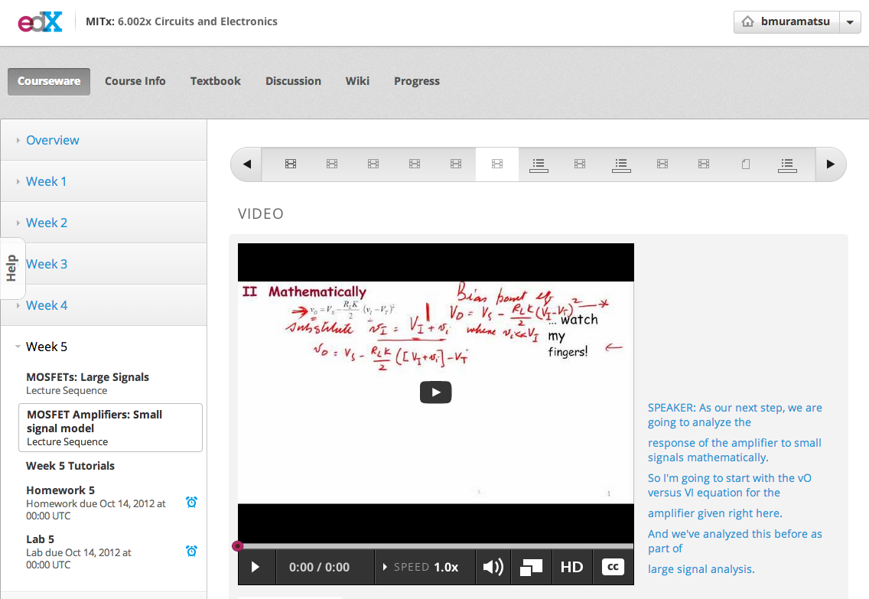
6.002x
Unless otherwise specified this work is licensed under a Creative Commons Attribution 3.0 License.

Slide 11
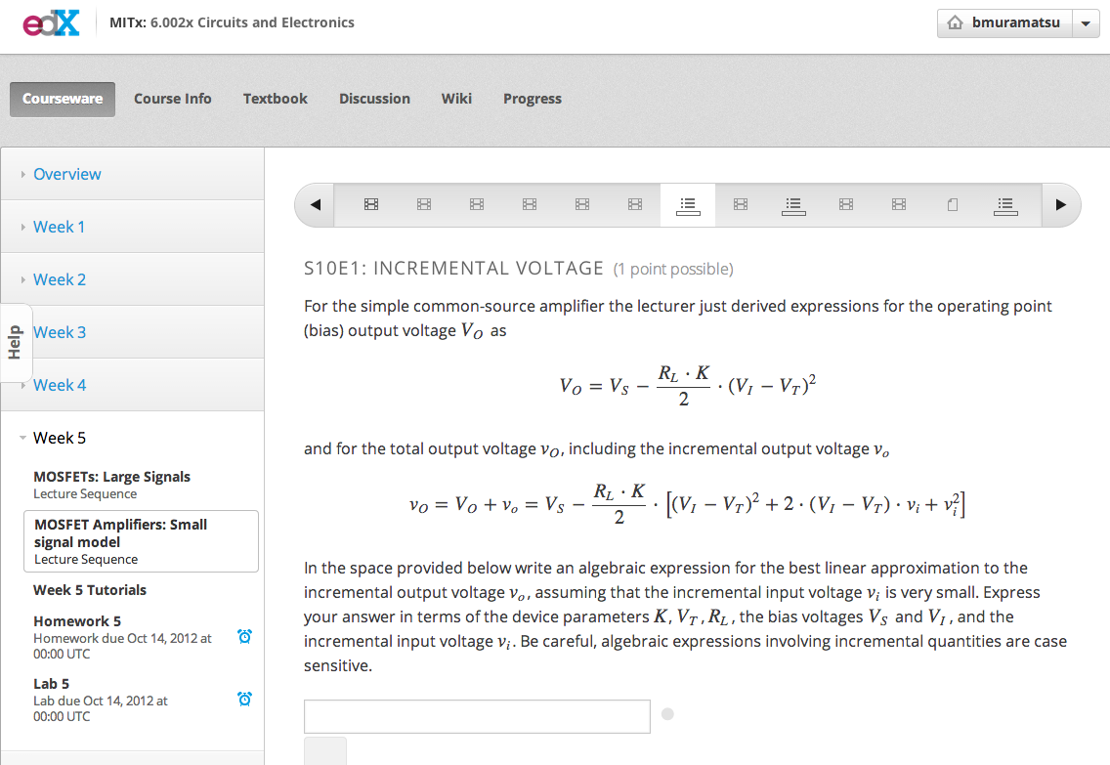
6.002x
Unless otherwise specified this work is licensed under a Creative Commons Attribution 3.0 License.

Slide 12
Our Approach: OpenAssessments.org

Slide 13
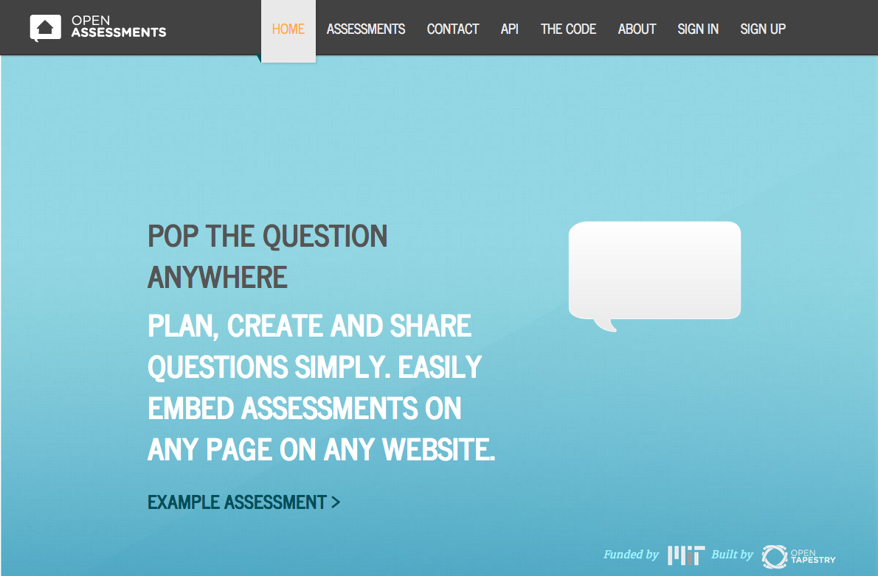
openassessments.org
Unless otherwise specified this work is licensed under a Creative Commons Attribution 3.0 License.

Slide 14
What is OpenAssessments.org?
Embed an assessment in any web content
Focus on formative assessments
Start with limited question types
Multiple-choice/single answer
Numerical answer
Short answer

Slide 15
How do you use it?
Create a question in a standardized format
Typically using IMS Question & Test Interoperability spec
Likely created in your learning management system
Put the question on a public web server
Copy and paste the URL to the question file
Viola — Open Embedded Assessment!

Slide 16
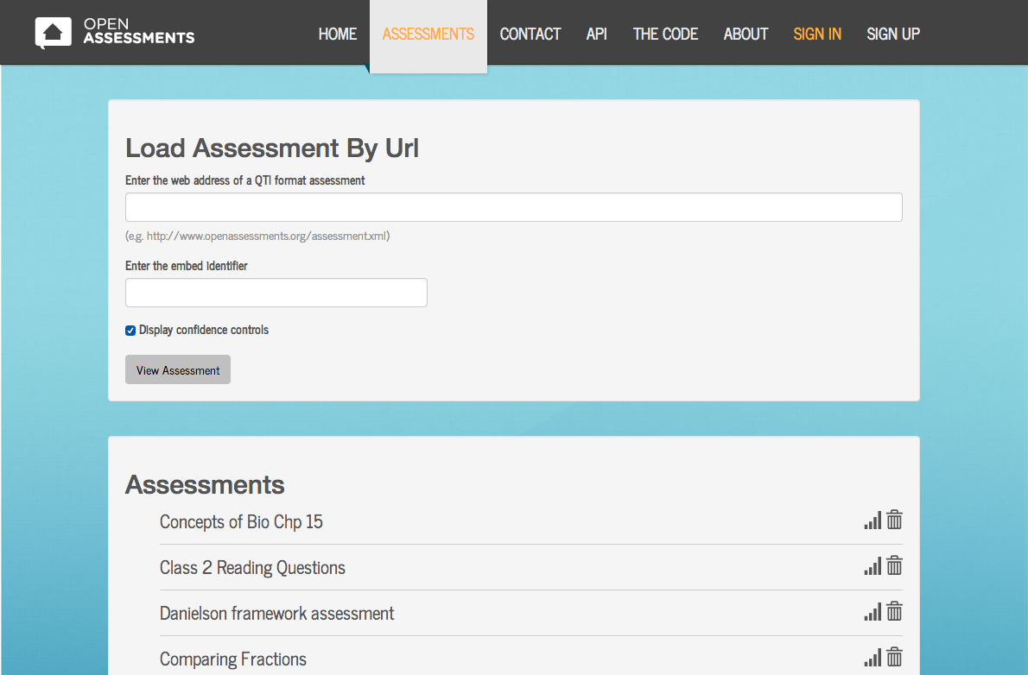

Slide 17
Using Open Embedded Assessments in MIT OpenCourseWare

Slide 18
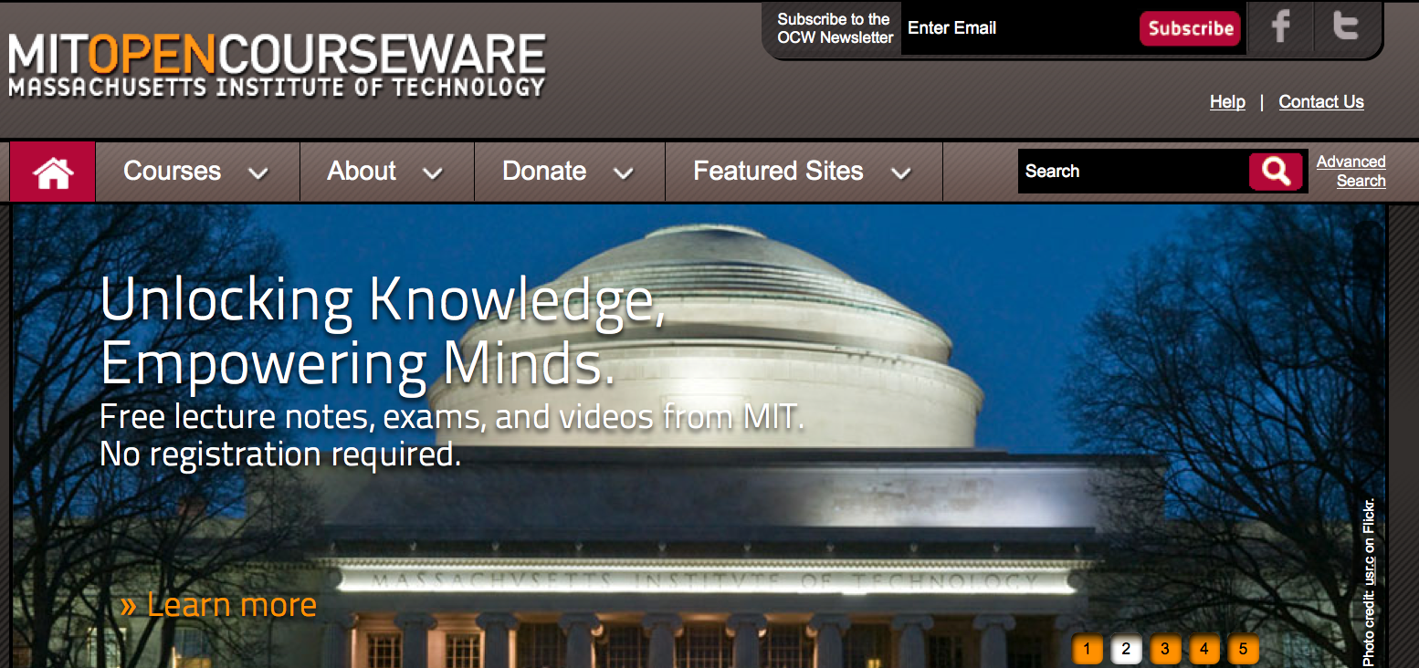
MIT OpenCourseWare
Unlocking Knowledge > 2,240 courses
120-150 new course each year
Materials taken directly from the classroom and published online
No certification
No registration
Completely Free

Slide 19
Why does MIT make OCW the way it does?
Many courses aren’t born digital
Minimizing faculty effort
Maximizing accessibility
Easing distribution
Simple maintenance
… and it’s not all static
Notes:
• or at least, not experienced digitally by students. And the the parts that are digital are the most cutting edge parts – which run into problems elsewhere
• We publish about 150 courses per year the goal for faculty is no more than 5 hours to get a course published
• that’s “little a accessibility,” meaning we try to avoid demanding software. As it is, we still distribute java apps, which are hard to install and run, and things like uncompiled matlab files
• we strongly prefer client-side technology – HTML, CSS, JavaScript – so that users can download it and redistribute it with little fuss
• We have few resources to go back and fix things, so you when you encounter interactivity, I always have to ask myself “how long before this breaks”

Slide 20
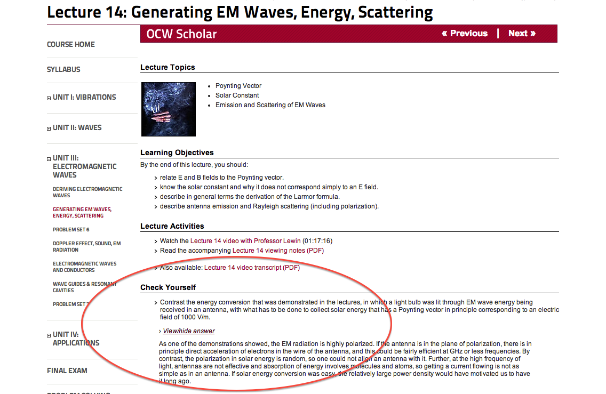
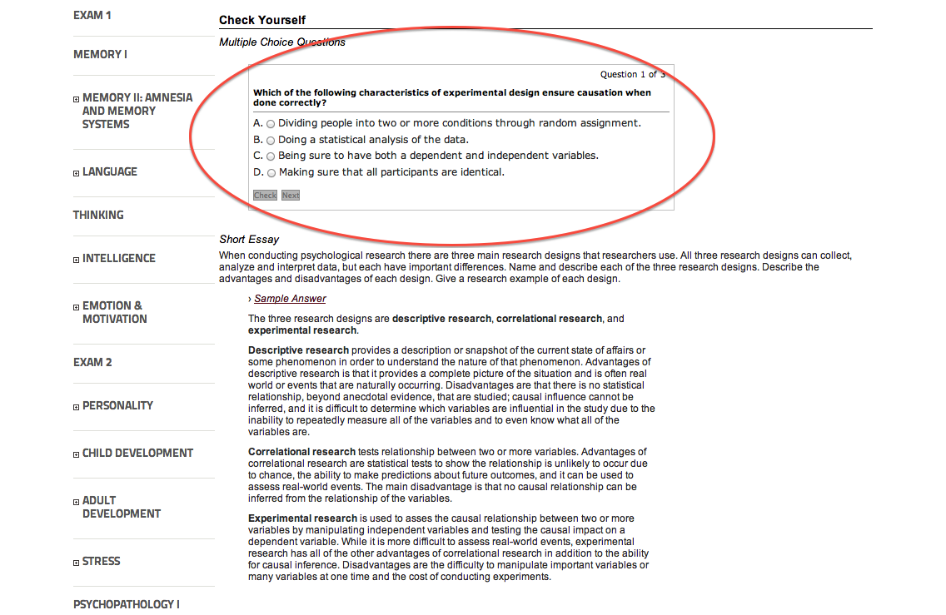
OCW Scholar – 8.03SC
Lewin, Walter, Wit Busza, George Stephans, and Martin Connors. 8.03SC Physics III: Vibrations and Waves, Fall 2012. (MIT OpenCourseWare: Massachusetts Institute of Technology), http://ocw.mit.edu/courses/physics/8-03sc-physics-iii-vibrations-and-waves-fall-2012 (Accessed 7 Nov, 2013). License: Creative Commons BY-NC-SA
Notes:
http://ocw.mit.edu/courses/physics/8-03sc-physics-iii-vibrations-and-waves-fall-2012/unit-iii-electromagnetic-waves/lecture-14/
Simple hide/reveal problem, written in JavaScript.

Slide 21
OCW Scholar – BCS9.00SC
Gabrieli, John. 9.00SC Introduction to Psychology, Fall 2011. (MIT OpenCourseWare: Massachusetts Institute of Technology), http://ocw.mit.edu/courses/brain-and-cognitive-sciences/9-00sc-introduction-to-psychology-fall-2011 (Accessed 7 Nov, 2013). License: Creative Commons BY-NC-SA
Notes:
http://ocw.mit.edu/courses/brain-and-cognitive-sciences/9-00sc-introduction-to-psychology-fall-2011/science-research/
Simple Multiple-choice problem, written in JavaScript.
However, it must be noted that these examples are from Scholar courses, which have additional production resources. This are actually “born digital” courses.

Slide 22
What happens when an MIT course is born digital?
MITx residential course; not a MOOC
Interactive reading questions
Problem set “checker”
Written in OLX
Notes:
18.05 was taught in the spring of 2014. It’s an introductory course on probability and statistics from a mathematics perspective. It used our residential version of open edX to offer students reading questions and a problem set checker. Students couldn’t do the problem set online, but they could use the checker to confirm the accuracy of their numeric responses.

Slide 23
What happens when an MIT course is born digital?
Notes:
Works in MITx: 78*6*6*11*4/2598960
Doesn’t work in MITx: 78*6*6*11*4 / (52! / (5! * (52-5)!))

Slide 24
Open Learning XML (OLX)
<problem url_name="ps1-check" showanswer="closed" rerandomize="never" weight="0" display_name="Check pset 1 answers">
<text>
<p>Probabality of two-pair:<br/>
<numericalresponse answer=".047539">
<textline>
<responseparam type="tolerance" default="0.001"/>
</textline>
</numericalresponse>
</p>
</text>
</problem>
Notes:
18.05 used OLX to author the course. Raises the question of, how can we transform this to make something interactive.
This is a little more complex in reality, because the OLX code gets spread across multiple, linked files.

Slide 25
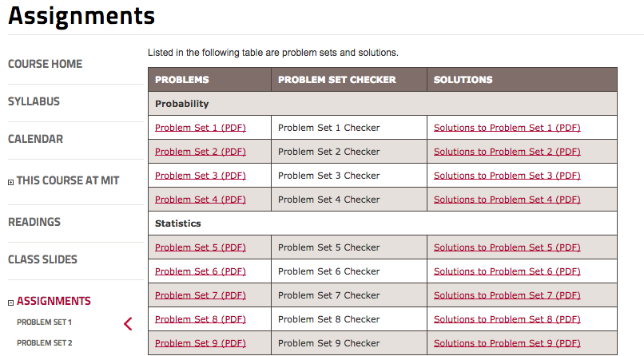
What happens when an MIT professor makes OCW?
Notes:
So the Math professor wrote his own transform from OLX to JavaScript. It works beautifully, but it has some of the same issues with earlier OCW JavaScript interactivity. It’s difficult to re-use – especially because students need to reference the PDF. We have no way to track user performance.

Slide 26
What happens when an MIT professor makes OCW?
Notes:
So the Math professor wrote his own transform from OLX to JavaScript. It works beautifully, but it has some of the same issues with earlier OCW JavaScript interactivity. It’s difficult to re-use – especially because students need to reference the PDF. We have no way to track user performance.

Slide 27
What happens when an MIT professor makes OCW?
Notes:
So the Math professor wrote his own transform from OLX to JavaScript. It works beautifully, but it has some of the same issues with earlier OCW JavaScript interactivity. It’s difficult to re-use – especially because students need to reference the PDF. We have no way to track user performance.

Slide 28
But can we make it reusable?

Slide 29
Embedded in MIT OpenCourseWare

Slide 30
How it works
We pass a URL for the raw OLX code to the open assessments web application:
http://www.openassessments.com/assessments/load?utf8=✓src_url=http://…/courses/mathematics/18-05-introduction-to-probability-and-statistics-spring-2014/sequential/ps1.xml
And then to embed it in MIT OCW, we use an iframe:
<iframe style="width: 100%; height: 600px;" src="http://www.openassessments.com/assessments/load?utf8=✓&style=ocw&src_url=http://…/courses/mathematics/18-05-introduction-to-probability-and-statistics-spring-2014/sequential/ps1.xml">

Slide 31
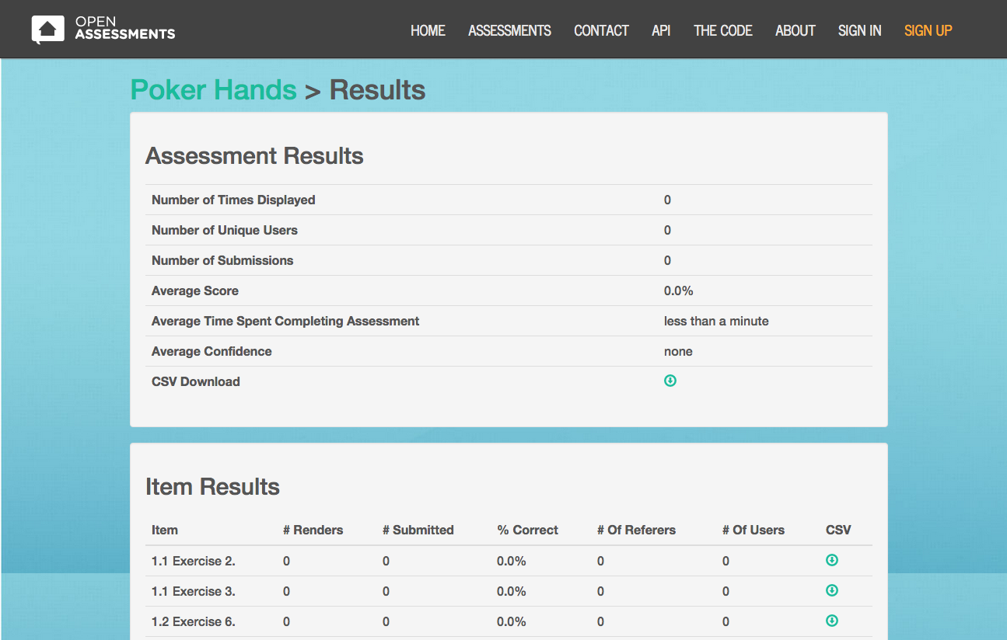
Analytics (Mockup)

Slide 32
Related and Future Work
Increasing use
Open Item Banks
Use in Lumen Learning-developed OER course
Extending to additional MIT OCW courses
Extending functionality
Additional question types, especially parameterized/interactive ones
How will use use it? openassessments.org

