Slide 1
Opening up Assessment: Open Tools and Item Banks
Brandon Muramatsu, mura@mit.edu
Justin Ball, justin@opentapestry.com
David Wiley, david.wiley@gmail.com
Joel Duffin, joel@opentapestry.com
Jeff Merriman, merriman@mit.edu
Cite as: Muramatsu, B., Ball, J., Duffin, J., Wiley, D. & Merriman, J. (2013, November). Opening up assessment: Open tools and item banks. Open Education 2013. Park City, UT.
Unless otherwise specified this work is licensed under a Creative Commons Attribution 3.0 License.
1
Notes:
Cite as: Muramatsu, B., Ball, J., Duffin, J., Wiley, D. & Merriman, J. (2013, November). Opening up assessment: Open tools and item banks. Open Education 2013. Park City, UT.
Unless otherwise specified this work is licensed under a Creative Commons Attribution 3.0 License.
1

Slide 2
openassessments.org
Unless otherwise specified this work is licensed under a Creative Commons Attribution 3.0 License.

Slide 3
Content and Assessment are Separate
OER Content
Videos
Lectures
Textbooks
Webpages
Assessments
Current State of
OER Assessments
PDF Files
Static
Contained in Separate Quiz
& Test Systems
The Challenge

Slide 4
The Potential?
Do for assessments and items, what’s been done for content (whole courses, lectures, videos)
Embed Anywhere
Share
Don’t reinvent the wheel for every course
Evaluate, Record and Track Responses
Scale ➔ More use of items/assessments for validity
May lead to evidence of impact?

Slide 5
Focus: Formative Assessment
Putting mechanisms for students to check their understanding / mastery of concepts directly in course materials
Primarily for formative (self-check, understanding) not summative (exams or formal assignments)

Slide 6
What’s done today in OER with embedded formative assessment?

Slide 7
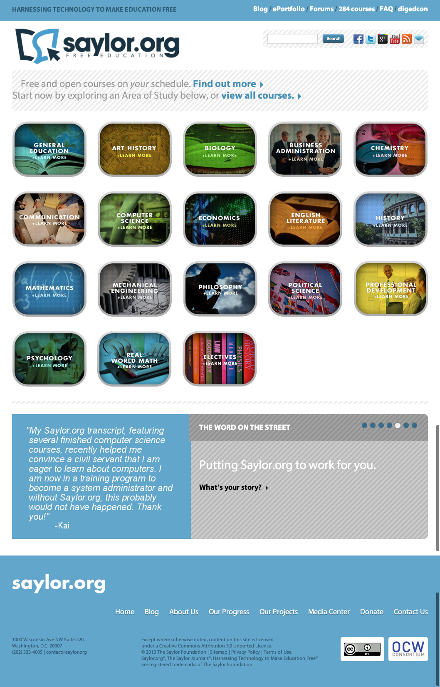
Saylor Foundation – saylor.org
www.saylor.org
Credit: Saylor Foundation, CC BY

Slide 8
Saylor.org Precalculus II
www.saylor.org
Course Assessments
http://www.saylor.org/courses/ma003/?ismissing=0&resourcetype=4
Credit: Saylor Foundation, CC BY

Slide 9
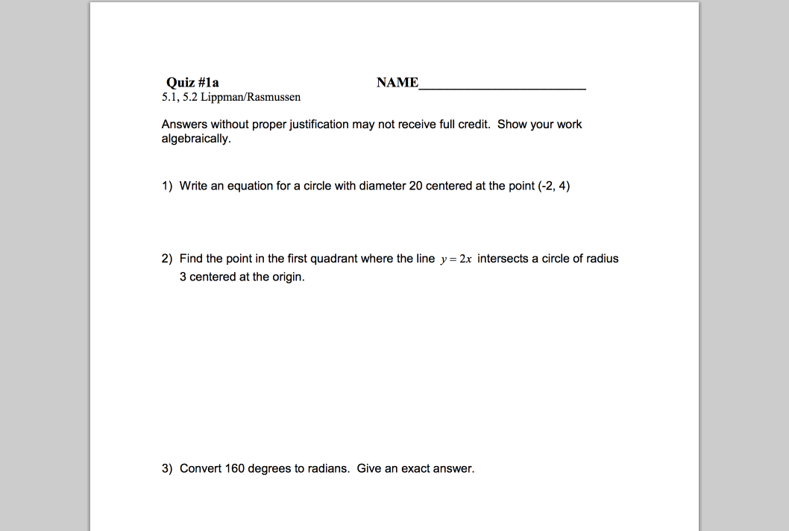
Saylor.org – “Assessment”
http://www.saylor.org/site/wp-content/uploads/2011/11/MA003-1.2.5-PART2.pdf
Credit: Washington SBCTC, CC BY

Slide 10
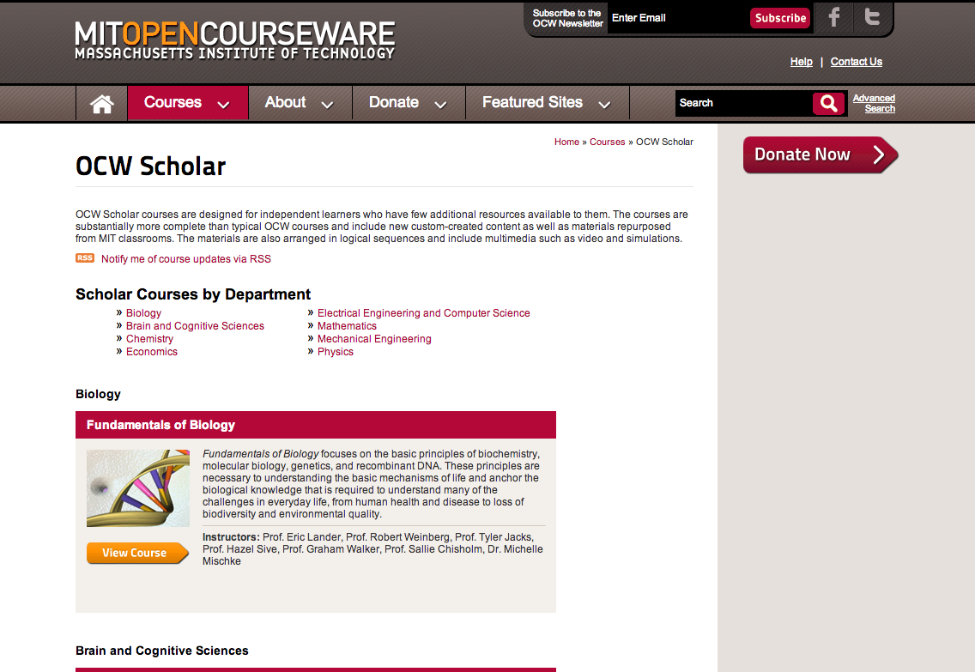
MIT OpenCourseWare: Massachusetts Institute of Technology, http://ocw.mit.edu/courses/ocw-scholar/ (Accessed 7 Nov, 2013). License: Creative Commons BY-NC-SA

Slide 11
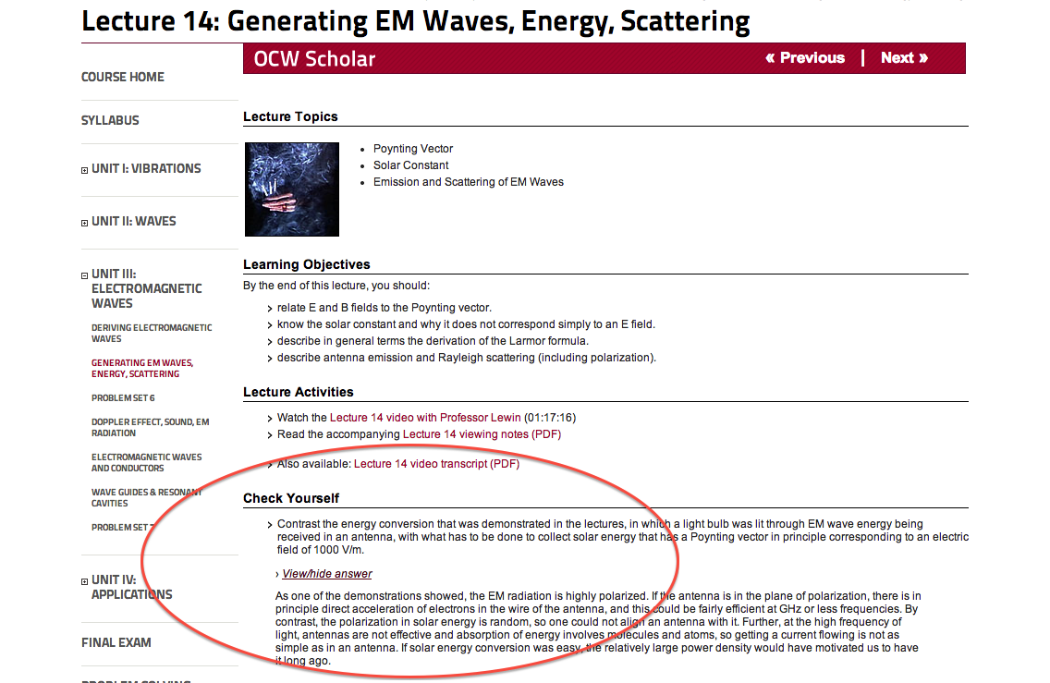
OCW Scholar – 8.03SC
Lewin, Walter, Wit Busza, George Stephans, and Martin Connors. 8.03SC Physics III: Vibrations and Waves, Fall 2012. (MIT OpenCourseWare: Massachusetts Institute of Technology), http://ocw.mit.edu/courses/physics/8-03sc-physics-iii-vibrations-and-waves-fall-2012 (Accessed 7 Nov, 2013). License: Creative Commons BY-NC-SA

Slide 12
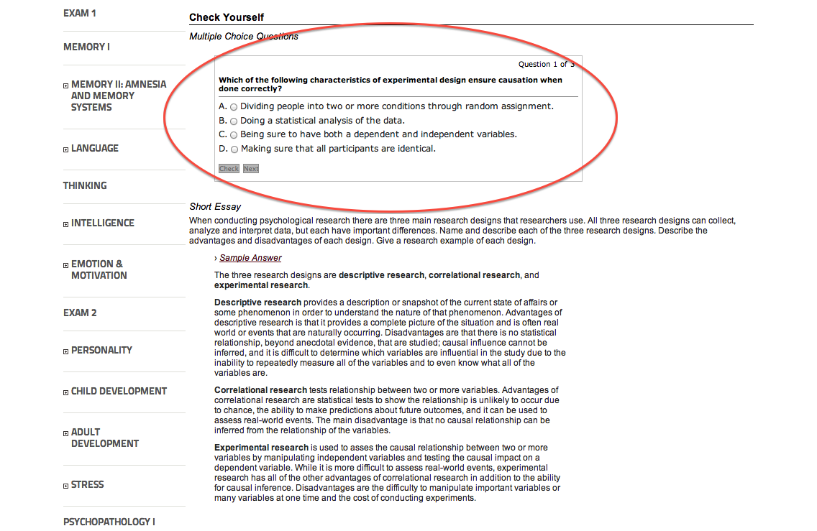
OCW Scholar – BCS9.00SC
Gabrieli, John. 9.00SC Introduction to Psychology, Fall 2011. (MIT OpenCourseWare: Massachusetts Institute of Technology), http://ocw.mit.edu/courses/brain-and-cognitive-sciences/9-00sc-introduction-to-psychology-fall-2011 (Accessed 7 Nov, 2013). License: Creative Commons BY-NC-SA

Slide 13
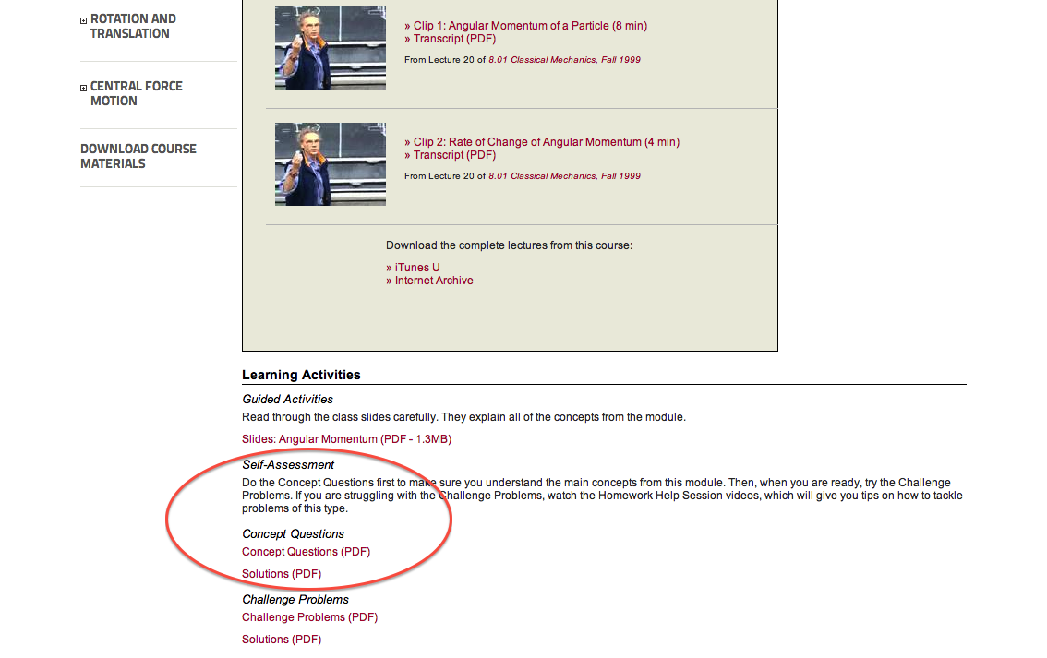
OCW Scholar – 8.01SC
Lewin, Walter, Peter Dourmashkin, Thomas Greytak, Craig Watkins, Andy Neely, Sahana Murthy, J. Litster, and Matthew Strafuss. 8.01SC Physics I: Classical Mechanics, Fall 2010. (MIT OpenCourseWare: Massachusetts Institute of Technology), http://ocw.mit.edu/courses/physics/8-01sc-physics-i-classical-mechanics-fall-2010 (Accessed 7 Nov, 2013). License: Creative Commons BY-NC-SA

Slide 14
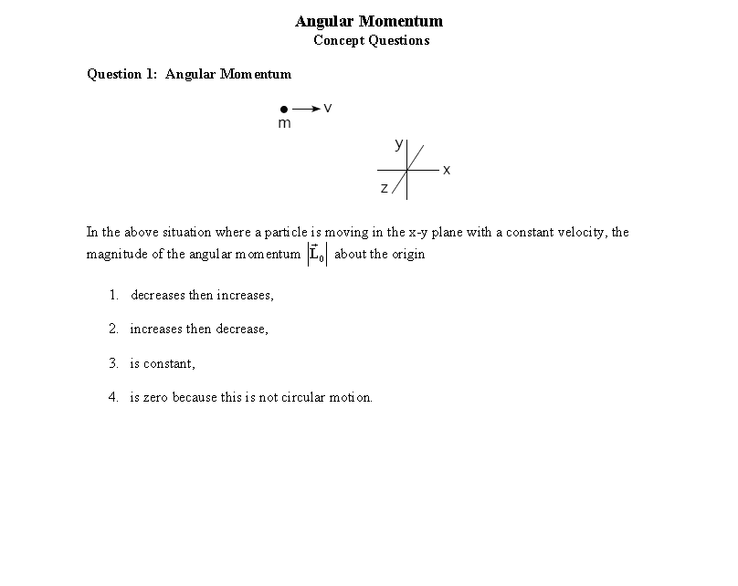
Lewin, Walter, Peter Dourmashkin, Thomas Greytak, Craig Watkins, Andy Neely, Sahana Murthy, J. Litster, and Matthew Strafuss. 8.01SC Physics I: Classical Mechanics, Fall 2010. (MIT OpenCourseWare: Massachusetts Institute of Technology), http://ocw.mit.edu/courses/physics/8-01sc-physics-i-classical-mechanics-fall-2010 (Accessed 7 Nov, 2013). License: Creative Commons BY-NC-SA

Slide 15
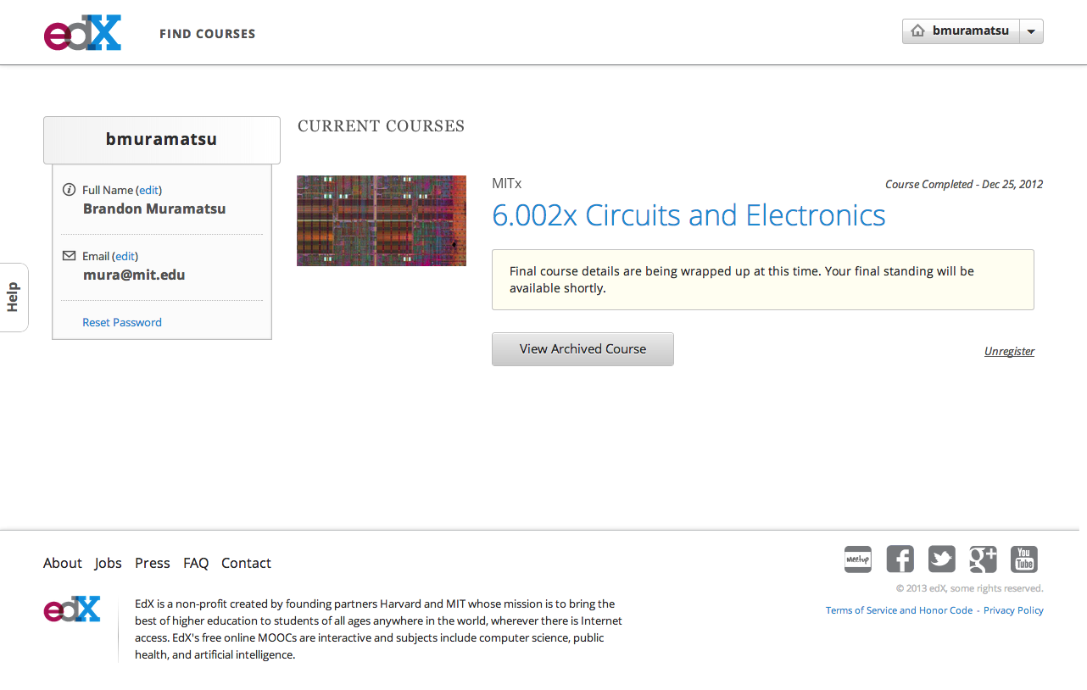
Unless otherwise specified this work is licensed under a Creative Commons Attribution 3.0 License.

Slide 16
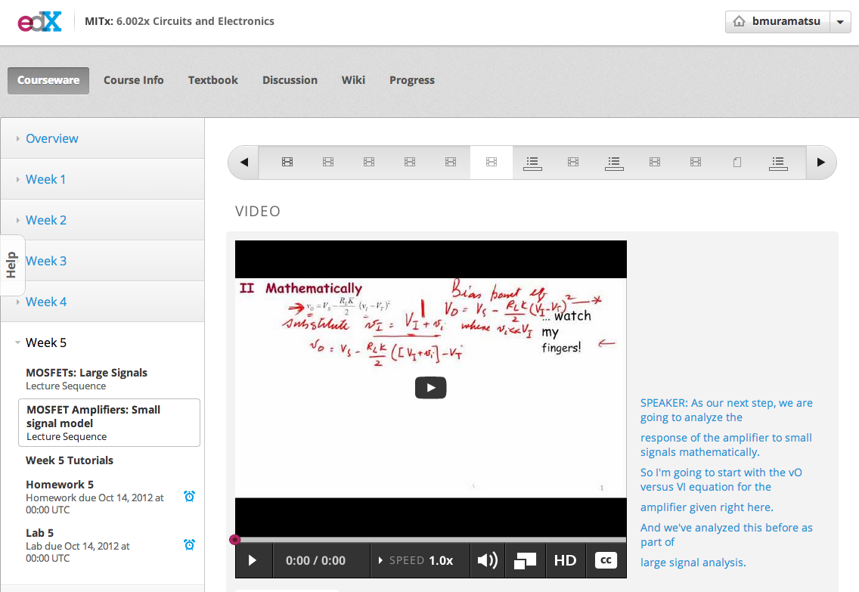
6.002x
Unless otherwise specified this work is licensed under a Creative Commons Attribution 3.0 License.

Slide 17
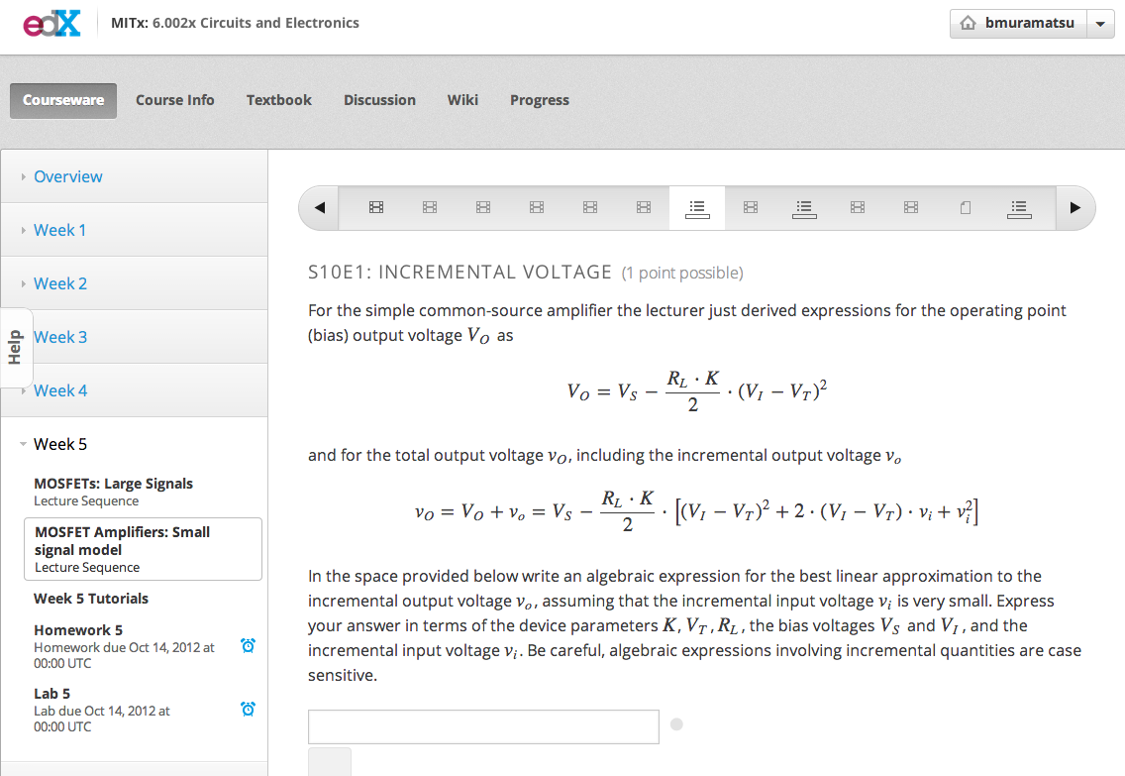
6.002x
Unless otherwise specified this work is licensed under a Creative Commons Attribution 3.0 License.

Slide 18
Our Approach OpenAssessments.org

Slide 19
openassessments.org
Unless otherwise specified this work is licensed under a Creative Commons Attribution 3.0 License.

Slide 20
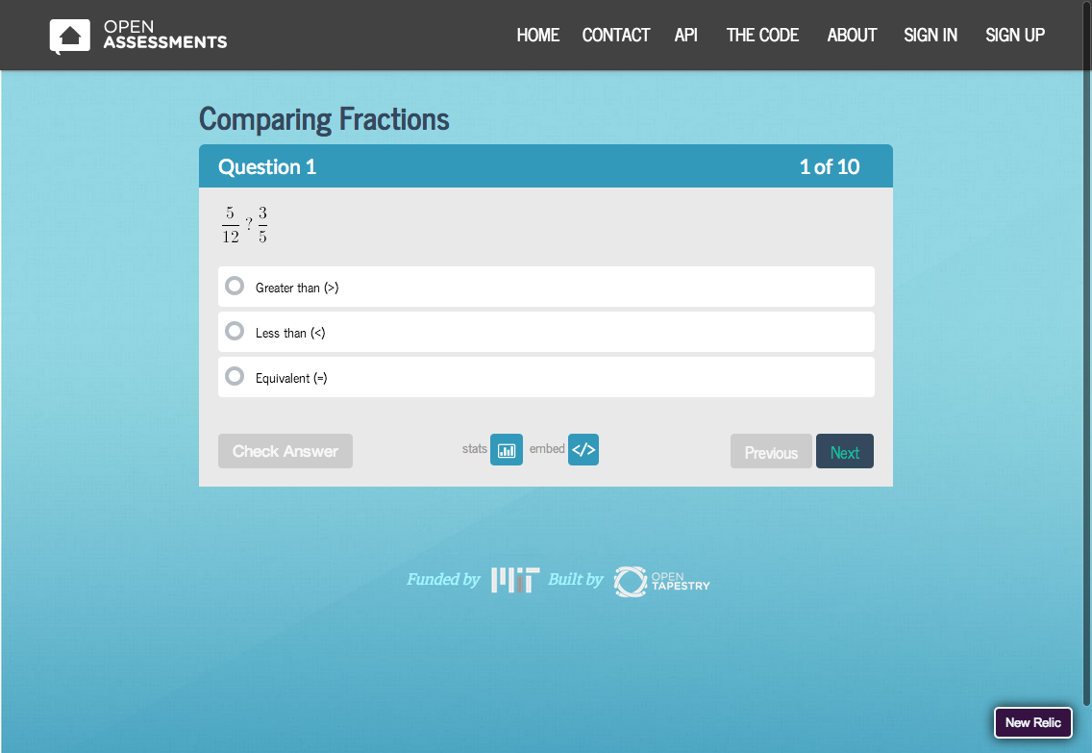
openassessments.org
Unless otherwise specified this work is licensed under a Creative Commons Attribution 3.0 License.

Slide 21
Proof-of-Concept
OpenAssessments.org
Embed an assessment in any web content
Focus on formative assessments
Start with limited question types (multiple-choice/single answer, short answer)

Slide 22
Demo! (cross your fingers)
Justin Ball

Slide 23
Where might we embed assessments?

Slide 24
OERPub – Real Remix Realized
Notes:
Fletcher, K. (2013). Real Remix Revisited. Open Education 2013. Park City, UT. Retrieved from: bit.ly/fletcher-opened13
CC-By

Slide 25
OERPub – Learning Content
Notes:
Fletcher, K. (2013). Real Remix Revisited. Open Education 2013. Park City, UT. Retrieved from: bit.ly/fletcher-opened13
CC-By

Slide 26
OERPub – Transmogrified
Notes:
Fletcher, K. (2013). Real Remix Revisited. Open Education 2013. Park City, UT. Retrieved from: bit.ly/fletcher-opened13
CC-By

Slide 27
OERPub – Everywhere
Notes:
Fletcher, K. (2013). Real Remix Revisited. Open Education 2013. Park City, UT. Retrieved from: bit.ly/fletcher-opened13
CC-By

Slide 28
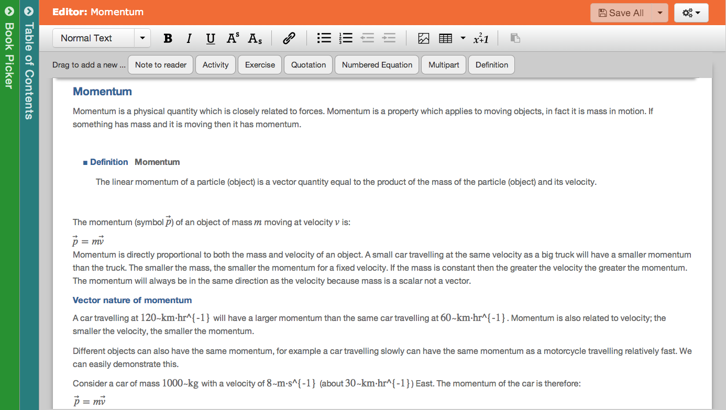
OERPub TextBook Editor - Momentum
Unless otherwise specified this work is licensed under a Creative Commons Attribution 3.0 License.

Slide 29
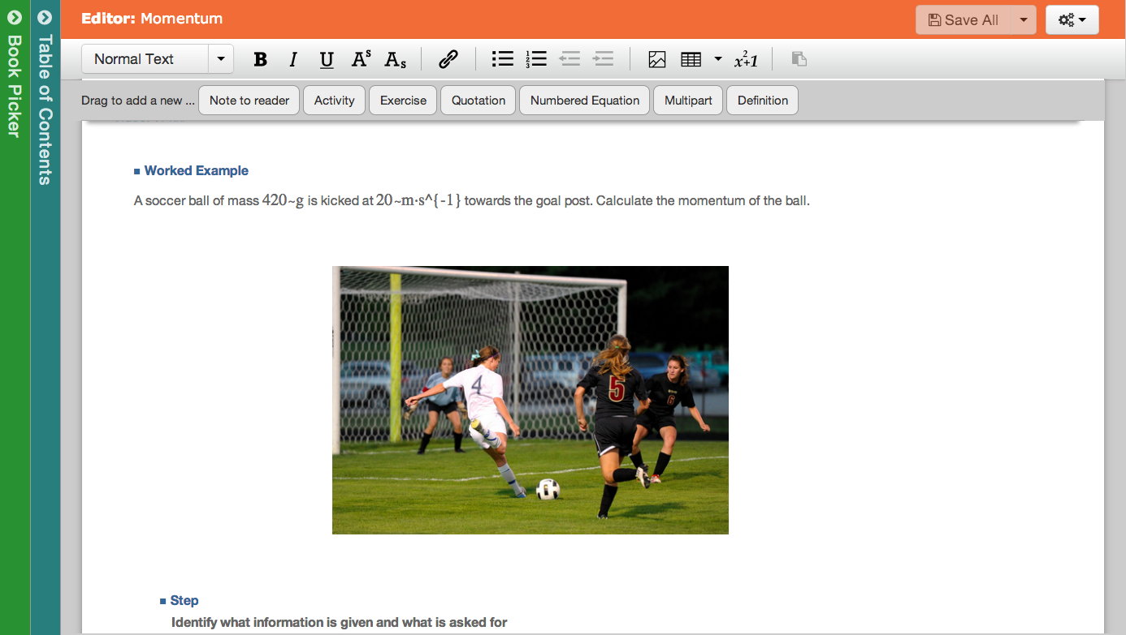
OERPub TextBook Editor – Worked Example
Unless otherwise specified this work is licensed under a Creative Commons Attribution 3.0 License.

Slide 30
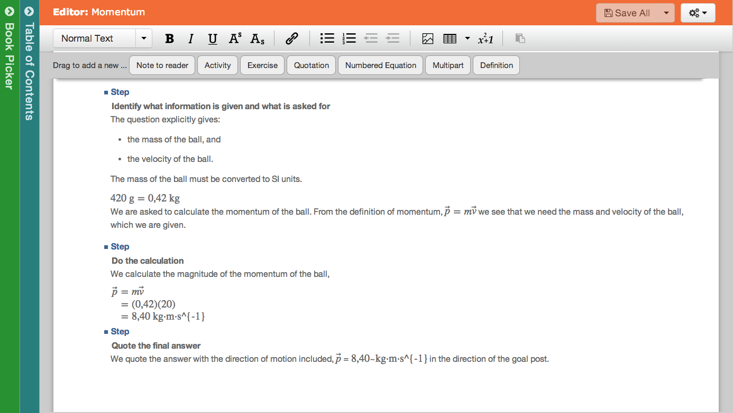
OERPub TextBook Editor – Worked Example Continued
Unless otherwise specified this work is licensed under a Creative Commons Attribution 3.0 License.

Slide 31
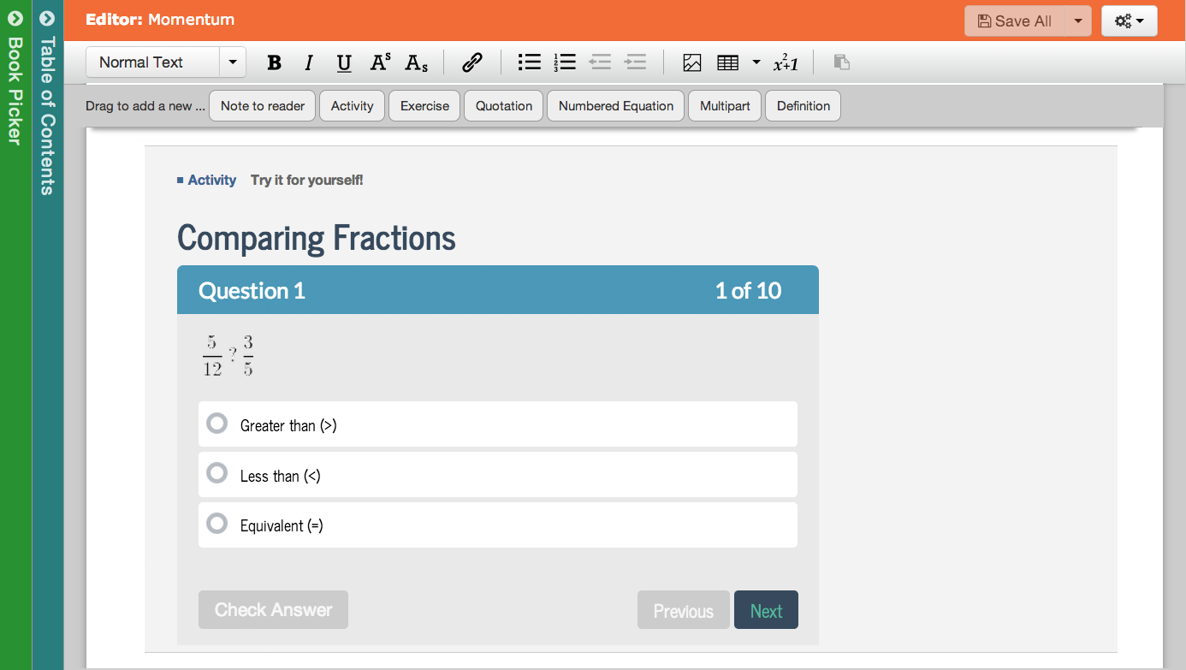
OERPub TextBook Editor – With Embedded Assessment
Unless otherwise specified this work is licensed under a Creative Commons Attribution 3.0 License.

Slide 32
Open Item Banks
David Wiley
Bueller?... Bueller?... Bueller?...

Slide 33
Opening up Assessment: Open Tools and Item Banks
Brandon Muramatsu, mura@mit.edu
Justin Ball, justin@opentapestry.com
David Wiley, david.wiley@gmail.com
Joel Duffin, joel@opentapestry.com
Jeff Merriman, merriman@mit.edu
Cite as: Muramatsu, B., Ball, J., Duffin, J., Wiley, D. & Merriman, J. (2013, November). Opening up assessment: Open tools and item banks. Open Education 2013. Park City, UT.
Unless otherwise specified this work is licensed under a Creative Commons Attribution 3.0 License.
33
Notes:
Cite as: Muramatsu, B., Ball, J., Duffin, J., Wiley, D. & Merriman, J. (2013, November). Opening up assessment: Open tools and item banks. Open Education 2013. Park City, UT.
Unless otherwise specified this work is licensed under a Creative Commons Attribution 3.0 License.
33

