Slide 1
CLIx Connected Learning Initiative
A bold and innovative partnership
between
Tata Groups (Tata Trust, Tata Institute of Social Sciences Center for Education Innovation and Action Research) and Massachusetts Institute of Technology
Brandon Muramatsu and Rita Sahu
[Office of Digital Learning, MIT]
November 18, 2015

Slide 2
Goal of Collaboration
To improve the professional & academic prospects of high school students in underserved communities in India
Scope (3 years): 150,000 students, 1,000 schools, 2700 teachers
That will help provide sustainable quality learning experiences at scale in English, Mathematics, and Science (Physics, Chemistry, Biology)
By incorporating thoughtful pedagogical design & contemporary technology

Slide 3
Key Outcomes
To raise social capital and expand educational opportunities for India’s youth substantially and positively
To provide continuous professional development for teachers via content knowledge pedagogy, teaching skills, and digital literacy
Arrive at a model that can have global relevance

Slide 4
Motivation
A number of studies of elementary schooling have established poor learning levels across states and school systems
by the end of grade VIII, about 20% have developed critical abilities that enhance their life opportunities and employability
a severe undersupply and shortage of Science, Mathematics, and English teachers
Teacher Education continues to remain conservative and resistant to modernization
children constitute over one-third of India’s population of approx. 1.2 billion people, which means India is home to 400 million children > every sixth child in the world lives in India
Timing and climate are right to trigger changes
The National Assessment Survey by NCERT (National Council of Educational Research and Training)

Slide 5
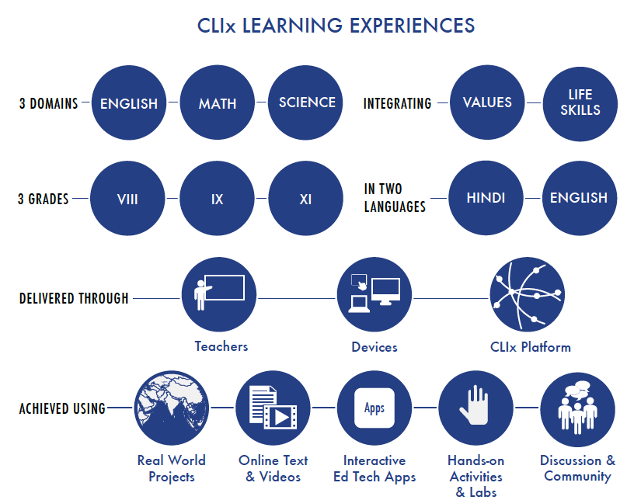
Focus > conceptual understanding and application of foundational concepts through active learning > emphasis will be on “Learning by Doing”

Slide 6
Multiple elements for delivering learning experiences and professional development at scale and for providing support for the learning communities

Slide 7
CLIx Ecosystem
Tata Groups
(Tata Trust, TISS)
MIT
(ODL, STEP)
+
Chhattisgarh – RMSA;
Mizoram – MZU;
Rajasthan – CERP; Telangana - SCERT
Dev. Partners
(Tata Class Edge, NIAS, Eklavya, HBCSE)
Impl. Partners (Govts. > Chhattisgarh, Mizoram, Rajasthan, Telangana)
+
NIAS – National Institute of Advanced Studies (Biology)
Eklavya – Chemistry, Physics
HBCSE – Homi Bhabha Centre for Science Education (i2C > Knowledge Lab)
Tata Class Edge - English
Field Implementation Teams
RMSA – Rashtriya Madhyamik Shiksha Abhiyan
CERP – Center for Education & Practices
SCERT – State Council for Educational Research & Training
MZU – Mizoram University
Schools
(Students + Teachers + Parents + Community)

Slide 8
CLIx Ecosystem (cont.)
Tata Groups
(TISS, Tata Trust)
MIT
(ODL, STEP)
+
Science
i2C
Math
English
Curriculum
Chhattisgarh – RMSA;
Mizoram – MZU;
Rajasthan – CERP; Telangana - SCERT
Technology
Dev. Partners
(Tata Class Edge, NIAS, Eklavya, HBCSE)
Impl. Partners (Govts. > Chhattisgarh, Mizoram, Rajasthan, Telangana)
+
Implementation
Field Implementation Teams
Research
Documentation
Schools
(Students + Teachers + Parents + Community)
Project
Management

Slide 9
Group: Curriculum
Collaborate with India teams to guide, design, and develop
curriculum
existing classroom and teaching conditions, scope, content selection criteria and pedagogy
teacher professional development activities and materials
Host design camps
professional development of India collaborators
Offer online education technology courses (e.g. 11.132x Design and Development of Education Technology & 11.133x Implementation and Evaluation of Education Technology)

Slide 10
Group: Technology
Collaborate with India partners to design and develop tools to author, manage, and deliver learning experiences through a CLIx platform
Infrastructure (computing devices, network, power) upon which learners will access the CLIx learning experience
Research (data collection, access controls)

Slide 11
Group: Research
Evaluate the impact of the initiative on student learning and performance outcomes
- guide subsequent phases
- propose recommendations for future implementation

Slide 12
Group: Implementation
Implement learning experiences in partnership with state governments and other partners to reach 150,000 students, 1,000 schools, 2700 teachers (3 years)
help create a local ecosystem (collaborating with community + experts)
school evaluation and studies
working with field support teams
integrate technology and platform to build connectivity of communities
coordinate with other groups

Slide 13
First Half, 2015
Closure with partners (development and implementation)
Launch of key activities in the following dimensions: Project Management, Curriculum, Technology, Implementation, Research, Documentation

Slide 14
Main Events, 2015
Feb 18-19th (Bangalore, India) – Introduction & Orientation to CLIx workshop
Reviewing core CLIx objectives
Creating working groups
Apr 11th (Mumbai, India) – Implementation workshop
Discussing implementation framework and strategies
Apr 25-29th (Mumbai, India) – Launch workshop
Building shared CLIx understanding
Discussing scope of program
Jul 20th (Mumbai, India) – Review workshop
Reviewing project status

Slide 15
Main Events, 2015 (cont.)
Aug 3-14th (Cambridge, US) – Design Camp workshop
[Preceded by course 11.132x - Design and Development of Education Technology]
Goals
To make the participants familiar with the EdTech design process in a hands-on way
To start designing tools and modules that could be integrated into the final curriculum
To facilitate team building across the larger team as well as within each domain group

Slide 16
Challenges
Connectivity – if connectivity fluctuates, the scope of the offering will be impacted. This can further affect collaboration efforts between students across schools/states, amongst other key variables.
Availability of teachers to facilitate the course – currently, not sure what to expect from the states in terms of teacher availability and time commitments. The teacher is a key motivator and fulcrum point. For example, his/her immediate feedback can impact how things move.
Structured within school timetable – if courses are not coordinated within this, it can be a serious deterrent to course participation and completion. Assuming that students stay beyond school hours in most schools, there will be logistical complications in terms of human resources to man the labs, as an instance.
Assessments and feedback mechanism - effective mechanisms to provide meaningful and if possible immediate feedback to students on tasks that they do is essential. No feedback can also be a deterrent to participation.

Slide 17
Thank you!

