Slide 1
Quality OER at Scale in India
The Curriculum, Interactive Tools and Platforms of the Connected Learning Initiative
Brandon Muramatsu, mura@mit.edu
April 24, 2018
Cite as: Muramatsu, B. (2018, April). Quality OER at Scale in India: The Curriculum, Interactive Tools and Platforms of the Connected Learning Initiative. Open Education Global 2018. Delft, Netherlands.
Unless otherwise specified this work is licensed under a Creative Commons Attribution 4.0 International License.
Notes:
Cite as: Muramatsu, B. (2018, April). Quality OER at Scale in India: The Curriculum, Interactive Tools and Platforms of the Connected Learning Initiative. Open Education Global 2018. Delft, Netherlands.
Unless otherwise specified this work is licensed under a Creative Commons Attribution 4.0 International License.
Curriculum, tools & platforms
Strong philosophical beliefs
Capacity at all levels

Slide 2
About CLIx

Slide 3
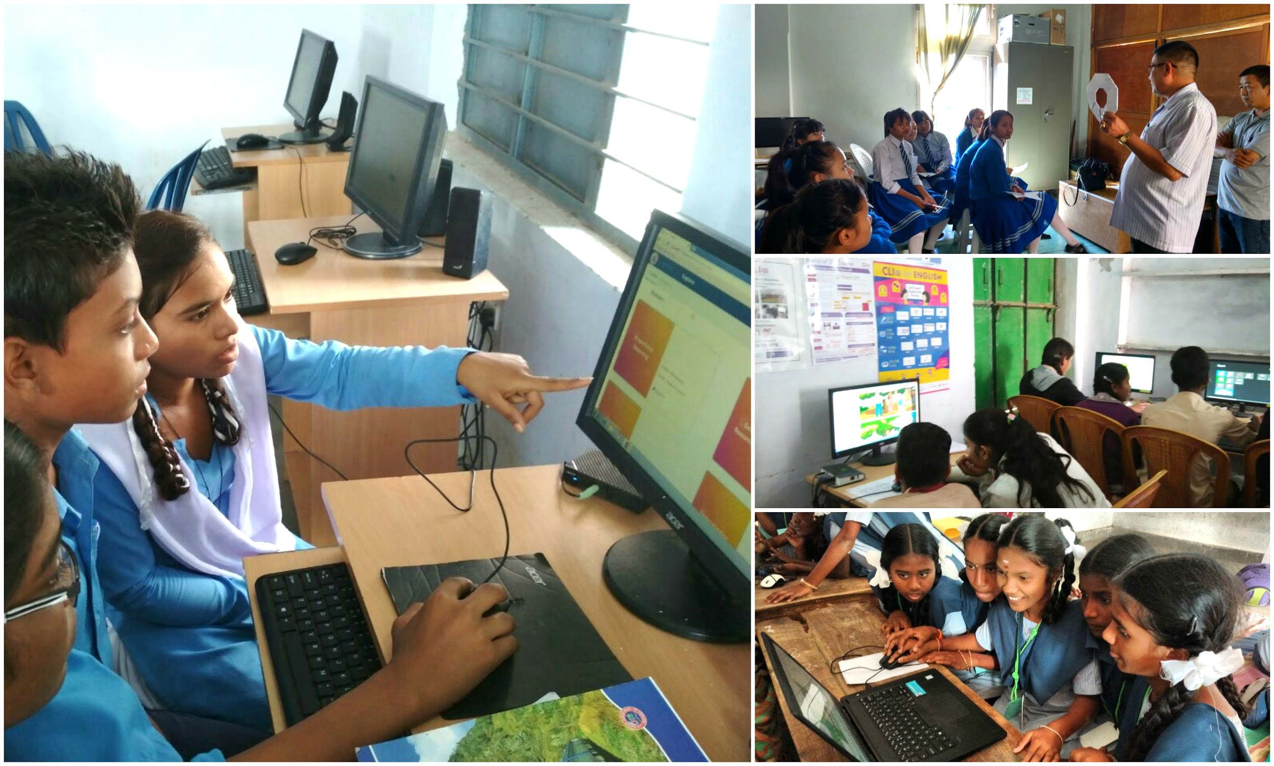
CLIx in the Classroom
Unless otherwise specified this work is licensed under a Creative Commons Attribution 4.0 International License.
Notes:
Began with a conversation
What could we do to bring opportunity to underserved communities, especially for those that might not continue into college or university? Education as opportunity. Relevance.
Scale of the challenge: ~ 250 million students (U.S. total population 325 million, 50 million students)
Cultivate conditions for irreversible change -> Capacity Building, Partnerships
Universal primary education, growth of secondary education (lower and upper)

Slide 4
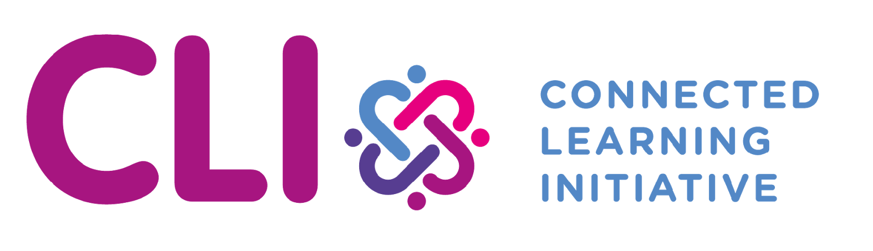





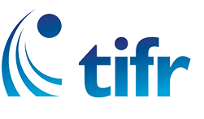
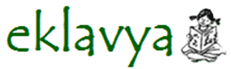




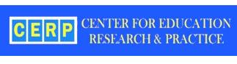
An Ecosystem Of Partners
State Governments, Civil Society Organisations, Universities, Research Institutes, Philanthropic Organisations, Schools
National Institute of Advanced Studies
Inter-University Centre for Astronomy and Astrophysics

Slide 5



CLIx – The Connected Learning Initiative
Unless otherwise specified this work is licensed under a Creative Commons Attribution 4.0 International License.
Quality at Scale
Students
Teachers
Platform
Improve the professional and academic prospects of high school students
Improve teacher education and transform teacher practice
“Platform” for curriculum, professional development of teachers, research and innovation in education

Slide 6
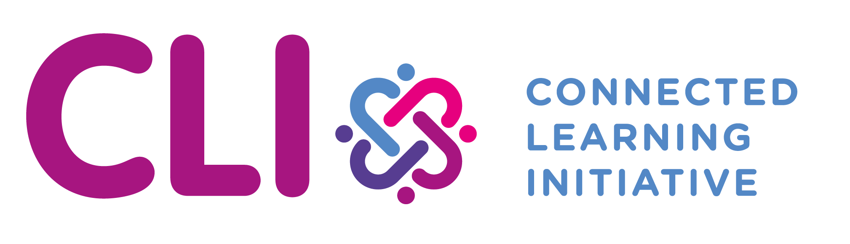
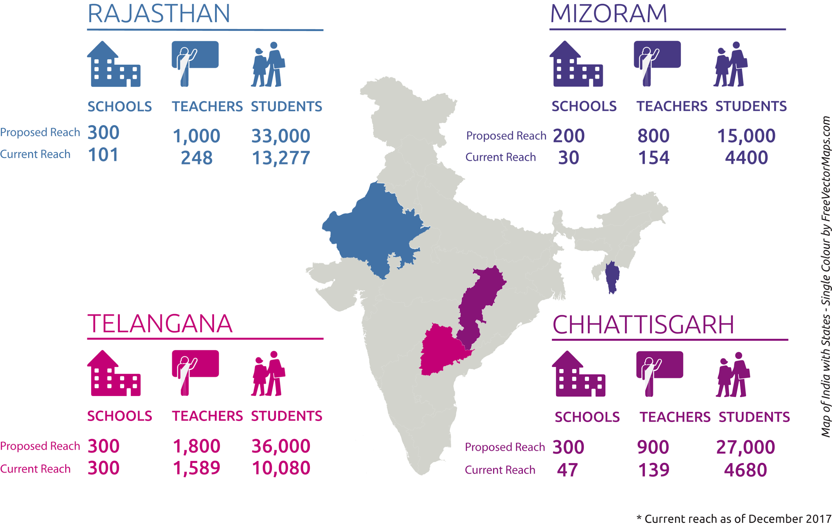
CLIx as of December 2017
Unless otherwise specified this work is licensed under a Creative Commons Attribution 4.0 International License.
Notes:
CLIx is currently implemented in 4 states, about 33,000 students, 2,100 teacher, 460 schools
Government schools in under-resourced / “rural” areas

Slide 7
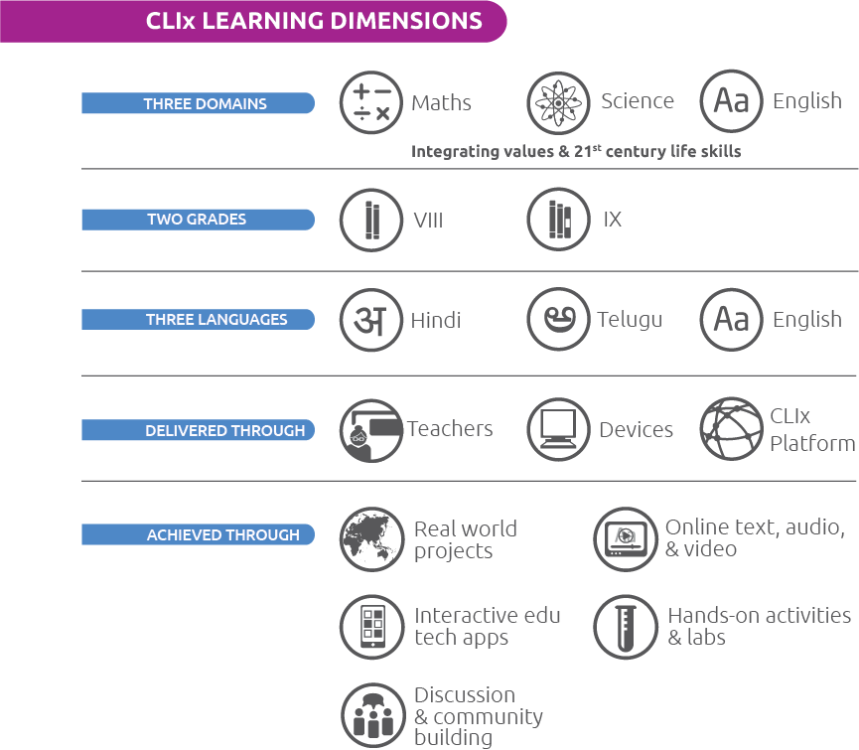
CLIx Learning Dimensions
Unless otherwise specified this work is licensed under a Creative Commons Attribution 4.0 International License.
Notes:
Three Pillars
Collaboration / Peer discussion
Safe space to learn from mistakes
Authenticity / Relevance

Slide 8
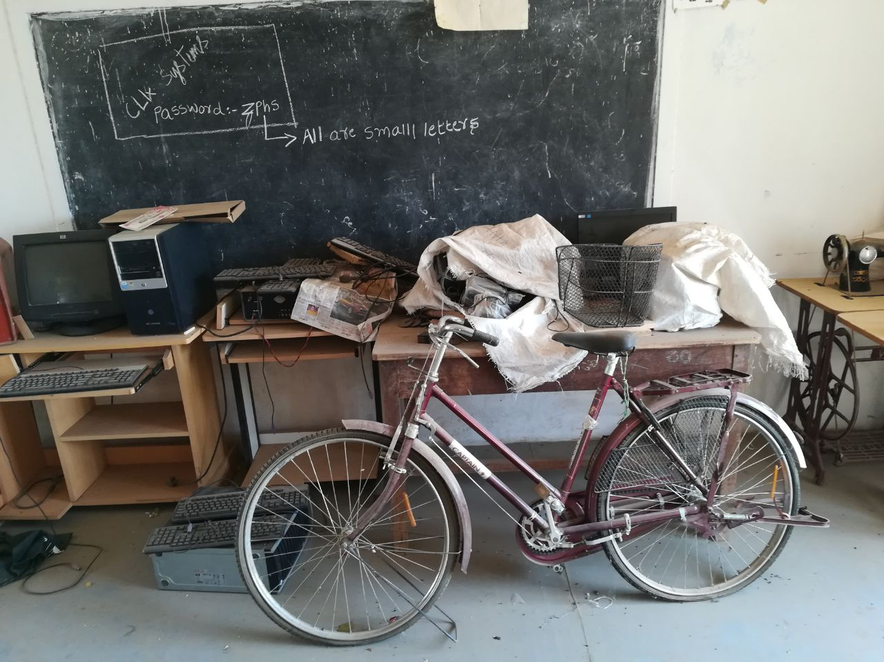
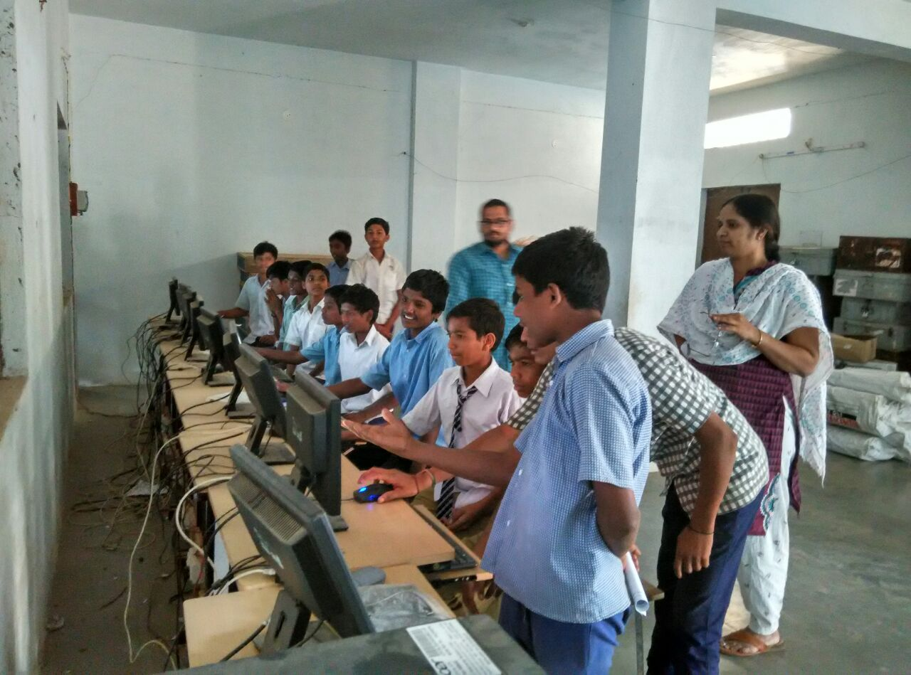
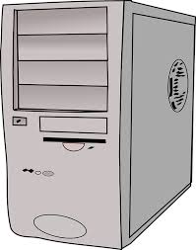
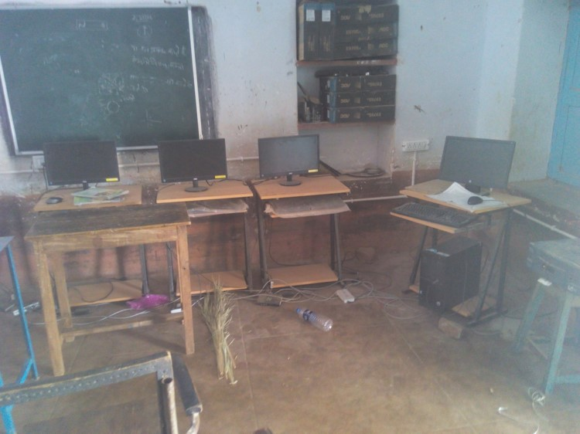
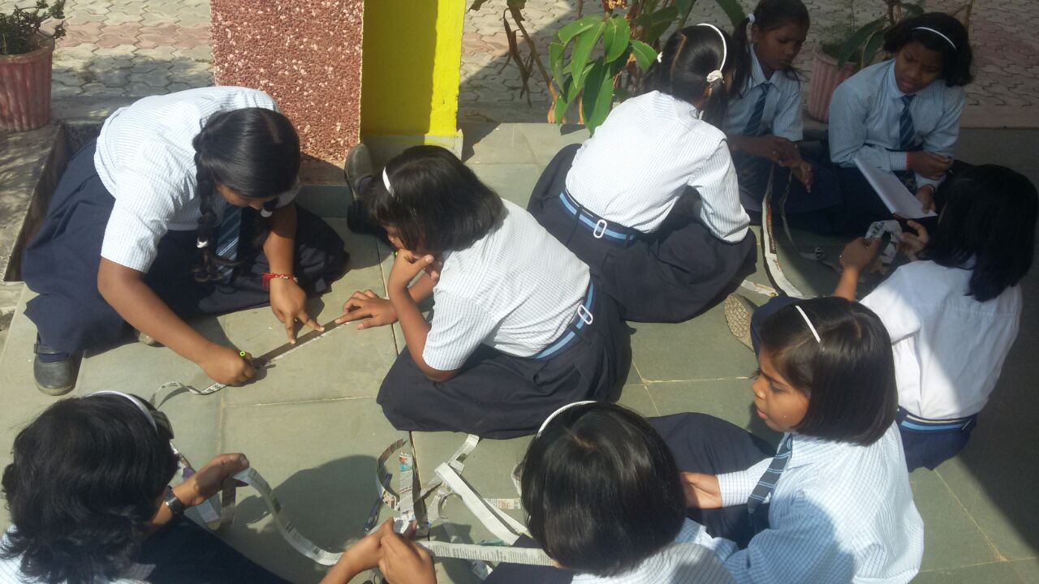

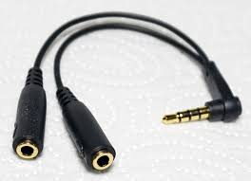
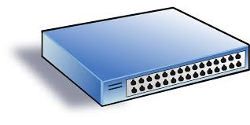
Activating
ICT Labs &
Hands-on Learning
Unless otherwise specified this work is licensed under a Creative Commons Attribution 4.0 International License.
Server
Notes:
School Computer and Science Labs
Limited utilization – MS Paint, Word
Nearly universally disconnected – no Internet, no web browsing
Disuse and disrepair -> “top up” to 10 working terminals
Many schools with a client/server system
Think compute capability a decade old
Windows XP -> Chrome end of life

Slide 9
CLIx and Open
Open content, open source, open pedagogy

Slide 10
“Open”
Unless otherwise specified this work is licensed under a Creative Commons Attribution 4.0 International License.
To reach the scale needed, the processes, curriculum and tools developed by CLIx must be readily usable by others (in India).
The project is using “OER Release” to describe a release of CLIx products for others to use as if they were “Open Educational Resources”.
The OER Release will include:
Software platforms (e.g., gStudio / CLIx Platform, Unplatform)
Interactive tools (e.g., Police Quad, Open Story Tool)
CLIx modules (e.g., English Beginner, Geometric Reasoning)
Teacher Professional Development materials

Slide 11
5R Activities
Retain - the right to make, own, and control copies of the content (e.g., download, duplicate, store, and manage)
Reuse - the right to use the content in a wide range of ways (e.g., in a class, in a study group, on a website, in a video)
Revise - the right to adapt, adjust, modify, or alter the content itself (e.g., translate the content into another language)
Remix - the right to combine the original or revised content with other material to create something new (e.g., incorporate the content into a mashup)
Redistribute - the right to share copies of the original content, your revisions, or your remixes with others (e.g., give a copy of the content to a friend)
This material was created by David Wiley and published freely under a Creative Commons Attribution 4.0 license at http://opencontent.org/definition/.

Slide 12
License
Unless otherwise specified this work is licensed under a Creative Commons Attribution 4.0 International License.
“strong philosophical beliefs”
Content modules, Teacher Professional Development materials
CC BY-SA
CC BY
Typical ”open” CC license in India
Recommended by Creative Commons
*Commercially friendly
No copy-left condition, most interoperable
*Required by Grant
Software Platforms, Interactive Tools
AGPL
MIT License
“Protects” original developer’s commercial interest, can commercialize but must share
*Commercially friendly
No copy-left condition, very interoperable

Slide 13
Open Content
Unless otherwise specified this work is licensed under a Creative Commons Attribution 4.0 International License.
“capacity”
New to OER, some new authors
What’s possible? Khan Academy, PhETs, Logo, etc.
Reuse existing & contextualize for curriculum
–or– design new?
  Nuance of licenses
  Much of traditional Indian OER used in printed materials (textbooks and workbooks)
  Attribution 👍, format 👋

Slide 14
Open Pedagogy
Unless otherwise specified this work is licensed under a Creative Commons Attribution 4.0 International License.
Contemporary pedagogies
  Changing expectations about teacher pedagogy
  Curriculum & learning experiences…move rote to active learning
  Learner and teacher empowerment…teacher exploration of learning materials, mostly lightly guided teaching experiences
“strong philosophical beliefs”

Slide 15
CLIx’s OER Release

Slide 16
CLIx Modules
Unless otherwise specified this work is licensed under a Creative Commons Attribution 4.0 International License.
🌐 Websites to explore modules
📙 “ePub” of module distribution
  Core learning materials are accessible, renders in some ePub readers
  ~50-500MB compressed (zip) file with module content as HTML,
📙 ePub(s) + 🖥 Unplatform distribution
  Some (but not all) learning activities are accessible (some are specific to gStudio)
  ~2GB compressed (zip) file loaded into Unplatform as a player, which also allows access to some (but not all) of the interactive tools
  Ubuntu, Mac, Windows versions
🌐 CLIx Platform with all modules and interactive tools distribution
  45-60GB Virtual machine with all modules and interactive tools
  CoreOS installation
Reusable, Revise, Retain, Remix, Redistribute
Editable HTML, and media
LMS with
edit &
authoring
capability

Slide 17
How to get CLIx software & content?
Unless otherwise specified this work is licensed under a Creative Commons Attribution 4.0 International License.
Well…
Some software is available now via Github: Unplatform, Open Educational Assessments (players and authoring), Open Story Tool, Run Kitty Run, Video Player
Rest of software should be available by ~August 2018: gStudio / CLIx Platform, math and science interactives, runtime of StarLogo NOVA
And…
Curriculum modules and Teacher Professional Development materials should be available by ~August 2018 from the CLIx website clix.tiss.edu

Slide 18
Missed Opportunities
Unless otherwise specified this work is licensed under a Creative Commons Attribution 4.0 International License.
Using most open licenses
Authoring workflow & CMS—easier revision, retention
  OERPub
  Google Docs -> translator -> (customized) ePub3 -> player platforms
  Strong structure in production (well formed HTML) and a true Content Management System
Having versions available for you!*
* You’re more likely to be able to use the process and software rather than the
curriculum modules as they’re highly localized to the Indian context

Slide 19

Thank You!

