Slide 1
Video Concept Browser
Brandon Muramatsu, mura@mit.edu Cole Shaw, cjshaw@mit.edu
MIT Office of Digital Learning
Cite as: Muramatsu, B. and Shaw, C. (2014, March). Video Concept Browser.
Matterhorn Unconference. Cambridge, MA. March 20, 2014.
Unless otherwise specified this work is licensed under a Creative Commons Attribution 3.0 License.
1
Notes:
Cite as: Muramatsu, B. and Shaw, C. (2014, March). Video Concept Browser. Matterhorn Unconference. Cambridge, MA. March 20, 2014.
Unless otherwise specified this work is licensed under a Creative Commons Attribution 3.0 License.
1

Slide 2
Background
2011-2012 Set of Experiment in “Online Courses” and “Modularity”
Question: How can we make the lecture video more valuable?
Blackboard lectures
Video production / post-production process
Delivery
In as “simple” / “low-impact” way as possible!

Slide 4
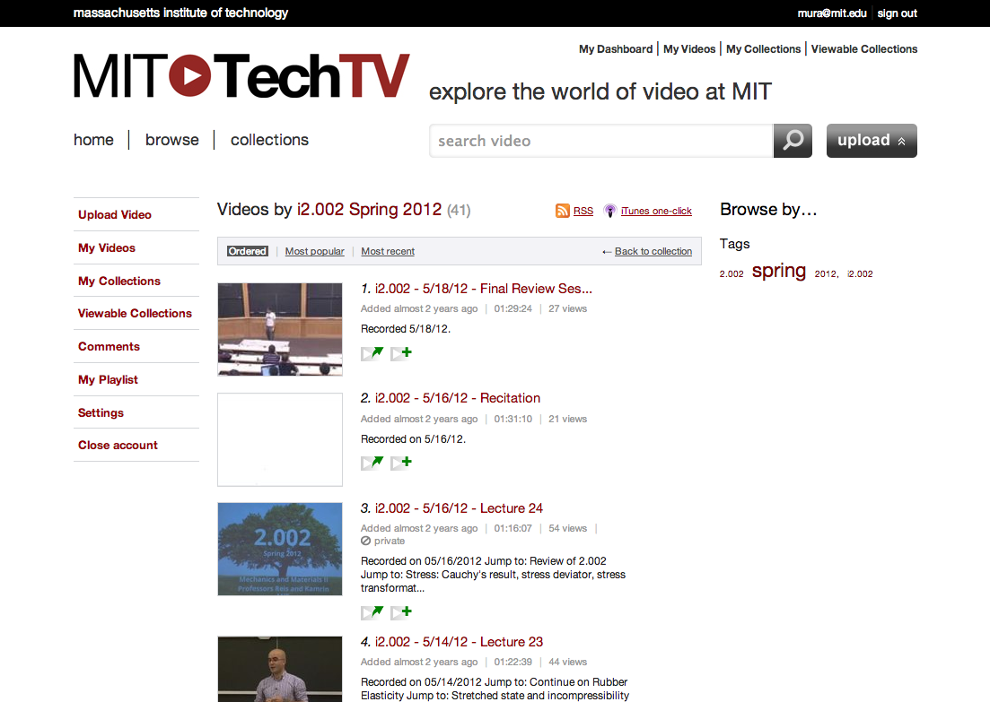
Version 1.0

Slide 5
Version 1.0 Continued

Slide 6
Background (cont.)
Video Recorded in Class
Video Prepared for Delivery
Video Watched on TechTV
TA Records Concept and Clock Time
TA Enters Data in Spreadsheet
Bookmarks on TechTV
Zero Extra Time
TA in Class Already
TA spends 5-10 minutes
Spreadsheet does the calculations
Cut and paste bookmarks into TechTV

Slide 7
What’s different today?
Custom Web App: Video Concept Browser
(Slightly) More Automated Concept + Time upload

Slide 8
vcb.mit.edu

