Slide 1
Finding Resources for The MITCET Chemistry Bridge Project
Brandon Muramatsu
Citation: Muramatsu, B.. (2012, February). Finding Resources for the MITCET Chemistry Bridge Project.
Notes:
Citation: Muramatsu, B. (2012, February). Finding Resources for the MITCET Chemistry Bridge Project.
Unless otherwise specified, this work is licensed under a Creative Commons Attribution 3.0 United States License.

Slide 2
Outline
Process
Evaluating Resources
Describing Resources
Licenses
Resource Sites

Slide 3
Process for finding resources
Catalog the resource
Check the license
Think up keywords/keyphrases for search
Evaluate the resource
Search Google or selected collections
Might it work?

Slide 4
Evaluating Resources
What’s important?

Slide 5
What might make a good resource?
Reputable
Source
Accurate
If cross-check out
What’s said in textbooks as generally accurate?? (maybe not true)
Presentation
Clear?
Quality of video/audio
Coherent
Simplicity
Not overly complicated
Multiple formats
Alternate sources and cross-check, to help build understanding
Clear explanation, in common terms for fundamental understanding
Models, 3D representation
Interactive and manipulate
Accessibility
Captions, Colors, etc.
If printed, maintains the clarity of the printed version
Also output in multiple forms

Slide 6
Describing Resources
Shhh…we’re going to talk about “metadata”…some consider it a four letter word.

Slide 7
Metadata: A brief history
U.S. MARC: Standard for metadata used by library catalogers
1990s digital resources start to push boundaries of MARC

Slide 8
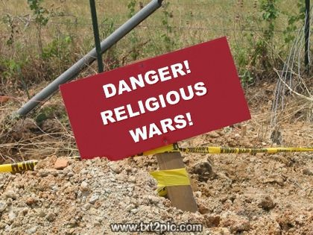
Enter Dublin Core and Learning Object Metadata
Dublin Core
Library Community
Started with 15 fields (simpler to get started)
Learning Object Metadata
Educators and Developers
A *lot* more fields
Richer potential
Photo: Flickr @dullhunk, cc-by

Slide 9
What do you think we need to describe resources?
Title
Creator
Organization
URL
Short description (written by cataloger)
Purpose (written by cataloger)
To understand this content, what assumptions are you making in to what the student knows?
“What do you get out of it?”
Type of Media (video, document)
When it was created
Audience (type of Chemistry, background of user)
Rating
Key:
Definitely catalog
Later

Slide 10
Brandon’s metadata list for the Chemistry Bridge Project
Title
Description (of the resource)
URL
Context (how it relates to the module)
Learning Objectives (topic and sub-topic)
Type of resource (Website, Video, Document, Simulation)
Time Point (if a video)
License (Creative Commons, other)

Slide 11
Licenses
What can you do with the resource?

Slide 12
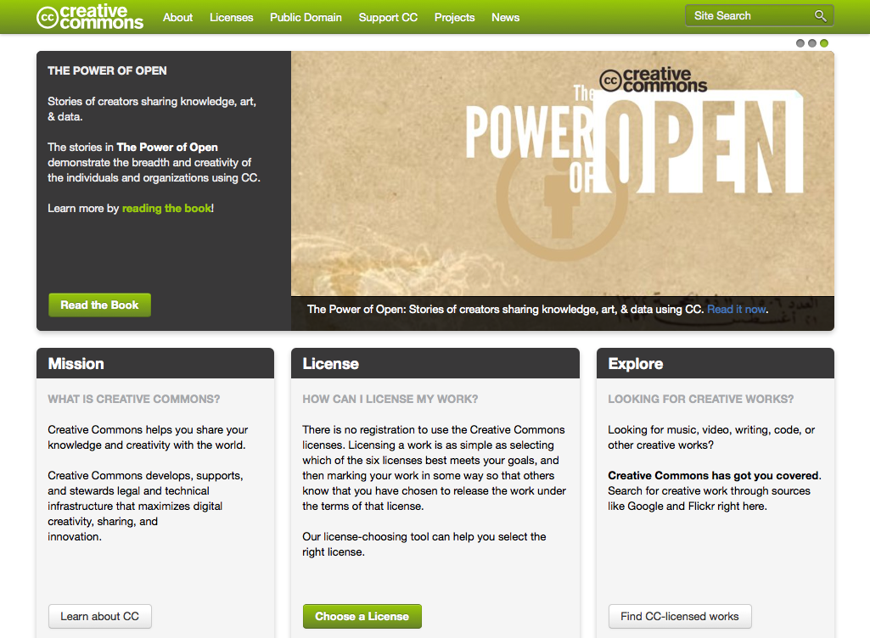
Creative Commons: Enabling OER

Slide 13
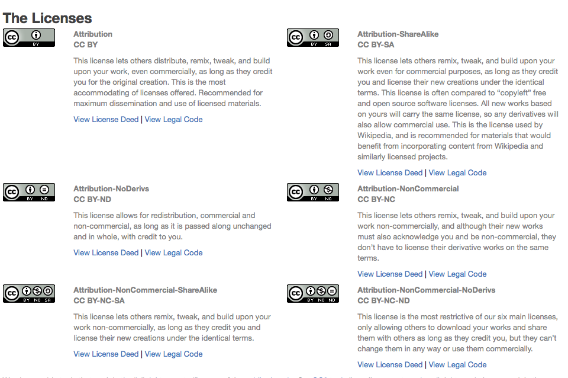
Creative Commons Licenses
creativecommons.org
A “standard” way providing permissions to your work
The easiest way of communicating your resource is “open”

Slide 14
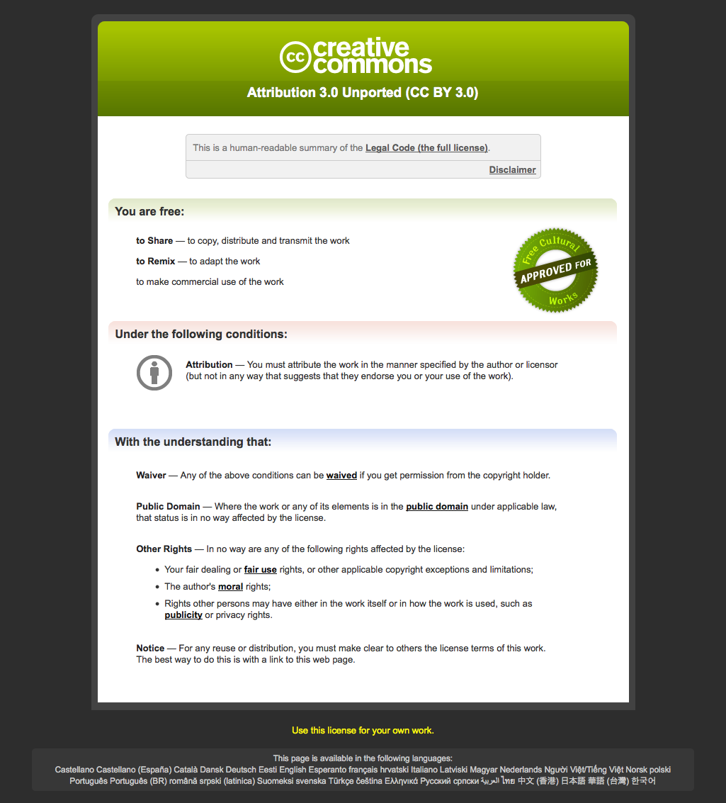
Creative Commons: CC-by License Deed

Slide 15
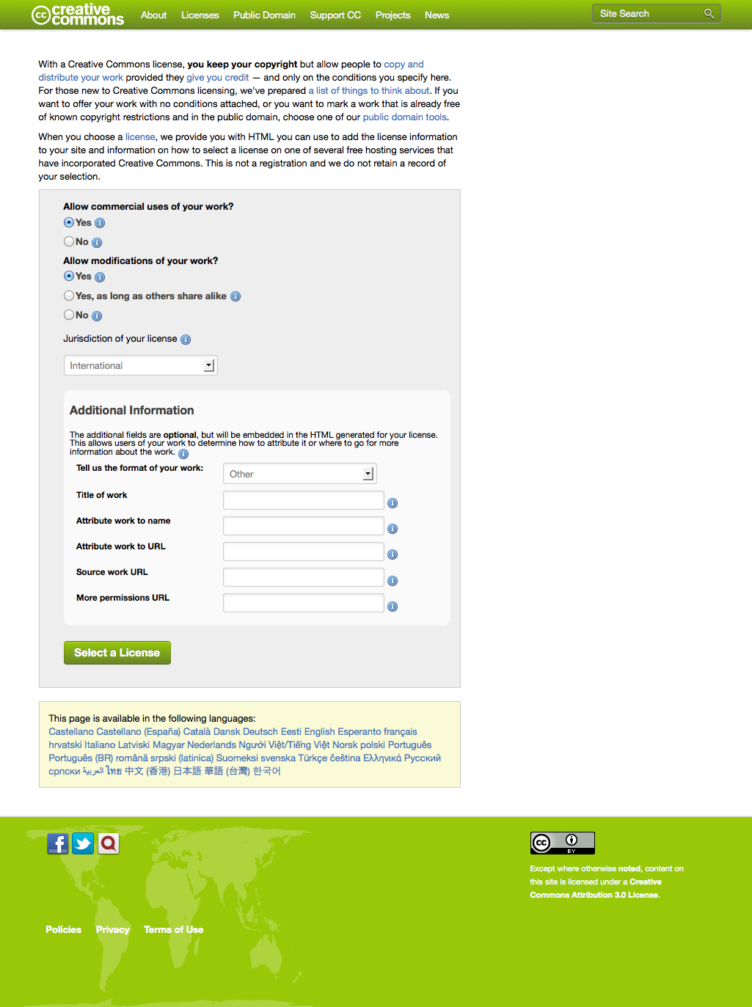
Creative Commons: Pick a License

Slide 16
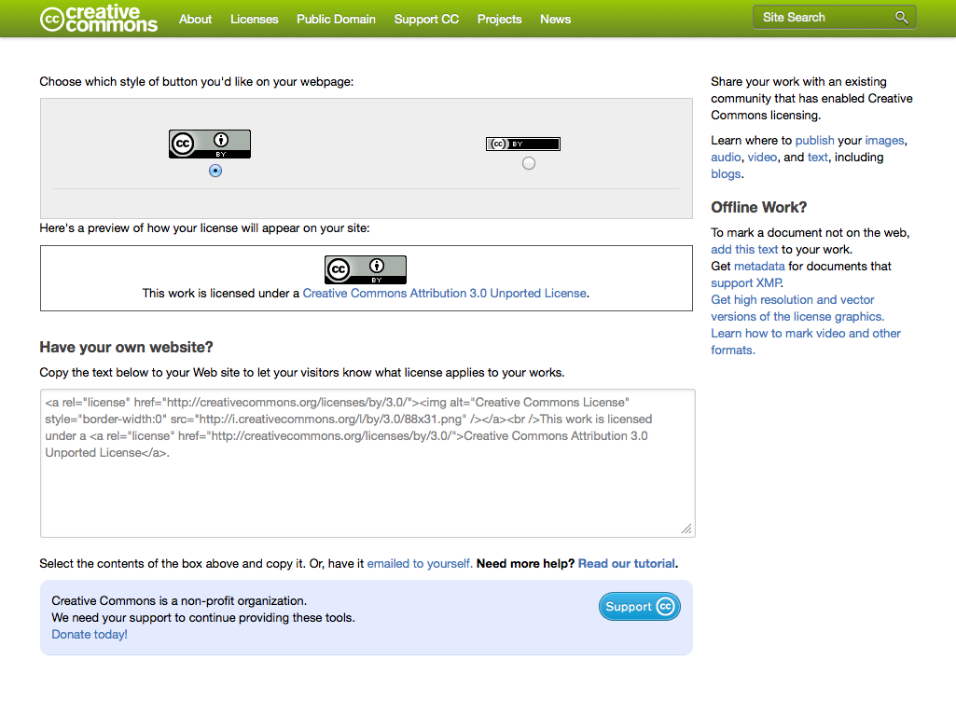
Creative Commons: Attribution

Slide 17
Advanced license topics
Using resources with different licenses

Slide 18
An OER walks into a bar…
Finding and Recognizing OERs
Demonstration

Slide 19
Recognizing OERs: Examples
Focusing on Creative Commons Resources
Flickr (www.flickr.com)
Google (www.google.com/advanced_search)
MIT OpenCourseWare (ocw.mit.edu)
MERLOT (www.merlot.org)
OER Commons (www.oercommons.org)
Wikipedia (www.wikipedia.org)
Notes:
Some of the largest collections of OERs (aka Creative Commons licensed resources)

Slide 20
Pattern for Evaluating OERs
Check out the Site for license
Search for Resources
Look at detailed results
Review the resource itself for license
Is it an OER?

Slide 21
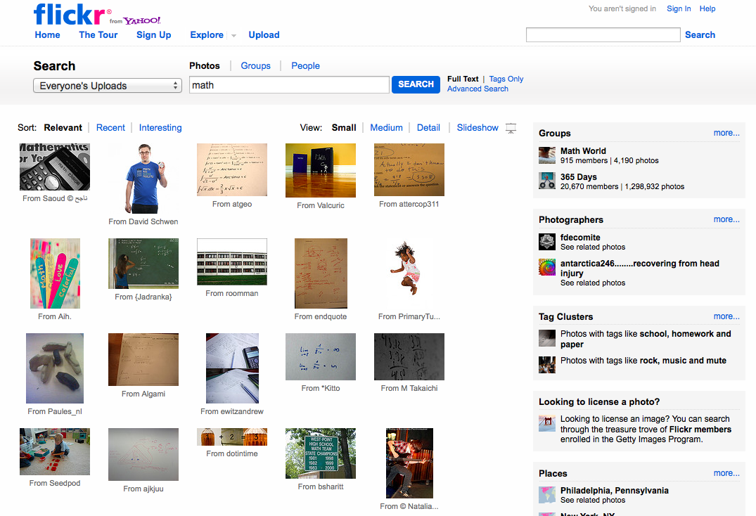
Have you used Flickr?
Did you know that Flickr allows photo sharers to indicate a license?
And that you can search for Creative Commons licensed photos?
Notes:
Did you know that Flickr allows photo sharers to indicate a license?
And that you can search for Creative Commons licensed

Slide 22
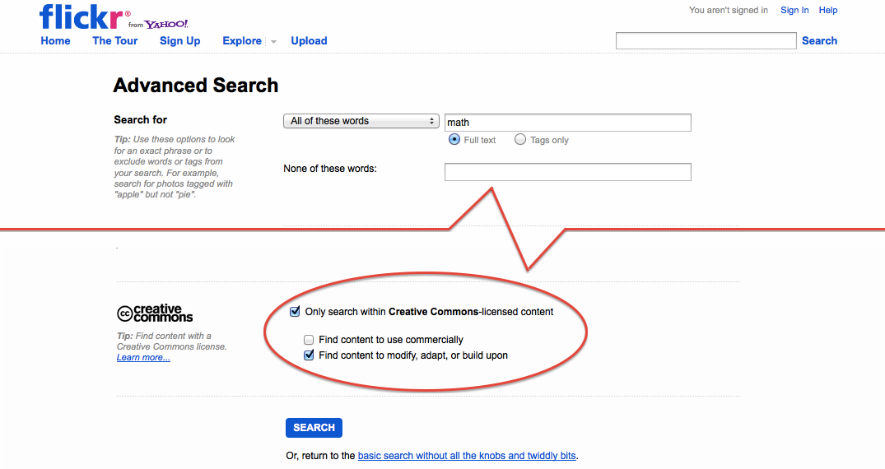
Searching for Openly Licensed Photos at Flickr

Slide 23
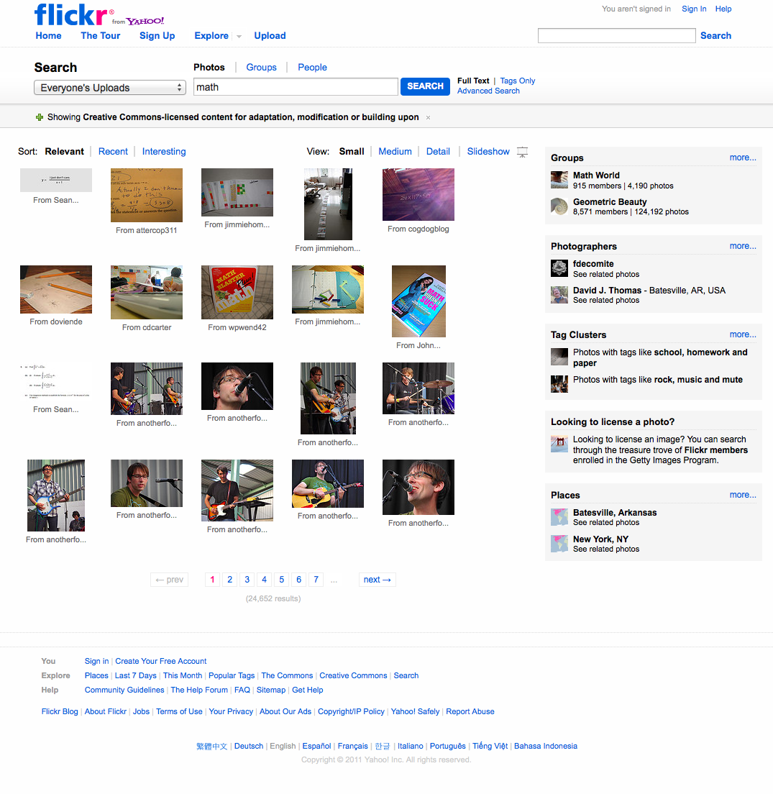
Flickr Search Results

Slide 24
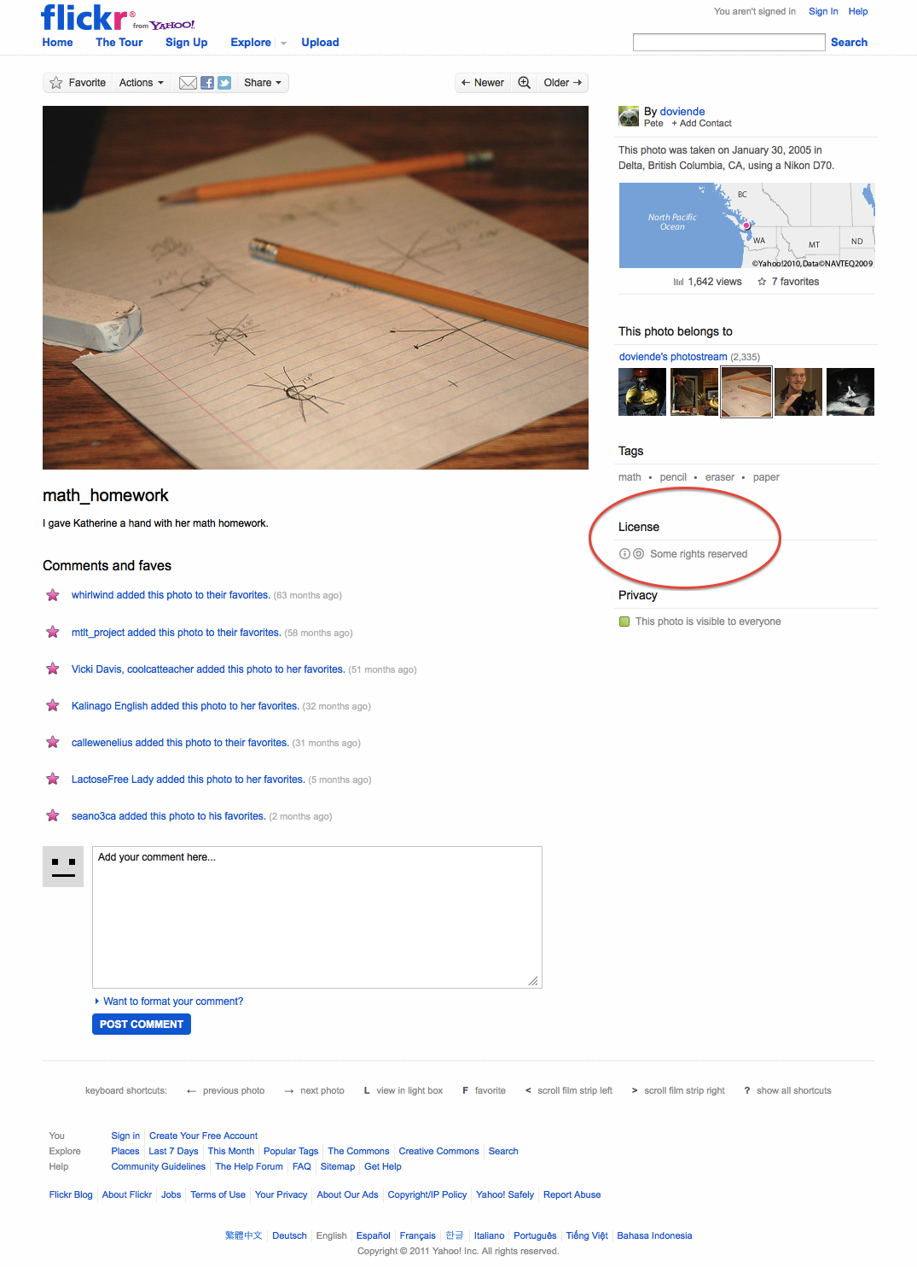
CC-Licensed Math Photo

Slide 25
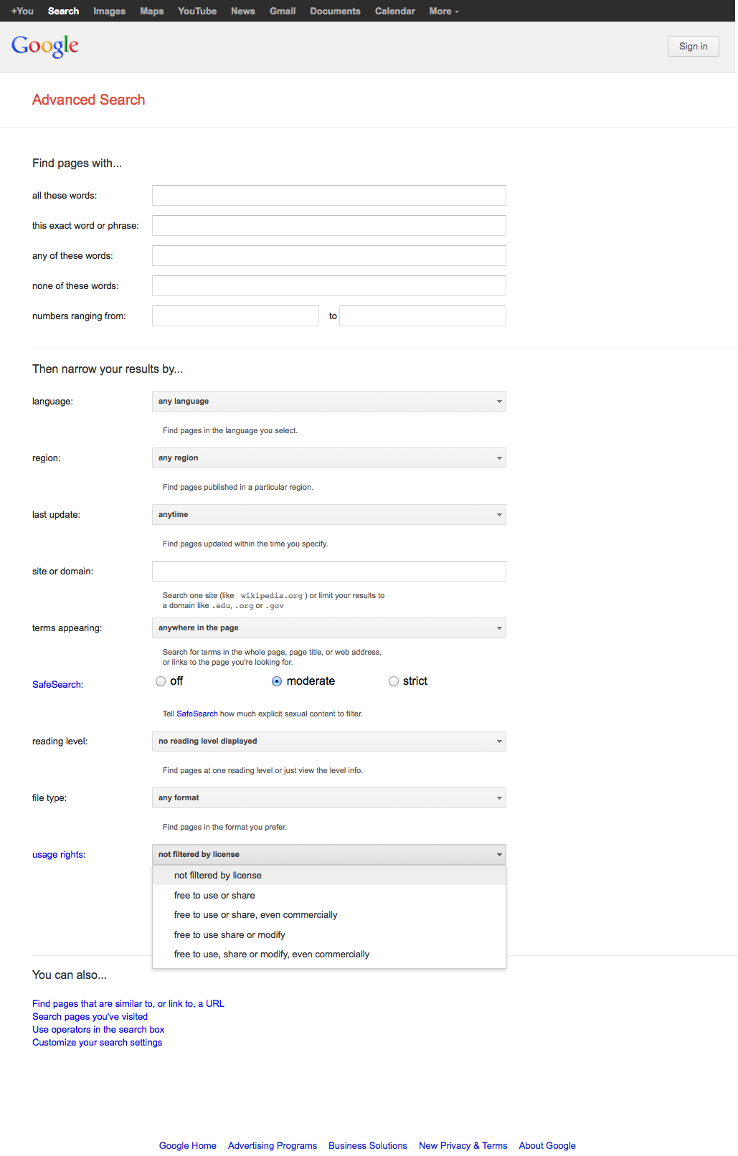
Google Advanced Search
http://www.google.com/advanced_search

Slide 26
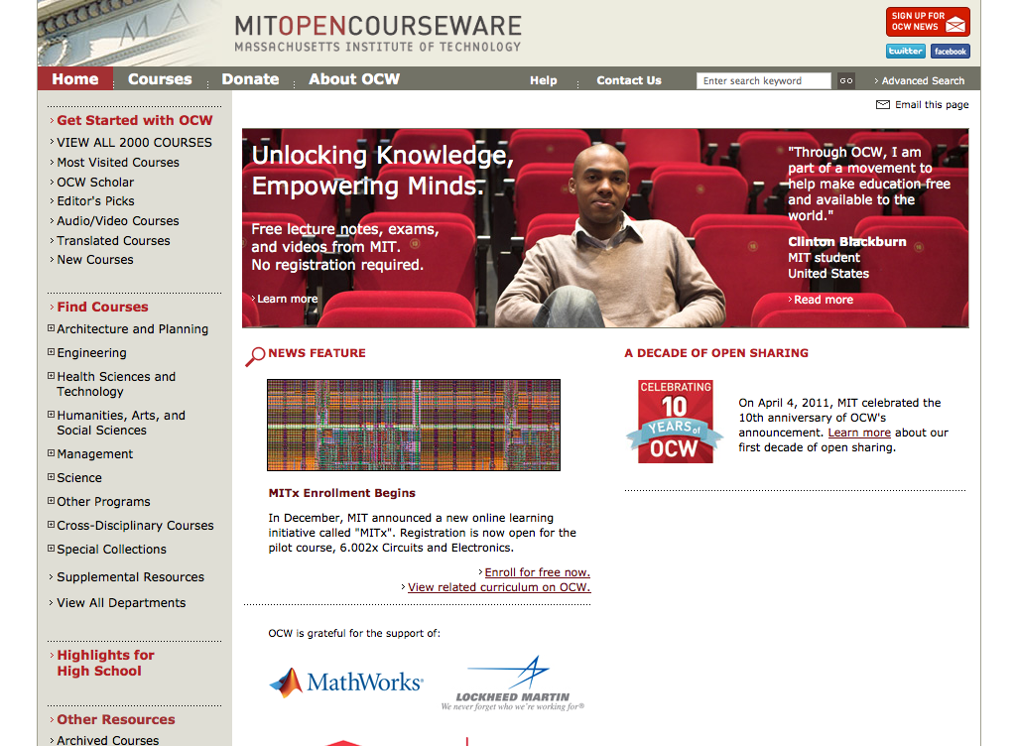
MIT OpenCourseWare
ocw.mit.edu

Slide 27
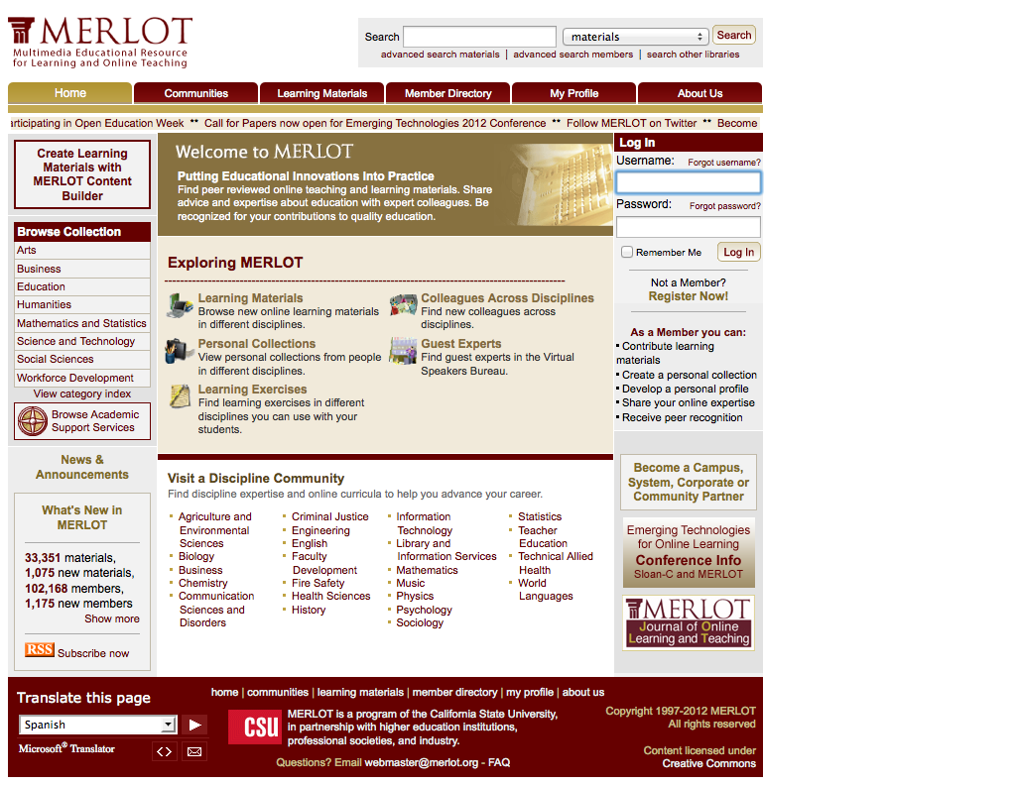
MERLOT
www.merlot.org

Slide 28
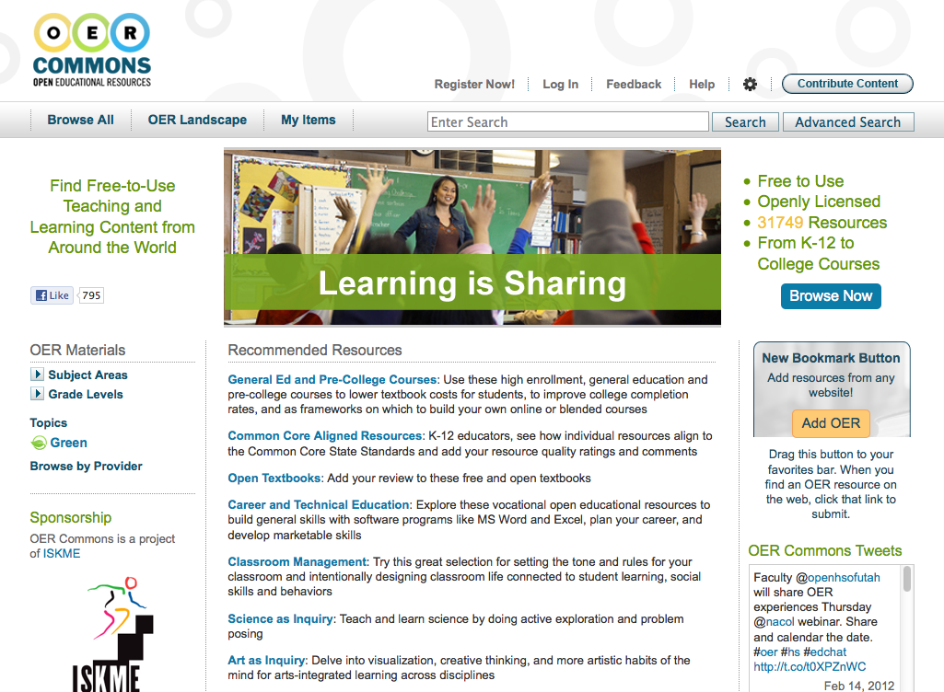
OER Commons
www.oercommons.org

Slide 29
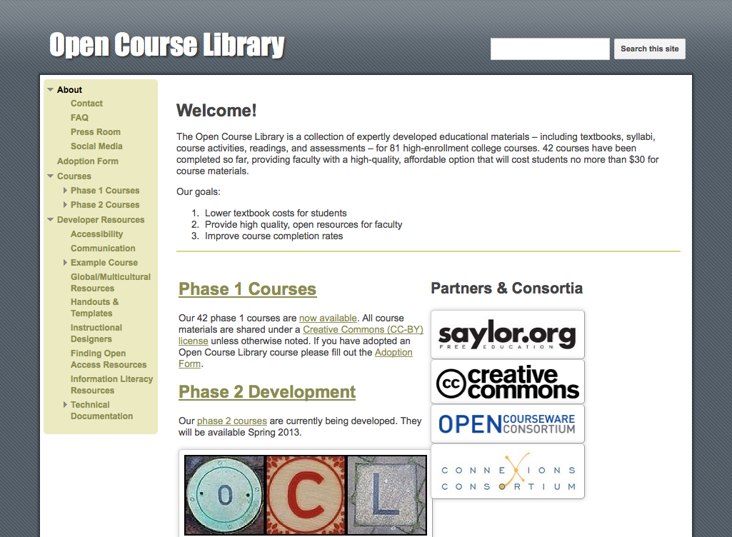
Open Course Library
www.opencourselibrary.org

Slide 30
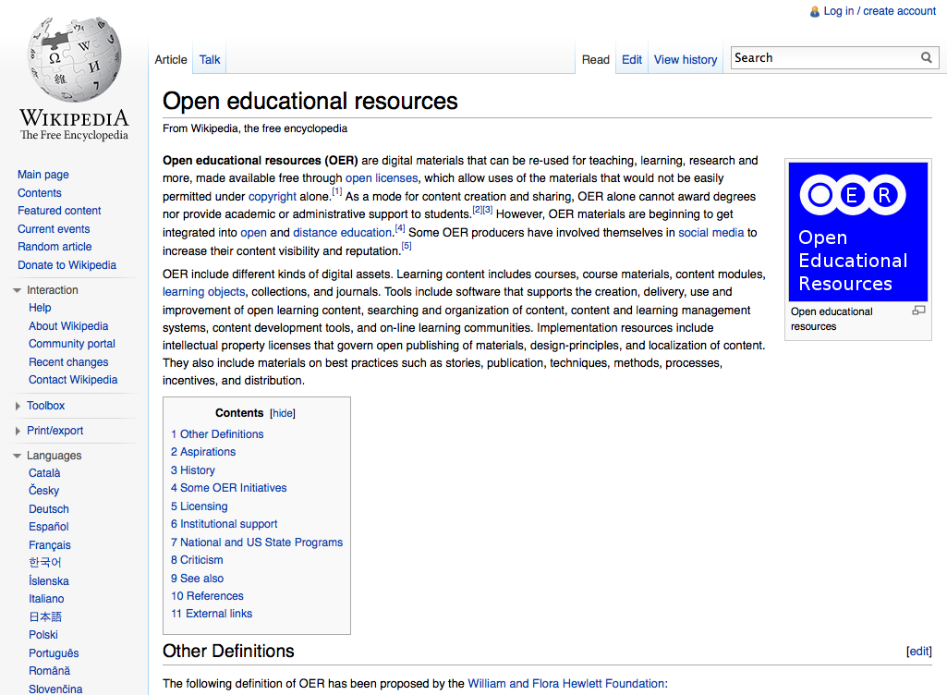
Wikipedia
www.wikipedia.org

Slide 31
Examples of OERs
Flickr (www.flickr.com)
Some CC-licensed, find via Advanced Search
MIT Open CourseWare (ocw.mit.edu)
One of the granddaddy’s of OERs, CC-by-nc-sa
MERLOT (www.merlot.org)
Wide range of resources, complex licensing
OER Commons (www.oercommons.org)
Wide range of resources, nearly all CC-licensed
Open Course Library (www.opencourselibrary.org)
Open Textbooks, 42 published, more coming, CC-by
Wikipedia (www.wikipedia.org)
Probably the biggest OER, support for attribution

Slide 32
Selected additional resources
CK-12, www.ck12.org
Open University OpenLearn, www.open.edu/openlearn
Saylor Foundation, www.saylor.org
WikiEducator, wikieducator.org
Curriki, www.curriki.org
YouTube EDU, www.youtube.com/education
OpenCourseWare Consortium, www.ocwconsortium.org
Creative Commons, search.creativecommons.org
iTunesU

Slide 33
Questions?
Brandon Muramatsu
mura@mit.edu
Slides will be posted to: http://slideshare.net/bmuramatsu
Notes:
Citation: Muramatsu, B. (2012, February). Finding Resources for the MITCET Chemistry Bridge Project.
Unless otherwise specified, this work is licensed under a Creative Commons Attribution 3.0 United States License.

