Slide 1

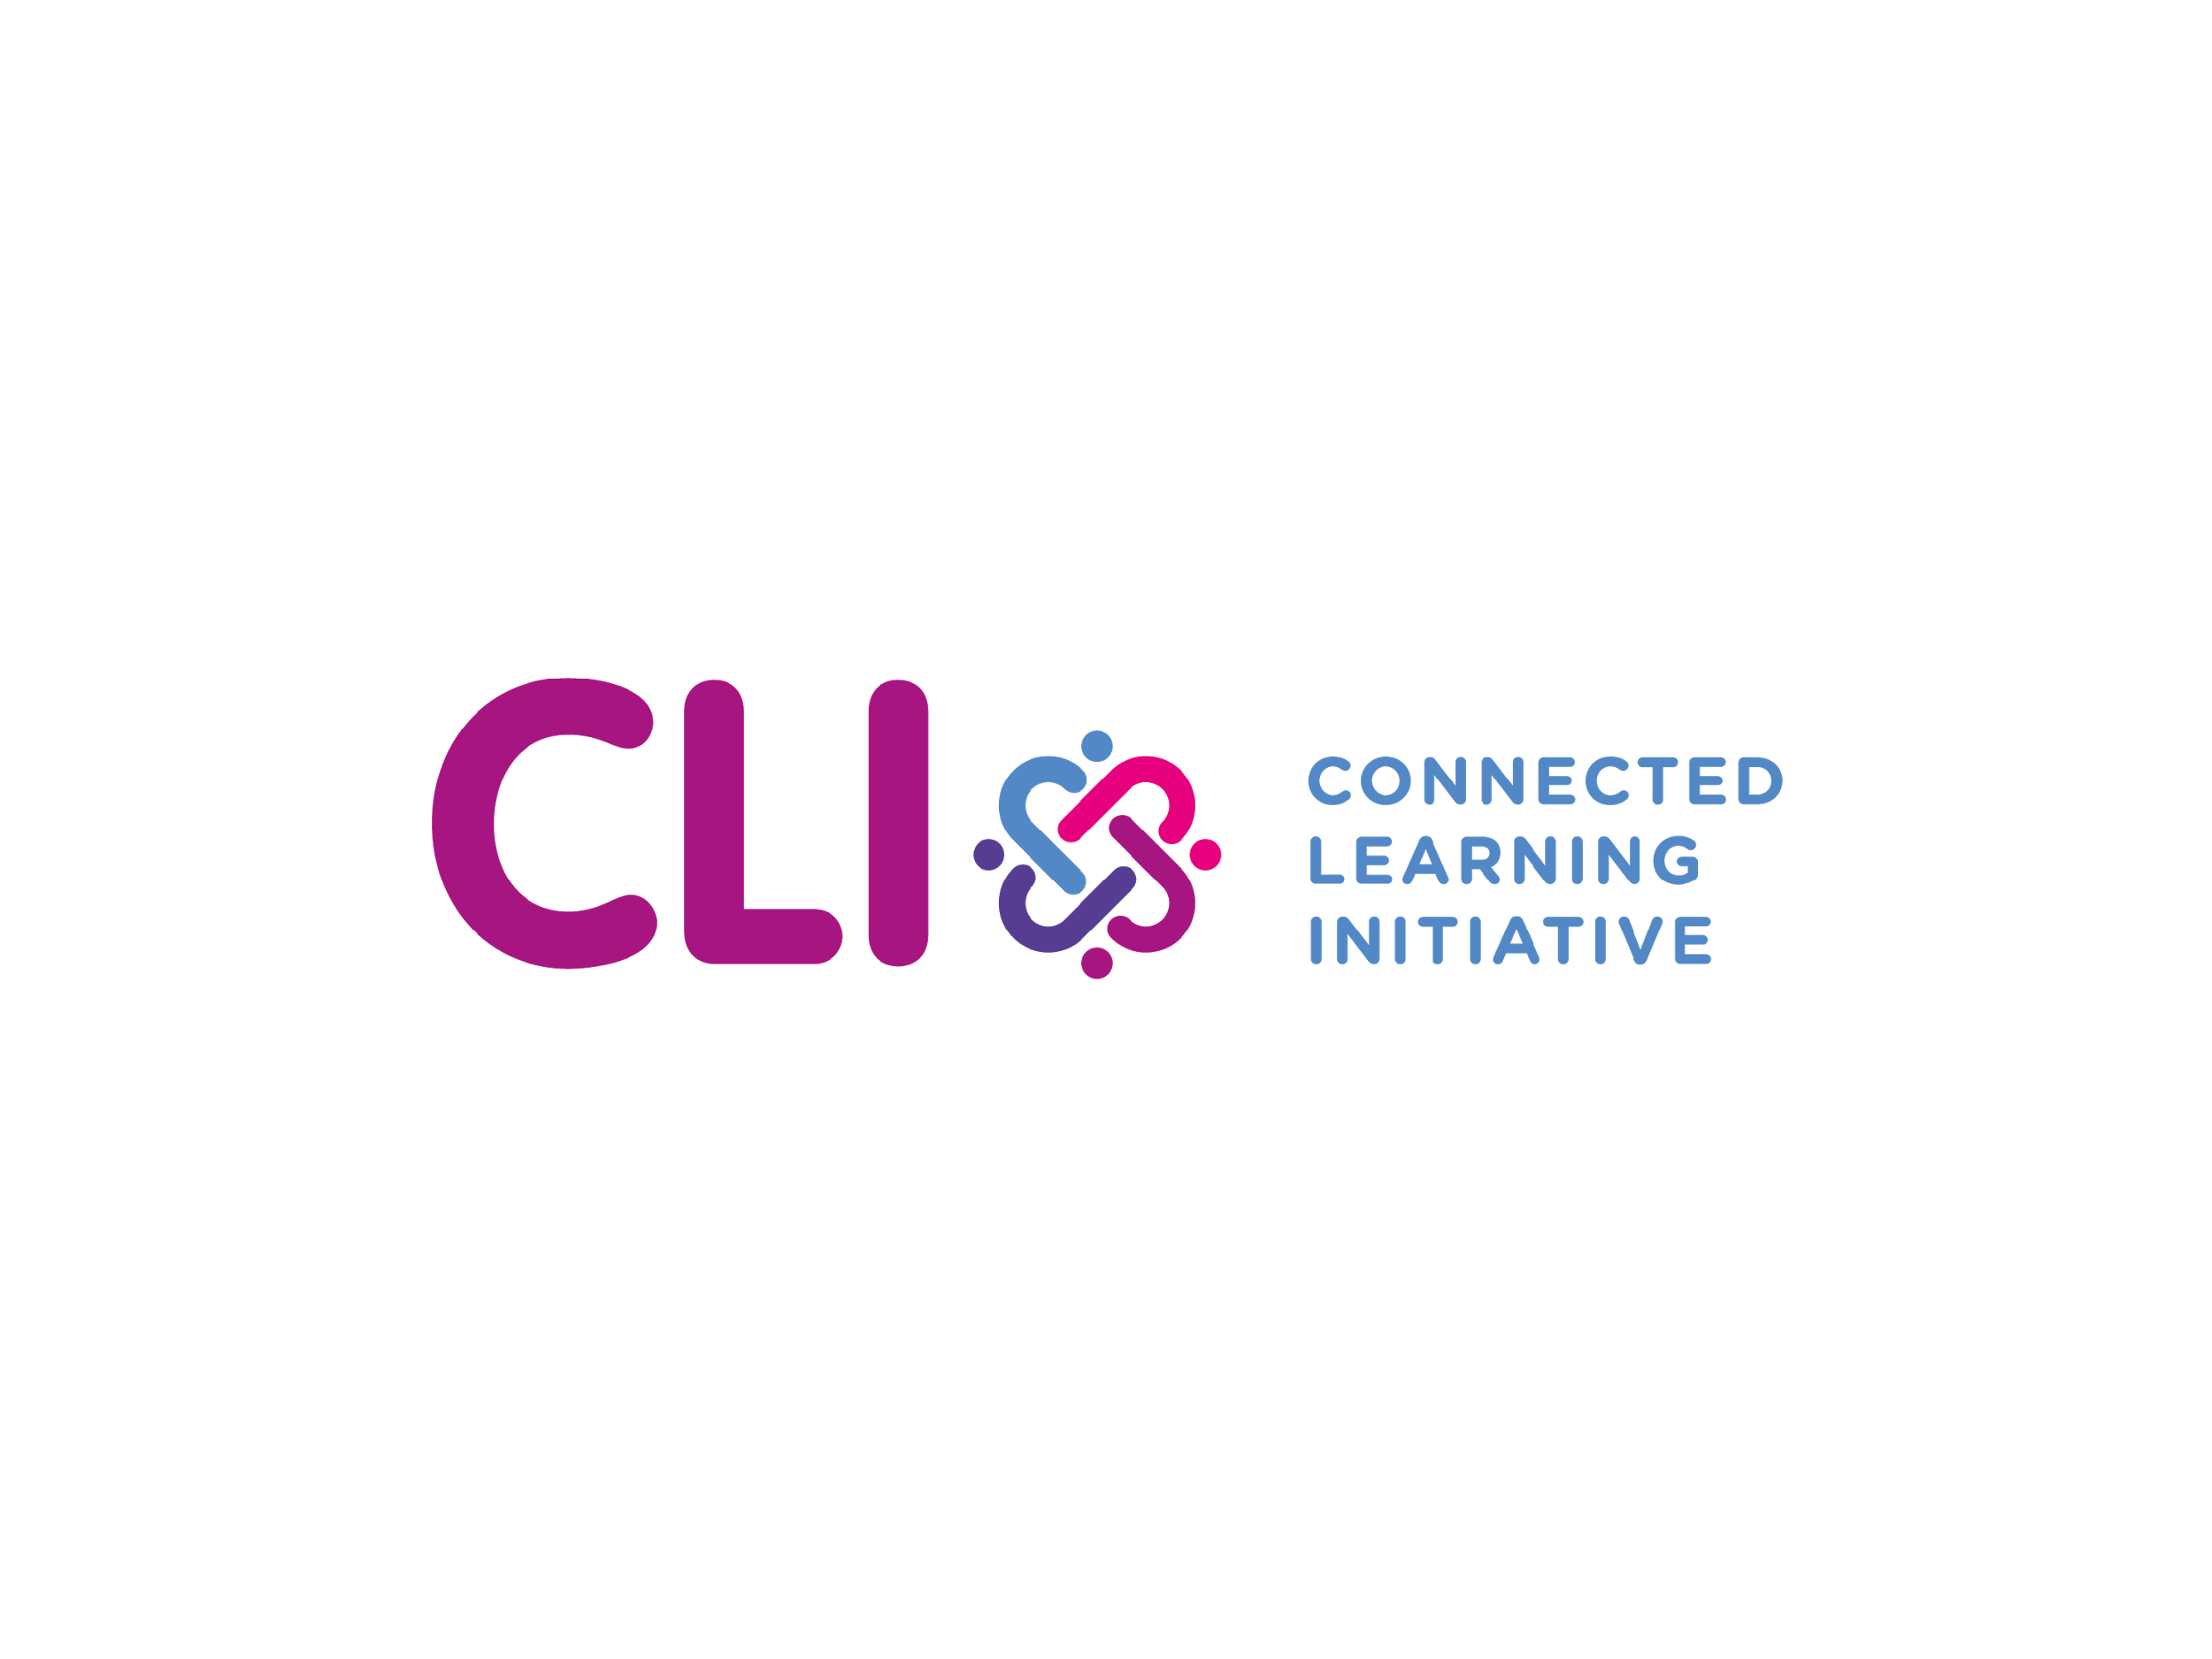
The Connected Learning Initiative
Quality at Scale in India
April 17, 2018
Notes:
The Connected Learning Initiative is a collaborative action research programme of the Tata Institute of Social Sciences, Mumbai, the Massachusetts Institute of Technology, Cambridge, MA and the Tata Trusts and began in 2015. CLIx aims to address the educational needs of students of underserved communities in India.

Slide 2
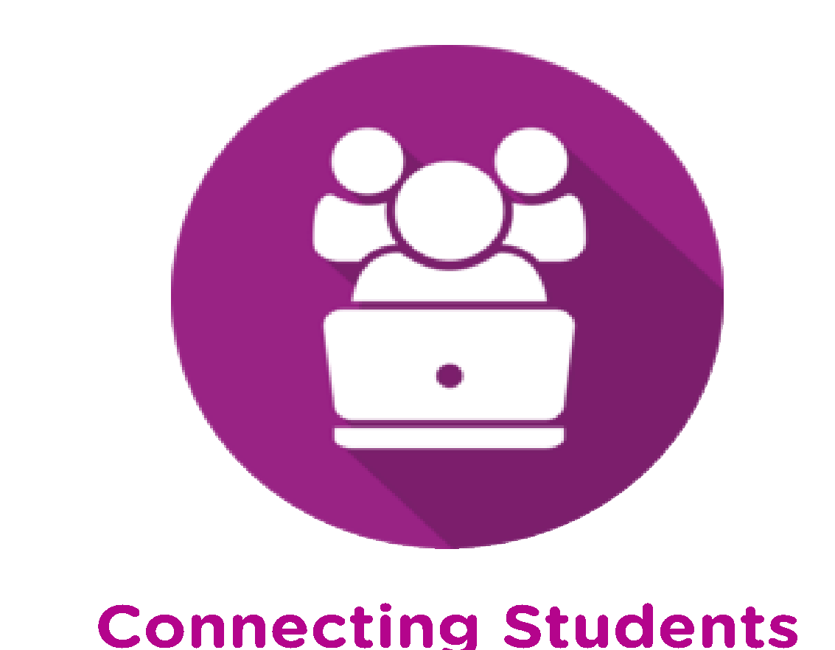


CLIx – Quality at Scale
Quality at Scale
Students
Teachers
Platform
Improve the professional and academic prospects of high school students
Improve teacher education and transform teacher practice
“Platform” for curriculum, professional development of teachers, research and innovation in education
Notes:
Began with a conversation
What could we do to bring opportunity to underserved communities, especially for those that might not continue into college or university? Education as opportunity.
Scale of the challenge: ~ 250 million students (U.S. total population 325 million, 50 million students)
Irreversible change

Slide 3
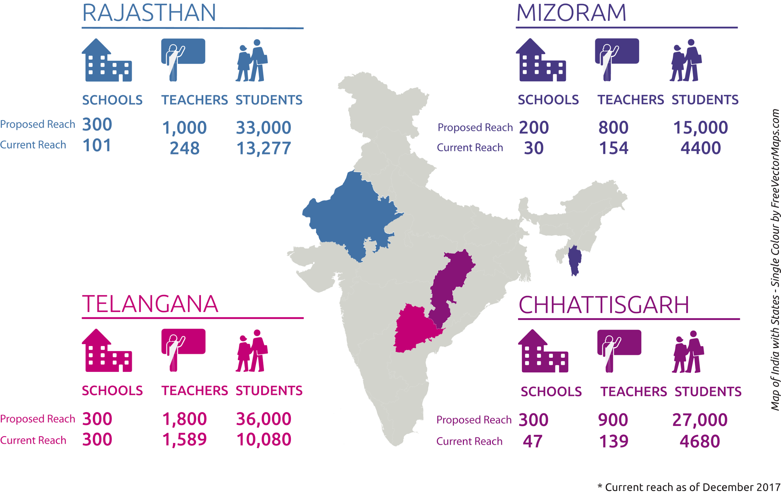
CLIx as of December 2017
Notes:
CLIx is currently implemented in 4 states, about 33,000 students, 2,100 teacher, 460 schools

Slide 4
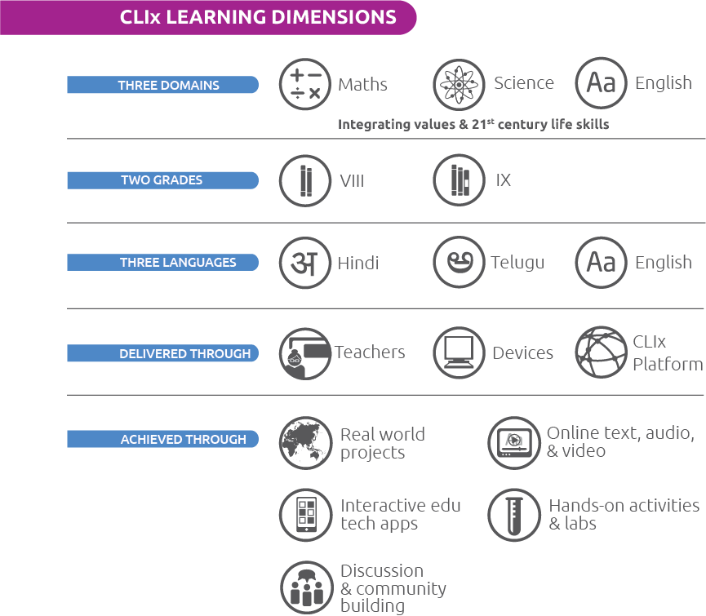
CLIx Learning Dimensions
Notes:
Three Pillars
Collaboration/Peer discussion
Safe space to learn from mistakes
Authenticity/Relevance

Slide 5
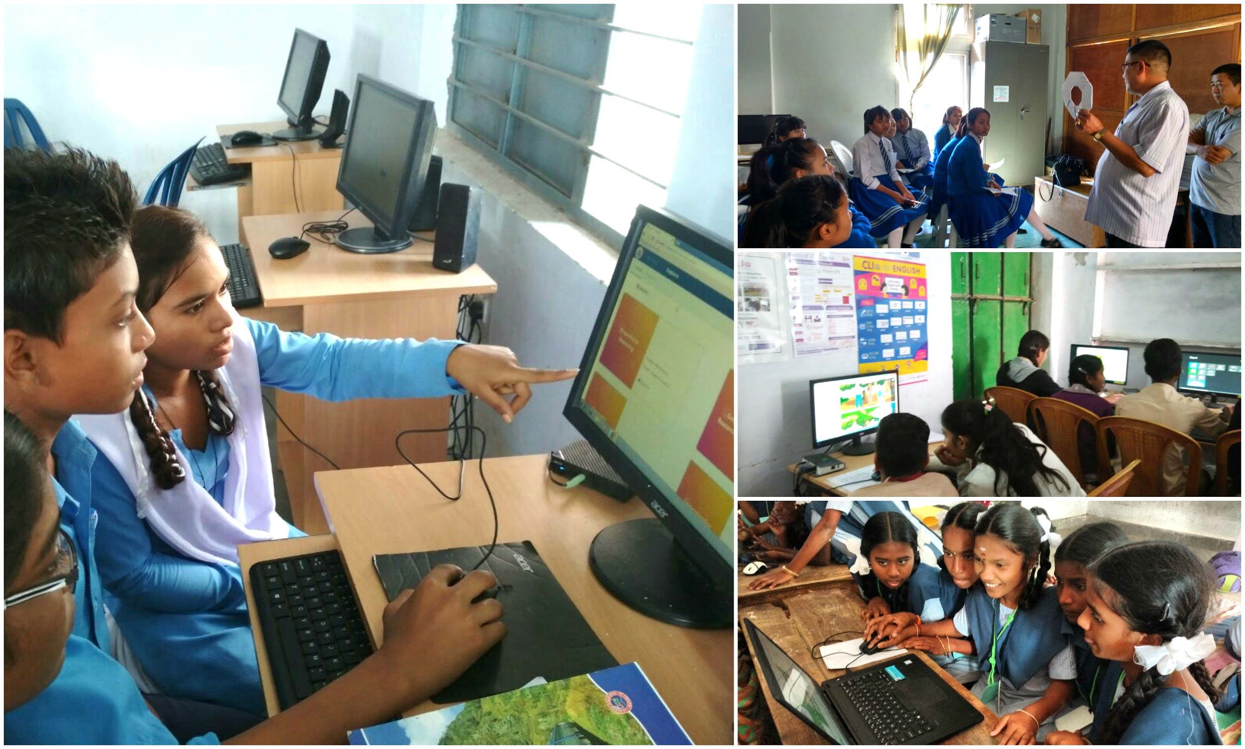
CLIx in Schools

Slide 6





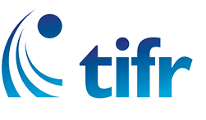
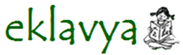




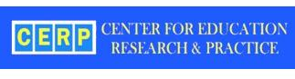
An Ecosystem Of Partners
State Governments, Civil Society Organisations, Universities, Research Institutes, Philanthropic Organisations, Schools
National Institute of Advanced Studies
Inter-University Centre for Astronomy and Astrophysics

Slide 7


Slide 8


Sparking a Global Renaissance in Education

Slide 9
Leverage MIT Resources
Digital Learning
Residential Innovation
Learning Science
MIT Faculty Creativity
Sustainable,
Worldwide,
Transformation
In Education
Engage Community of Collaborators
jwel.mit.edu
Sparking a Global Renaissance in Education
Notes:
J-WEL has become MIT’s primary platform for engagement with the world for educational transformation (not just for digital learning, but for any kind of educational change)
To address important challenges and opportunities (e.g., relevant to changing marketplace of competencies, underserved learners, etc.)
J-WEL’s process and modality are designed for sustainability
Active membership recruitment process
Mechanisms to actively engage MIT faculty and students in J-WEL activities and research

