Slide 1
The “Other” EdTech “Stuff” at MIT
Brandon Muramatsu, mura@mit.edu
Citation: Muramatsu, B. (2013, June). The “Other” EdTech “Stuff” at MIT. Plenary Presentation at LINC 2013, June 19, 2013.
Notes:
Citation: Muramatsu, B. (2013, April). The “Other” EdTech “Stuff” at MIT. Plenary Presentation at LINC 2013, June 19, 2013.
Unless otherwise specified, this work is licensed under a Creative Commons Attribution 3.0 United States License.

Slide 2

Flickr/@mit_shass_gallery © MIT, All Rights Reserved
Notes:
MIT celebrated its 150th birthday in 2011 – it’s also when we announced MITx
It’s a great time to be at MIT – there’s lots going on with education technology
It’s more than MOOCs
We’ve already heard some of the cool MIT educational technology projects as part of LINC 2013: BLOSSOMS, others
I’ll describe a few more!

Slide 3
“Other” EdTech “Stuff” at MIT
Modularity Experiments
Concept-based Approaches
Embedded Assessment

Slide 4
About
MIT Office of Educational Innovation and Technology
  Partners with faculty across MIT
  Leads experiments in innovative approaches to learning and teaching
  Scales up projects from individual faculty to departments and the university
  Partners with other campus entities to sustain innovations long-term

Slide 5
MIT Council on Educational Technology
MITCET’s “mission…is to enhance the quality of MIT education by encouraging the appropriate application of technology, both on and off campus.”
Representation from across campus

Slide 6
Modularity Experiments
Experiments to explore:
  Deeper learning experiences
  Flexibility in time (not always organized into one-semester chunks) and geography (not always on campus)
Call for participation
  Aero/Astro, Chemistry, Mechanical Engineering

Slide 7
i2.002 in Mechanical Engineering
The department is interested in experimenting with it’s curriculum, perfect candidate
2.002 Mechanics and Materials II
is a typical MIT engineering class:
  Traditional lectures, lots of equations using blackboards
  Problem sets, labs
  “MIT Hard”
Set of experiments beginning in Spring 2012
  *gasp*

Slide 8


i2.002
Mechanics & Materials II
Department of Mechanical Engineering
Office of Educational Innovation and Technology
Teaching & Learning Laboratory
(with funds from MIT Council on Education Technology,
Class of 1960 and the Office of Digital Learning)

Slide 9

i2.002: Mechanics and Materials II
Fracture &
Fatigue
Viscoelasticity
Plasticity
Rubber
3D Continuum Mech
& Linear Elasticity
Pre-reqs. & 2.001
Notes:
Divide the course into: Trunk = 3-D Continuum Mechanics and Linear Elasticity and Branches = Original concept that students could take the branches in any order
Describes the modularity of the course

Slide 10
i2.002 Spring 2012 Experiment
MIT students took i2.002 online and at a distance
  Students in Spain, Puerto Rico and California
  Same course, same lectures, same p-sets (homework), same labs and same exams
Lecture videos
  Traditional classroom videos
  But… we had a TA divide the video into segments by concepts
Online and In-Person Students Performed the Same
Added about 10 minutes per lecture, that’s it!

Slide 11
i2.002 Spring 2013 Experiment
Linked “typical” online course content with concept-based tools
  Video browsable by concepts
Virtual TA’s
  Help students get started with p-sets, similar to the help they’d get in office hours
On-going Experiments
Continuous Innovation

Slide 12
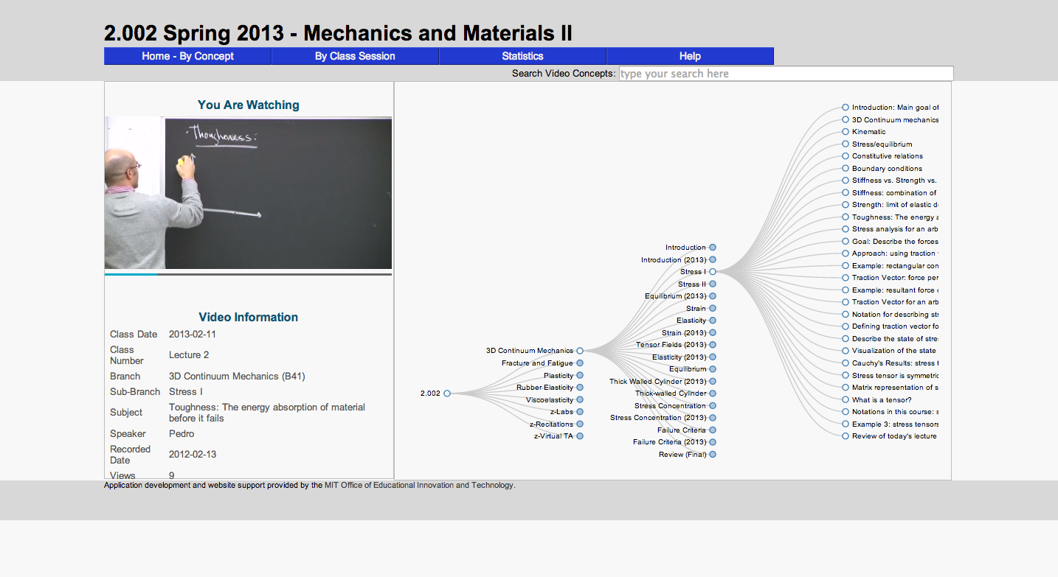
i2.002 Website

Slide 13
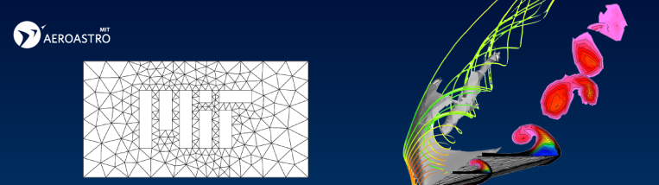
16.20/16.90 Aero/Astro
Flipped classroom with embedded assessment
  Students review materials ahead of time
  Including answering questions embedded in content
  Quick feedback loop allowing faculty to address items in class, with examples

Slide 14
Open Embedded Assessment
edX presents content and embedded assessment tightly linked
  Quick feedback loops
  Lots of opportunity to practice/apply
OEIT New Project: Embed formative assessment in any web-based content
  Overcome limitations of current approaches

Slide 15
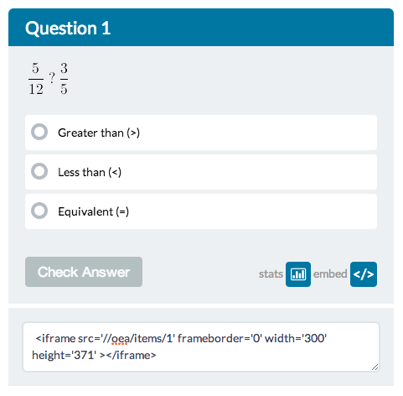
Open Embedded Assessment
Notes:
Powerfully simple idea

Slide 16
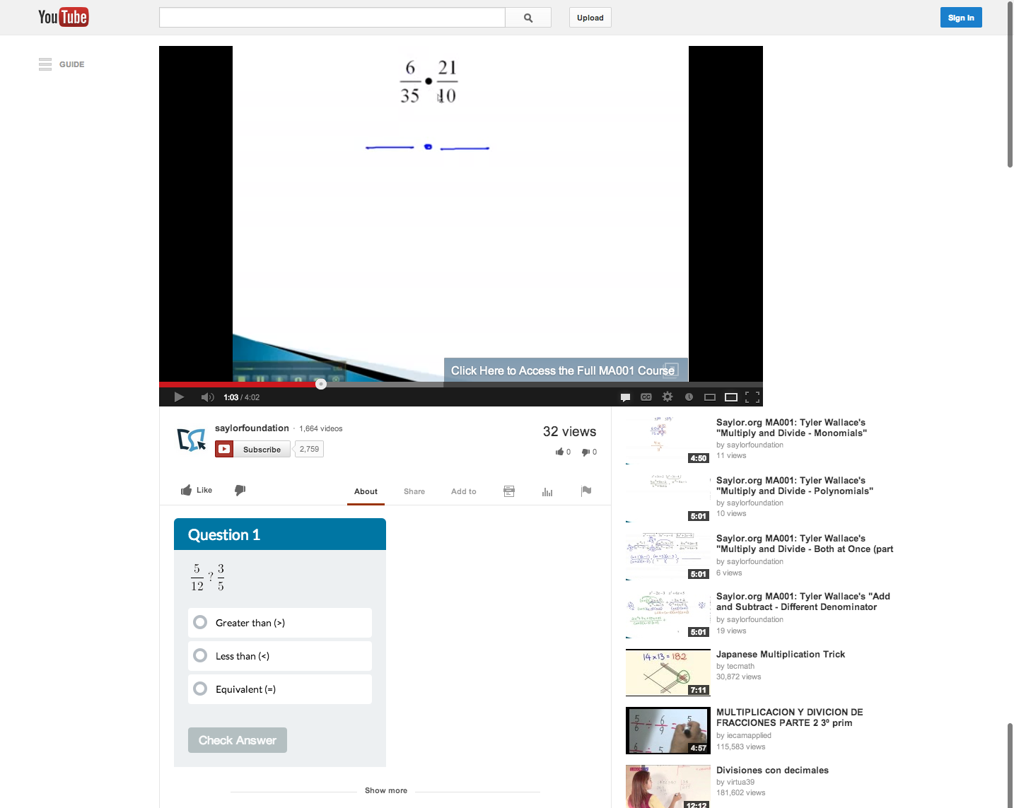

Slide 17
“More” EdTech Stuff in OEIT
Collaborations in Online Teacher Education and Professional Development
  MIT-Haiti Initiative & EDC-Pakistan
Interactive software, visualizations
  StarGenetics, StarBiochem
Infrastructure software development
  MIT Core Concept Catalog & Repositories
Collaborations with Community Colleges

Slide 18
Contact Me
Brandon Muramatsu
mura@mit.edu
@bmuramatsu (Twitter, Slideshare)
Citation: Muramatsu, B. (2013, June). The “Other” EdTech “Stuff” at MIT. Plenary Presentation at LINC 2013, June 19, 2013.
Notes:
Citation: Muramatsu, B. (2013, April). The “Other” EdTech “Stuff” at MIT. Plenary Presentation at LINC 2013, June 19, 2013.
Unless otherwise specified, this work is licensed under a Creative Commons Attribution 3.0 United States License

