Slide 1

Enabling Digital eXchange
Dale Allen, Ph.D. – QCC
Jeff Merriman – MIT
Brandon Muramatsu – MIT
Domy Raymond – USA Funds
Mike Reilly – ACCRAO
Presentation to
October 22 – 23, 2015
Notes:
Cite as: Allen, D., Merriman, J., Muramatsu, B. Raymond, D. & Reilly, M. (2015). DXtera enabling digital exchange. Grantmakers for Education. San Francisco, CA.
Unless otherwise specified this work is licensed under a Creative Commons Attribution 4.0 International License.
Image: Canva, Used under Canva One Time Use License, https://about.canva.com/license-agreements/onetime/

Slide 2
Survey: bit.ly/dx-gfe
What areas are you interested in data integration and/or tools and application development?
  Academic and/or career planning
  Program development
  Program assessment
  Student tracking
  Other?
If you are a funder, what investments have you made for educational data integration? Have you funded the development of any tools or applications? If yes, what tools? How many schools, states or systems does your investment support?
If you are a practitioner, what data are you trying to integrate, and why?
Notes:
Cite as: Allen, D., Merriman, J., Muramatsu, B. Raymond, D. & Reilly, M. (2015). DXtera enabling digital exchange. Grantmakers for Education. San Francisco, CA.
Unless otherwise specified this work is licensed under a Creative Commons Attribution 4.0 International License.

Slide 3
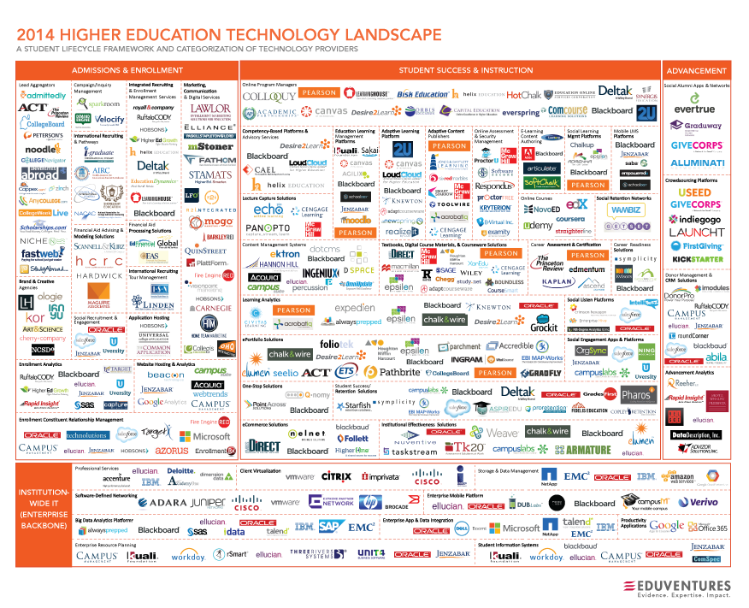
http://www.eduventures.com/2014/09/higher-education-landscape/#
Notes:
Source: http://www.eduventures.com/2014/09/higher-education-landscape/#

Slide 4

Mr. Potato Head
...Picasso Sculpts Van Gogh… by flickr/darrentunnicliff, CC-By-NC-ND 2.0
Notes:
Image: ...Picasso Sculpts Van Gogh… by flickr/darrentunnicliff, CC-By-NC-ND 2.0

Slide 5
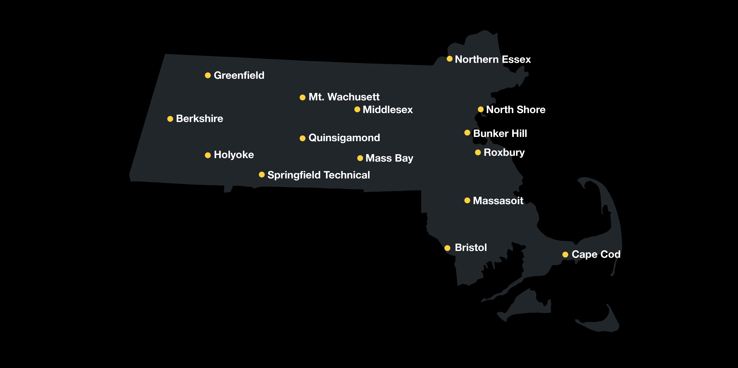

Transformation Agenda
Scaling Innovations
for student success
Massachusetts
Community Colleges
Key Partners
+ Massachusetts Executive Office of Labor
& Workforce Development
+ Massachusetts Executive Office of Housing
& Economic Development
+ Massachusetts Department of Career Services
+ Massachusetts Department of Elementary
& Secondary Education
+ Massachusetts Department of Higher Education
+ One-Stop Career Centers
+ Massachusetts Workforce Investment
Board Association
+ Industry Representatives
Notes:
Cite as: Allen, D., Merriman, J., Muramatsu, B. Raymond, D. & Reilly, M. (2015). DXtera enabling digital exchange. Grantmakers for Education. San Francisco, CA.
Unless otherwise specified this work is licensed under a Creative Commons Attribution 4.0 International License.

Slide 6
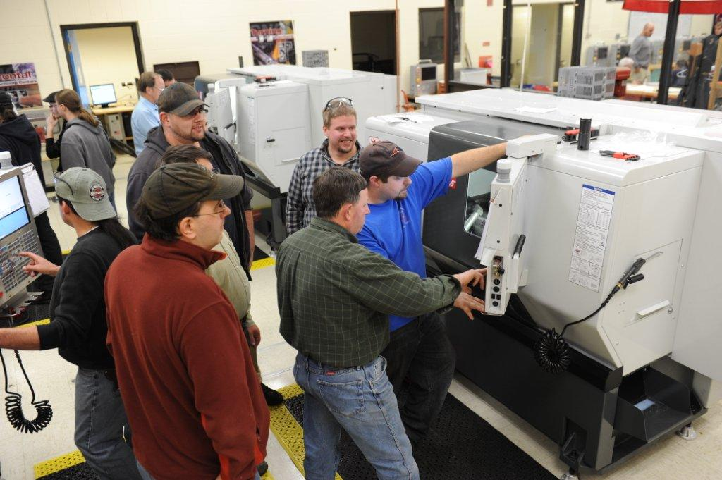
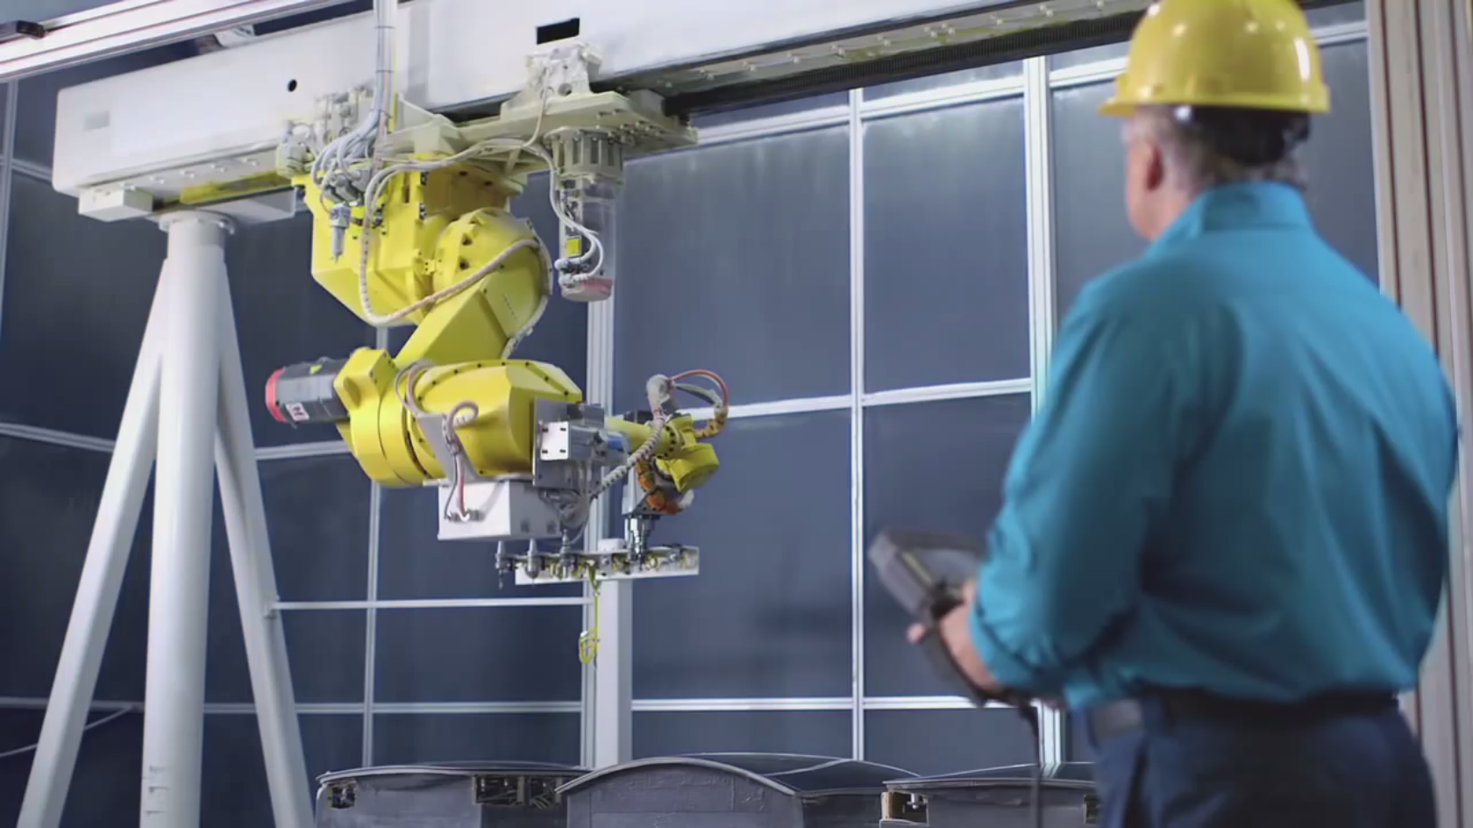
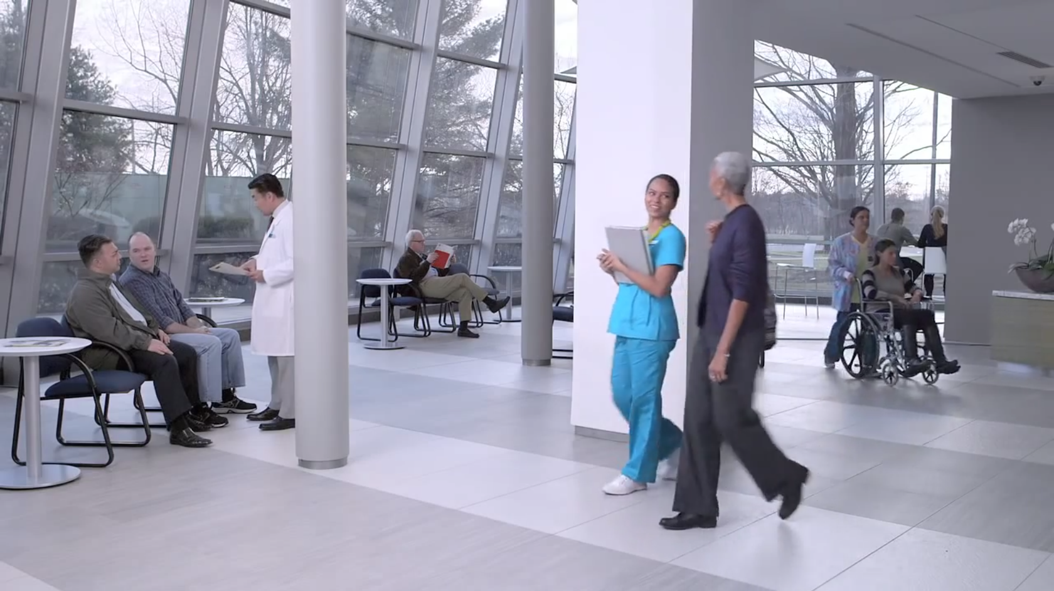

Transformation Agenda Mission
STUDENT SUCCESS THROUGH
INNOVATIVE
STUDENT
SUPPORTS
NEW PROGRAM
DESIGN &
ACCELERATED
CAREER PATHWAYS
LEVERAGE
TECHNOLOGY
Notes:
Cite as: Allen, D., Merriman, J., Muramatsu, B. Raymond, D. & Reilly, M. (2015). DXtera enabling digital exchange. Grantmakers for Education. San Francisco, CA.
Unless otherwise specified this work is licensed under a Creative Commons Attribution 4.0 International License.

Slide 7
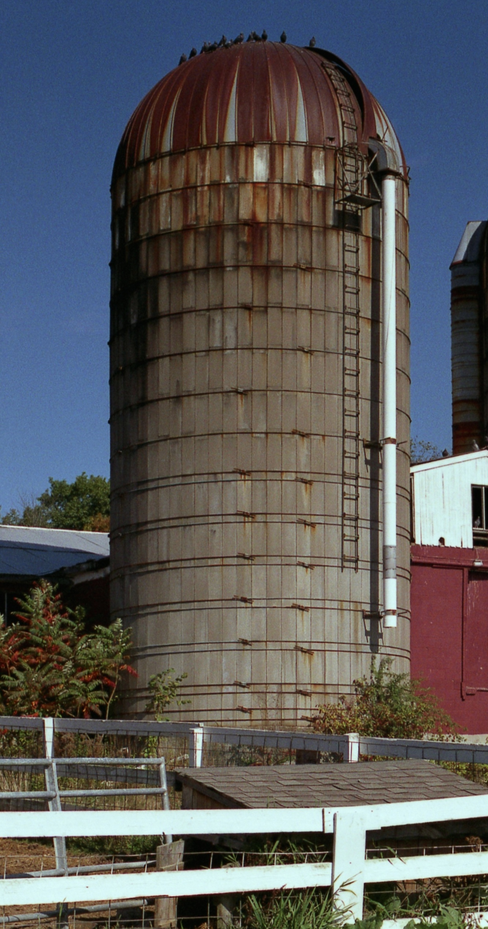
The Challenge
DATA SILOS IN MASSACHUSETTS
15 Community Colleges
4 Student Information Systems
15 Learning Management Systems
33 Career Centers
2 State Agencies
Silos Photo Here
Jeff has one we can use
Image: Silo183 by Jeff Merriman, CC-By 4.0
Notes:
Cite as: Allen, D., Merriman, J., Muramatsu, B. Raymond, D. & Reilly, M. (2015). DXtera enabling digital exchange. Grantmakers for Education. San Francisco, CA.
Unless otherwise specified this work is licensed under a Creative Commons Attribution 4.0 International License.
Image: Silo183 by Jeff Merriman, CC-By 4.0

Slide 8
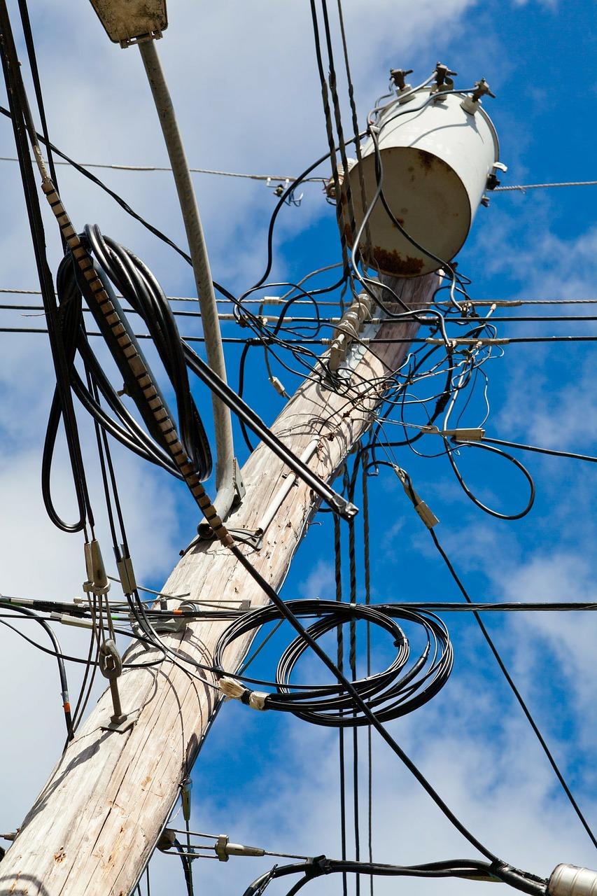
Point-to-Point Integration
Telephone pole,, CC0
Notes:
Cite as: Allen, D., Merriman, J., Muramatsu, B. Raymond, D. & Reilly, M. (2015). DXtera enabling digital exchange. Grantmakers for Education. San Francisco, CA.
Unless otherwise specified this work is licensed under a Creative Commons Attribution 4.0 International License.
Image: Telephone pole, https://pixabay.com/en/industrial-mess-electric-power-69750/, CC0
Point Solutions:
Cost prohibitive
$$ for customized modules updates
Requires TA for modules

Slide 9
This can’t scale!
How can we rethink existing processes?
Student
Telephone pole,, CC0
Notes:
Cite as: Allen, D., Merriman, J., Muramatsu, B. Raymond, D. & Reilly, M. (2015). DXtera enabling digital exchange. Grantmakers for Education. San Francisco, CA.
Unless otherwise specified this work is licensed under a Creative Commons Attribution 4.0 International License.
Image: Telephone pole, https://pixabay.com/en/industrial-mess-electric-power-69750/, CC0
Need real-time solution – have to wait 6 months until DHE aggregates and updates their system
Can’t scale
number of integrations increases exponentially as you add more colleges

Slide 10
National Challenges
SIS SILOS
SIS are the most customized of institutional enterprise systems
87% of institutions maintain at least some SIS customization
SIS rank among the oldest institutional enterprise systems at an average 13 years old
http://net.educause.edu/ir/library/pdf/ERB1411.pdf
Image: Silo183 by Jeff Merriman, CC-By 4.0
Notes:
Cite as: Allen, D., Merriman, J., Muramatsu, B. Raymond, D. & Reilly, M. (2015). DXtera enabling digital exchange. Grantmakers for Education. San Francisco, CA.
Unless otherwise specified this work is licensed under a Creative Commons Attribution 4.0 International License.
Image: Silo183 by Jeff Merriman, CC-By 4.0
SIS are still the backbone of the college data systems

Slide 11
Enabling Digital eXchange
Federated Program Search
Shared Case Management
Guided Pathways, Scheduling
Labor
Analysis
Predictive Analytics
Digital eXchange
College A
College B
Career
Center
Dept. of Ed
Notes:
Cite as: Allen, D., Merriman, J., Muramatsu, B. Raymond, D. & Reilly, M. (2015). DXtera enabling digital exchange. Grantmakers for Education. San Francisco, CA.
Unless otherwise specified this work is licensed under a Creative Commons Attribution 4.0 International License.

Slide 12
Case Study #1
Proof of concept
Federated Student Information System (SIS) integration
Notes:
Cite as: Allen, D., Merriman, J., Muramatsu, B. Raymond, D. & Reilly, M. (2015). DXtera enabling digital exchange. Grantmakers for Education. San Francisco, CA.
Unless otherwise specified this work is licensed under a Creative Commons Attribution 4.0 International License.
Image: Canva, Used under Canva One Time Use License, https://about.canva.com/license-agreements/onetime/

Slide 13
Proof of Concept Application
Federated program search
Federated Program Search App
Digital eXchange
Quinsigamond
Community College
Middlesex
Community College
Bristol
Community College
Mass Dept. of Higher Education
Jenzabar SIS
Banner SIS
Banner SIS
HEIRS Longitudinal Database
Notes:
Cite as: Allen, D., Merriman, J., Muramatsu, B. Raymond, D. & Reilly, M. (2015). DXtera enabling digital exchange. Grantmakers for Education. San Francisco, CA.
Unless otherwise specified this work is licensed under a Creative Commons Attribution 4.0 International License.

Slide 14
Demo
Federated Program Search
Notes:
Cite as: Allen, D., Merriman, J., Muramatsu, B. Raymond, D. & Reilly, M. (2015). DXtera enabling digital exchange. Grantmakers for Education. San Francisco, CA.
Unless otherwise specified this work is licensed under a Creative Commons Attribution 4.0 International License.
Image: Canva, Used under Canva One Time Use License, https://about.canva.com/license-agreements/onetime/

Slide 15
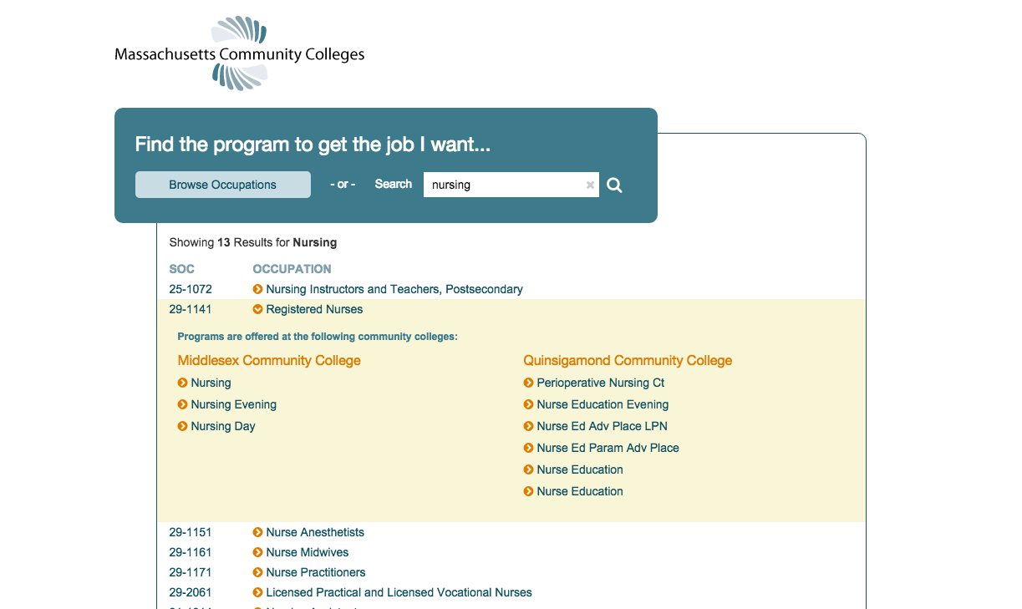
Demo Screenshot
Notes:
Cite as: Allen, D., Merriman, J., Muramatsu, B. Raymond, D. & Reilly, M. (2015). DXtera enabling digital exchange. Grantmakers for Education. San Francisco, CA.
Unless otherwise specified this work is licensed under a Creative Commons Attribution 4.0 International License.

Slide 16
Bring to Scale
Federated program search
Notes:
Cite as: Allen, D., Merriman, J., Muramatsu, B. Raymond, D. & Reilly, M. (2015). DXtera enabling digital exchange. Grantmakers for Education. San Francisco, CA.
Unless otherwise specified this work is licensed under a Creative Commons Attribution 4.0 International License.

Slide 17
Case Study #2
Predictive Analytics tools
Notes:
Cite as: Allen, D., Merriman, J., Muramatsu, B. Raymond, D. & Reilly, M. (2015). DXtera enabling digital exchange. Grantmakers for Education. San Francisco, CA.
Unless otherwise specified this work is licensed under a Creative Commons Attribution 4.0 International License.
Image: Canva, Used under Canva One Time Use License, https://about.canva.com/license-agreements/onetime/

Slide 18
Case Study – Trajectory Analytics
TennesSee Board of Regents
Tristan Denley, PH.d Vice Chancellor for Academic Affairs
Tennessee Board of Regents
Notes:
Cite as: Allen, D., Merriman, J., Muramatsu, B. Raymond, D. & Reilly, M. (2015). DXtera enabling digital exchange. Grantmakers for Education. San Francisco, CA.
Unless otherwise specified this work is licensed under a Creative Commons Attribution 4.0 International License.

Slide 19

Case Study – Trajectory Analytics
Current State
Tennessee Board of Regents
Notes:
Cite as: Allen, D., Merriman, J., Muramatsu, B. Raymond, D. & Reilly, M. (2015). DXtera enabling digital exchange. Grantmakers for Education. San Francisco, CA.
Unless otherwise specified this work is licensed under a Creative Commons Attribution 4.0 International License.

Slide 20
Case Study – Trajectory Analytics
Inserting DX Integration
Tennessee Board of Regents
Notes:
Cite as: Allen, D., Merriman, J., Muramatsu, B. Raymond, D. & Reilly, M. (2015). DXtera enabling digital exchange. Grantmakers for Education. San Francisco, CA.
Unless otherwise specified this work is licensed under a Creative Commons Attribution 4.0 International License.

Slide 21
Case Study – Trajectory Analytics
Deploy for QCC
Quinsigamond
Community College
Notes:
Cite as: Allen, D., Merriman, J., Muramatsu, B. Raymond, D. & Reilly, M. (2015). DXtera enabling digital exchange. Grantmakers for Education. San Francisco, CA.
Unless otherwise specified this work is licensed under a Creative Commons Attribution 4.0 International License.

Slide 22
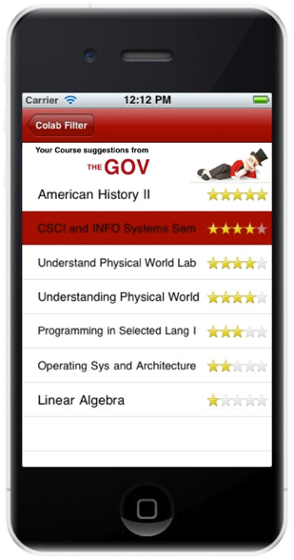
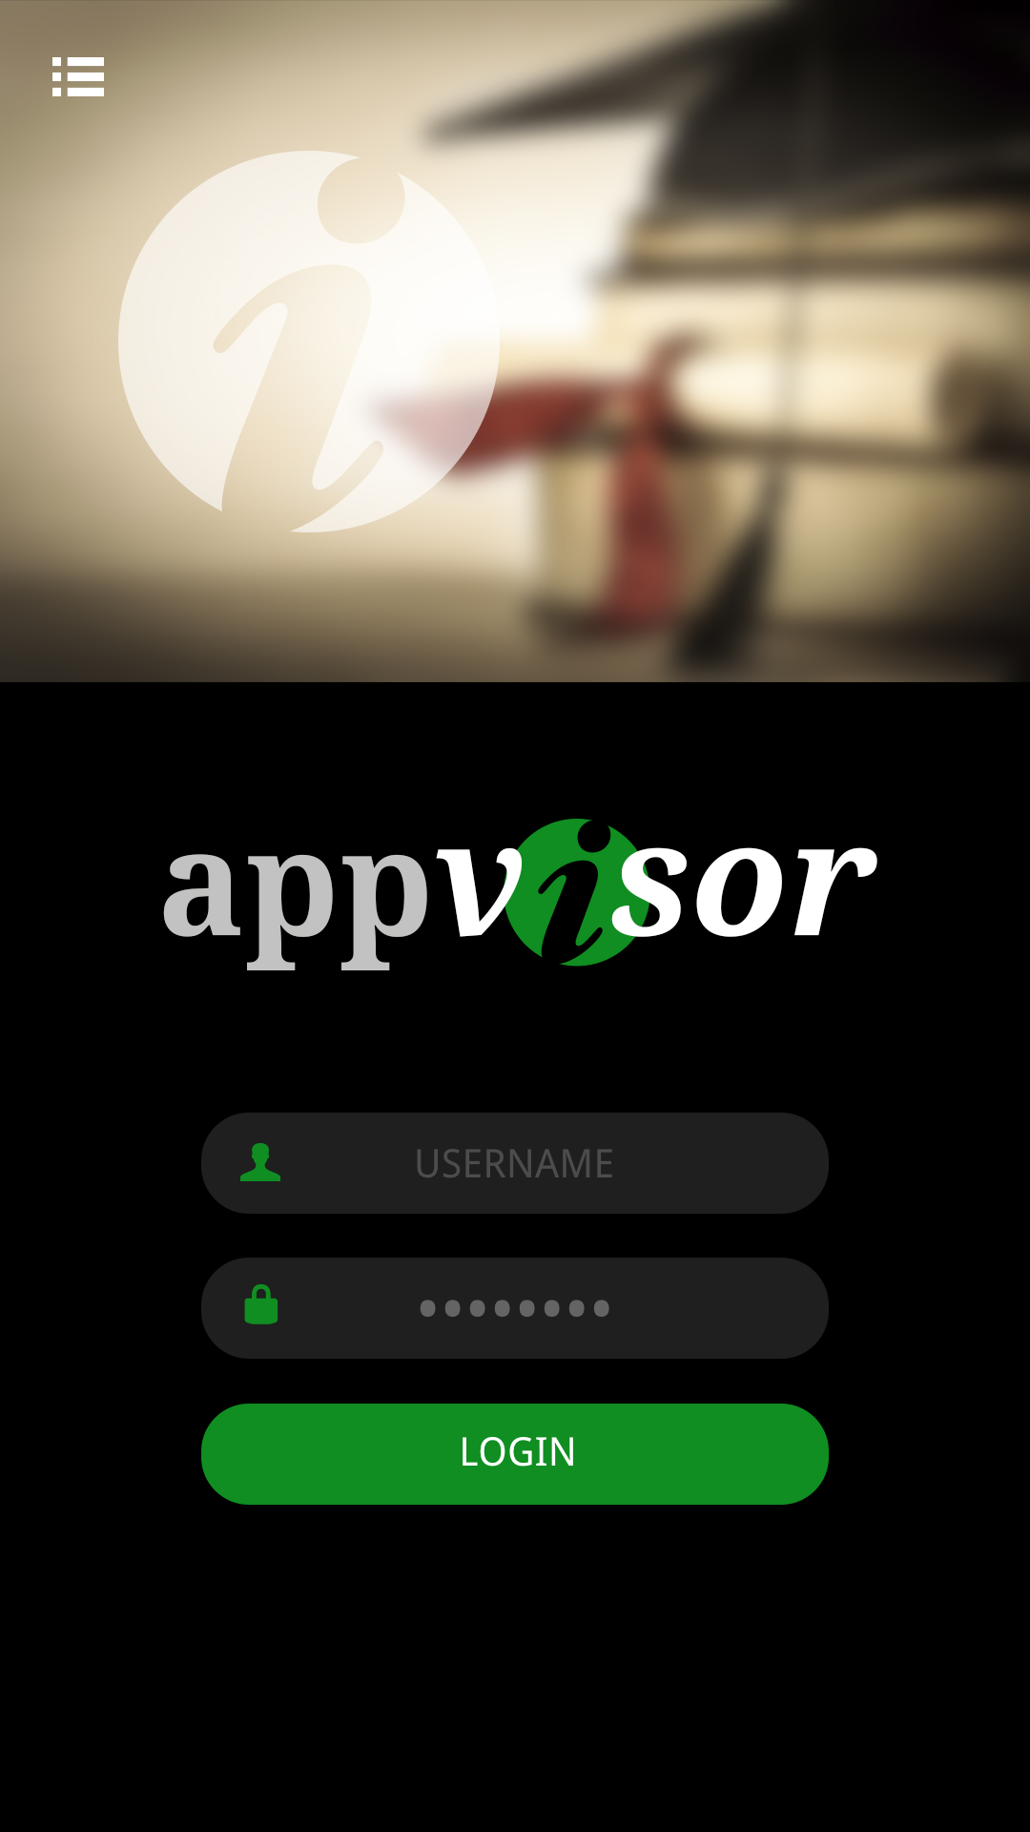
Case Study – Trajectory Analytics
AppVisor
Tennessee Board of Regents
Notes:
Cite as: Allen, D., Merriman, J., Muramatsu, B. Raymond, D. & Reilly, M. (2015). DXtera enabling digital exchange. Grantmakers for Education. San Francisco, CA.
Unless otherwise specified this work is licensed under a Creative Commons Attribution 4.0 International License.

Slide 23
Wrap up

Slide 24
Enabling Digital eXchange
Contact Us
Dale Allen, Ph.D.
dallen@qcc.mass.edu
Vice President for Community Engagement
Quinsigamond Community College
Jeff Merriman
merriman@mit.edu
Associate Director
Strategic Education Initiatives, Office of Digital Learning
Massachusetts Institute of Technology
Notes:
Cite as: Allen, D., Merriman, J., Muramatsu, B. Raymond, D. & Reilly, M. (2015). DXtera enabling digital exchange. Grantmakers for Education. San Francisco, CA.
Unless otherwise specified this work is licensed under a Creative Commons Attribution 4.0 International License.

Slide 25
Credits
Ball and Stick image: Canva One Time Use Licensehttps://about.canva.com/license-agreements/onetime/
...Picasso Sculpts Van Gogh... (Mr. Potato Head) by flickr/darrentunnicliff
https://www.flickr.com/photos/darrentunnicliff/3448543264/
CC-By-NC-ND 2.0
Telephone pole: https://pixabay.com/en/industrial-mess-electric-power-69750/
CC0 Public Domain (https://pixabay.com/en/service/terms/#usage)
Silo: Jeff Merriman
CC-By 4.0 (https://creativecommons.org/licenses/by/4.0/)
Icons: Font Awesome
SIL OFL 1.1(http://scripts.sil.org/OFL)

