Slide 1
FEDERATIONS & BACKSTAGE Thoughts for a Geoscience Education Infrastructure
Brandon Muramatsu, mura@mit.edu
Cite as: Muramatsu, B. (2019, November). Federations & Backstage: Thoughts for a Geoscience Education Infrastructure.

Slide 2
Brief Background
To build a successful National SMETE Digital Library for deployment in Fall 2002…
That focuses on science, mathematics, engineering and technology at all levels
And more importantly, it focuses on education
…we needed to develop a team…
To overcome the challenges we face in developing a National SMETE Digital Library
To cover target audiences and disciplines
To share in the development efforts
Unless otherwise specified this work is licensed under a Creative Commons Attribution 4.0 International License.

Slide 3
The SMETE Open Federation is committed to providing a service
to support learning
across disciplines in science, mathematics, engineering and technology
providing access to high-quality resources
in support of education reform and cross-disciplinary learning
from K-12 to higher education to professional development
by identifying and working with partners
Unless otherwise specified this work is licensed under a Creative Commons Attribution 4.0 International License.

Slide 4
SMETE Open Federation |  |  | Universities
Access Excellence @ the National Health Museum (www.accessexcellence.org) American Association for the Advancement of Science (www.aaas.org) Association for Women in Science (www.awis.org) Biology Education Online (www.accessexcellence.org/LC/BEOn/) BioQUEST Curriculum Consortium (www.bioquest.org) Biosci Ed Net (www.benproject.org) CITIDEL (www.citidel.org) Coalition for Networked Information (www.cni.org) Computer Science Teaching Center (www.cstc.org) Digital Library for Earth Systems Education (www.dlese.org) | Education Development Center (www.edc.org) Eisenhower National Clearinghouse for Mathematics and Science Education (www.enc.org) iLumina (www.ilumina-project.org) Instructional Architect (ia.usu.edu) Interactive University (iu.berkeley.edu) Internet Scout Project (scout.cs.wisc.edu) Learning Matrix (thelearningmatrix.enc.org) LearningOnline Network with CAPA (www.lon-capa.org) Mathematical Association of America (www.maa.org) Mathematical Sciences Digital Library (www.mathdl.org) Math Forum (www.mathforum.org) | MERIT Network (www.merit.edu) Michigan Teacher Network (mtn.merit.edu) MERLOT (www.merlot.org) National Center for Supercomputer Applications (www.ncsa.org) NEEDS—National Engineering Education Delivery System* (www.needs.org) Project Kaleidoscope (www.pkal.org) SRI International, Center for Technology in Learning (www.cilt.org & www.escot.org) TeacherLIB (www.teacherlib.org) | California State University (www.calstate.edu) California State University, Sacramento (www.csus.edu) Eastern Michigan University (www.emich.edu) University of California Teaching and Learning with Technology Center (www.uctltc.org) University of California at Berkeley (www.berkeley.edu) University of California Office of the President, Academic Initiatives (www.ucop.edu/acadinit/) University of Florida (www.ufl.edu) University of Maryland, Baltimore County (www.umbc.edu) Utah State University (www.usu.edu) Virginia Tech (www.vt.edu)

Slide 5
Development Philosophy
The difference is learning, not just bibliographic information retrieval
Teaching and learning require something more
Guided by user needs and philosophy of education that is constructivist
Link content to community and services
Build integrative tools and incorporate “best of breed” tools from partners
Unless otherwise specified this work is licensed under a Creative Commons Attribution 4.0 International License.

Slide 6
Setup: The Problem at MIT
“MITx needs to add a Content Management System (CMS) for course asset status tracking and reporting, search and reuse, and archiving. While OCW’s custom-built CMS currently serves its needs, over time there may be prospects to align or integrate CMS across all ODL projects.”
Muramatsu, Merriman & Shaw August 2014
Streamlining Open Education and Production Workflows Executive Summary, ODL Work Team #1

Slide 7
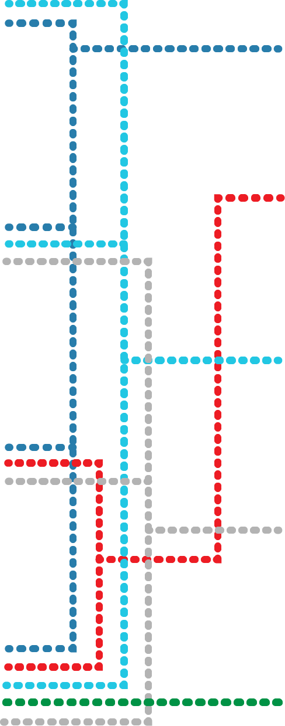
Backstage Core Service Suite
Educational Content Related Services
Sample Applications
Assessments
Producer
VCB
Assets
Embedded Assessment
Videos
Videos
PRISM
Learning Objectives
MC3
MIToces
Course
Grading
Authorization
Logging
Commenting / Annotating
Mapping
Journaling / Versioning
Others…

Slide 8
Backstage Content Services
“Headless” content services with published APIs
Open Service Interface Definitions, osid.org
Implementations: REST, Python, Java
Enables key applications, separate yet interoperable
Enables a developer community for product development and functional enhancements

Slide 9
Backstage Core Service Suite
Educational Content Related Services
Sample Applications
Assessments
Producer
VCB
Assets
Embedded Assessment
Videos
Videos
PRISM
Learning Objectives
MC3
MIToces

Slide 10
Auxiliary Services
Additional services play auxiliary roles
MIT services already available or in the pipeline
IS&T’s Membership and Roles Services
Stellar Grading Service
Logging
Basic Course/Subject information from MIT’s Data Warehouse
Course
Grading
Authorization
Logging
Commenting / Annotating
Mapping
Journaling / Versioning
Others…

Slide 11
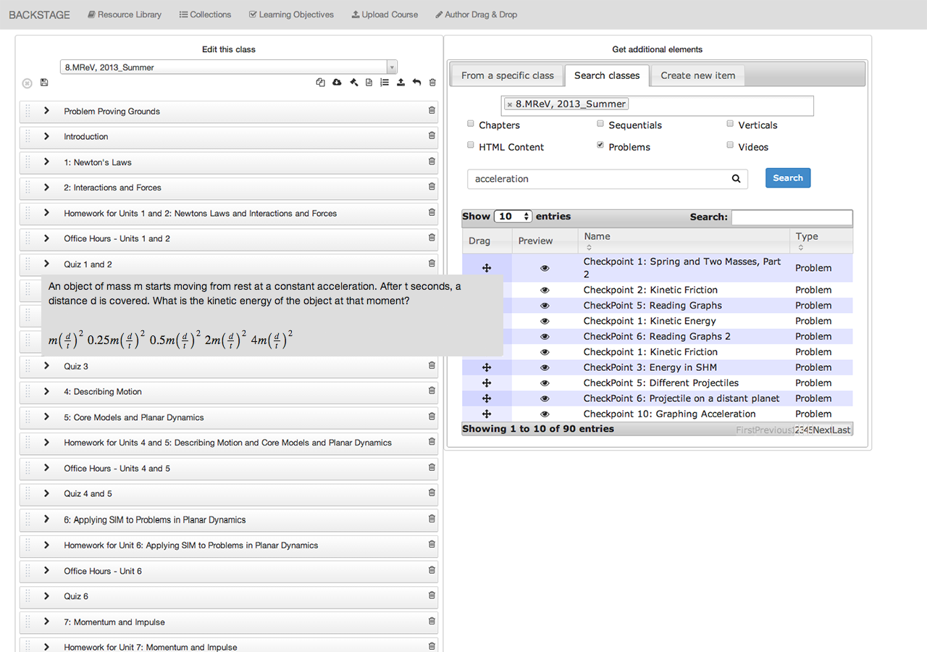
Producer
MIT Online Course Platforms
Muramatsu, Merriman & Shaw August 2014
Assessments
Producer
Assets
Videos
Videos
Learning Objectives
MC3
Notes:
Producer is a flagship application in MIT’s educational content management strategy.
It will provide for authoring, search and re-use of MITx & MITr content and courses as well as export to edX & OCW formats for course delivery.
Producer includes plug-in architecture for service integration and export schemas (e.g., IMS Common Cartridge—used by Canvas, etc).

Slide 12
Video Concept Browser (VCB)
Muramatsu, Merriman & Shaw August 2014
Assessments
VCB
Navigate course video by concept
or learning outcome
Need to refactor /
Rebuild to include
Asset service
Assets
Videos
Learning Objectives
MC3
Notes:
The Video Concept Browser allows learners and faculty to navigate course video by concept or learning outcome.
It uses traditional lecture video and provides tools to enable faculty to assign concepts/learning outcomes to specific timepoints.

Slide 13
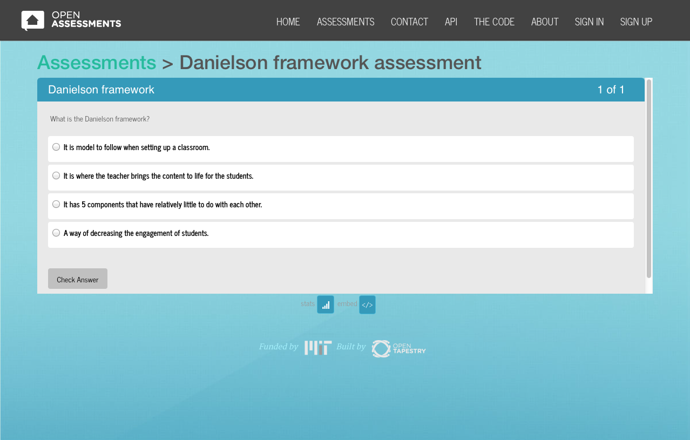
Embedded Assessment
Muramatsu, Merriman & Shaw August 2014
Assessments
Embedded Assessment
Embed assessment directly in
content anywhere and everywhere
Assets
Videos
Learning Objectives
MC3
Notes:
Embedded Assessment provides faculty and course developers the ability to embed formative assessment in any web accessible content.
We believe that by making it easy to embed assessment directly in content anywhere and everywhere, we have the potential to dramatically increase learning effectiveness.

Slide 14
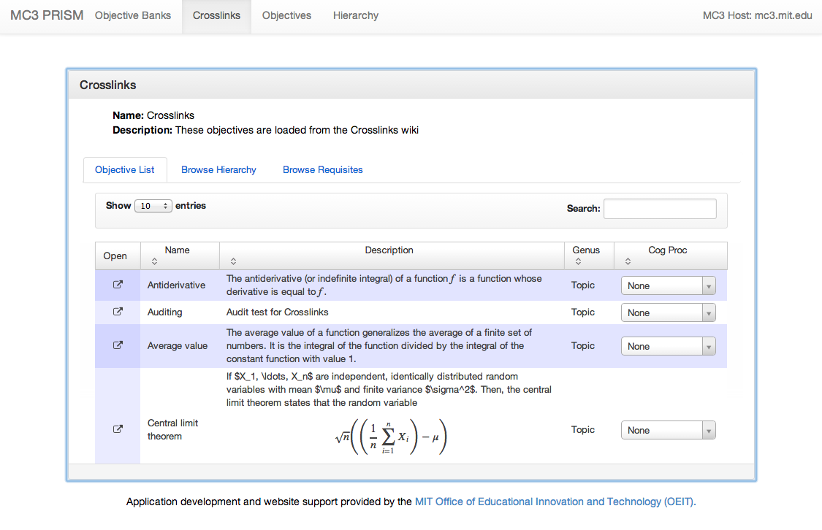
PRISM – Learning Objective Management
Muramatsu, Merriman & Shaw August 2014
Assessments
Prism
Author and catalog the topics and learning
outcomes presented within a given curriculum
Assets
Videos
Learning Objectives
MC3
Notes:
Prism provides educators the ability to author and catalog the topics and learning outcomes presented within a given curriculum, describe the interrelationships between these ideas, and link them to any variety of supporting materials from anywhere on the Web—videos, simulations, articles, or quizzes.

Slide 15
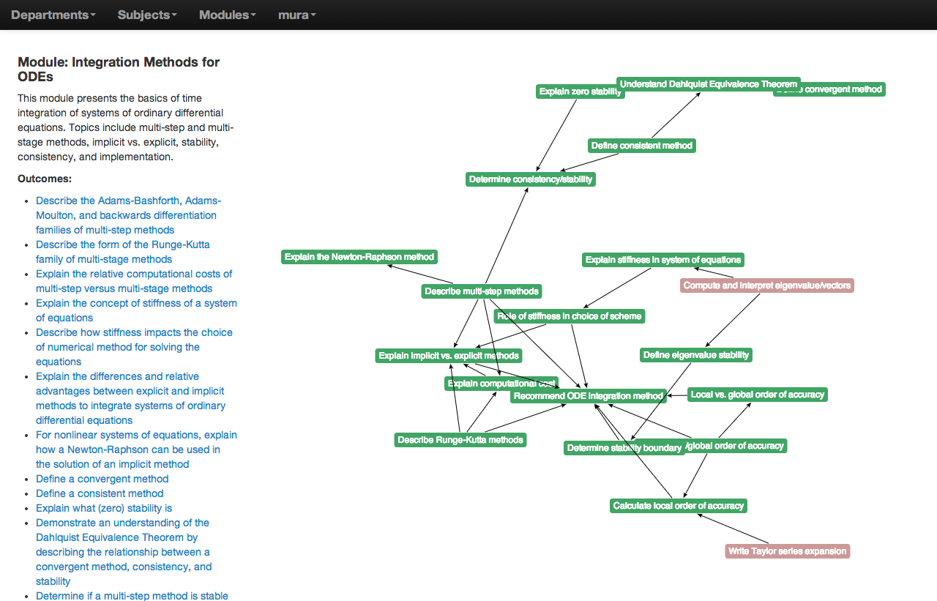
MIToces – Curricular Module Mapping
Muramatsu, Merriman & Shaw August 2014
Assessments
MIToces
Document, group and connect learning outcomes
across the undergraduate curriculum at MIT
Assets
Videos
Learning Objectives
MC3
Notes:
MIToces will document, group and connect learning outcomes across the undergraduate curriculum at MIT.
MIToces is beginning with the undergraduate curriculum in the Department of Aeronautics and Astronautics.
MIToces developers are exploring effective ways to display the information graphically and for exploiting shared resources related to learning outcomes.

Slide 16
Status – Service Design
Interface Definitions – Complete
Developer Toolkits – Dev/Testing/Refinement
Java toolkit
Python toolkit (DLKit)
RESTful Interface Design
Complete for Learning Objectives
Under development for Assessment, Repository
RESTful Implementations
Complete for Learning Objectives (MC3)
Muramatsu, Merriman & Shaw August 2014

Slide 17
Status – Learning Objective Service
Production service released Fall 2013
Initial “internal” applications
Crosslinks 2, Crosslook, Prism, browser extension, Salaam/CMAP
Initial “external” applications
TLL CurriMap application, Spring 2014
MITOCES (K. Willcox)
Crosslinks 3 (K. Willcox, H. Miller)
Other potential “external” implementation:
MIT Institutional Research is investigating MC3 for management of ABET accreditation process (J. Daries)
Muramatsu, Merriman & Shaw August 2014

Slide 18
Status — Assessment Services
Production service released circa 2014
Two “internal” projects:
Connected Learning Initiative Open Embedded Assessments
Project delivered to India project partners, includes authoring interfaces and players
Community College 3D Visualization Exercises
Project delivered 2013 to community colleges, including assessment bank
Two “external” proof-of-concept projects:
MIT Physics Question Bank
Project scoped, internally resourced, development underway, Fall 2013 delivery, currently identifying content (I. Chuang, D. Pritchard)
OCW/18.05r Embedded Assessments
Project scoped, development underway, Fall 2013 delivery (J. Orloff, J. Bloom)
Muramatsu, Merriman & Shaw August 2014

Slide 19
Status — Asset Services
Production service released circa 2013
“Internal” implementation
Part of CLIx Open Embedded Assessment
Potential “third-party” service: Pragya KnowledgeHub
Designed roughly to service specifications
Integration possible, but not yet scoped
Exploring business model and pricing with Pragya
Muramatsu, Merriman & Shaw August 2014

Slide 20
Status — Video Services
Same core service model as for Assets
Video Asset Service
Project defined and scoped for initial use at MIT (not implemented)
Muramatsu, Merriman & Shaw August 2014

