Slide 1
Services to Link OpenCourseWare Repositories and the NSDL
Brandon Muramatsu
Licensed Under a Creative Commons Attribution-ShareAlike License (http://creativecommons.org/licenses/by-sa/3.0/)
Cite as: Muramatsu, B.. (March, 2007). Services to Link OpenCourseWare Repositories and the NSDL. Pedagogical Services Workshop, Carleton, MN.
Notes:
OCW Finder
Proof of concept, will be updated and put into full production later in 2007
Based of RSS/meta tag Dublin Core Metadata
Browse interface
Portals: OCW Consortium, each OCW, OER portals

Slide 2
Outline
OpenCourseWare Repositories
Proposed Work (NSDL)
MOCSL Tools
Future Steps
Or something completely different…

Slide 3
Open Enables Quite A Bit!

Slide 4
OpenCourseWare (OCW) Repositories
OpenCourseWare started by MIT in 2002
“Publication” of MIT providing access to course materials
Key Aspects
Does not grant degrees
Does not provide access to faculty*
Course materials (content varies in depth and breadth)
Licensed “openly” (aka “open content”), using a Creative Commons Attribution-NonCommercial-ShareAlike* license
1550 courses published (of 1800 anticipated)
MIT OCW, ~640,000 monthly visits (09/2006)

Slide 5
OCW Movement
Movement expands outside of MIT
Tufts, Johns Hopkins School of Public Health, Utah State University
MIT OCW Translation Partners in Taiwan, China, Universia (in Latin America and Europe)
Notre Dame, British Open University, Open University of the Netherlands
OCW Consortium (launched 2006)
Over 100 members
Over 3,000 courses published
www.ocwconsortium.org
Consortium-wide, ~810,000 monthly visits (est., 09/ 2006)

Slide 6
eduCommons
OpenCourseWare Management System developed at Utah State
Content management and publication
Platform for services
Adopters
In production: Notre Dame, OUNL, Utah State, Wheelock
Pilots underway: 10-20*
Planned adoptions: Kyoto University (and Japan OCW Consortium), CORE (China), Universia
Funded by the Hewlett Foundation
http://cosl.usu.edu/projects/educommons/

Slide 7
Relevant Challenges and Opportunities
Wide range of content
Few courses media rich
Fewer interactivity rich
A number of universities are adopting eduCommons
Most universities focused on content publication
NSDL, Pathways and Learning Object Repositories have both
Common platform for shared solutions
Utah State is the “tools” and services provider to the OCW Consortium

Slide 8
Proposed Work (NSDL)
Improve discoverability of courses in OCW repositories
Federated search of OCW repositories
Portal to OCW repositories
Harvest metadata of OCW repositories
Improve user experience by providing a combination of rich content and context
Find NSDL resources from OCW repositories
Use OCW courses to provide context for NSDL content

Slide 9
OCW Metadata, Search and Portal
“Web 2.0” approach
Metadata
RSS feeds of Dublin Core metadata forthcoming for all OCW Consortium members (MIT OCW, all eduCommons adopters already doing this)
Richer metadata for eduCommons adopters
Low barrier to entry
Enables Utah State to build tools to enable federated search and OAI-PMH for consortium members

Slide 10
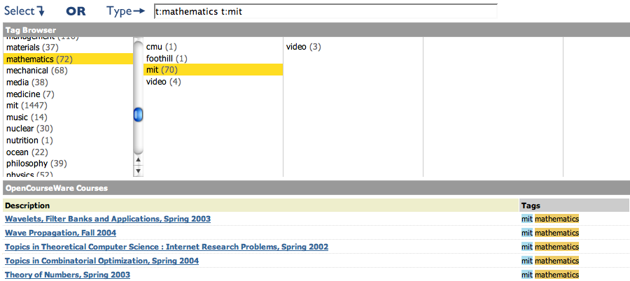
OCW Metadata, Search and Portal (cont.)
OCW Finder
Proof of concept, will be updated and put into full production later in 2007
Based of RSS/meta tag Dublin Core Metadata
Browse interface
Portals: OCW Consortium, each OCW, OER portals
http://www.opencontent.org/ocwfinder/

Slide 11
And then we took a slight detour…
Notes:
Continuing to develop eduCommons
Making eduCommons ready to accept external services
Working “social” aspect to get consortium members ready for external services
Exploring technologies to make adoption easier (Greasemonkey for Firefox, Plug-ins, Javascript code)
And then…

Slide 12
MOCSL Tools
Learner support for open content
Based on folksonomies and relational data
“Web 2.0”
Funded by the Mellon Foundation
http://cosl.usu.edu/projects/mocsl/

Slide 13
MOCSL…
…the underlying infrastructure for our NSDL work

Slide 14
MOCSL Tools (cont.)
RelStore – store
OER Finder- find
Ozmozr.com – find, aggregate and share
Send2Wiki.com – create derivative works
Annorate – annotate and rate
MakeaPath.com – sequence
Scrumdidilyumptio.us – relate

Slide 15
MOCSL Tools (cont.)
RelStore – store 
OER Finder- find 
Ozmozr.com – find, aggregate and share
Send2Wiki.com – create derivative works
Annorate – annotate and rate
MakeAPath.com – sequence 
Scrumdidilyumptio.us – relate 

Slide 16
Brief Demo
Didily – relate
Describes relations between websites, uses folksonomic descriptions, stored in RelStore
http://scrumdidilyumptio.us/
Ozmozr – find, aggregate, share
Build online identity, share information, social filtering
http://ozmozr.com/
Send2Wiki – create, share
http://send2wiki.com/

Slide 17
Future Steps: Metadata, Search and Portals
Update OCW FinderOER Finder
Develop federated search across eduCommons repositories and RSS-harvested metadata
Build and expose web services
Setup OAI Provider for OCW Metadata (probably)

Slide 18
Future Steps: Content and Context
Collect metadata on courses and learning objects
Sequence and store data in MOCSL Tools
Build recommender system (LOCourse and CourseLO)
Build and expose web services
Test at eduCommons sites
Plan to test at MERLOT, NSDL

Slide 19
Pedagogical Services
Data feed and relationships (RSS)
Input and output
Recommender Services to enable OCW<->NSDL relationships
Work to begin in April

Slide 20
Questions?
Brandon Muramatsu
Brandon.Muramatsu@usu.edu

Slide 21
Something Completely Different
How do you get scale?
How do you get relevant content/context at the right place at the right time?
How do you expose current content/context/relationships outside of initial deployment?
MOCSL

