Slide 1
OER Interoperability Sprint Outcomes:
Linking OER Providers
Brandon Muramatsu
Center for Open and Sustainable Learning
brandon.muramatsu@usu.edu
Originally Published 2008. Republished 2013. This work is licensed under a Creative Commons Attribution-Noncommercial-Share Alike 3.0 United States License (http://creativecommons.org/licenses/by-nc-sa/3.0/us/)

Slide 2
Outline
Introduction
  Background, challenges, definitions
  Goals, philosophy
OER Interoperability Sprint
  Participants, activities
Projects
Outcomes
Notes:
Introduction:
Background information on Center for Open and Sustainable Learning
Definitions: Of the terms used, Interoperability, OER, Sprint
Goals: What did we intend to do?
Philosophy: What drove our decisions?
Process
Participants: Who and from what organizations participated
Activities: How did we organize the activities that resulted in completed projects?
Projects
What were the projects we worked on
What projects are completed and available to end users
Outcomes
What did all this work result in?

Slide 3
Center for Open and Sustainable Learning (COSL)
Center for Open and Sustainable Learning
  Supported by the William and Flora Hewlett Foundation
    Andrew W. Mellon Foundation (Folksemantic)
    U.S. National Science Foundation (OER Recommender)
  “Center” with capacity to develop tools and services to support open educational resources
  Established at Utah State University in December 2005
  Founder Dr. David Wiley (learning objects, open content)

Slide 4
Challenges
Good intentions, life interrupts
  Meet colleagues at conferences, meetings
  Discuss interesting projects
  Go home, hard to keep momentum
  What’s the business case?
Individual projects
  Individual goals, activities
  Many people working on similar projects/activities, but not interconnected

Slide 5
Challenges (cont.)
Technology is easy, social stuff is more challenging
  Technology and standards/specifications are the easy part, getting people to work together and collaborate is more challenging

Slide 6
Challenges (cont.)
Standards and specifications
  Can be good
  Sometimes large, overly ambitious, overwhelming
  Sometimes difficult to implement
  Sometimes unclear why an organization should implement them
  Unclear return on investment, long payoffs versus short term investment

Slide 7
Definitions
Open Educational Resources
  What are they?: “Open educational resources are educational materials and resources offered freely and openly for anyone to use and under some licenses to re-mix, improve and redistribute.” (Wikipedia)
  Term developed by UNESCO in 2002
  “Movement”: Individuals and organizations worldwide working alone and together to further the concept of open access to education (teaching, learning, materials)

Slide 8
Definitions (cont.)
Sprint
  Concept/process from open source community
  Focused development by programmers who don’t normally work together, or work on the same projects
  Typically informal and little structure (usually lots of background organization)
  Various shapes, sizes, activities

Slide 9
Goals
Improve interoperability between open educational resources projects
Prototype implementations between projects
“Working code trumps all theory”
– Philip Dodds

Slide 10
Ultimate Goal—What are we really trying to do?
Improve end-user experience
  Educators, students, world-at-large
  Increase access and opportunity afforded by education
  Prevent “Unsatisfied User Syndrome” as described by Fabrizio Cardinali—it’s not ok!
…by…
  Getting projects to work together to extend access to OERs/content
  Interlinking content, projects, services

Slide 11
Philosophy
Working code is better than talk
Simple, simple, simple
Small focused projects
Meet immediate needs/interest of developers and users

Slide 12
December 2007 OER Interoperability Meeting
Goals:
  Set stage to enable collaboration
  Get “buy-in”/agreement on important issues
  Help leadership understand value
Participants
  Senior leadership from OER and related repositories/collections
  Primarily Hewlett Foundation OER Grantees

Slide 13
OER Interoperability Sprint :: February 2008
Held in February 2008, at COSL
  Operations staff & programmers from 9 organizations
  22 participants
Built on meeting in December 2007
  Executive directors and directors of technology
  Discussed bigger “issues” regarding interoperability
Step in journey, capacity-building

Slide 14
OER Interoperability Sprint Participants
Organization | Product/Service
COSL | OER Recommender, MakeAPath
Connexions | Connexions
Creative Commons | ccLearn Search
enPraxis | eduCommons OCW software
ISKME | OER Commons
MIT OEIT* | OKI
Open University UK | OpenLearn
OpenCourseWare Consortium | Blog aggregator and Search
Open Learning Exchange* | Software for OLPC

Slide 15
OER Recommender
Content-based recommender service
  www.oerrecommender.org
Web service to interlink content repositories
Links learning objects and courses
Easy to use
  1-line Javascript (or XML)
  Greasemonkey script

Slide 16
OER Recommender Contents
90,000 Resources
  OER and NSDL Collections
Multilingual
  Deutsch (293 records)
  English (71175 records)
  Español (14890 records)
  Français (1824 records)
  Nederlands (629 records)
  Русский язык (34 records)
  中文 (34 records)
  日本語 (44 records)

Slide 17
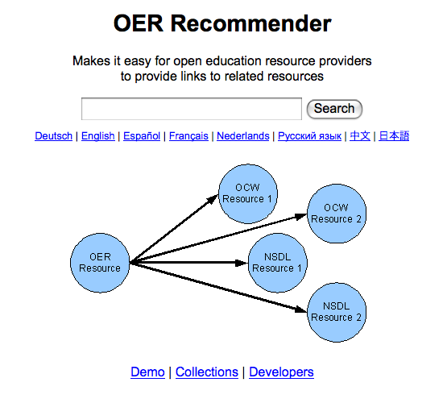
OER Recommender

Slide 18
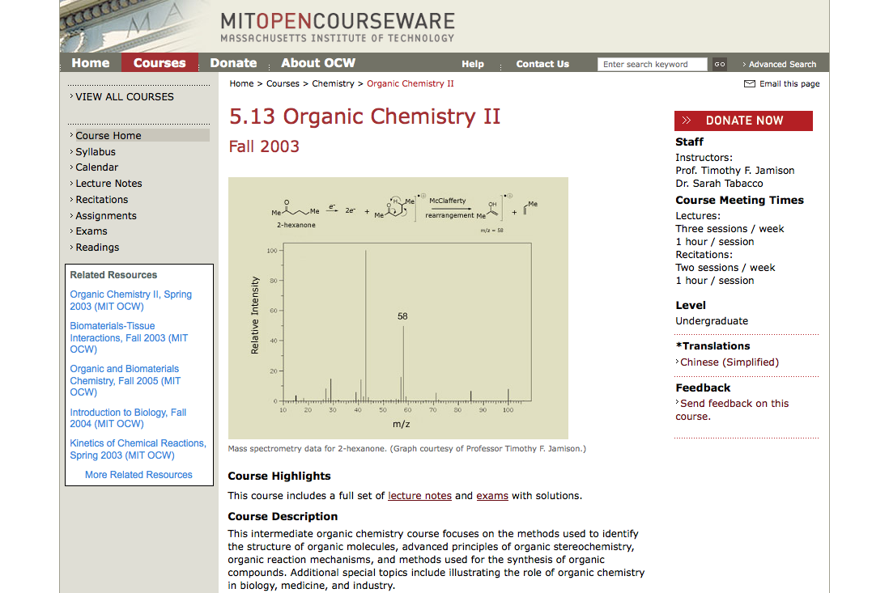

Slide 19
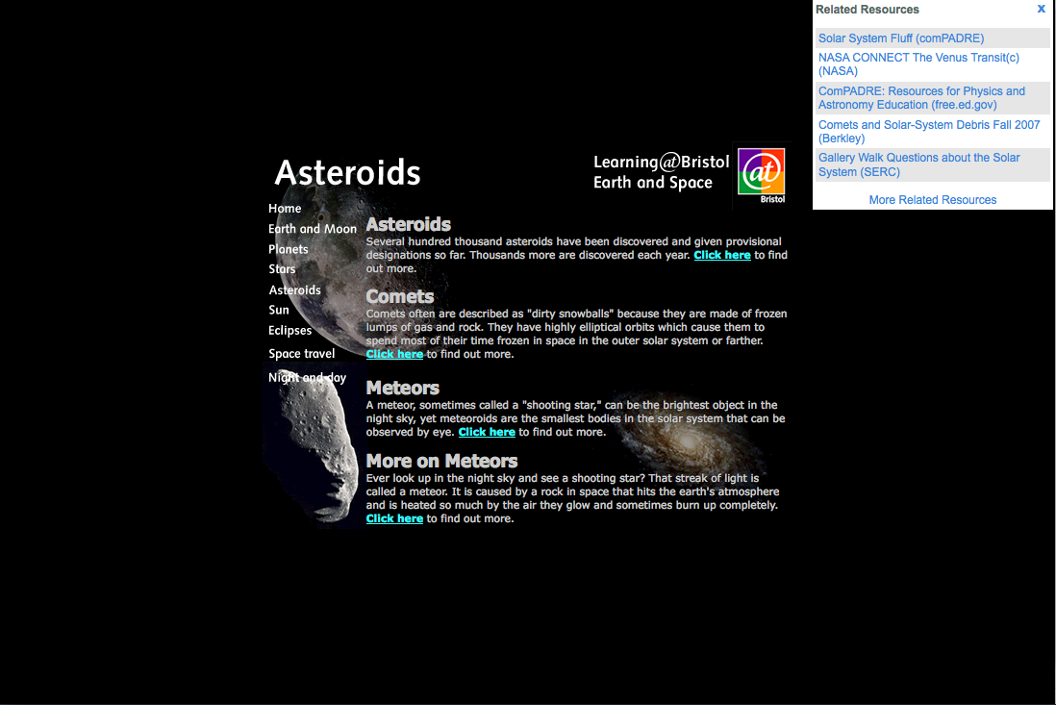

Slide 20
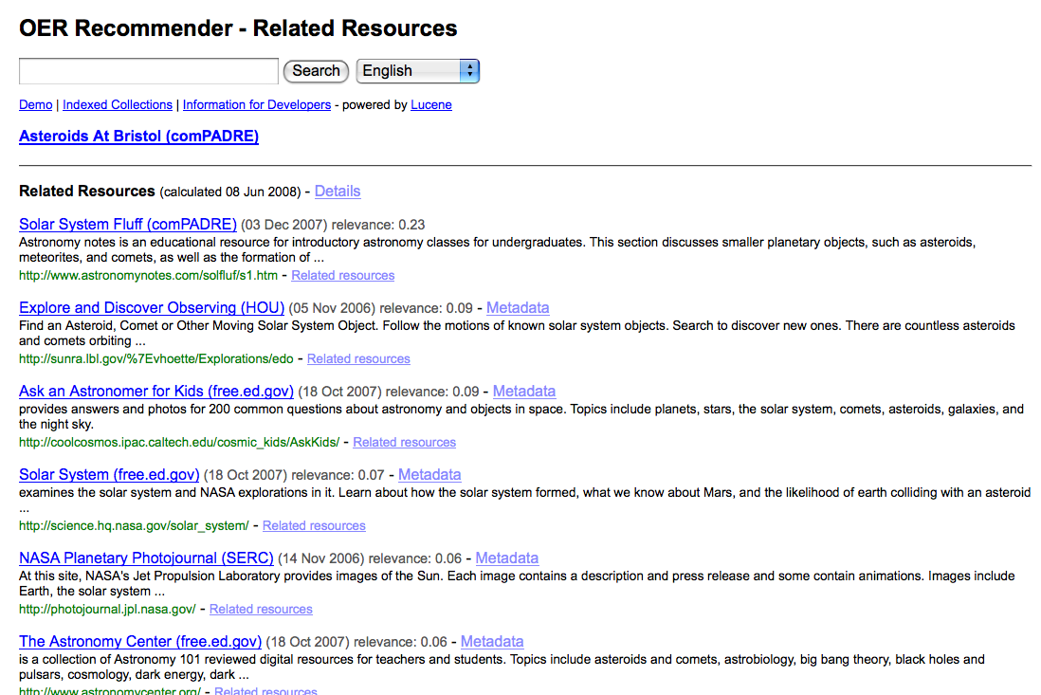

Slide 21
Integrating OER Recommender at OER Commons
OER Commons is a portal to OERs
www.oercommons.org
OER Recommender
  Enables interlinking (via 3rd party provided service)
  Extends OER Commons to other materials not in its catalog
  First deployed instance of integration from Sprint

Slide 22
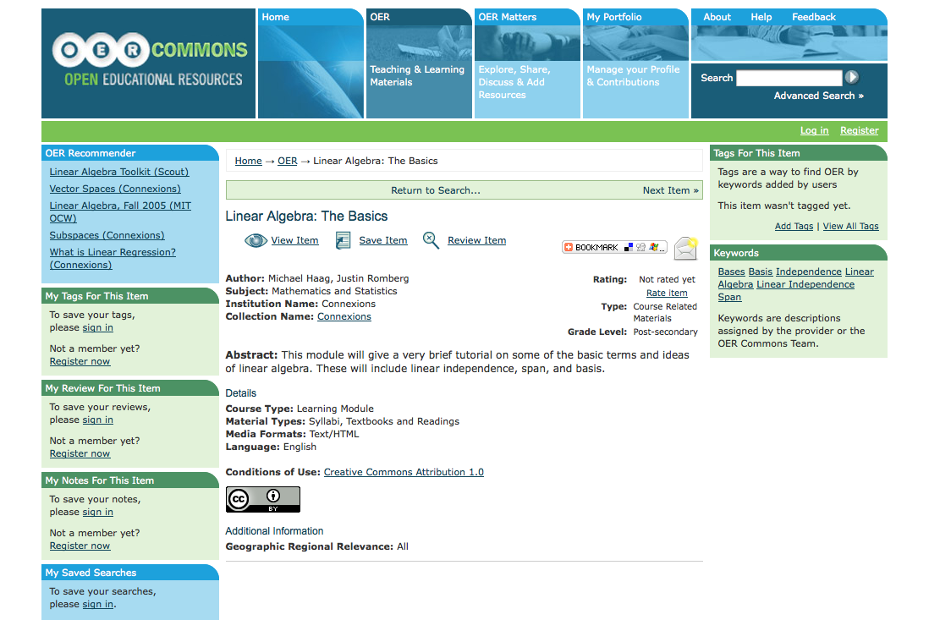

Slide 23
Integrating OER Recommender at OpenLearn
Work still progressing
Works similarly to OER Commons
COSL adding features requested by OpenLearn
  Excludes OpenLearn resources from recommendations (they already cross-link their resources)

Slide 24
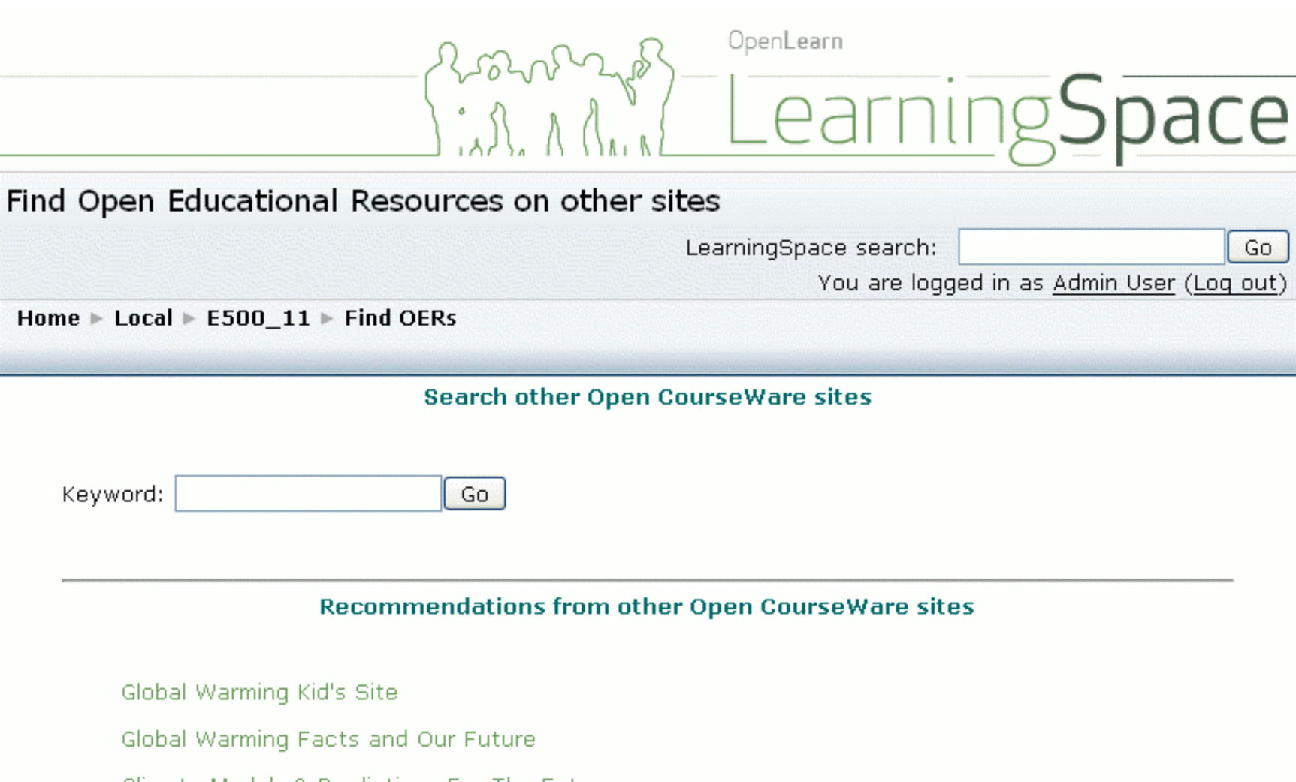

Slide 25
Why does this work? -> What can my work do for others?
Service builds upon work of others
Aggregate metadata from collection providers
  RSS and OAI-PMH
  Dublin Core and IEEE LOM Metadata
  Capacity provided by NSDL and individual collections
  Sharing is good, and enables good things
Designed to be integrated/used by others
  Service is significantly improved with more use

Slide 26
Make-A-Path
Bookmarking service to create a pathway (sequence) between resources
Begins to expose tacit knowledge (Kumar Keynote)
www.makeapath.com

Slide 27
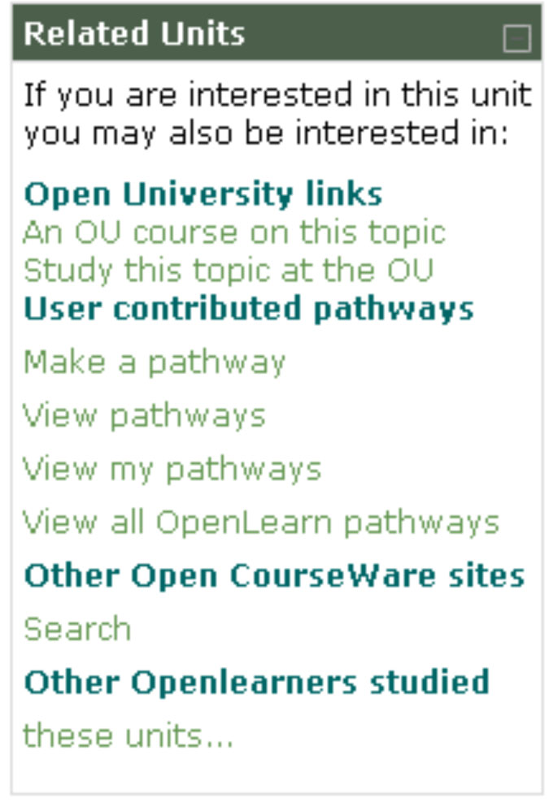
Integrating MakeAPath at OpenLearn

Slide 28
Outcomes
Working code
  Successful prototypes of interoperability
Commitment to deploy prototypes to production websites
Developer community
  Increasingly more comfortable working together
Small steps…

Slide 29
Future OER Interoperability Sprints
August 2008? and January/February 2009
We welcome your participation
You provide travel support, we provide lodging and meals during the event
Come with projects in mind, specific work with other participants

Slide 30
Brandon Muramatsu
brandon.muramatsu@usu.edu

