Slide 1
Center for Open and Sustainable Learning
Brandon Muramatsu
Project Director
Originally Published 2008. Republished 2013. This work is licensed under a Creative Commons Attribution-Noncommercial-Share Alike 3.0 United States License (http://creativecommons.org/licenses/by-nc-sa/3.0/us/)

Slide 2
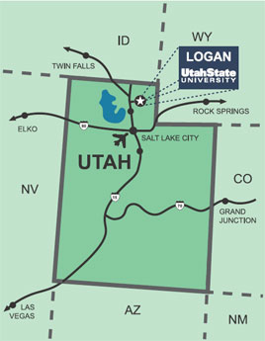
Where’s That?

Slide 3
Outline this is very informal!
About the Center
Vision, Statistics, Philosophy
Past Me
Engineering Education Reform, Educational Digital Libraries, Learning Technology Standards
Present COSL
eduCommons, USU OCW/UOCWA, OHSU, TWB, OER Recommender & OCW Finder
Future? Us?

Slide 4
About the Center :: Vision
The Center for Open and Sustainable Learning (COSL,), at Utah State University, is dedicated to increasing access to educational opportunity worldwide. At the Center, we believe that all humans beings are endowed with a capacity to learn, improve, and progress. Educational opportunity is the mechanism by which we fulfill that capacity.

Slide 5
About the Center :: Statistics
Founder: David Wiley
Renamed December 2005 (2.5 years)
Size: 10 Staff (8.75 FTE), 2 Grad Assistants
Funding: $6M Total / ~$1M Annual
Current Funding Sources:
William and Flora Hewlett Foundation
National Science Foundation

Slide 6
About the Center :: Philosophy
Do what we can…
Recruit the right people
Smart, talented, dedicated
Research and Development
Build a capability
Rapid development, simple, relevant, useful, scalable
Don’t reinvent the wheel
Use best of breed, mashups, innovative approaches

Slide 7
Past :: UC Berkeley (1993 – 2004)
Engineering Education Reform
NSF Synthesis Coalition
Educational Digital Libraries
NEEDS—A Digital Library for Engineering Education
SMETE.ORG (~30 partners across U.S.)
National Science Digital Library
Learning Technology Standards
IEEE Learning Object Metadata, Early IMS

Slide 8
Past :: Cal State University Chancellor’s Office (2002-2004)
Educational Digital Libraries
MERLOT

Slide 9
Present :: COSL
eduCommons
OCW Management System, software development, support and marketing
USU OCW / Utah OCW Alliance
Course production
OER Recommender / OCW Finder
Standards, collaboration, interoperability
Open High School of Utah <- NEW!
Putting it all together!

Slide 10
Present :: COSL (cont.)
MOCSL
Web 2.0 tools to enable use of open educational resources
Teachers Without Borders
Support and development, capacity building
Open Learning Support
Where we got started, community-based support for OCW

Slide 11
Future :: ???
COSL
Interoperability
Open High School
Courses and Operations
“Library”

Slide 12
Brandon Muramatsu
brandon.muramatsu@usu.edu
+1.435.797.2703

