Slide 1
Is there an opencourseware in your future?
John Dehlin, Director of Outreach
Brandon Muramatsu, Project Director
Center for Open and Sustainable Learning
Utah State University
Originally Published 2005. Republished 2013. This work is licensed under a Creative Commons Attribution-Noncommercial-Share Alike 3.0 United States License (http://creativecommons.org/licenses/by-nc-sa/3.0/us/)

Slide 2
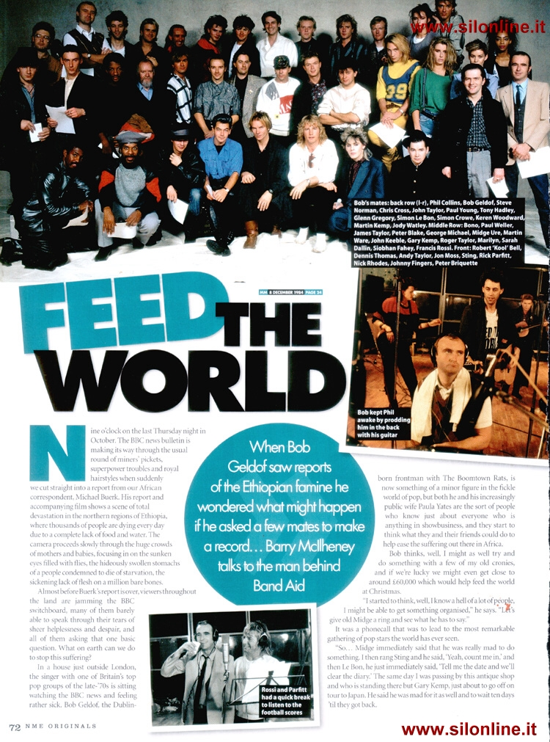

Slide 3
USU Case Study

Slide 4
Outline
What is opencourseware?
Why do opencourseware?
Case Studies:
MIT OCW
USU OCW
De-Anza Foothill OCW
How we can help you get started

Slide 5
What is OpenCourseWare?
Publication of high quality, IP-clean, university course materials
Open access for all noncommercial uses
OCW is not:
Courses for credit
Access to faculty members
A degree-granting program
Notes:
A FIRST STEP is to provide broader access to the raw components of educational opportunity

Slide 6
Why do opencourseware? (THE reason)
Increase access to educational opportunity….
Not by yourself…of course, but as part of a MOVEMENT!!!
Notes:
The OSLO Group does projects with goals specifically target toward these outcomes.
Before we can say what an OCW/MS is, we have to define OCW.

Slide 7
The World of Open Educational Resources
Tools
Software for development and delivery of content
Content
Materials published for learning or reference
Standards
Shared conventions for digital publishing of open resources
Content Management Systems (CMS)
• USU’s
Educommons
Development Tools
Rice Connexions
Pachyderm
Learning
Reference
Collections
UTOPIA
Library of Congress
Internet Archive
Google Scholar
Wikis
PLoS and other open journals
Licensing Tools
• Creative
Commons
Best Practices
• CMU (design
principles)
Courseware
MIT OCW
JHSPH OCW
Tufts OCW
Umich OCW
Utah St. OCW
Sofia
Groupware
• H20 (at
Harvard)
• Wikis
• USU’s OSLO
research
Learning Management Systems (LMS)
• Sakai
• Moodle
Learning Objects
Rice Connexions • Merlot
UC-Berkely videos
Metadata
• IEE LOM
• Dublin Core
• RDF
Interopability
• OKI
• IMS
Search Tools
• Lucene

Slide 8
Why do opencourseware? (the OTHER reasons)
Increase access to educational opportunity
Learners
Other educators (“Rising tide lifts all ships”)
Increase visibility and notoriety
Institutions (Universities/Colleges)
Departments
Professors
Potential recruiting enhancement
Cement your legacy/life’s work (faculty)

Slide 9
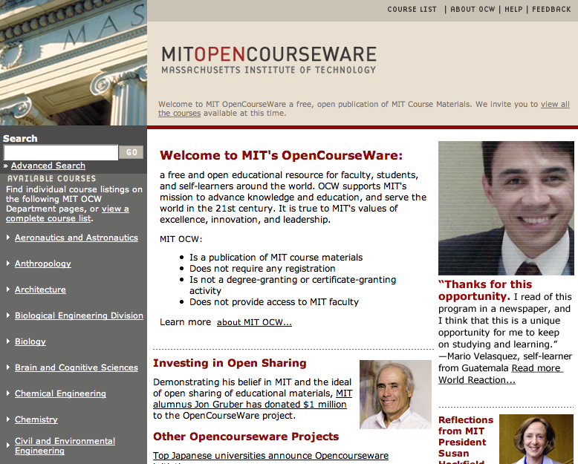
MIT Showcase

Slide 10
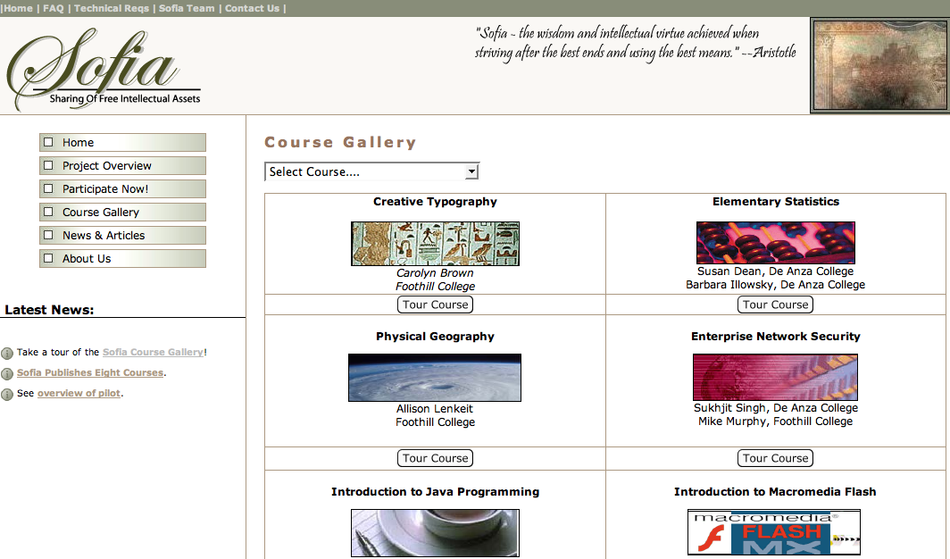
De-Anza Foothill Showcase

Slide 11
“So…..how does this work?”

Slide 12
USU Case Study

Slide 13
USU Case Study
Land Grant school with mission to reach out with distance education offerings
World leaders in agriculture, irrigation engineering, and space sciences
100s of online courses in WebCT
Access to all of MIT’s experience and process, legal, and other docs
Notes:
Here is the situation USU finds itself in. Faculty are bought in as part of uni mission. Many resources are already digital for webct delivery. The next biggest hole is the infrastructure, but MIT helps us understand how to build it.

Slide 14
The Process--Today
Recruit faculty and courses
Plan
Collect, transcribe, scrub, convert materials
Review IP
Design layout of course
Build
Upload materials
Link material to templates
Add metadata
Clear IP
Initial QA
Publish
Final QA
Faculty signoff
Publish
Support
Respond to inquiries
Troubleshoot
Planning & Content Collection
Content Management
Content Distribution,
Search Tools,
Discussion Groups
*CMS is OCW’s content management system
Notes:
So how did we get all that content in there?
We started by designing a publishing process that begins with recruiting faculty. Participation is voluntary so it’s important that we make it as easy as possible for the faculty to participate and deliver enough value back to them to outweigh the time and effort they must put in. 700
The ideal publishing process is tightly integrated with the normal process the faculty use to prepare materials for teaching.
So therefore, we work with the faculty as they plan their course, build the course adding materials over the semester as they teach the course and then we publish the course as a snapshot of that particular course for that particular semester. As the course changes over time, new versions of the course will be published, again as a snapshot of the course for a specific semester and the prior version will be archived.
Some of the publishing steps performed by the OCW staff include: transcribing, converting and enhancing the materials, design the layout within OCW template, add metadata, scrub material for privacy and identify and clear 3rd party IP items. 4500 – OK, remove, replace or permission
The amount of time required of the faculty, depends, of course on the faculty member and what shape his/her materials are in and how complete they want them to appear. In some cases, it takes as little as one meeting with us and a few follow-up emails.

Slide 15
eduCommons = opencourseware Management System (OMS)
Workflow support for assembly, IP clearance, QA, cataloging, and publication of open access course materials
“OCW” look and feel
Free and unfettered access to the published course materials
Open source software

Slide 16
USU OCW Web Site

Slide 17
The Process--Future
OCW baked into the LMS
Course designed from ground up with OCW in mind
“IP Clean” content used where possible
Content tagged in LMS as either “for credit” or “open”
Public and Private views of course
Benefits: Lowest cost, courses kept up to date, and not orphaned
Notes:
So how did we get all that content in there?
We started by designing a publishing process that begins with recruiting faculty. Participation is voluntary so it’s important that we make it as easy as possible for the faculty to participate and deliver enough value back to them to outweigh the time and effort they must put in. 700
The ideal publishing process is tightly integrated with the normal process the faculty use to prepare materials for teaching.
So therefore, we work with the faculty as they plan their course, build the course adding materials over the semester as they teach the course and then we publish the course as a snapshot of that particular course for that particular semester. As the course changes over time, new versions of the course will be published, again as a snapshot of the course for a specific semester and the prior version will be archived.
Some of the publishing steps performed by the OCW staff include: transcribing, converting and enhancing the materials, design the layout within OCW template, add metadata, scrub material for privacy and identify and clear 3rd party IP items. 4500 – OK, remove, replace or permission
The amount of time required of the faculty, depends, of course on the faculty member and what shape his/her materials are in and how complete they want them to appear. In some cases, it takes as little as one meeting with us and a few follow-up emails.

Slide 18
How we can help you (steps to proceed)
Let us know you are interested
We will help you evangelize within your institutions (administration and faculty)
We will share with your our best practices for OCW process
We will provide you with the software and support you need (including hosting)
We will even provide course design support for very early adopters

Slide 19
Potential eduCommons Adopters
Notre Dame
Michigan State University
Wheelock College
Utah Consortium
Weber State University
University of Utah
Brigham Young University
Utah Valley State College
And growing…..

Slide 20
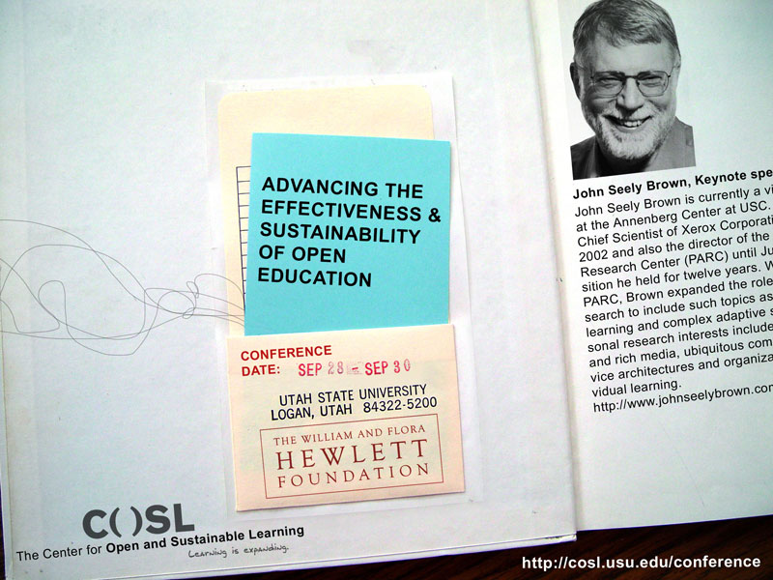

Slide 21
USU Case Study

Slide 23
Backup

Slide 24
How?
Increase access to educational opportunity by lowering barriers to entry for OpenCourseWare projects
Provide open source, “out of the box” OpenCourseWare Management System
Notes:
MIT made a significant investment in MS CMS and customizations. This work

Slide 25
How Does It Work?
Course materials come from:
SAKAI, WebCT, Blackboard,Apache, local drives
Bulk import entire working sites (zipped)
Store each individual component in the database as a reusable LO and catalog

Slide 26
How Does It Work?
Automatically reassemble the LOs into a functioning course site
Move the LOs and the course through a supportive workflow and publish

Slide 27
What is eduCommons NOT?
A general purpose repository system or workflow system
A Learning Management System
Not built on authenticate / join paradigm
Not gradebook, homework dropbox, announcements page

Slide 28
Development Tools
CVS / ViewCVS
Sourceforge
Python
Zope
Plone
Squid
Twiki
Bugzilla

Slide 29
Future Vision
eduCommons becomes the OCW platform of choice
Chrome-less content distribution by IMSCP
Cross-eduCommons search and insert
Remix with attribution (students!)
Recommender systems
Semantic web OCW

Slide 30
Process (aka Obstacles)
Getting faculty to participate, administrative buy-in
Authoring / capturing / acquiring content
Clearing intellectual property
Managing the publication process
Notes:
OCWs are great, and many institutions are interested. But The process can be expensive and time consuming!

