Slide 1
OpenContent for Education:
Utah State University’s Opencourseware Initiative
Brandon Muramatsu, Project Director
John Dehlin, Outreach Director
Originally Published 2004. Republished 2013. This work is licensed under a Creative Commons Attribution-Noncommercial-Share Alike 3.0 United States License (http://creativecommons.org/licenses/by-nc-sa/3.0/us/)

Slide 2
Overview
What & Why?
Utah State’s Approach and Strengths
Process
Recruiting
Workflow
Challenges
Notes:
What will the audience learn?
How to build upon MIT as a Model
Overcome feeling of inadequacy, “we don’t have $45M to spend”
Revisit points John Paul Potts makes in his talk

Slide 3
What is an opencourseware initiative?
Promotes free and open access to knowledge
Publishes substantially complete set of course materials created by faculty used in the course
Contains intellectual propery cleared materials
Offers the materials free of charge for non-commercial use and is universally accessible via the Web
Permits use, reuse, adaptation and redistribution
Pioneered by MIT, Hewlett Foundation and Mellon Foundation

Slide 4
MIT’s OpenCourseWare Initiative
University-wide commitment to open access to material for all on-campus courses
727 courses available to date, 33 academic subjects (8/16/04)
Major foundation funding (over $45M)
ocw.mit.edu

Slide 5
Why?
Why should Utah State, or any university, develop an opencourseware project?
Notes:
Why develop an opencourseware initiative project?
Multiple approaches to the

Slide 6
Answer:
Promotes free and open access to knowledge
Supports public service and teaching missions of the university
Provides diversity of perspectives
Build on the groundwork of MIT

Slide 7
Why at Utah State?
Showcase high quality of education at Utah State
Complementary content to MIT, especially content of greater interest to underserved populations
Partner with like-minded institutions, co-marketing activities
MIT, USU, others?
Maintain leadership position in online courses, outreach and extension

Slide 8
Our Approach
OpenContent for Education
Build upon MIT’s OpenCourseWare (OCW) Initiative
Model documents, concepts, process
Build upon strengths of Utah State
Develop model processes that other universities can follow
Develop open source infrastructure to enable opencourseware projects—Educommons

Slide 9
Utah State’s Strengths
Grassroots effort with administration support
Cooperate with faculty, all-volunteer participation
Focuses on content that is unique to Utah State
Biological & Irrigation Engineering, Agriculture, etc.

Slide 10
What’s Different?
Begin with readily available digital content from online courses, not creating new digital content
Uses research assistants—building heavily on MIT’s documents and process—to do copyright checking
Focuses on materials created by faculty—leaving out other 3rd-party materials
Uses (developing) open source software to manage workflow

Slide 11
Support
William and Flora Hewlett Foundation support
Currently $450K/year for startup phase
Est. at $600K/year for production phase
Estimated* cost per course is 1/5 of MIT’s (when in production mode)

Slide 12
What is OpenContent for Education Not?
It’s not a replacement for existing classes
Users don’t get course credit or other certification
It’s not a university-wide initiative
Participation by faculty is voluntary
It’s not about creating new content, but repurposing existing digital content
It’s not about putting courses and course materials in the public domain—all materials are licensed via Creative Commons

Slide 13
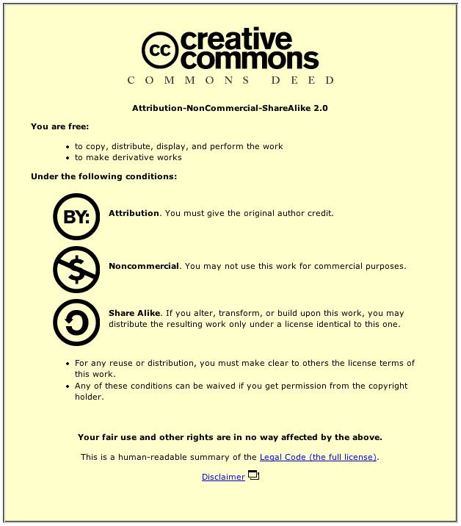
License
Licenses users to use materials per Creative Commons Attribution-Non-Commercial-ShareAlike 2.0
Faculty license Utah State to make their courses and course materials available in this manner (MIT License)

Slide 14
Process
Identify
Faculty and
Courses
Recruit
Faculty
Create OCE
Version
of Course
Review and
Publish
Course
OCE Team identifies
potential faculty and
courses.
Director of Outreach
meets with faculty to
recruit them.
RA works with Faculty
to identify and
copyright clear content,
and create course.
RA meets
with Faculty to review
course and give
approval.

Slide 15
OCE “Evangelism”

Slide 16
Our first engagement…
“I want you to continue, and I’m keeping an open mind, but I just want to let you know up front that based on what you have told me so far, there’s no way in HELL that I’m going to be interested in participating in this initiative”
--Our 1st OCE Candidate
By end of discussion, he had given verbal consent (for part of his course, at least) :)

Slide 17
By the numbers….
41 -- Professors contacted
13 -- No response
28 -- Interested/willing to meet
14 -- Have provided verbal consent
5 -- Have actually provided us access to their courses (4 are IT faculty :) )
1 -- Outright rejection

Slide 18
Their concerns…
“Won’t this destroy the University?”
“What about enrollment in my for-credit classes?”
“This is my Intellectual Property, d$#@ it!!!”
“My courses are very textbook-centered”
“I’m not sure I WANT the world to see my courses” or “My courses aren’t ‘ready’ yet--I’m updating them”
“What’s this gonna cost me?”
What’s in it for me?”

Slide 19
Our selling points….
Good for the university
Partnership with top universities, great PR
Good for enrollment
The more people know about your course, the more that will enroll
Good for professor
Increased visibility will lead to more awareness, reputation, and consulting contracts :)
Good for the world
The “Warm and fuzzy” argument

Slide 20
Our biggest evangelism risk
The politeness factor… Getting from “Yes” to
“Here’s my course”

Slide 21
Potential Courses
Biological and Irrigation Engineering
Biochemical engineering
Hazardous Waste Management
Biomaterials
Bioinstrumentation
Surface Irrigation Systems Design
Sociology
Introductory Sociology
Cultural Anthropology
Anthropology of Religion
Juvenile Delinquency
Criminology
Instructional Technology
Learn and apply HTML
Learning and communication theory in IT
International IT
Social interaction on the Internet
Distance Education
Adult Spanish/English literacy
College of Agriculture
Humanity and the Food Web

Slide 22
Evangelism Lessons Learned
Do lots of background reading on professor before 1st meeting
Come with a prepared “deck”, but be very willing to deviate/adapt
Don’t just “make the pitch”, but build the relationship as well
As you progress, aggregate questions/concerns into a Q&A doc for organizational memory/web use
Personal relationships always much more effective than “cold calling”
Departmental support can be quite helpful
“Experienced” professors seem to be most amenable

Slide 23
Workflow for Faculty
Initial Meeting
Preliminary
Content
Meeting
Copyright
Clearance and
Upload
Final
Review
Meeting
Est.: 30-60 min.
Est.: 30-60 min.
As Needed
Est.: Up to 3 hrs.
Faculty meets
with Director of
Outreach
Faculty meets
with RA to discuss
course and content.
Faculty reviews and
signs “contract”.
RA clears
copyright on
content and
uploads to OCE.
RA contacts Faculty
as needed.
Faculty meets
with RA to review
course and give
approval.

Slide 24
Workflow for Research Assistants
Course
Assignment
Course
Published
Content Triage
& Preliminary
Meeting
Content
Copyright
Clearance and
Upload
Quality
Assurance
of Content
Course
Creation
Quality
Assurance of
Course
Final
Review
Meeting
Est.: 10 hrs.
Est.: 10 hrs.
Est.: 10 hrs.
Est.: 10 hrs.
Est.: 10 hrs.
Est.: 3 hrs.
RA triages content
and meets with
Faculty to discuss
course and content.
RA has faculty sign
“contract” and get
access to course
content.
RA uploads content
and adds metadata
to OCE. RA clears
copyright. RA
contacts Faculty as
Needed to confirm
copyright.
Quality Assurance
of Content by
separate team
member.
RA creates Course
sections and
uploads content
into Course
sections.
Quality Assurance
of Course by
separate team
member.
Faculty meets
with RA to review
course and give
Approval.

Slide 25
Educommons
Open source infrastructure for open content
Priority goal: To make content available for educational purposes.
Not an Learning Management System (e.g., not a WebCT, SAKAI)
Supports workflow to create opencourseware projects

Slide 26
OCE Challenges
Continuing to generate faculty interest and overcoming concerns
Converting faculty from “yes” to “here’s my content”
Getting content uploaded and made available in cost-effective manner
IP clearance may become problematic
Quality of materials
Evangelizing use of OCE
Long-term sustainability

Slide 27
Summary
What & Why?
Utah State’s Approach and Strengths
Recruiting
Workflow
Challenges

Slide 28
Links
MIT’s OCW site: ocw.mit.edu
“How To”: ocw.mit.edu/OcwWeb/HowTo/
Creative Commons: creativecommons.org
OSLO Research Group: oslo.usu.edu

Slide 29
For More Information:
oslo.usu.edu
Brandon Muramatsu
brandon.muramatsu@usu.edu
John Dehlin
john.dehlin@usu.edu

Slide 30
OCE is generously supported by
The William and Flora Hewlett Foundation
Thank You!

