Slide 1
Building a National Science, Mathematics, Engineering and Technology Education Digital Library
Brandon Muramatsu & Flora McMartin
UC Berkeley
Tom Boyd
Colorado School of Mines
Originally Published 2000. Republished 2013. This work is licensed under a Creative Commons Attribution-Noncommercial-Share Alike 3.0 United States License (http://creativecommons.org/licenses/by-nc-sa/3.0/us/)

Slide 2
Outline
What is an NSDL?
Towards a National SMETE Digital Library
Emerging NSDL Designs and Prototypes
DLESE
WWW.SMETE.ORG
Copies of this presentation will be available at:
http://www.smete.org/info/presentations/

Slide 3
Vision...
“… a network of learning environments and resources for Science, Mathematics, Engineering and Technology education, will ultimately meet the needs of students and teachers at all levels—K-12, undergraduate, graduate, and lifelong learning—in both individual and collaborative settings.”
National Science Foundation

Slide 4
Towards A National SMETE Digital Library...
NSF should establish and fund a National Science, Mathematics, Engineering and Technology Education Digital Library
April 1996 - NSF Committee Meeting (LIBUSE)
“Towards a National Library for Undergraduate Science Education Resources in Science, Mathematics, Engineering and Technology”
August 1997 National Research Council
Digital National Library for SME&T Education Workshop
July 1998 National Science Foundation
SMETE-Lib Workshop
January 1999 National Science Foundation
Digital Libraries and Education Workshop
Notes:
Digital National Library
One program currently under development at NSF is the development of a digital library to support Science, Mathematics, Engineering, and Technology Education.

Slide 5
National SMETE Digital Library Program
Test-bed funding under the Digital Libraries Initiative—Phase 2, 1998-2001
Demonstration and full scale development, 2000-2006?
Four focus areas
Core Integration System
Collections
Services
Targeted Research

Slide 6
Anticipated 2000-2001 Projects
Core Integration System
Cornell University
Eastern Michigan University - TeacherLib
University of Missouri
UCAR - DLESE, and Columbia University Press
WWW.SMETE.ORG

Slide 7
Emerging NSDL Designs and Prototypes DLESE and WWW.SMETE.ORG

Slide 8
Digital Library
for Earth System Education
A Community Resource

Slide 9
DLESE’s Purpose
The goal of the DLESE is to help educators and learners find, evaluate, use, and create resources that support active learning about the Earth system.

Slide 10
Built by the Community
To support learning about the Earth
To improve science education

Slide 11
DLESE Vision
Rapid, sophisticated access to collections of peer-reviewed teaching and learning resources
Interfaces and tools to allow student exploration of Earth data sets
Services to help users effectively create and use materials
A community center to facilitate sharing and collaboration

Slide 12
Essential Design Strategies
Responding to the needs of the Earth system education community
A distributed network built as a community effort

Slide 13
Coordinating the Community Effort
DLESE Community Governance
Steering Committee
Standing Committees
DLESE Program Center

Slide 14
WWW.SMETE.ORG

Slide 15
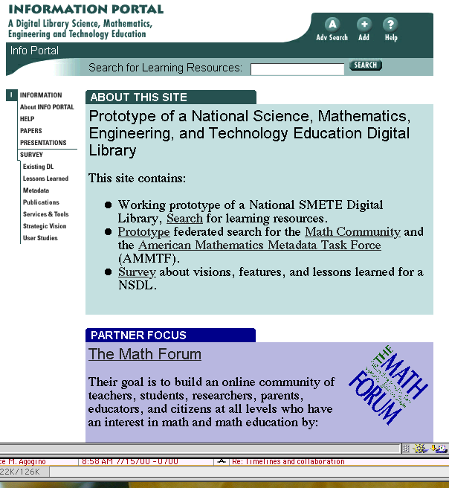
What is www.smete.org?
Learning and teaching resources for science, math and engineering
“Re-use” of learning materials:
Evaluate quality
Locate resources
User comments
Online discussion

Slide 16
Needs Assessment with Members of the Math, Science and Engineering Community
Purpose:
To understand the math, science and engineering communities of educators and examine their needs in order to design services and structures to support users from multiple communities.
Research Questions:
What services, features & programs are integral to success?
What do users expect with regards to quality of the holdings?
Who makes up the SMETE digital library community?
American Association of Physics Teachers, American Mathematical Society, American Association for the Advancement of Science, members of the NSF Chemistry Consortia and the NSF Engineering Education Coalitions

Slide 17
Translating Findings into Services & Features
Content, Quality and Community
a system to easily identify the type/ quality of holdings
a place for comments and discussion
a review system that addresses pedagogy and content
quality content and community interaction to ensure participation by authors, reviewers, adapters/adopters & consumers
embedded structures for developing & maintaining a community of users
a flexible design, and be a facile, adaptable organization that can meet the needs of changing learning community

Slide 18
Systems Development
Expand www.smete.org
Continue participation in the development of IEEE/IMS Learning Object Metadata Standards
Adopt emerging IEEE standards
Implement discussion systems
Expand user comments
Implement customized
user profiles
Expand Collections
Chemistry, Physics, and
Mathematics
Total Collection
Engineering 54%
Chemistry 21%
Physics 17%
Math 5%
Other 3%

Slide 19
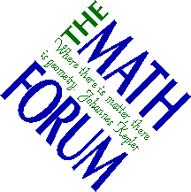
Collaboration with Partners
Eisenhower National Clearinghouse and
Math Forum
Identify common metadata
Exchange records for common searching
Work together on the American Mathematics Metadata Task Force
www.enc.org
www.mathforum.com

Slide 20
Collaboration with Partners
University of California Office of the President - (10 campuses)
Develop TLT@UC Website to showcase teaching and learning with technology at the University of California

Slide 21
Demonstration: www.smete.org
NACME
WebCT
BioQUEST
John Wiley
Math Forum
Berkeley
ENC
UMBC
UCOP
ILT
Utah State
AAAS
PKAL
Stanford
DLESE
GDL
Northern
Arizona
Virginia Tech
Cisco
Sun
SRI
Eduprise
MAA
TI

Slide 22
www.smete.org Goals
Develop a NSDL Core Integration System
Provide seamless access to services and resources
Create a dynamic learning community that promotes and supports SMET education in the 21st century
Demonstrate effectiveness of collaboration to provide
Expanded services
Resources
Community

Slide 23
Challenges - Core Integration System
To help users find what they’re really looking for and to personalize content
Expand understanding of user needs and develop mechanisms to support changing needs
Improve ability to encapsulate instructional intent and use of materials
Metadata standards and cataloging practices
Support Communities
Pedagogy and Content

Slide 24
Challenges - Community
Search for learning resources
Catalogue (adding) learning resources
Standards, IEEE and IMS
Evaluate the quality of learning resources
“User” reviews
“Expert” reviews
Form a community of users in SMETE
PKAL workshops and seminars
Research on adapters

Slide 25
Contact Information
Brandon Muramatsu, Project Director
mura@needs.org, (510) 643-1817
Flora McMartin, Evaluation Director
mcmartin@needs.org, (510) 643-2928
Tom Boyd, DLESE Technology Manager
tboyd@mines.edu
Copies of this presentation will be available at:
http://www.smete.org/info/presentations/

