Slide 1
Building the SMETE.ORG Alliance
Brandon Muramatsu
SMETE.ORG
mura@smete.org
Originally Published 2001. Republished 2013. This work is licensed under a Creative Commons Attribution-Noncommercial-Share Alike 3.0 United States License (http://creativecommons.org/licenses/by-nc-sa/3.0/us/)

Slide 2
Outline
Working Assumptions
SMETE.ORG Vision
Commitment and Philosophy
Developing the Organization
Making Everything Work Together
Interoperability and Federated Search

Slide 3
Working Assumptions
To build a successful NSDL for deployment in Fall 2002…
To focus on science, mathematics, engineering and technology
And more important, it focuses on education
…we needed to develop a team…
To overcome the challenges we face in developing a NSDL
To cover target audiences and disciplines
To share in the development efforts

Slide 4
SMETE.ORG Vision
A Digital Learning Community
SMETE.ORG, An Alliance of over 20 partners
Collections of science, mathematics, engineering and technology learning resources
Networked distribution of pedagogical material providing seamless access through a tightly coupled federation of educational digital libraries
Promotes education reform through participatory communities of learners

Slide 5
Commitment
SMETE.ORG Alliance Partners are committed to providing a service…
to the nation
to support learning
across disciplines in science, mathematics, engineering and technology
in support of education reform and cross-disciplinary learning
from K-12 to higher education to professional development and lifelong learning
is standards-based & supports the NSDL Program

Slide 6
Development Philosophy
The difference is learning, not just bibliographic information retrieval
Teaching and learning require something more
Guided by user needs and philosophy of education that is constructivist
Link content to community and services
Build integrative tools and incorporate “best of breed” tools from partners

Slide 7
Information Architecture Design Principles
Principle 1: Information Organization
Organize information to provide opportunities for students and educators to create, synthesize, manipulate or debate content rather than merely to passively receive instruction.
Principle 2: Information Labeling
Label resources with pedagogical identifiers such as age group, teaching method, and academic standards to indicate educational uses.

Slide 8
More Design Principles
Principle 3: Information Navigation
Guide the collection and adaptation of learning elements towards individual learning goals.
Principle 4: Information Search
Optimize search to meet the interests, knowledge, understanding, abilities, and experiences of the users in their roles as educators or students.

Slide 9
Developing the Organization
SMETE.ORG Alliance…
Evolving over time
Balancing the diversity, history, needs and strengths of each organization
Developing partnerships and affiliations to strengthen the whole
…partners identify with SMETE.ORG

Slide 10
Alliance Partners |  | Industry | Collaborators
American Association for the Advancement of Science (www.aaas.org) BioQUEST Curriculum Consortium (www.bioquest.org) Coalition for Networked Information (www.cni.org) Digital Library for Earth Systems Education (www.dlese.org) Eisenhower National Clearinghouse for Mathematics and Science Education (www.enc.org) Interactive University (iu.berkeley.edu) Mathematics Association of America (www.mathdl.org and www.maa.org) Math Forum (www.mathforum.com) | National Action Council for Minorities in Engineering (www.nacme.org) NEEDS—National Engineering Education Delivery System (www.needs.org) Project Kaleidoscope (www.pkal.org) SRI International, Center for Technology in Learning (www.cilt.org and www.escot.org) University of California Teaching and Learning with Technology Center (www.ucop.edu/acadinit/tltc) University of Maryland Baltimore County (www.umbc.edu/engineering/me/wood.html) Utah State University (ia.usu.edu) | Cisco Systems (www.cisco.com) John Wiley & Sons (www.wiley.com) Texas Instruments (www.ti.com) Eduprise (www.eduprise.com) Sun Microsystems (www.sun.com) WebCT (www.webct.com) | Biology Education Online/Access Excellence & National Assoc. Biology Teachers (www.accessexcellence.org and www.nabt.org) Columbia University (www.earthscape.org) Cornell University (www.siteforscience.org) MERLOT (www.merlot.org) TeacherLib/MERIT Network and Michigan Teacher Network (www.merit.edu) University of Missouri Columbia (cecssrv1.cecs.missouri.edu/NSDLProject)

Slide 11
Strengths of Partners
Partners with existing collections each have a decade of experience providing digital SMETE resources to their target audiences and disciplines
ENC, NEEDS, Math Forum, BioQUEST
Most partners each have more than ten years of experience as organizations promoting SMETE reform
AAAS, Project Kaleidoscope, NACME, Mathematical Association of America, SRI International

Slide 12
Strengths of Partners (cont.)
Collections and service providers range from well established collections to incipient collections
Organizations serve full spectrum of audiences
K–12, pre-College, community colleges, liberal arts colleges and universities, public and private research universities, and professional societies
Extended affiliations include professional development organizations

Slide 13
Organizational Models
Various models at work in SMETE.ORG
Individual partners make new partnerships
Ex., ENC’s partnership with the Education Development Center (professional development collection) or International Technology Education Association (“T”echnology collection)
The Alliance adds new partners
Ex., MERLOT
Individual partners/projects are themselves a partnership
Ex., Biosci Ed Net Collaborative, led by AAAS

Slide 14
Making it All Work
What do we mean by interoperability?
We want to provide “seamless access to collections and services”
Existing and new collections
Existing and new services
We recognize there are different types of agreements necessary to provide “seamless access”
Social
Technical

Slide 15
Social Aspects of Interoperability
Agree to interoperate
Shared principles
Shared understanding of the issues
Build an identity
Meet to develop common language and technical protocols

Slide 16
Technical Aspects of Interoperability
Agree to common methods of representing information
Common metadata to help organize and describe collections
Common thesauri/controlled vocabularies to describe resources in consistent manner across collections
Agree to common methods for transmitting information
Protocols/specifications/API’s for shared access to contents of collections and services

Slide 17
Technical Aspects of Interoperability
Agree to common methods of representing information
Common metadata to help organize and describe collections
Common thesauri/controlled vocabularies to describe resources in consistent manner across collections
Agree to common methods for transmitting information
Protocols/specifications/API’s for shared access to contents of collections and services

Slide 18
Federated Search
Working definition: Ability to search contents of one collection from another collection
Common database of records
Pointers to either external or internal content
Could be cataloged in a single location
Could be “contributed” or “harvested” (OAI model)
Separate databases with a search gateway
Could search contents of all collections at once
Could potentially search from any location to any location
Might be multiple types

Slide 19
Federated Search and SMETE.ORG
Approach values independence of collection partners
Will enable search from any partner collection to any other partner collection
Is a multi-tier approach:
Working specification issued, initially using http post and name/value pairs
Moving toward more formal protocol for learning resources based on SDLIP
Using a prototype Z39.50 (and OAI) gateway to link in “primary” resources from traditional libraries

Slide 20
Other Areas of Interoperability
Shared User Profiles
Could be a common user profile registry
Will have to handle authentication
Will probably interface with a digital rights management system
Shared Reviews
Could work in similar fashion to learning resources and federated search

Slide 21
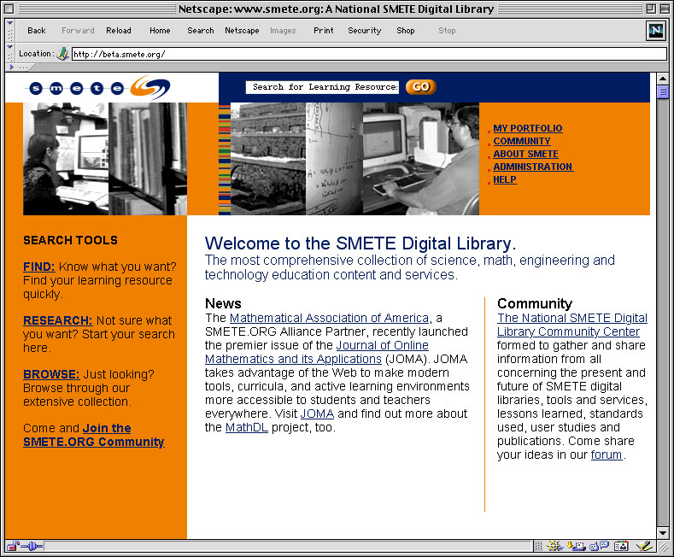
Portal at www.smete.org

Slide 22
Key Features of SMETE.ORG
Search for learning resources
Three mechanisms, find, research and browse, aimed at levels of knowledge of catalog metadata
Locally cataloged collections
Partner collections through federated search mechanism
Books and journal articles thru Z39.50 gateway (also OAI Gateway)
Receive recommendations to learning resources through collaborative filtering system
Form a community
Find persons with similar educational goals through people recommender service
Participate in online workshops and focus groups
Form ad-hoc communities organized around learning resources and user-initiated discussion topics
Review and comment on use of learning resources

Slide 23
Contacting SMETE.ORG
www.smete.org
Alice Agogino, Principal Investigator
agogino@smete.org
Brandon Muramatsu, Project Director
mura@smete.org

