Slide 1
A Digital Learning Space for Science, Mathematics, Engineering and Technology Education
Brandon Muramatsu
NEEDS Project Director
University of California at Berkeley
Originally Published 2000. Republished 2013. This work is licensed under a Creative Commons Attribution-Noncommercial-Share Alike 3.0 United States License (http://creativecommons.org/licenses/by-nc-sa/3.0/us/)

Slide 2
Outline
Introduction
Synthesis Coalition
NEEDS—The National Engineering Education Delivery System
Towards a Digital Learning Space for Science Mathematics Engineering and Technology Education
Prototype: www.smete.org
Copies of this presentation will be available at:
http://www.smete.org/smete/info/presentations/

Slide 3
Synthesis
Cornell
Berkeley
Iowa
State
Stanford
Hampton
Northern
Arizona
Cal Poly
Tuskegee
Southern
Synthesis Coalition Goals (1990–1998)
• Reform undergraduate engineering curricula
• Improve retention
• Link to K-14
• Develop digital infrastructure ⬅ NEEDS

Slide 4
Synthesis Coalition Strategy
Introduce multidisciplinary systems design
Mechatronics
Architecture/Engineering/Construction
Bring industry and research into the classroom
Enhance laboratory/hands-on learning
Increase social context of technology
Improve student’s communication and teaming skills
Introduce new delivery/learning styles

Slide 5
Multidisciplinary, Multimedia Case Studies
Highlight examples of successfully
engineered design products.
Brings “best practices” from industry into the classroom:
customer-driven design
quality and continuous improvement
multifunctional teams
design for ‘x’ (assembly, environment, service, etc.)
Complements dissection and design activities.
Promotes integrative thinking.

Slide 6
Multidisciplinary Mechatronic Cases and Dissection Exercises
Some of the Disciplines Involved:
Mechanical Engineering
Electrical Engineering
Computer Engineering
User Interface Designers
Manufacturing Engineering
Industrial/Process Engineering
Business and Management of Technology

Slide 7
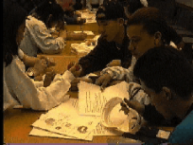
Multimedia Cases & Mechanical Dissection Promote Integrative Learning
Concrete
Experiences
Active
Experimentation
Reflection
Abstract Theory & Conceptualization
Virtual Disk Drive Case Study
Integrates multimedia case, dissection
and design activities

Slide 8
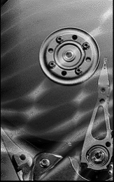
Synthesis Courseware Integrates Research, Education and Industry
Technical Research
Disk Drive
High Speed Networks
Multimedia & Video Servers
Design & Mfg. Integration
Education
Research
peer,
scaffolded &
experiential
learning
Industry
Western Digital
IBM Almaden Research
Berkeley Computer
Mechanics Lab
Virtual Disk Drive Case Study - Game, Dissection Example

Slide 10
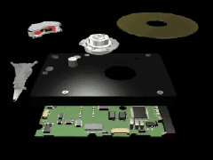
disk
platter

Slide 11
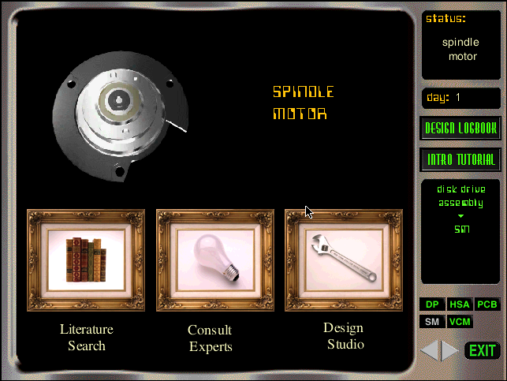
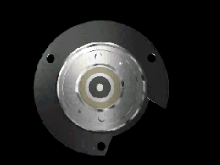

Slide 12
Synthesis Coalition Strategy
Introduce multidisciplinary systems design
Bring industry and research into the classroom
Enhance laboratory/hands-on learning
Increase social context of technology
Improve student’s communication & teaming skills
Introduce new delivery/learning styles
Synthesis Coalition Goals (1990–1998)
• Reform engineering education curricula
• Develop digital infrastructure ⬅ NEEDS

Slide 13
Outline
Introduction
Synthesis Coalition
NEEDS—The National Engineering Education Delivery System
Towards a Digital Learning Space for Science Mathematics Engineering and Technology Education
NSDL: www.smete.org
Copies of this presentation will be available at:
http://www.smete.org/smete/info/presentations/

Slide 14
NEEDS—The National Engineering Education Delivery System www.needs.org

Slide 15
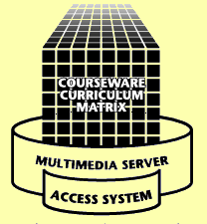
www.needs.org
Delivery
Classrooms
Instructional Labs
Small Study Groups
Residences
Libraries
Anywhere
Three Components Connected Through the Internet
Development
Courseware Studios
Instructional Labs
Faculty Offices & Residences
Libraries
Anywhere
We are building upon our experience with NEEDS as the foundation for the SMETE Information Portal, coupled with on-going research.

Slide 16
How does NEEDS help users “re-use” learning materials?
Provides mechanisms to help user locate materials
Uses standardized descriptions (metadata) to describe resources
Provides mechanisms to help users evaluate the “quality of materials”
Developed upon an extendable platform to support multiple uses, as well as integrate new services and features

Slide 17
NEEDS
Berkeley
UMBC
Stanford
Virginia
Tech
Northern
Arizona
Goals (1998–2001)
Provide a service to the
engineering education community
Grow and evolve NEEDS as the foundation
for an on-line engineering education community
Expand courseware review and evaluation efforts
Serve as a bridge to the development of a
National SMETE Digital Library

Slide 18
What Is NEEDS?
Integrated Database of Multimedia Engineering Courseware
Bibliographic records with downloadable courseware
Multimedia elements - downloadable movies, images, and text
Multilevel Courseware Evaluation System
Peer Review of Courseware
Premier Award for Excellence in Engineering Education Courseware
Expanding Services and Features

Slide 19
Example Record: www.needs.org

Slide 20
Quality Review of Courseware on the NEEDS Database
Establish credibility of NEEDS as a source of Quality educational material
Enhance recognition of scholarly and creative effort of courseware developers
Peer/Expert Review of Courseware
Premier Award for Excellence in Engineering Education Courseware

Slide 21
The Premier Award for Excellence in Engineering Education Courseware
A national competition to identify and reward the authors of high-quality, non-commercial courseware designed to enhance engineering education.
The Premier Award is about the entire experience of using the courseware by learners, not just the courseware itself
A dissemination system to distribute the Premier Courseware (via CD’s and presentation at engineering education conferences).

Slide 22
Premier Award Criteria
We recognize that all the categories are interwoven.
Engineering Content
Is the content error free?
Software Design
Is it well designed and usable?
Instructional Design
Will students learn from the courseware?
See http://www.needs.org/premier/
1999/criteria.html for more info

Slide 23
Evaluation Criteria
Instructional Design:
Interactivity
Cognition/conceptual change
Content
Multimedia use
Instructional use/adaptability
Notes:
Premier Award Criteria (cont.)
See the previous page for additional information.

Slide 24
Evaluation Criteria, cont.
Software Design:
Engagement
User interface and navigation
Interactivity
Multimedia use
Technical reliability
Engineering Content:
Accuracy of content
Organization of content
Consistency with learning objectives
Notes:
Premier Award Criteria (cont.)
See the previous page for additional information.

Slide 25
Premier Courseware of 1997 & 1998
Virtual Disk Drive
Design Studio
Drill Dissection and
Bicycle Dissection
Mars Navigator
Della Steam Plant
MDSolids
Structural Engineering Visual Encyclopedia - UNH
3600 CD-ROMs Distributed
1800 CD-ROMs Distributed
For more info or to receive copies go to http://www.needs.org/premier/

Slide 26
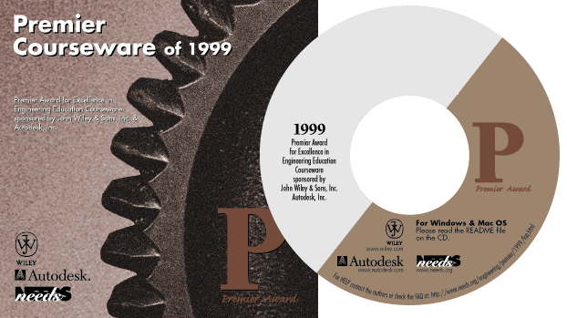
Premier Courseware of 1999 & 2000
Engineering Graphics
Cracking Dams
Submit for the 2000 Premier Award
1000 CD-ROMs Distributed
For more info or to receive copies go to http://www.needs.org/premier/

Slide 27
NEEDS
Berkeley
UMBC
Stanford
Virginia
Tech
Northern
Arizona
Goals (1998–2001)
Provide a service to the
engineering education community
Grow and evolve NEEDS as the foundation
for an on-line engineering education community
Expand courseware review and evaluation efforts
Serve as a bridge to the development of a
National SMETE Digital Library

Slide 28
Outline
Introduction
Synthesis Coalition
NEEDS—The National Engineering Education Delivery System
Towards a Digital Learning Space for Science Mathematics Engineering and Technology Education
Prototype NSDL: www.smete.org
Copies of this presentation will be available at:
http://www.smete.org/smete/info/presentations/

Slide 29
Towards A Digital Learning Space for Library for Science, Mathematics, Engineering and Technology Education

Slide 30
A National SMETE Digital Library
Should NSF Establish and Fund a National Science, Mathematics, Engineering and Technology Education Digital Library?
April 1996 - NSF Committee Meeting (LIBUSE)
“Towards a National Library for Undergraduate Science Education Resources in Science, Mathematics, Engineering and Technology”
August 1997 National Research Council
Digital National Library for SME&T Education Workshop
July 1998 National Science Foundation
SMETE-Lib Workshop
January 1999 National Science Foundation
Digital Libraries and Education Workshop
Funding through
Digital Libraries
Initiative – Phase 2
Notes:
Digital National Library
One program currently under development at NSF is the development of a digital library to support Science, Mathematics, Engineering, and Technology Education.

Slide 31
Vision of NSDL ...
“… a network of learning environments and resources for Science, Mathematics, Engineering and Technology education, will ultimately meet the needs of students and teachers at all levels—K-12, undergraduate, graduate, and lifelong learning—in both individual and collaborative settings.”

Slide 32
Needs Assessment with Members of the Math and Science Community
Purpose:
To understand the math and science communities of educators and examine their needs in order to design services and structures to support users from multiple communities.
Research Questions:
What services, features & programs are integral to success?
What do users expect with regards to quality of the holdings?
Who makes up the SMETE digital library community?
American Association of Physics Teachers, American Mathematical Society, American Association for the Advancement of Science, members of the NSF Chemistry Consortia and the NSF Engineering Education Coalitions

Slide 33
Findings, Trends, & Design Implications
Quality
Library as a marketplace/shopping mall of ideas and products
Contents range from “works in progress” to highly rated products
“Peer review” includes cognitive science, pedagogy, curriculum and user reviews

Slide 34
Findings, Trends, & Design Implications
Community
Communication potential is most highly valued
A place for networking, learning from peers and communication — not just a repository
Users look to their peers first to learn about teaching — strong discipline identify
Contents
Library holdings should be diverse:
problem sets to entire courses, books to data sets, visualizations and simulations, instructors’ guides and assessment tools

Slide 35
Translating Findings into Services & Features
Quality
System to rapidly identify the quality of holding
Place to comment about a learning object or regarding something of interest to the community
Reviewers should include experts in pedagogy and content

Slide 36
Translating Findings into Services & Features
Community
Embedded structures for developing and maintaining communication links
Developing community should be on par with building content
Build on discipline based communities to establish connection to a broader community
Content
Useful content and community interaction will ensure user participation as authors, reviewers, adapters/adopters, and consumers

Slide 37
Outline
Introduction
Synthesis Coalition
NEEDS—The National Engineering Education Delivery System
Towards a Digital Learning Space for Science Mathematics Engineering and Technology Education
Prototype: www.smete.org
Copies of this presentation will be available at:
http://www.smete.org/smete/info/presentations/

Slide 38
Prototype: www.smete.org

Slide 39
Building a SMETE Information Portal
Searching for learning resources
Cataloging (adding) learning resources
Standards, IEEE and IMS
Evaluating the quality of learning resources
“User” reviews
“Expert” reviews
Forming a community of users in SMETE

Slide 40
www.smete.org
SMETE Digital Library Prototype Under Development based on NEEDS Infrastructure
User Comments (user-based reviews)
Adopted IEEE/IMS Metadata
Expanded Collections
Expanding into Chemistry,
Physics, and Mathematics
Working with Partners
Eisenhower National Clearinghouse
Math Forum at Swarthmore College
Math Metadata Task Force
Total Collection
Engineering 58%
Chemistry 21%
Physics 14%
Math 5%
Other 2%

Slide 41
Prototype Project Goals
Expand partnerships
Math Forum at Swarthmore College
University of California Nexus K–12 project
Collaborate with partners to develop a prototype SMETE Digital Library
test interoperability of federated searches and shared services with partners
expand requirements analysis to include K–12
develop criteria and standards to assess the impact of learning objects across disciplines
implement community feedback systems and evaluate services

Slide 42
www.mathmetadata.org
Development of Best Practices of using metadata for the Mathematics community
Development of subject thesaurus for range of mathematics resources
Level I: Pre-variable Mathematics
Level II: Post-variable, pre-proof oriented
mathematics
Level III: Pre-professional and
professional mathematics

Slide 43
www.mathmetadata.org
www.needs.org
www.enc.org
www.mathforum.org
www.smete.org

Slide 44
Challenges Toward the Future
Understanding and supporting users’ needs
Improving ability to encapsulate the instructional intent and use of materials
Metadata standards and cataloging practice
Supporting communities of use and practice
pedagogy
content
Which allows for a user to find what they’re really looking for as well as personalization of content.

Slide 45
Contact Information
Brandon Muramatsu, Project Director
mura@needs.org
3115 Etcheverry Hall
University of California
Berkeley, CA 94720-1750
(510) 643-1817
Copies of this presentation will be available at:
http://www.smete.org/smete/info/presentations/

