Slide 1
Steps Toward A National Digital Library for Science, Mathematics, Engineering and Technology Education
Alice Agogino, Gene Klotz, Len Simutis, Flora McMartin, Brandon Muramatsu, Robby Robson
January 20, 2000
Originally Published 2000. Republished 2013. This work is licensed under a Creative Commons Attribution-Noncommercial-Share Alike 3.0 United States License (http://creativecommons.org/licenses/by-nc-sa/3.0/us/)/.

Slide 2
Outline
NSF Program Solicitation
Vision
Background on NEEDS
Prototype NSDL: www.smete.org
Copies of this presentation will be available at:
http://www.smete.org/smete/info/presentations/

Slide 3
NSF Program Solicitation
National Science Foundation Program Solicitation (NSF 00-44):
NATIONAL SCIENCE, MATHEMATICS, ENGINEERING, AND TECHNOLOGY EDUCATION DIGITAL LIBRARY (NSDL)
Over the last four to five years, NSF has investigated the development of a NSDL
Numerous NSF and NRC reports recommend the development of a system

Slide 4
Vision of NSDL ...
“… a network of learning environments and resources for Science, Mathematics, Engineering and Technology education, will ultimately meet the needs of students and teachers at all levels—K-12, undergraduate, graduate, and lifelong learning—in both individual and collaborative settings.”

Slide 5
www.needs.org
www.enc.org
www.mathforum.org
www.mathmetadata.org

Slide 6
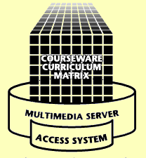
www.needs.org
Delivery
Classrooms
Instructional Labs
Small Study Groups
Residences
Libraries
Anywhere
Three Components Connected Through the Internet
Development
Courseware Studios
Instructional Labs
Faculty Offices & Residences
Libraries
Anywhere
We are building upon our experience with NEEDS as the foundation for the SMETE Information Portal, coupled with on-going research.

Slide 7
The Premier Award for Excellence in Engineering Education Courseware
A national competition to identify and reward the authors of high-quality, non-commercial courseware designed to enhance engineering education
The Premier Award is about the entire experience of using the courseware by learners, not just the courseware itself
A dissemination system to distribute the Premier Courseware (via CD’s and presentation at engineering education conferences)

Slide 8
Prototype Project Goals
Expand partnerships
Math Forum at Swarthmore College
University of California Nexus K–12 project
Collaborate with partners to develop a prototype SMETE Digital Library
test interoperability of federated searches and shared services with partners
expand requirements analysis to include K–12
develop criteria and standards to assess the impact of learning objects across disciplines
implement community feedback systems and evaluate services

Slide 9
Building a SMETE Information Portal
Searching for learning resources
Cataloging (adding) learning resources
Standards, IEEE and IMS
Evaluating the quality of learning resources
“User” reviews
“Expert” reviews
Forming a community of users in SMETE

Slide 10
www.smete.org
SMETE Digital Library Prototype Under Development based on NEEDS Infrastructure
User Comments (user-based reviews)
Adopted IEEE/IMS Metadata
Expanded Collections
Expanding into Chemistry,
Physics, and Mathematics
Working with Partners
Eisenhower National Clearinghouse
Math Forum at Swarthmore College
Math Metadata Task Force
Total Collection
Engineering 58%
Chemistry 21%
Physics 14%
Math 5%
Other 2%

Slide 11
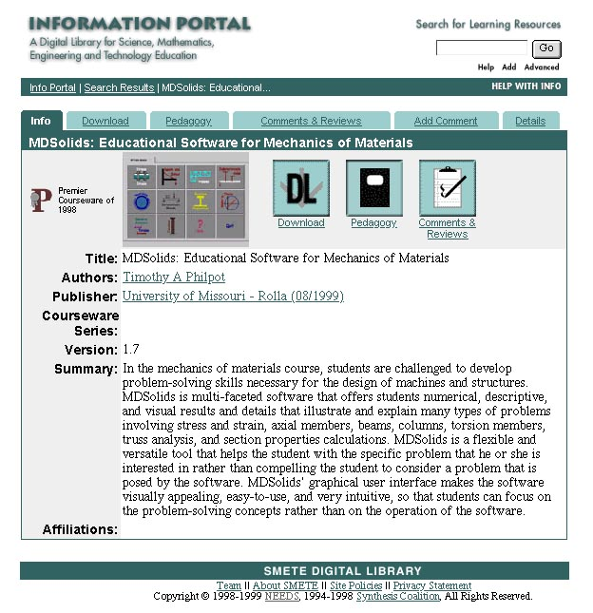
Example Record: www.smete.org

Slide 14
www.mathmetadata.org
Development of Best Practices of using metadata for the Mathematics community
Development of subject thesaurus for range of mathematics resources

Slide 15
SMETE Information Portal Needs Assessment
Purpose:
To understand the math and science communities of educators and examine their needs in order to design services and structures to support users from multiple communities.
Research Questions:
What services, features & programs are integral to success?
What do users expect with regards to quality of the holdings?
Who makes up the SMETE digital library community?
American Association of Physics Teachers, American Mathematical Society, American Association for the Advancement of Science, members of the NSF Chemistry Consortia and the NSF Engineering Education Coalitions

Slide 16
Translating Findings into Services & Features
Quality
System to rapidly identify the quality of holding
Place to comment about a learning object or regarding something of interest to the community
Reviewers should include experts in pedagogy and content

Slide 17
Translating Findings into Services & Features
Community
Embedded structures for developing and maintaining communication links
Developing community should be on par with building content
Build on discipline based communities to establish connection to a broader community
Content
Useful content and community interaction will ensure user participation as authors, reviewers, adapters/adopters, and consumers

Slide 18
www.smete.org
www.needs.org
www.enc.org
www.mathforum.org
www.mathmetadata.org

Slide 19
Contact Information
Brandon Muramatsu, Project Director
mura@needs.org
3115 Etcheverry Hall
University of California
Berkeley, CA 94720-1750
(510) 643-1817
Copies of this presentation will be available at:
http://www.smete.org/smete/info/presentations/

