Slide 1
NEEDS—The National Engineering Education Delivery System
Evaluation Criteria and Premier Award
Originally Published 1999. Republished 2013. This work is licensed under a Creative Commons Attribution-Noncommercial-Share Alike 3.0 United States License (http://creativecommons.org/licenses/by-nc-sa/3.0/us/)

Slide 2
NEEDS—The National Engineering Education Delivery System
An Established Dissemination Tool
National program developed within the Engineering Coalitions program (1990-1999)
Courseware readily searchable and accessible
Expanding to include Science, Mathematics, Engineering and Technology Education (SMETE)
Established Quality Review Programs
Criteria for evaluating courseware
The Premier Award for Excellence in Engineering Education Courseware
New user-based review mechanisms

Slide 3
NEEDS
Berkeley
UMBC
Stanford
Virginia
Tech
Northern
Arizona
Oklahoma
National digital library developed within the Engineering Coalitions program (1990-1999)
Established Quality Review Programs
Expanding to include Science, Mathematics, Engineering and Technology Education (SMETE)
Developing digital learning spaces for
SMETE teaching & learning communities

Slide 4
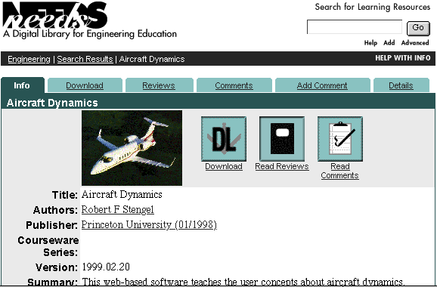
www.needs.org

Slide 5
The Premier Award for Excellence in Engineering Education Courseware
A national competition to identify and reward the authors of high-quality, non-commercial courseware designed to enhance engineering education
The Premier Award is about the entire experience of using the courseware by learners, not just the courseware itself
A dissemination system to distribute the Premier Courseware (via CD’s, ASEE Prism ads, presentations at FIE and ASEE)

Slide 6
About the Premier Award
Why Create the Premier Award?
Establish NEEDS as a source of quality learning materials
Provide recognition to developers for time and intellectual
How do we decide the Premier Award?
A rigorous, on-site 2-day review process with 6-10 judges (engineering content experts, instructional designers, students and publishers)
Apply the Premier Award Criteria

Slide 7
Premier Award Criteria
Instructional Design
Will students learn from the courseware?
Software Design
Is it well designed and usable?
Engineering Content
Is the content error free?
We recognize that all the categories are interwoven.

Slide 8
Evaluation Criteria
Instructional Design:
Interactivity
Cognition/conceptual change
Content
Multimedia use
Instructional use/adaptability
Software Design:
Engagement
User interface and navigation
Technical reliability
Notes:
Premier Award Criteria (cont.)
See the previous page for additional information.

Slide 9
Evaluation Criteria, (cont.)
Engineering Content:
Accuracy of content
Organization of content
Consistency with learning objectives
Notes:
Premier Award Criteria (cont.)
See the previous page for additional information.

Slide 10
Premier Courseware of 1998
Della Steam Plant
By P. K. Raju and Chetan Sankar
at Auburn University
MDSolids
By Timothy Philpot at Murray State University
SEVE-UNH
Robert M. Henry at the University of
New Hampshire
Distribution
2000 CD-ROMs
See http://www.needs.org/premier/1998/
for more info

Slide 11
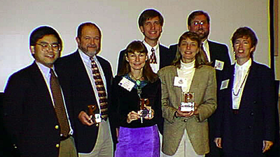
Premier Courseware of 1997
Virtual Disk Drive
Design Studio
Drill Dissection and Bicycle Dissection
Mars Navigator
See
http://www.needs.org/premier/1997/
for more info
Distribution - 3000 CD-ROMs
100 Copies to Authors
650 Copies to FIE `97 Participants
300 Copies to Engineering Deans
400 Copies to ASEE `98 Participants
200 Copies to ICEE `98 Participants
200 Copies to FIE `98 Participants

Slide 12
Premier Courseware of 1999
Two entries selected as the Premier Courseware of 1999
Official announcement to be made at FIE 1999, San Juan, Puerto Rico on Saturday, November 13, 1999
See http://www.needs.org/premier/1999/ for more info
Notes:
1998 Premier Award Competition
We are now accepting submissions for the 1998 Premier Award Competition. Full submission information can be found at http://www.needs.org/premier/1998/.

