Slide 1
Selecting and Adapting Learning Technologies to Improve Engineering Education
Flora McMartin, mcmartin@needs.org
Brandon Muramatsu, mura@needs.org
Originally Published 2001. Republished 2013. This work is licensed under a Creative Commons Attribution-Noncommercial-Share Alike 3.0 United States License (http://creativecommons.org/licenses/by-nc-sa/3.0/us/)

Slide 2
Background
Information technologies provide the opportunity to “re-think” how we teach our classes
Computers, Web and other learning technologies
Builds upon the work of:
The Engineering Education Coalitions
NEEDS, a digital library for engineering education
Premier Award for Excellence in Engineering Education Courseware
National Institute for Science Education

Slide 3
Background, continued
This presentation...
Provides a number of models and processes for selecting and adapting learning technologies
Forms the basis for a workshop at 2001 IEEE/ASEE Frontiers in Education Conference

Slide 4
Approach we will be discussing...
Provides processes and frameworks
To help you understand what tools you might want to use
To evaluate the quality of learning technologies
Leading to selecting and adapting learning technologies for your courses
Uses learning technologies as tools to improve teaching and learning
Learning technologies provide a number of benefits … but … don’t use technology just because you can.

Slide 5
Selecting Learning Technologies...
Begins with understanding the environment in which it will be used
Establish Course Goals
Identify Student Learning Outcomes
Design Learning Environment
Design Learning Process
(e.g., individual or collaborative)
Design Learning Activities
(e.g., computer or other non-computer
Assess Student Learning

Slide 6
Designing Learning Environments
Jon Jungck, et. al, suggests a model for selecting activities to achieve your learning objectives
Three axes (on next slide)
Learning Centeredness: emphasizes teaching and learning that transforms the student as “receiver” to “constructor” of knowledge
Nature of Learning Task: emphasizes transformation of the task itself from simple to more complex activities
Collaboration: emphasizes transformation from individual to group activities

Slide 8
7 Principles of Good Teaching
Encourages contact between students and faculty
Develops reciprocity and cooperation among students
Encourages active learning
Gives prompt feedback
Emphasizes time on task
Communicates high expectations
Respects divers talents and ways of learning
Chickering, A.W. & Z. F. Gamson. (1991). “Applying the Seven Principles for Good Practice in Undergraduate Education.” New Directions for Teaching and Learning. Vol. 47. San Francisco: Jossey-Bass Inc.

Slide 9
Evaluating Learning Technologies
Identifying high-quality learning materials based upon criteria developed for Premier Award for Excellence in Engineering Education Courseware
Developed with the help of a number of experts in the field
Evolved over the last four years of competition
Brings diverse viewpoints together -- content area experts, instructional designers, students and publishers

Slide 10
Premier Award Selection Criteria
Instructional Design
Will students learn from the courseware?
Interactivity: Is the learner actively involved and does the interaction enhance learning?
Cognition/Conceptual Change: Is learning significant and long lasting, allowing the construction of useful cognitive models?
Content: Is the content well chosen and structured?
Multimedia Use: Is multimedia used effectively to promote learning objectives and goals?
Instructional Use/Adaptability: Can the software be used in a variety of settings?

Slide 11
Premier Award Selection Criteria, cont.
Software Design
Is the software well designed and useable?
Engagement: Does the software hold the interest of a diversity of learners?
Learner interface and navigation: Is the software easy to use?
Technical reliability: Is the software free from technical problems?

Slide 12
Premier Award Selection Criteria, cont.
Engineering Content
Is the content appropriate and error-free?
Accuracy of content: Is the content error-free?
Organization of content: Is the content presented consistent with typical engineering instruction.
Consistency with learning objectives: Does the content match the stated learning objectives?

Slide 13
Premier Courseware of 1997 & 1998
Virtual Disk Drive
Design Studio
Drill Dissection and
Bicycle Dissection
Mars Navigator
Della Steam Plant
MDSolids
Structural Engineering Visual Encyclopedia - UNH
3,800 CD-ROMs Distributed
1,950 CD-ROMs Distributed
For more info or to receive copies go to http://www.needs.org/engineering/premier/

Slide 14
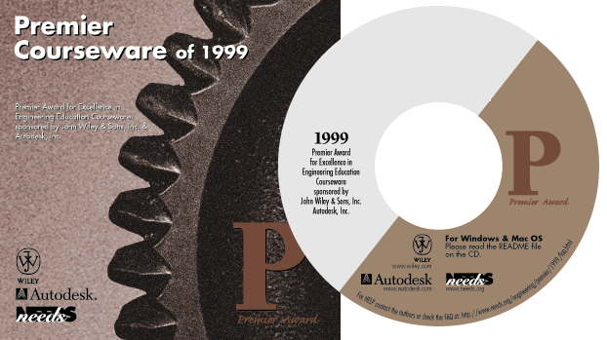
Premier Courseware of 1999 & 2000
Engineering Graphics
Cracking Dams
Project Links
West Point Bridge Designer
2,000 CD-ROMs Distributed
1,600 CD-ROMs Distributed
For more info or to receive copies go to http://www.needs.org/engineering/premier/

Slide 15
Guidelines for Selecting Learning Technologies
Support Good Practices in Higher Education (Seven Principles)
Support teaching goals and learning outcomes
Use quality resources
Consider (technical) support environment

Slide 16
The SMETE Open Federation
Brandon Muramatsu
SMETE.ORG
mura@smete.org

Slide 17
Brief Background
To build a successful National SMETE Digital Library for deployment in Fall 2002…
To focus on science, mathematics, engineering and technology at all levels
And more important, it focuses on education
…we needed to develop a team…
To overcome the challenges we face in developing a National SMETE Digital Library
To cover target audiences and disciplines
To share in the development efforts

Slide 18
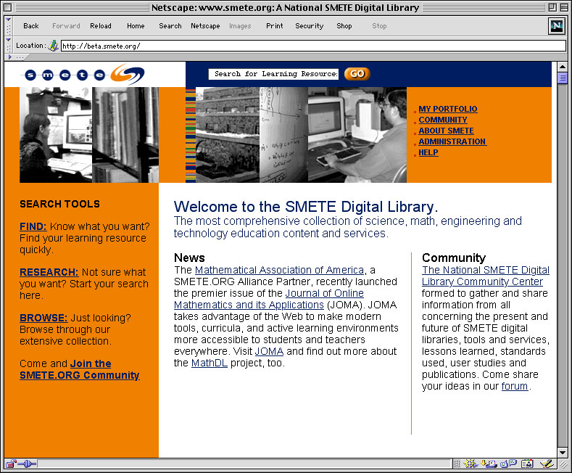
Portal at www.smete.org

Slide 19
SMETE Open Federation |  |  | Industry
Access Excellence & National Assoc. Biology Teachers (Biology Education Online) (www.accessexcellence.org and www.nabt.org) American Association for the Advancement of Science (www.aaas.org) BioQUEST Curriculum Consortium (www.bioquest.org) Coalition for Networked Information (www.cni.org) CITIDEL (www.citidel.org) Digital Library for Earth Systems Education (www.dlese.org) Eisenhower National Clearinghouse for Mathematics and Science Education (www.enc.org) | iLumina (www.ilumina-project.org) Mathematics Association of America (www.maa.org) MathDL (www.mathdl.org) Math Forum (www.mathforum.com) MERIT Network/Michigan State University (Michigan Teacher Network and TeacherLIB) (www.merit.edu) MERLOT (www.merlot.org) National Action Council for Minorities in Engineering (www.nacme.org) NEEDS—National Engineering Education Delivery System* (www.needs.org) | Project Kaleidoscope (www.pkal.org) University of California Teaching and Learning with Technology Center (www.ucop.edu/acadinit/tltc) University of Maryland Baltimore County (www.umbc.edu/engineering/me/wood.html) Utah State University (ia.usu.edu) Virginia Tech* (www.vt.edu & fox.cs.vt.edu) | Autodesk* (www.autodesk.com) Cisco Systems (www.cisco.com) John Wiley & Sons* (www.wiley.com) Collegis (http://www.collegis.com/) Mathworks* (www.mathworks.com) Microsoft Research* (research.microsoft.com) Sun Microsystems (www.sun.com) *Involved with NEEDS

Slide 20
Vision
The SMETE Open Federation is committed to providing a service
to support learning
across disciplines in science, mathematics, engineering and technology
providing access to high-quality resources
in support of education reform and cross-disciplinary learning
from K-12 to higher education to professional development

Slide 21
Contact Info
Brandon Muramatsu, Project Director
mura@needs.org
University of California, Berkeley
3115 Etcheverry Hall
Berkeley, CA 94720-1750 USA
(510) 643-1817

