Slide 1
Criteria for Selecting Instructional Software in Engineering Education
Flora McMartin, Brandon Muramatsu and Alice Agogino
NEEDS — National Engineering Education Delivery System
Originally Published 2003. Republished 2013. This work is licensed under a Creative Commons Attribution-Noncommercial-Share Alike 3.0 United States License (http://creativecommons.org/licenses/by-nc-sa/3.0/us/)

Slide 2
Outline
Introduction to NEEDS
Overview of criteria for the Premier Award for Excellence in Engineering Education Courseware
Overview of ILT research on successful adaptation
Proposed process/criteria
Conclusion

Slide 3
NEEDS
Berkeley
UMBC
Stanford
Virginia
Tech
Northern
Arizona
National digital library
emerging from the Synthesis Coalition (1990 - 1999)
Integrated database of multimedia courseware
Multilevel courseware evaluation system (peer review, Premier Award for Excellence in Engineering Education Courseware)
Community of Engineering Educators

Slide 4
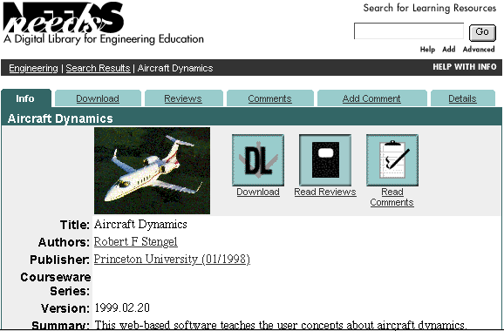
www.needs.org

Slide 5
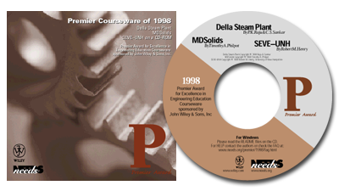
The Premier Award
National competition rewards authors of high-quality, non-commercial courseware that promotes
effective learning practices
1999 - Engineering Graphics, Cracking Dams
1998 - Della Steam Plant, MDSolids, Structural Engineering Visual Encyclopedia - UNH
1997 - Virtual Disk Drive Design Studio, Drill Dissection & Bicycle Dissection, Mars Navigator

Slide 6
Premier Award Selection Criteria
Engineering Content
Is the content error free?
Software Design
Is it well designed and usable?
Instructional Design
Will students learn from the courseware?
http://www.needs.org/premier/1999/criteria.html

Slide 7
ILT Research on Effective Adaptation*
Adaptation successful when faculty
Chose LT to support learning goals
Improve performance
Increase student engagement
Improve student attitudes towards SMET
Curriculum deficiency
* 9 Case Studies of effective adaptation by SMET educators in diverse institutional types and disciplines conducted in 1999-2000

Slide 8
Effective Adaptation, continued
Selected LT to support good instructional practices
Collaborative learning
Faculty/student interaction
Viewed technology as tool rather than driving force for course
Visualizaton, simulation, real-time data acquisition, speed
communication

Slide 9
P/A Criteria - Instructional Design
Interactivity: promotes active learning - interaction enhances learning
Cognition/conceptual change: learning appears to be significant and long lasting, and strong, useful cognitive models can be built
Content: well chosen and structured
Multimedia use: effective and promotes learning objectives and goals
Instructional Use/Adaptability: useful in a variety of settings

Slide 10
P/A Criteria - Software Design
Engagement: software holds the interest of a diversity of learners.
Learner Interface and Navigation: software is easy to use
Technical Reliability: software is free from technical problems

Slide 11
P/A Criteria - Engineering Content
Accuracy: content is error free
Organization: structure is consistent with typical engineering instruction
Consistent with Learning Objectives: content matches stated learning objectives and goals

Slide 12
Conclusions
How do I know this courseware/LT is good?
Instruction design criteria most difficult to apply - must begin process by articulating clear learning goals
Software design criteria critical to students’ motivation to use the LT
Know your students and their equipment

Slide 13
Contact Information
Flora McMartin, Evaluation Director
Brandon Muramatsu, Project Director
mura@needs.org
3115 Etcheverry Hall
University of California
Berkeley, CA 94720-1750
(510) 643-1817
Copies of this presentation will be available at:
http://www.needs.org/engineering/info/presentations/

